Slide 1

ACTIVE
SIT-STAND DESKS

Slide 2
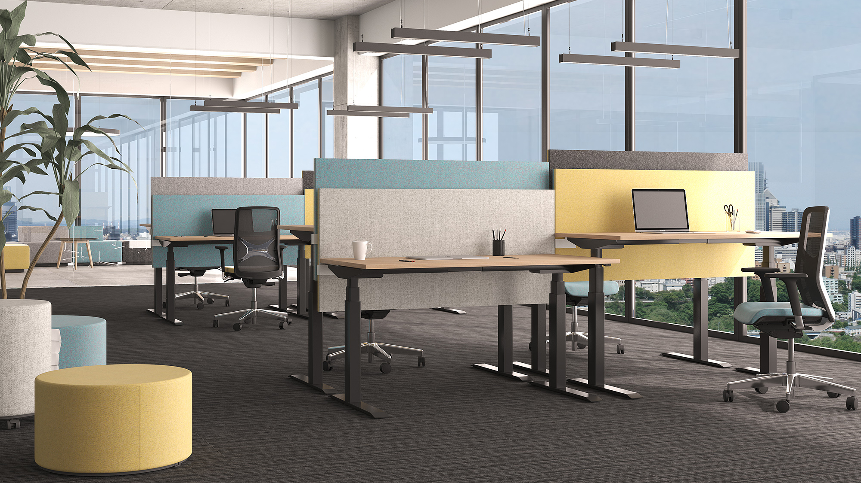
ACTIVE

Slide 3
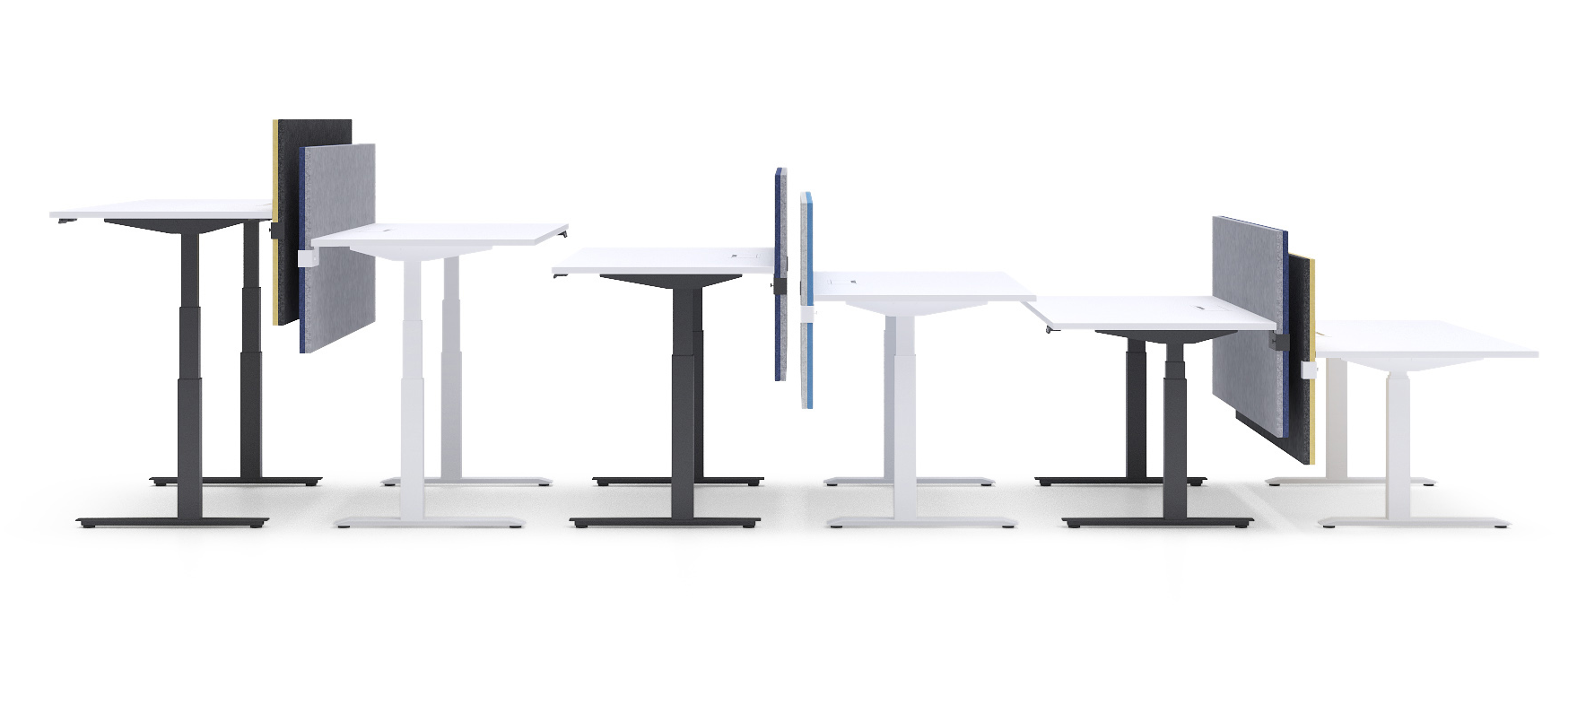
Simple to be ACTIVE at work!

Slide 4
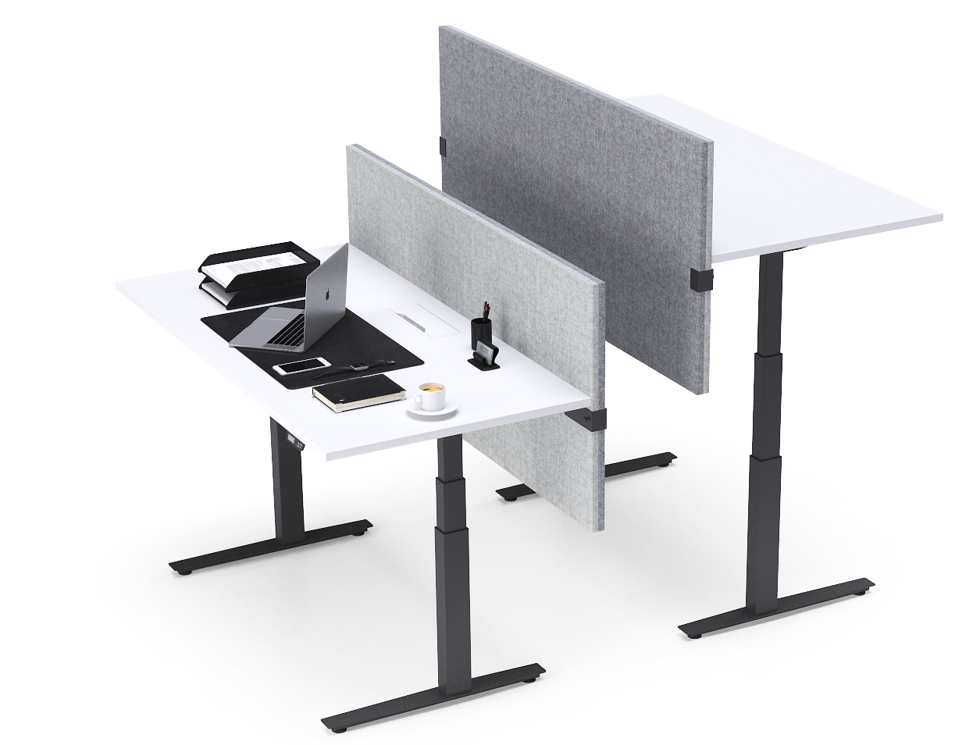
ACTIVE
Height adjustable desking system stands for two key characteristics: functionality and quality.

Slide 5
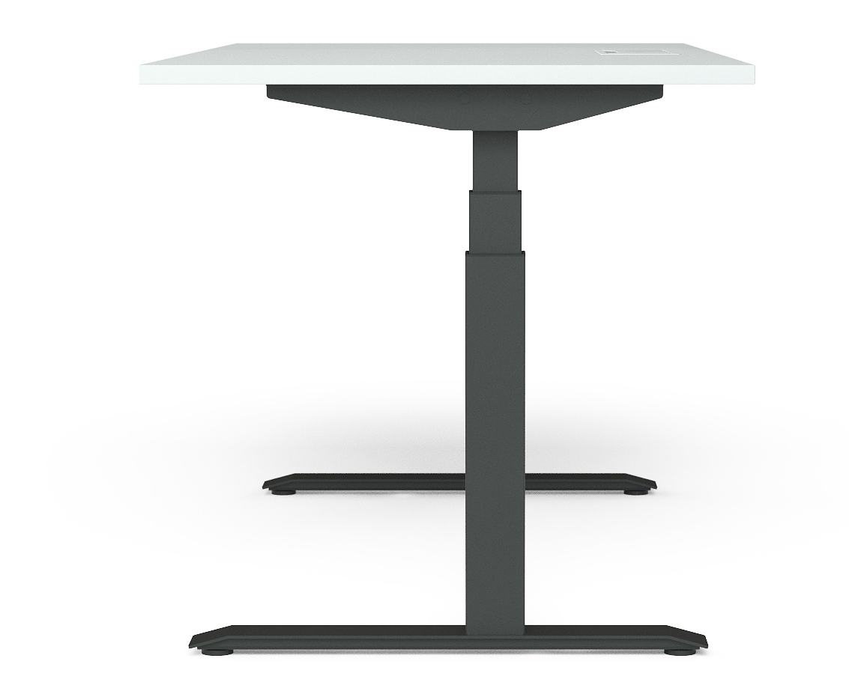
ACTIVE
Not centered 2-level or 3-level column with a wider segment at the bottom (DOWN version).

Slide 6
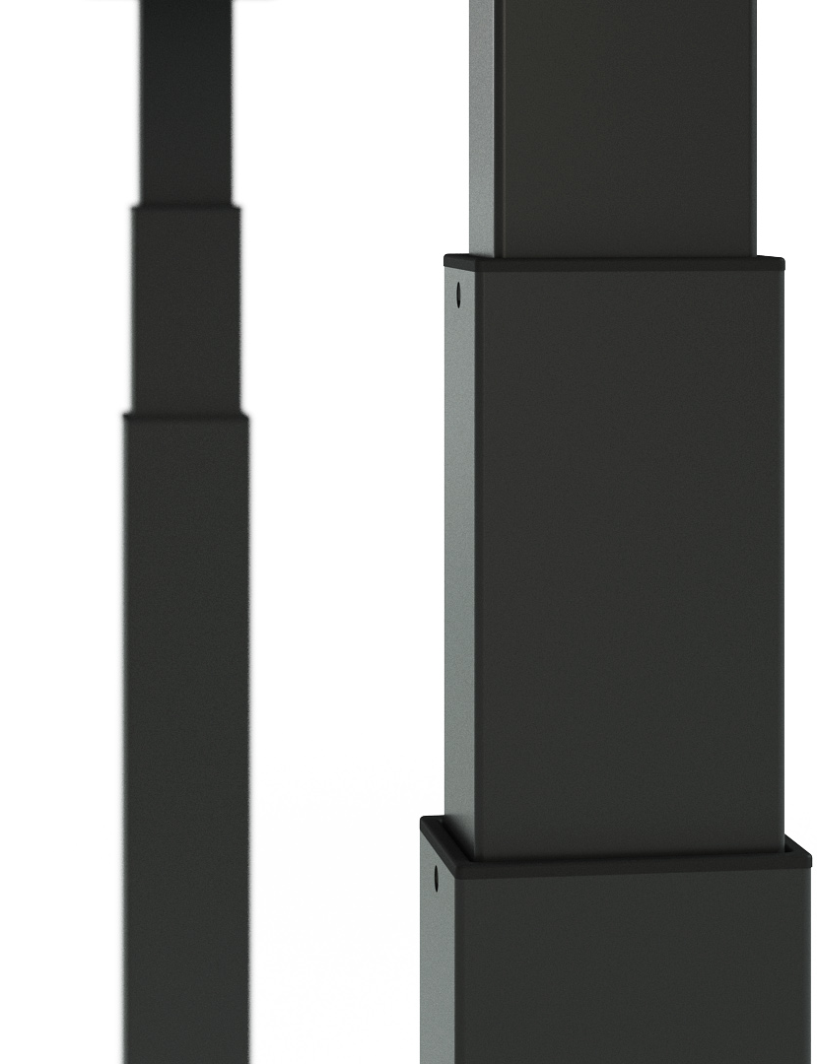
ACTIVE
Aesthetic design column.
Glide system solution prevents desk columns from possible paint scratches.

Slide 7
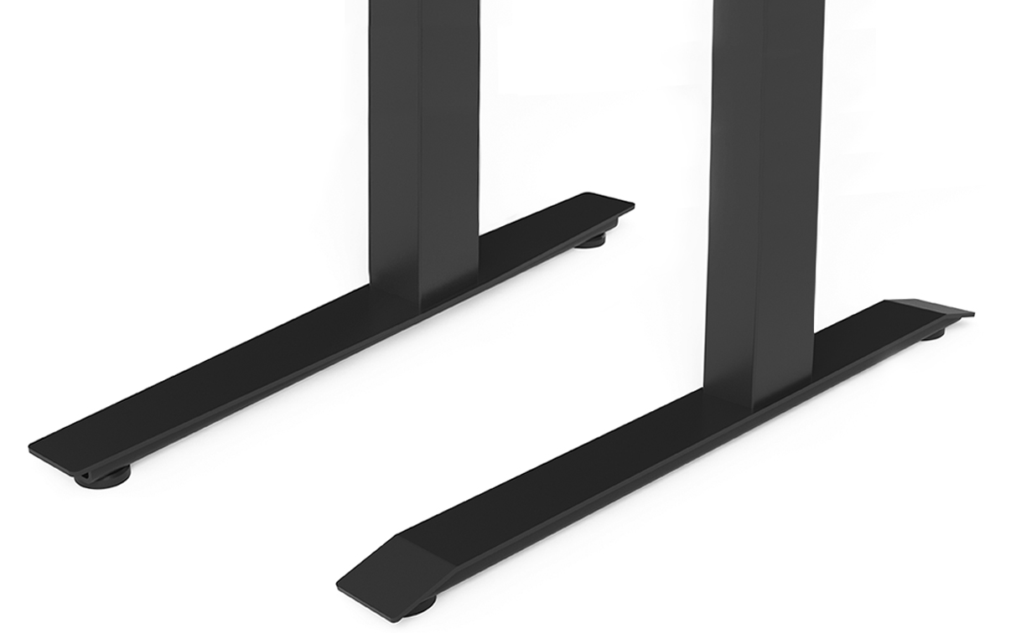
ACTIVE
2 types of feet.

Slide 8
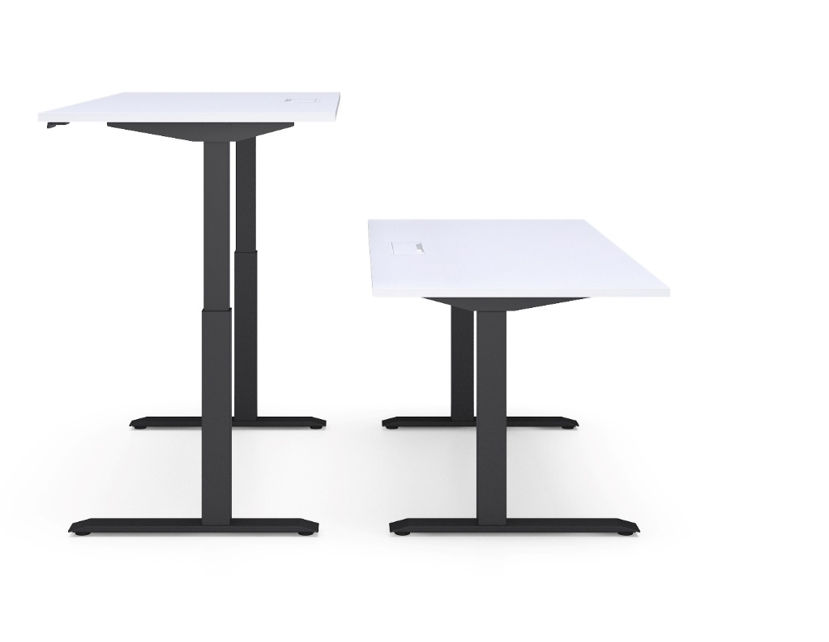
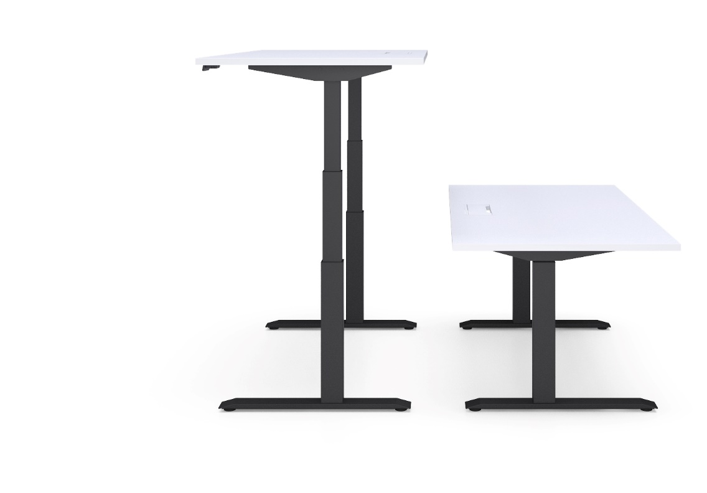
Height control
1292
1193
723
642
2 level columns
3 level columns
! Plastic feet with height levelling (+10 mm)

Slide 9
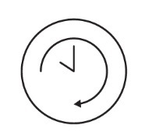
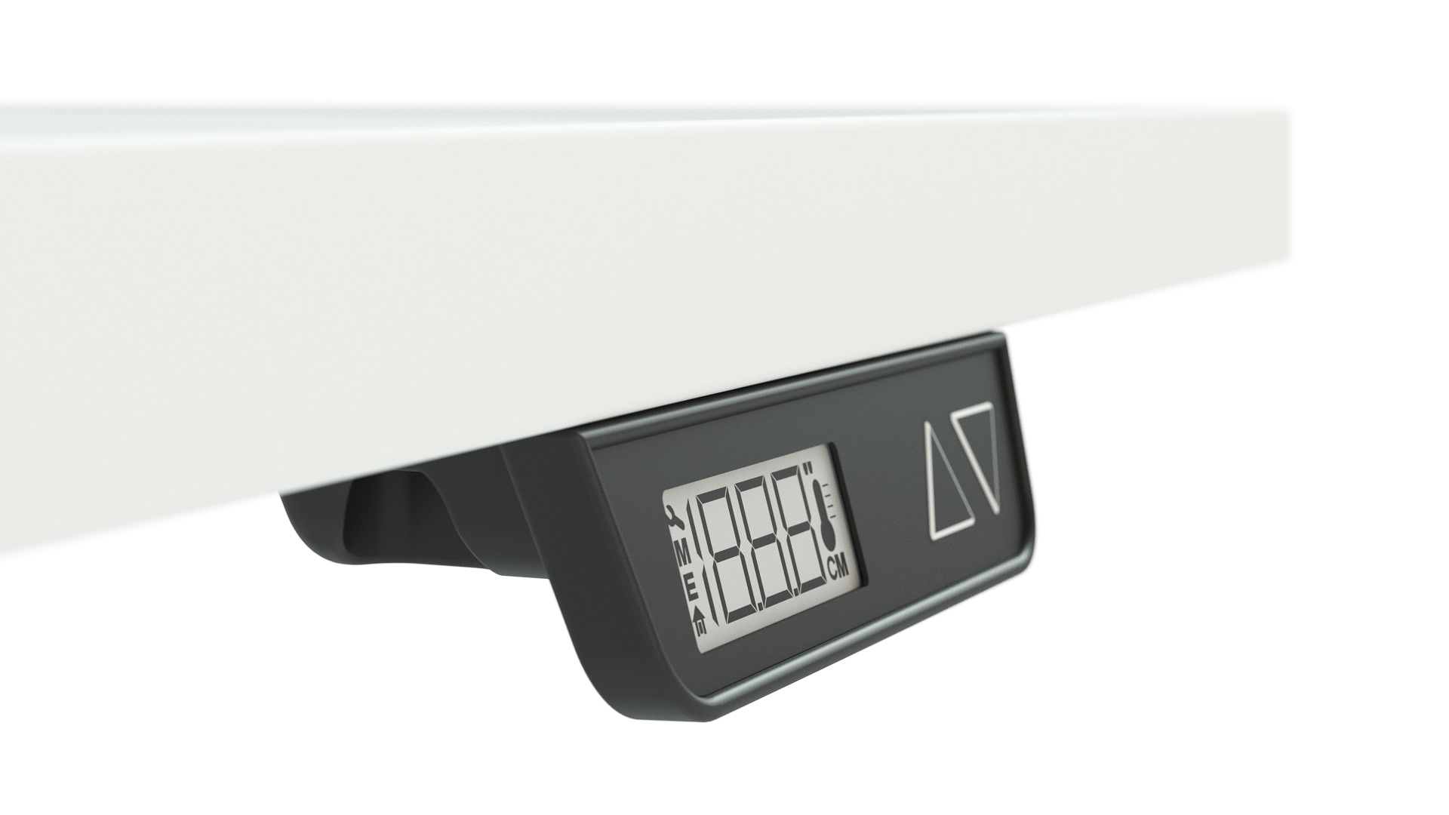
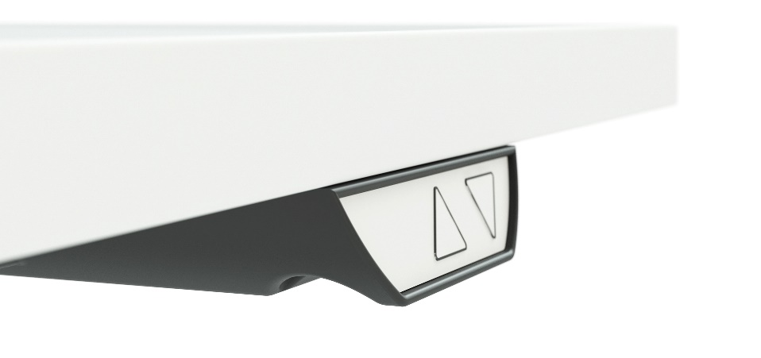
Height adjustment with memory function and screen
Other option – up/down.

Slide 10
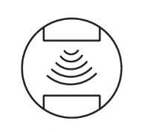
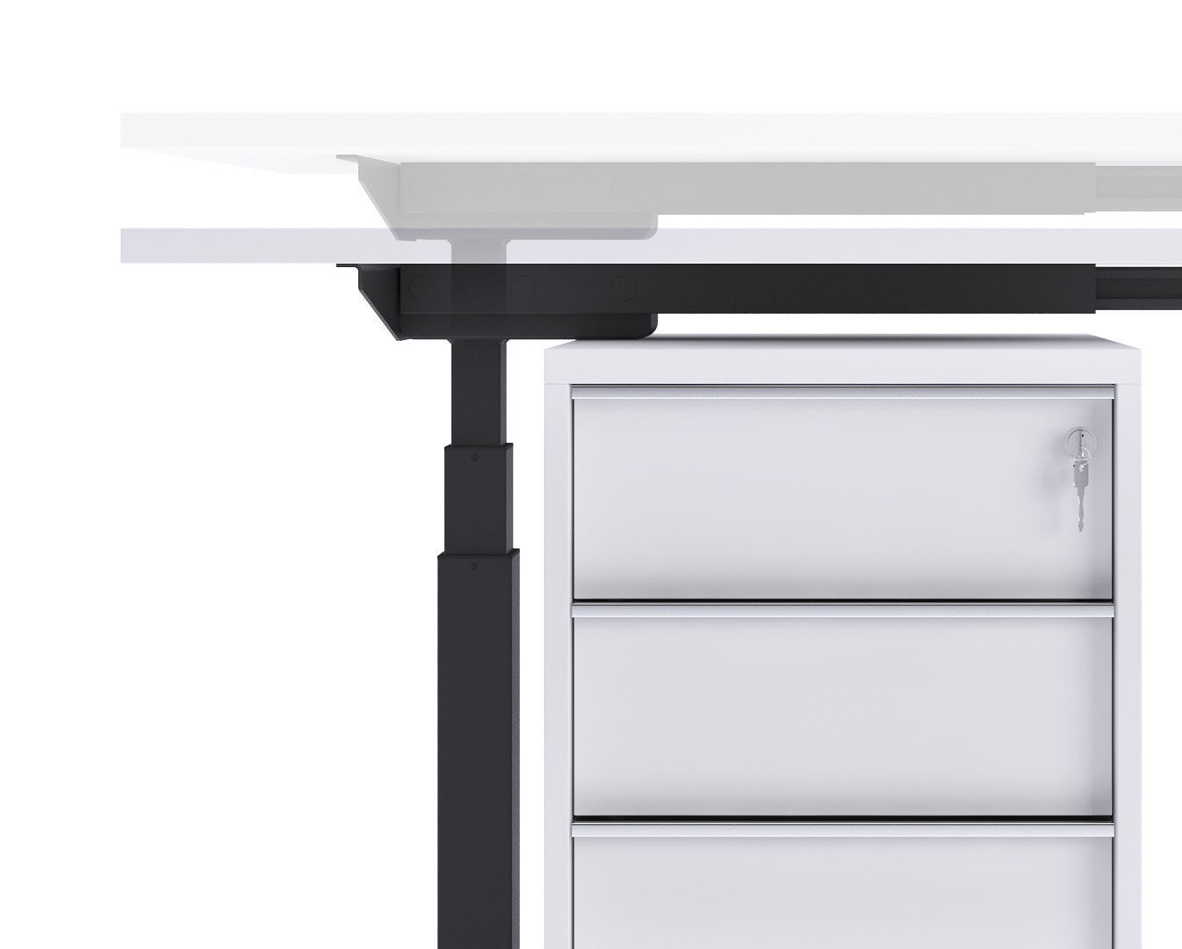
Anti-collision solution
ACTIVE with 2-level and 3-level columns has hardware based anti-collision solution that limits material damages in case desk collides with a solid object.

Slide 11
Fabric screens

Slide 12
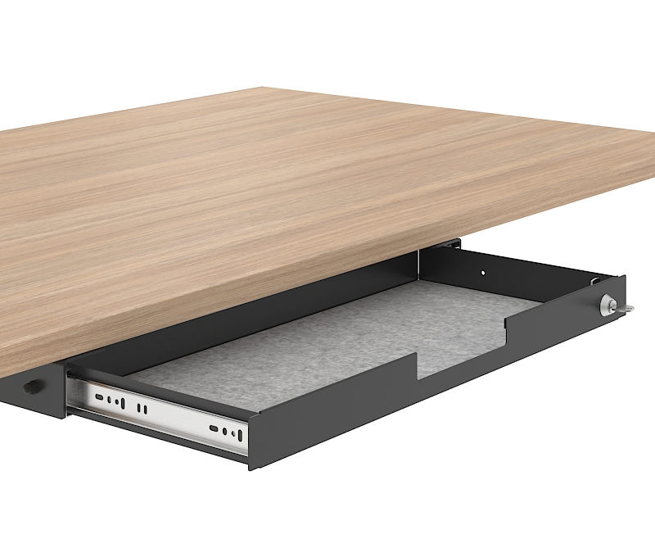
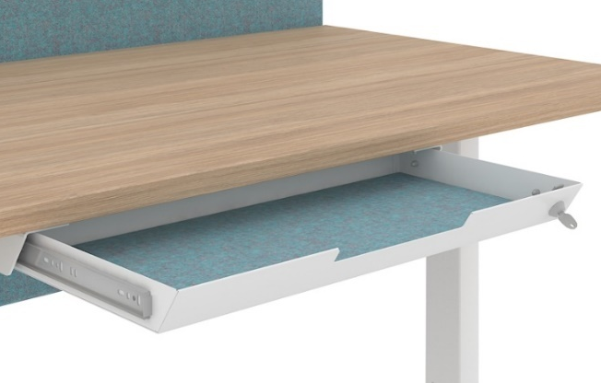
2 options of fabric-lined metal drawers with lock
NEW

Slide 13
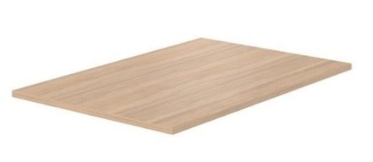
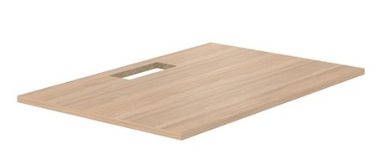
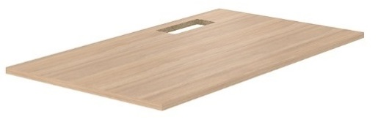
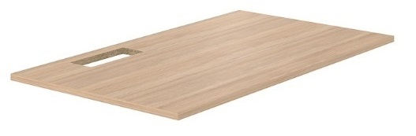
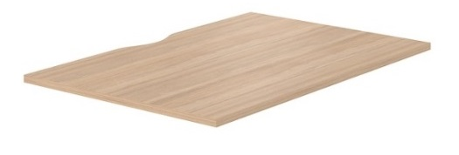
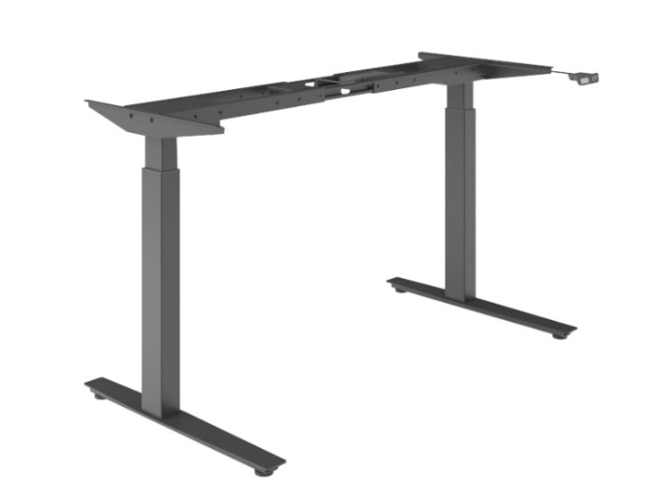
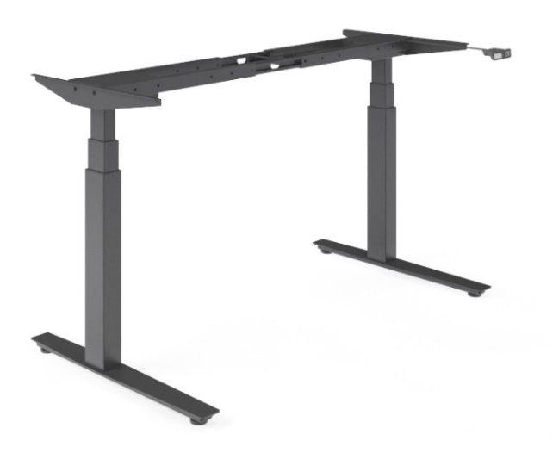
Range
Desktop
Plain
With cut-out for grommet
With cut-out (scallop) for wire management
Desk length: 1200 / 1400 / 1600 / 1800 mm*
Desk width: 700 / 800
Telescopic frame
With adjustable electric legs (2-level columns)
With adjustable electric legs (3-level columns)
*Available only with 800 mm width desktop

Slide 14
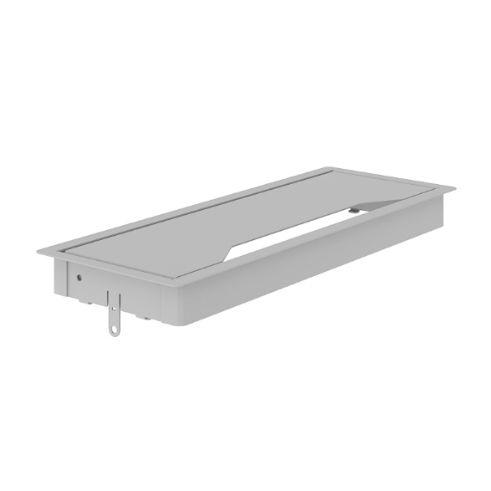
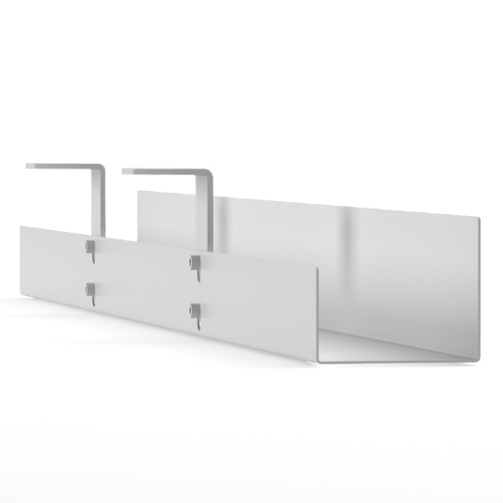
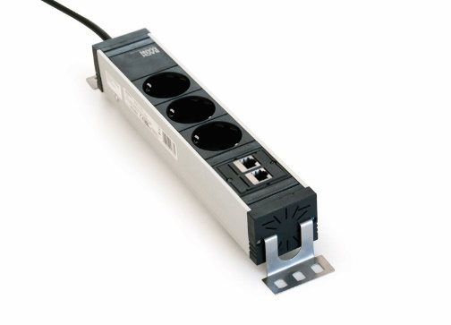
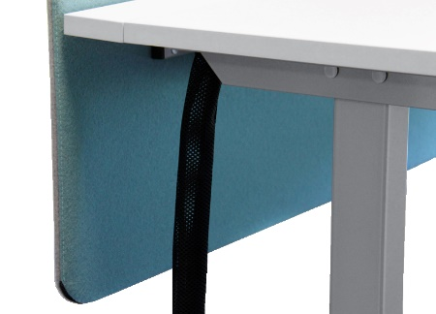
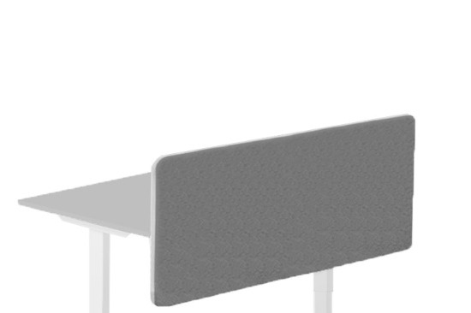

Mus be ordered
for desktops with cut-out
Optional
Metal grommet:
317x119 mm, H=27 mm
Cable trays
Power socket blocks
Cable ducts
Screens
Felt-lined metal drawer with lock

