Slide 1

EASY
SIT-STAND DESKS

Slide 2
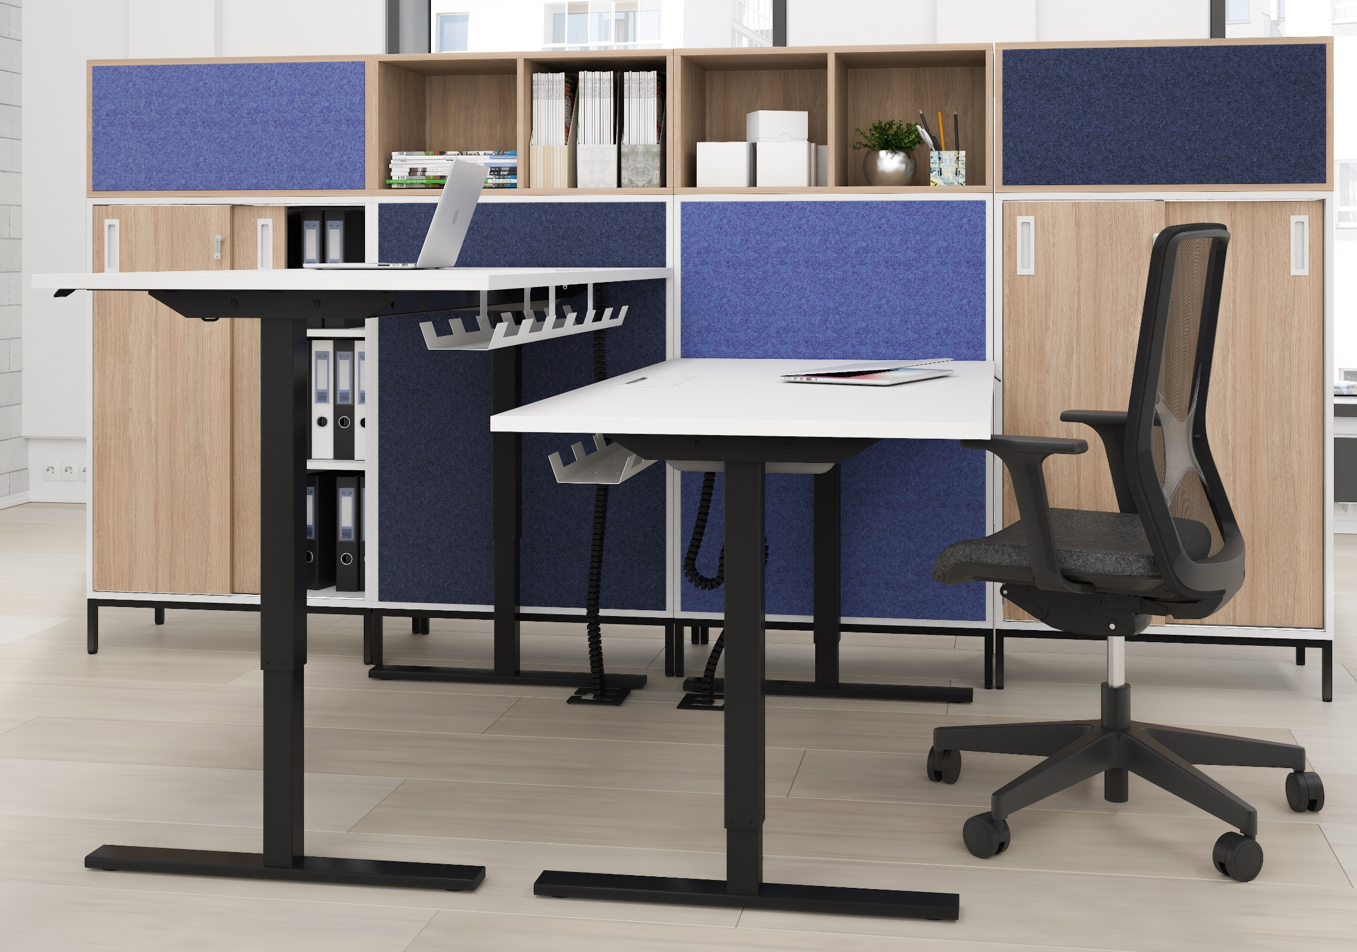
EASY
Electric height adjustable desks with a set of capabilities that make a great value for any office.

Slide 3
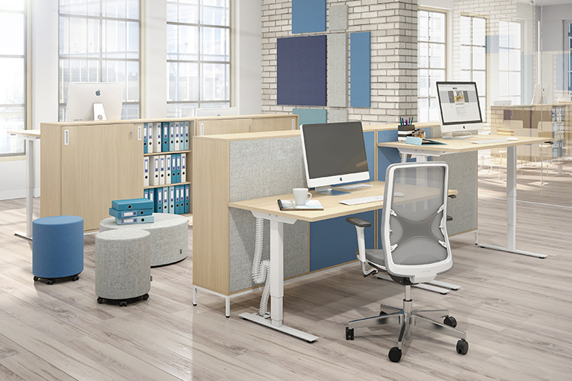
EASY

Slide 4
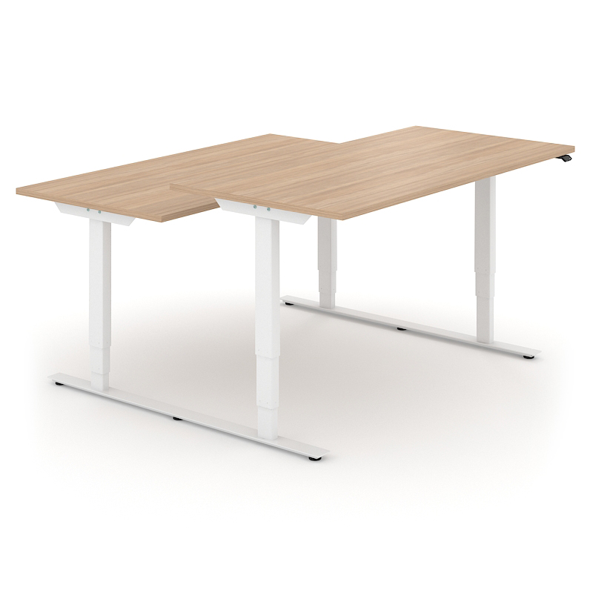
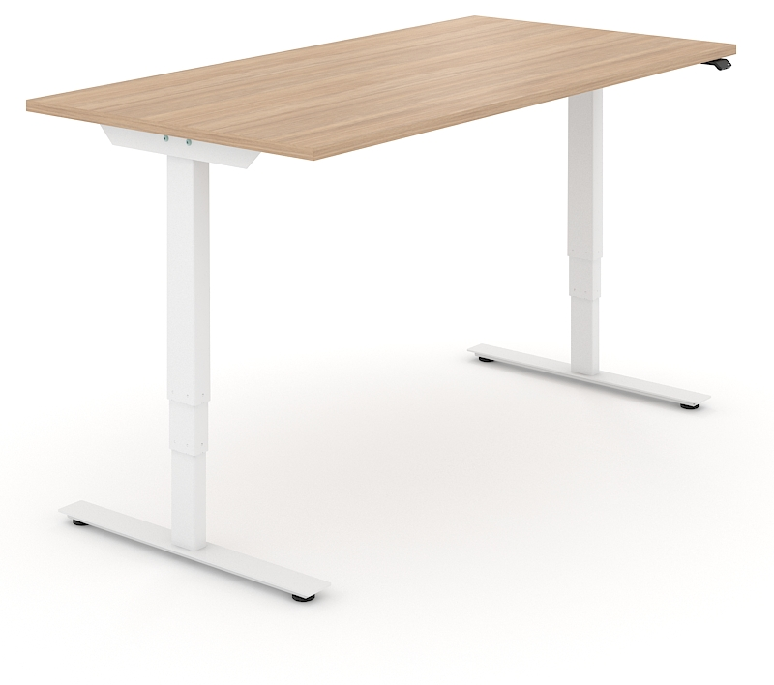
Two types of desks
Single desks
2-desk bench

Slide 5
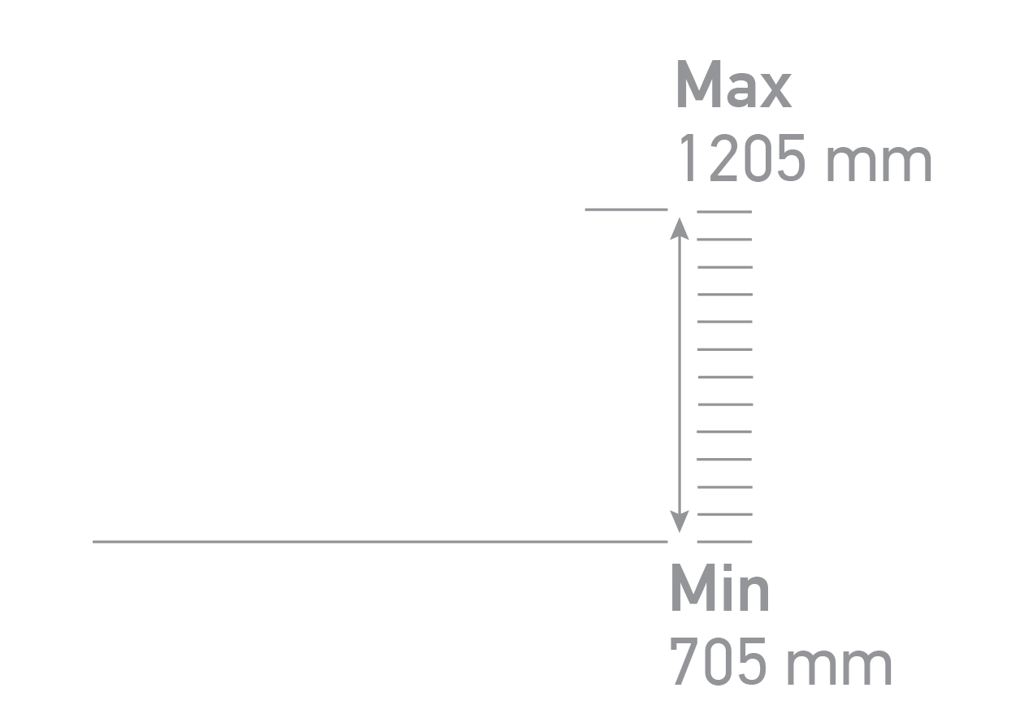
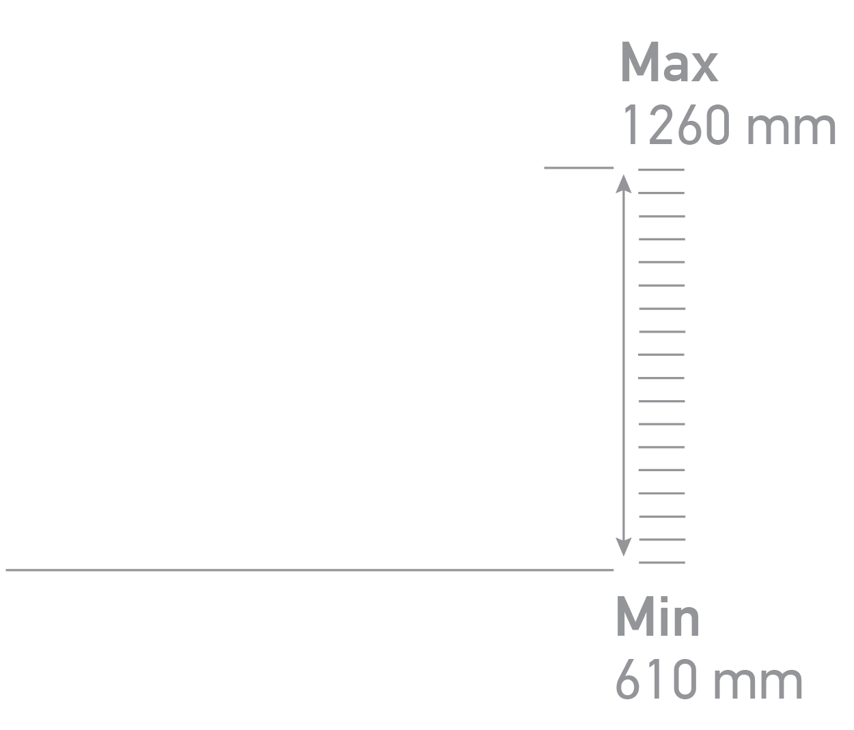
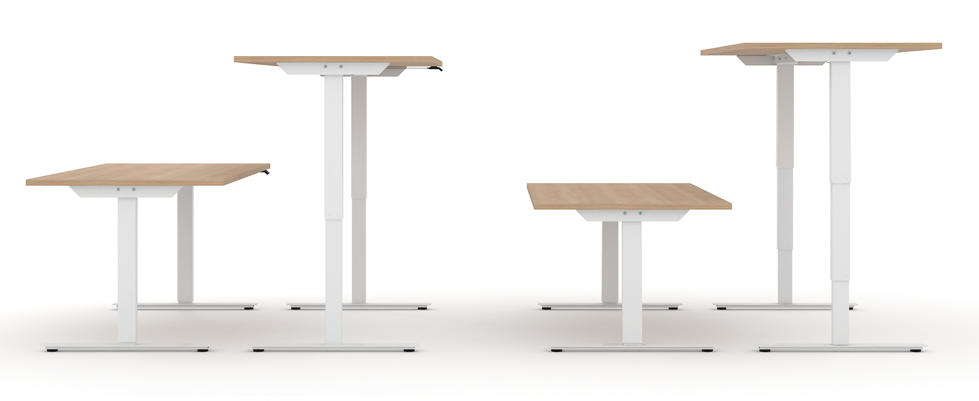
Height control
2 columns
3 columns

Slide 6
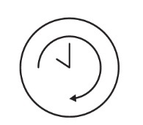
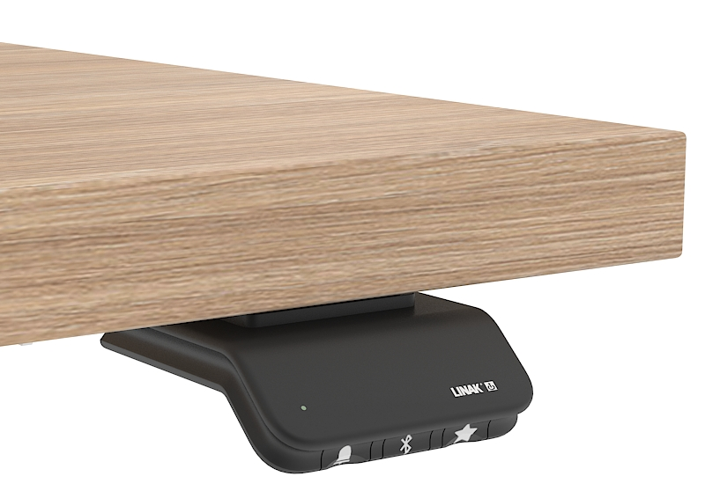
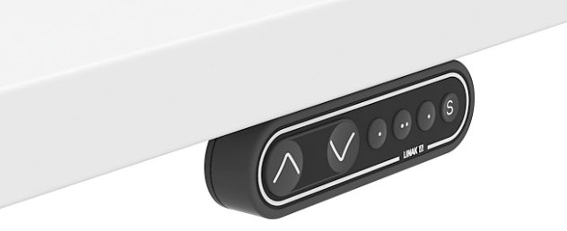
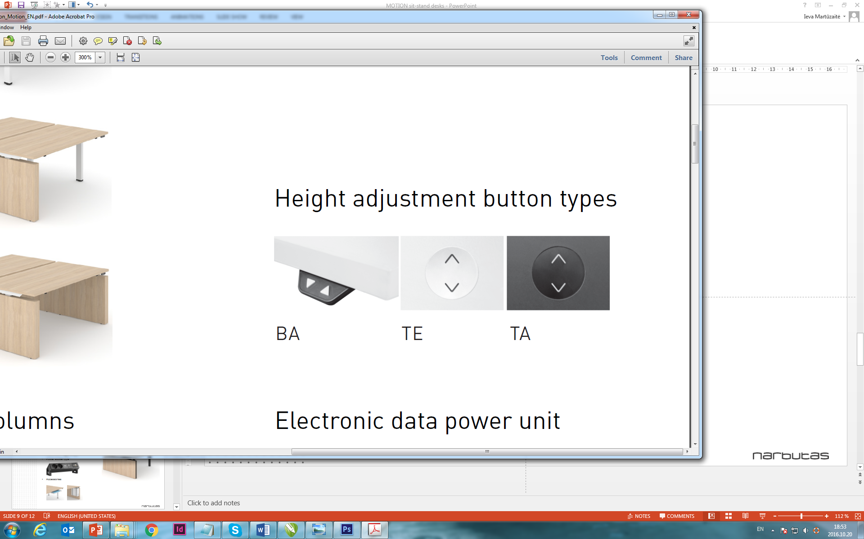
Height adjustment with memory function, Bluetooth and LED reminder
Other options

Slide 7
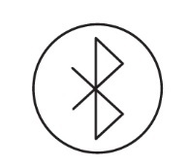
Adjust your desk height with remote control application via Bluetooth (Android, iOS)
Up and down drive
Displays actual height
Easy support
2-3 memory positions
Possibility to enable automatic drive on memory positions
Available in English, German, French, Spanish, Italian, Korean, Chinese and Japanese.

Slide 8
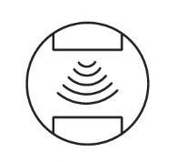
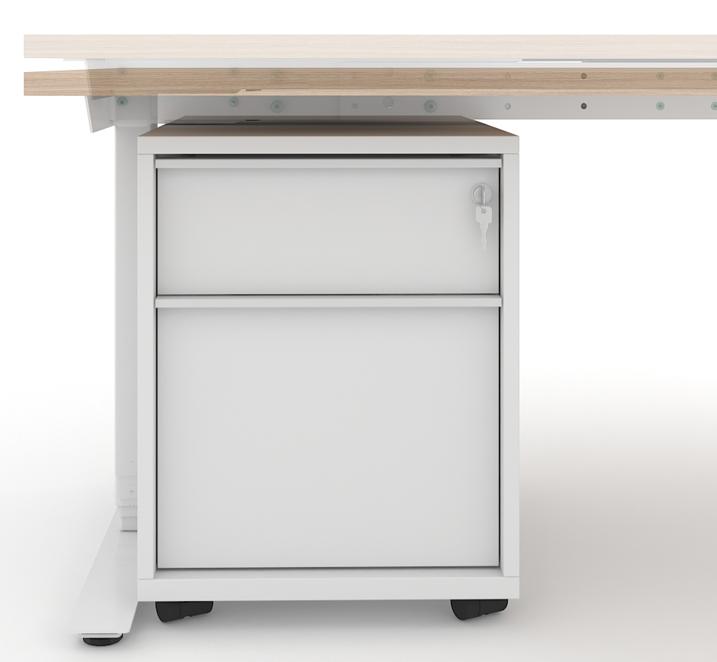
Anti-collision solution
Hardware based anti-collision solution limits material damages in case desk collides with a solid object.
Note: only desks with 3 columns have anti-collision function.

Slide 9
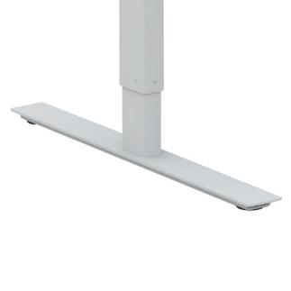
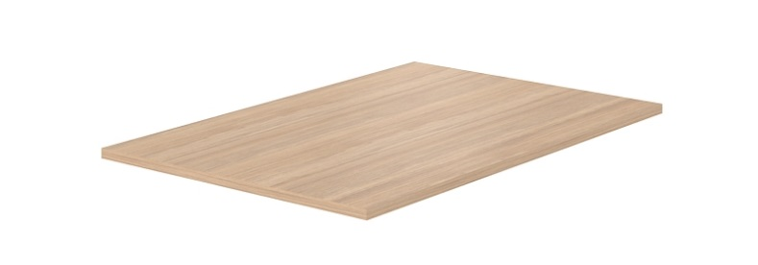
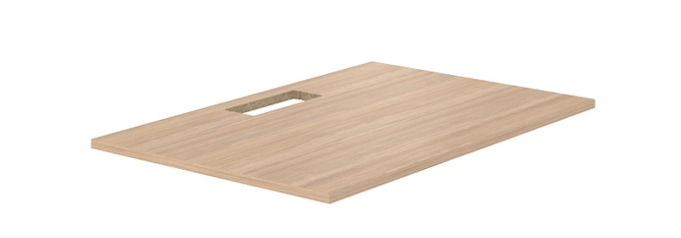
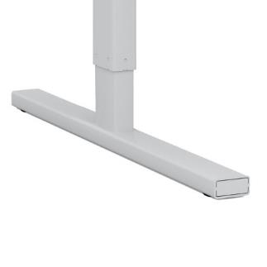
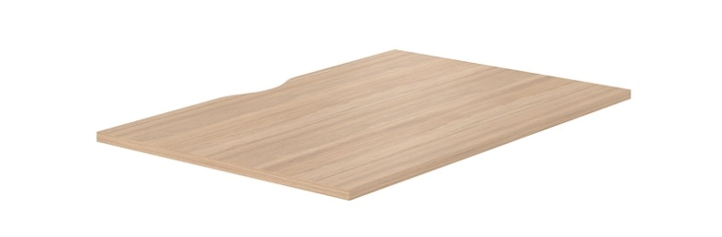
2 types of feet
3 types of desktop
Plain
W
With cut-out for grommet
I
With cut-out (scallop) for wire management

Slide 10
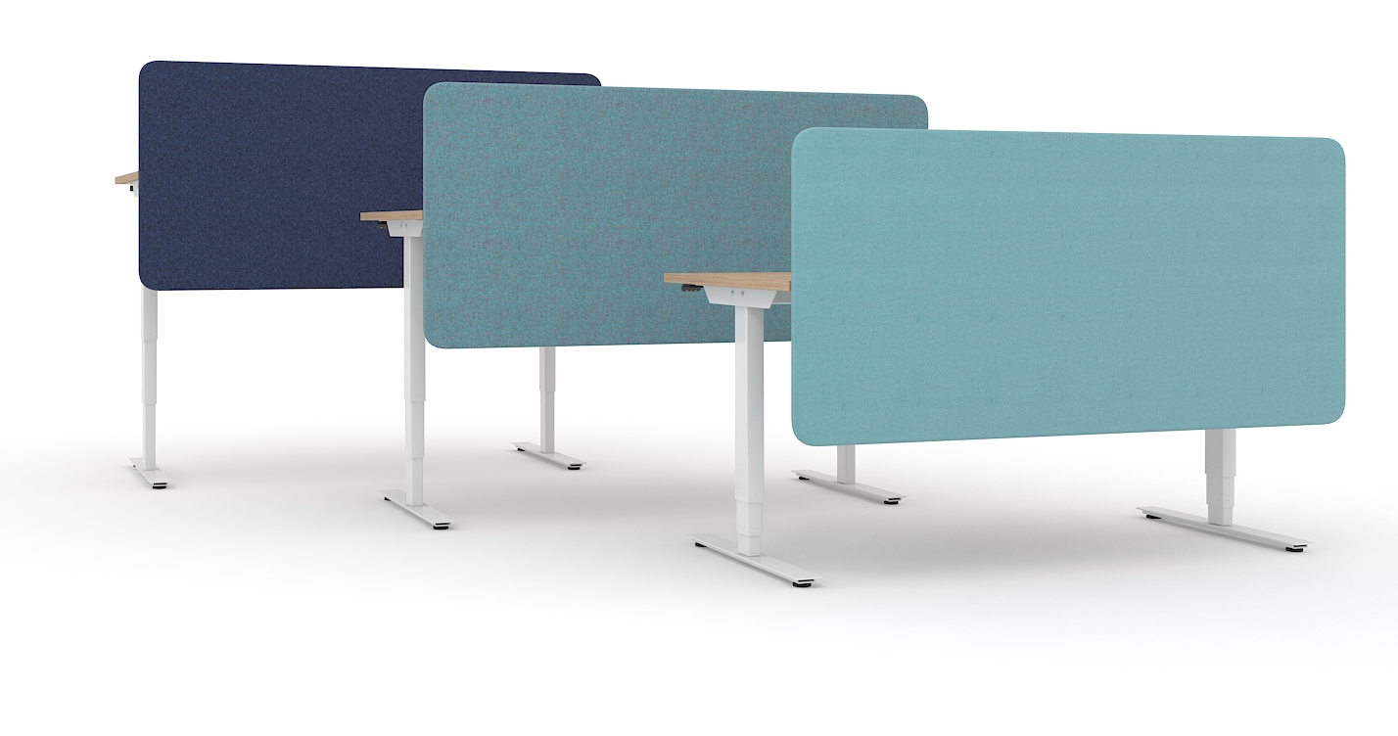

Fabric screens

Slide 11
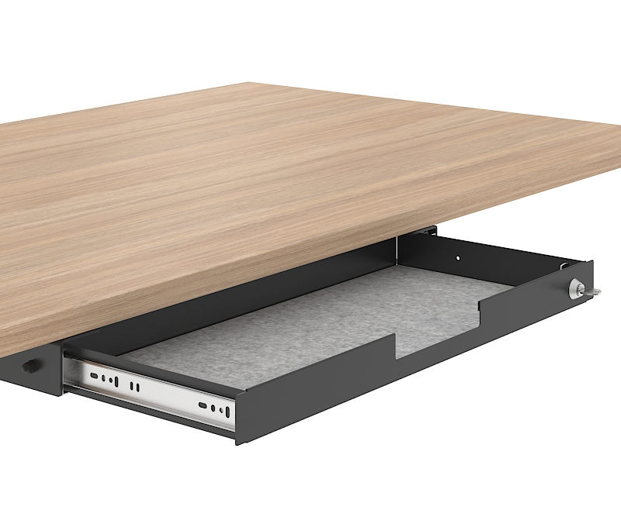
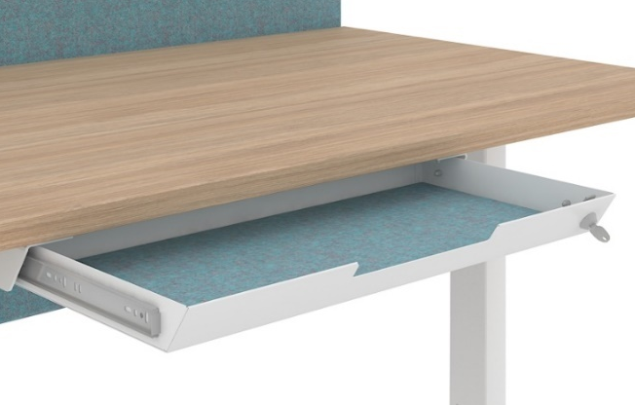
2 options of fabric-lined metal drawers with lock
NEW

Slide 12

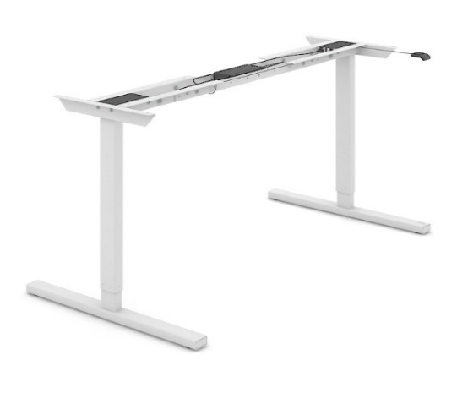

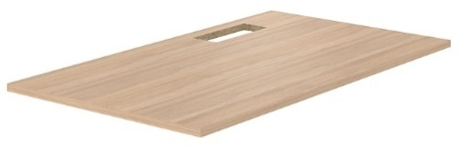
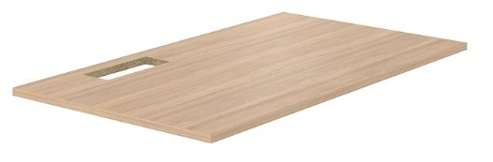
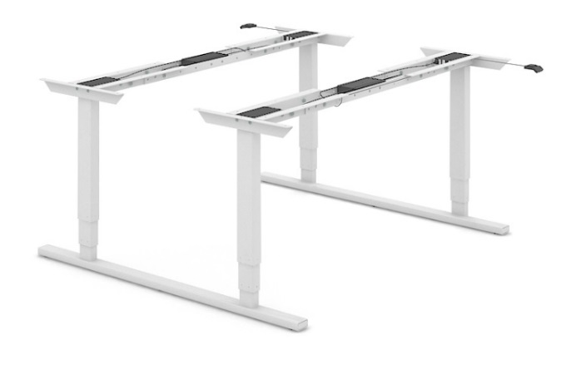

Range
Desktop
Telescopic frame
Plain
With adjustable electric legs (2 columns)
With cut-out for grommet
For 2 desk bench (3 columns)
With cut-out (scallop) for wire management
! Desk length 1200 / 1400 / 1600 / 1800 mm

Slide 13
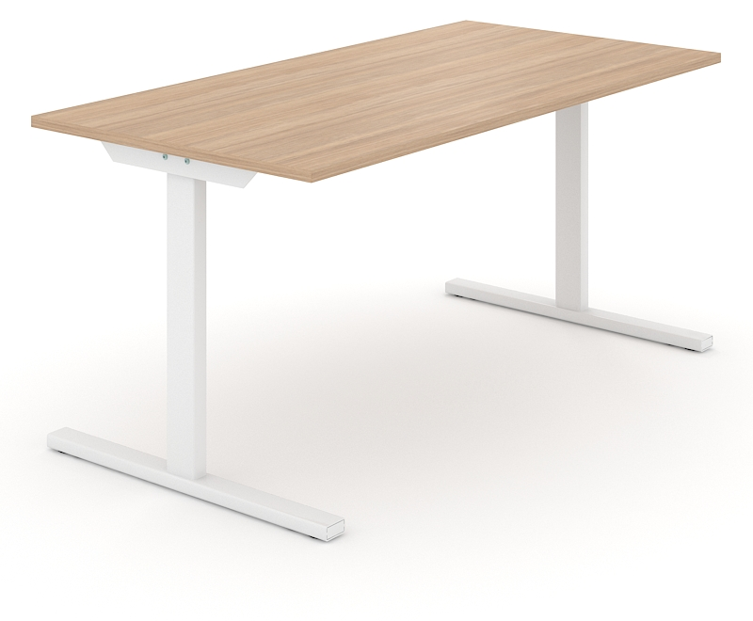
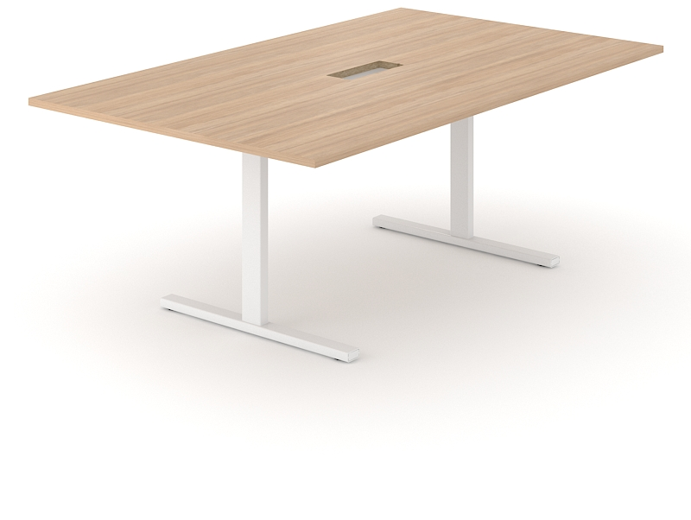
EASY desks are compatible with:
T-EASY desks
T-EASY meeting tables

