Slide 1


GIRO
POUFS

Slide 2
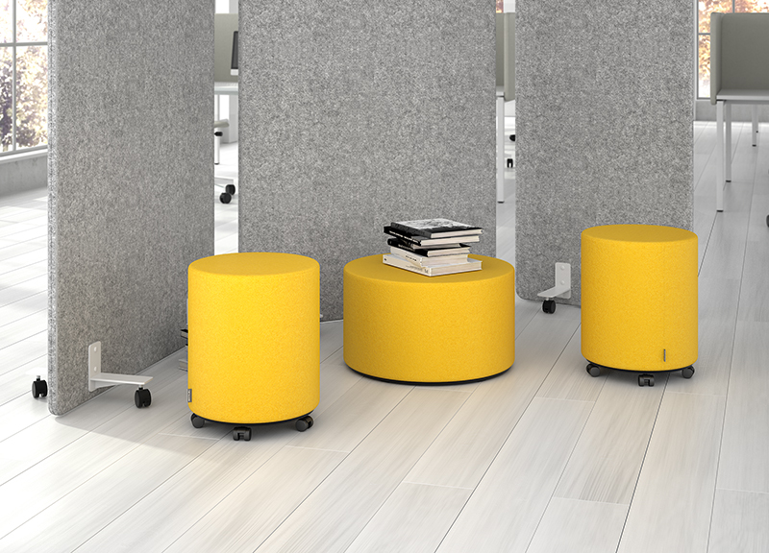
GIRO - light, mobile poufs to enliven your office spaces.

Slide 3

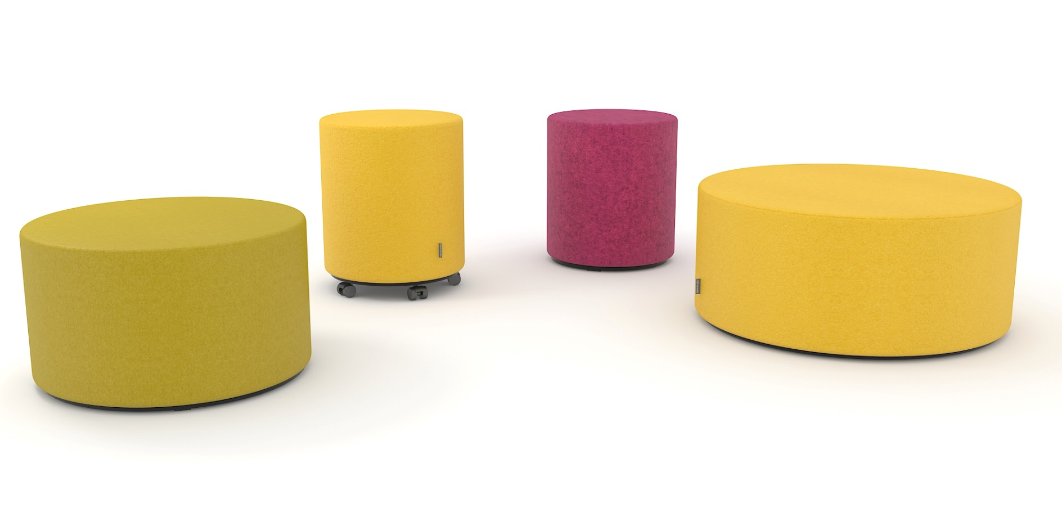
Various heights and sizes for different combinations;
Wide choice of colours and upholstery materials;
Easy to move and transport due to its light weight.

Slide 4
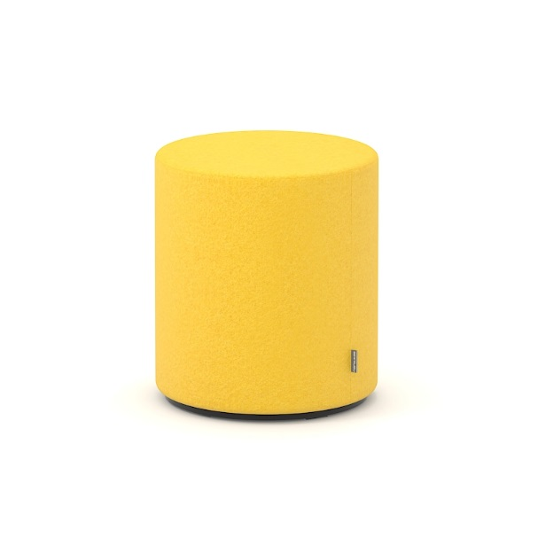
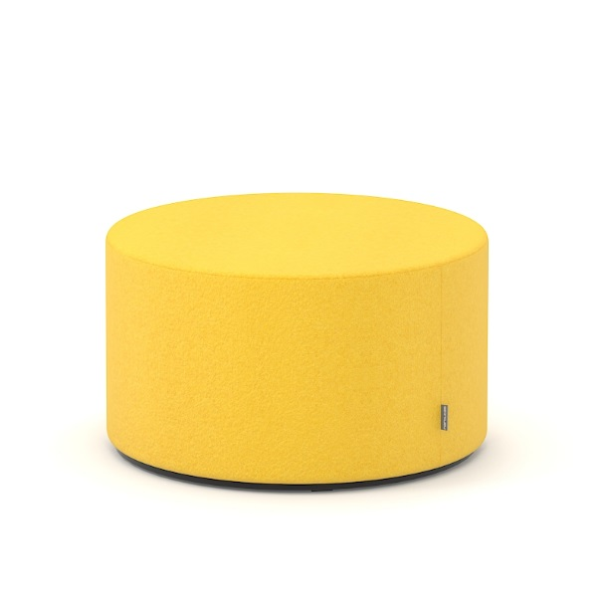
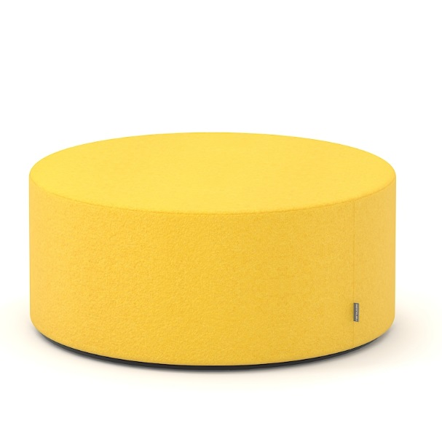
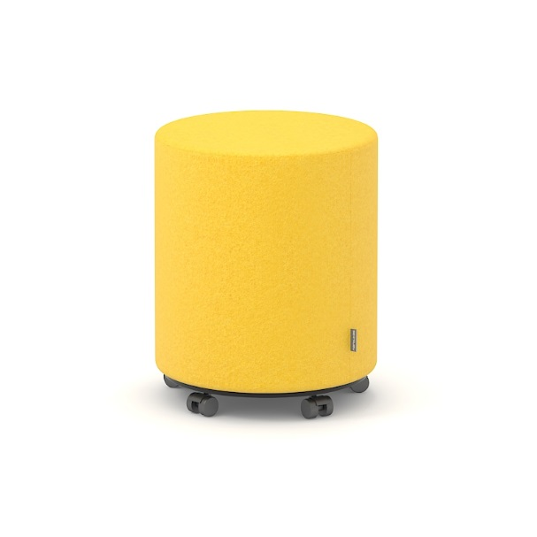
RANGE
With glides
With castors
Ø400, H=450 mm
Ø600, H=350 mm
Ø800, H=350 mm
Ø400, H=490 mm

Slide 5


