Slide 1
JAZZ
RANGE AND TECHNICAL INFORMATION

Slide 2
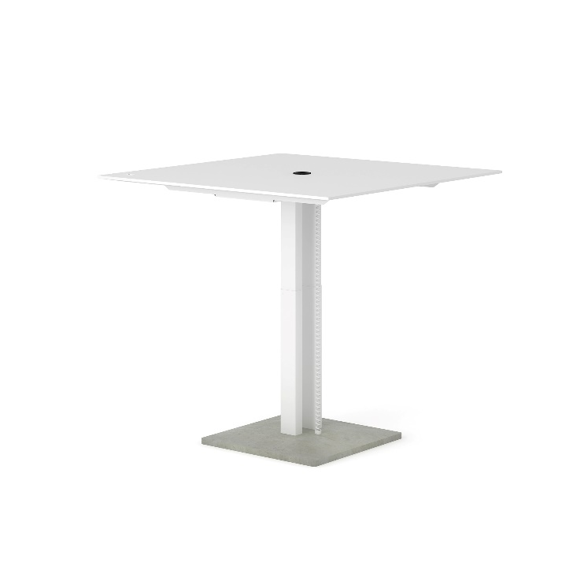
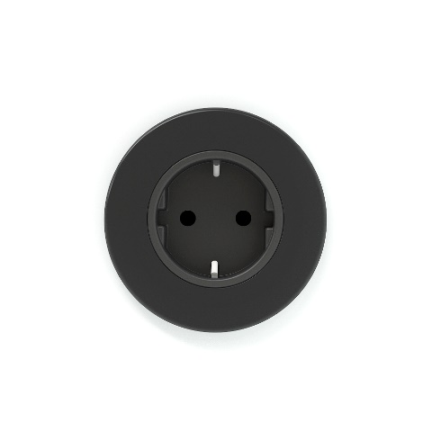
ADJUSTABLE MEETING COLUMN (I)
JAZZ
1. Tabletop MDF 25mm (bevelled edge around):
Dark gray marmoleum; black edge, lacquered;
White-CPL; white edge, painted;
White-CPL; black edge lacquered;
1.1 Tabletop MFC 25mm, with 2mm ABS edge; white
1.
4.
2.
2. LINAK DL5 lifting column:
“Compact” design where inner tube is hidden under the tabletop;
Dimensions:50x80mm (outer tube) and 43.5x73.5mm (inner tube);
Max. thrust 80kg (per leg);
Stroke length 500mm;
Low noise level;
Powder coated: white or black (the same like frame‘s colors).;
3. Concrete base:
Dimensions: 600x600x45mm;
Color – always gray (natural concrete);
Water resistant/impregnated
Weight 29 kg.
3.
1200x1200, H=710-1210
4. Power socket (included):
By OE ELECTRICS (EU, UK, FR, CH). Tables with concrete base only EU, UK, FR.
• 1/2 sockets for 230V/110V

Slide 3
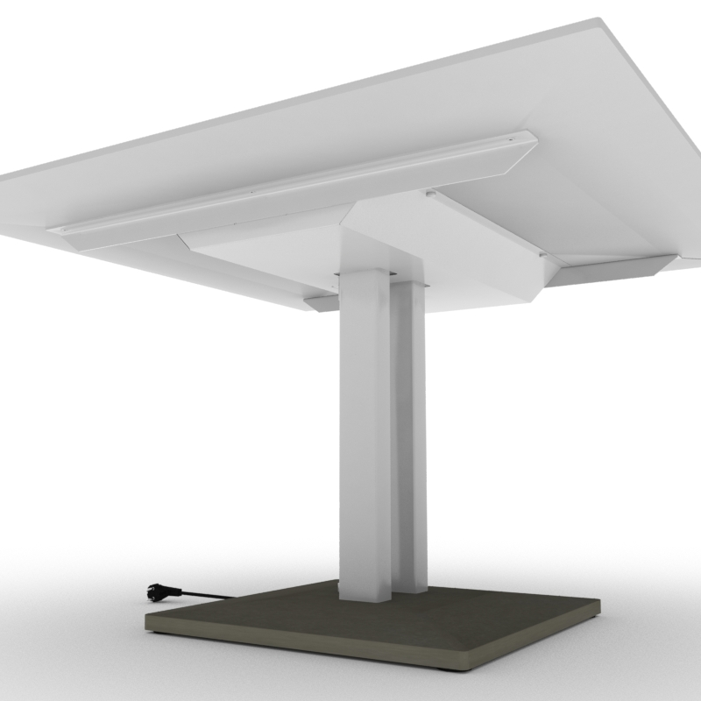
ADJUSTABLE MEETING COLUMN (II)
JAZZ
1. Frame:
Metal profile 40x40x3mm;
Powder coated, color white or black (the same like the legs).
2. Cable tray (included/ part of the desk) :
The tray hides electric leg cable installation;
No tools required to open;
Powder coated; white or black (the same colors like the frames’).
3. Electric cable:
230 V. L 1.5m
EU, UK
1.
2.
3.
1200x1200, H=710-1210

Slide 4
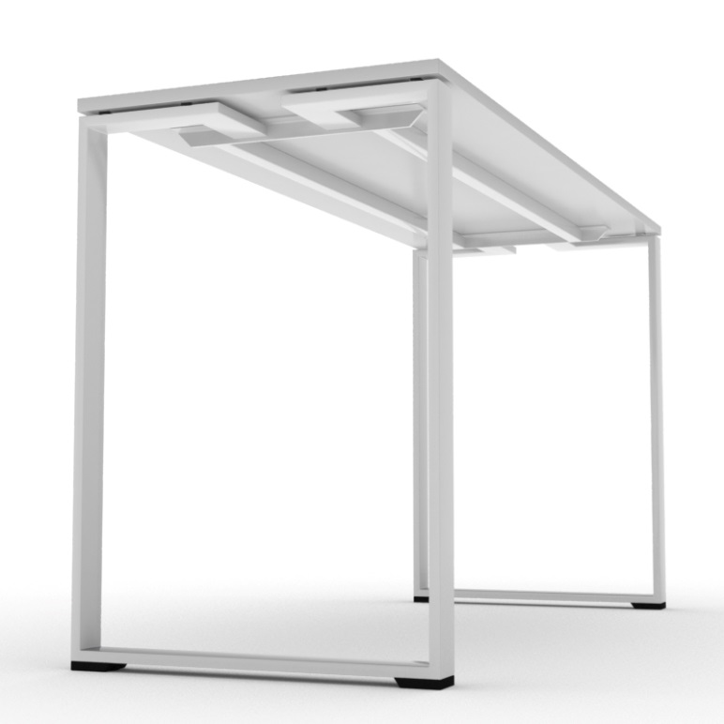
HIGH COFFEE TABLE
JAZZ
1. Tabletop:
MFC 25mm with 2mm ABS edge;
Color – white;
8mm gap between the tabletop and the legs (distancers are always black).
2. Legs:
Metal tube 70x20x2mm;
Hight levelling feet. Always black;
Powder coated; white or black.
3. Frame:
Metal profile 35x35x4mm;
Powder coated; color the same like the legs.
1.
3.
2.
1800x700, H=900/1030

Slide 5
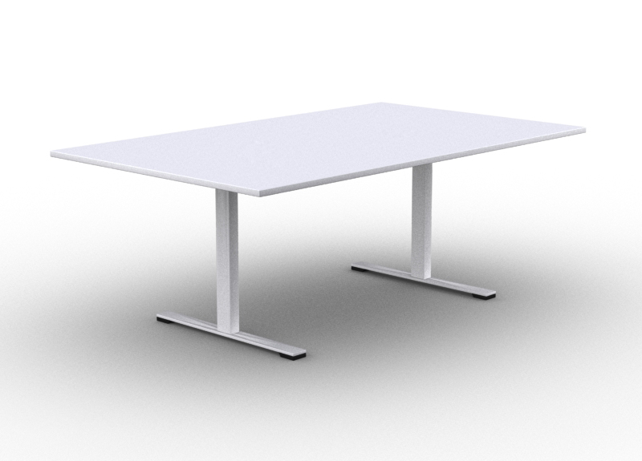
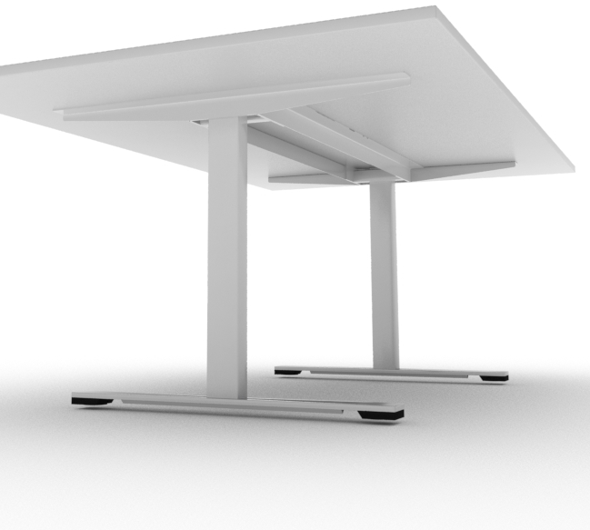
MEETING TABLE
JAZZ
1. Tabletop MDF 25mm (bevelled edge around):
dark gray marmoleum; edge black lacquered;
white-CPL; edge white painted;
1.1 Tabletop MFC 25mm, with 2mm ABS edge; white.
2. Metal frame:
Metal “L”profile: 50x50x3mm;
Powder coated metal.
3. Leg column:
Dimensions (mm) : 50x80x686H;
Powder coated metal. Colors black and white
1.1
1.
2.
4. Leg base:
A leg base made of 12mm thick steel sheet;
Dimensions 70x800x30mm.
Leg base has height leveling feets;
Leveling feet covers made of black lacquered MDF;
3.
4.
2000/2800/3200x1200, H=740

Slide 6
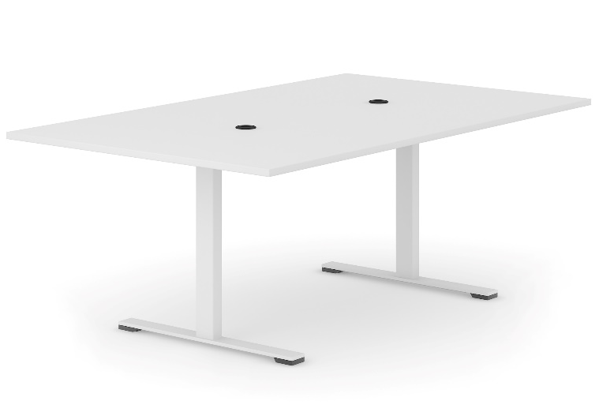
MEETING TABLE
JAZZ
1. Power sockets (included/ part of the desk):
By OE ELECTRICS (EU, UK, FR, CH). Tables with concrete base only EU, UK, FR.
• 1/2 sockets for 230V/110V
1.
2. Cable tray (included/ part of the desk) :
Tray hides electric installation and power sockets;
Dimensions: 920/1120x190x52mm;
No tools required to open;
Available in white and black colours
2.
2000/2800/3200x1200, H=740

Slide 7
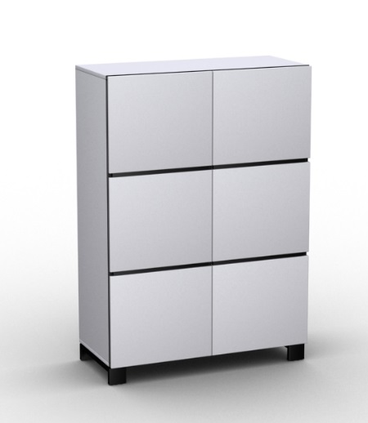
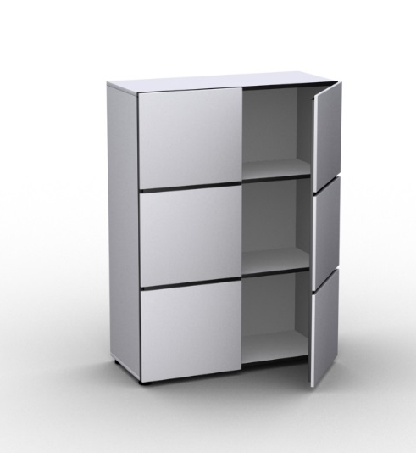
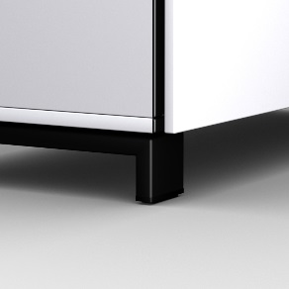
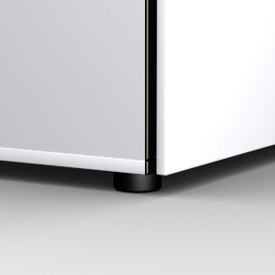
CABINETS
JAZZ
1. Body:
Made of white color 16mm MFC;
The front edge is always black; 2mm ABS;
All other edge are white , 1,5mm ABS;
Dimensions (mm): 850x360x754/1138H.
2. Doors:
Made of two layers 12mm MFC.
Inner layer is always black;
Outer layer in red or white color;
Hinges: BLUM 155 º opening angle, with “blumotion” system (soft closing);
Without lock.
3. Legs:
Metal profile: 70x20x2mm;
Hight levelling feet;
Durable leg-frame welded construction;
Dimensions (mm): 848x356x75H;
Powder coated metal. Black color.
1.
2.
3.
850x382, H=740/1210
850x382, H=740/1210

Slide 8
Let the work flow with JAZZ…

