Slide 1

MOTION
Set yourself in MOTION!

Slide 2
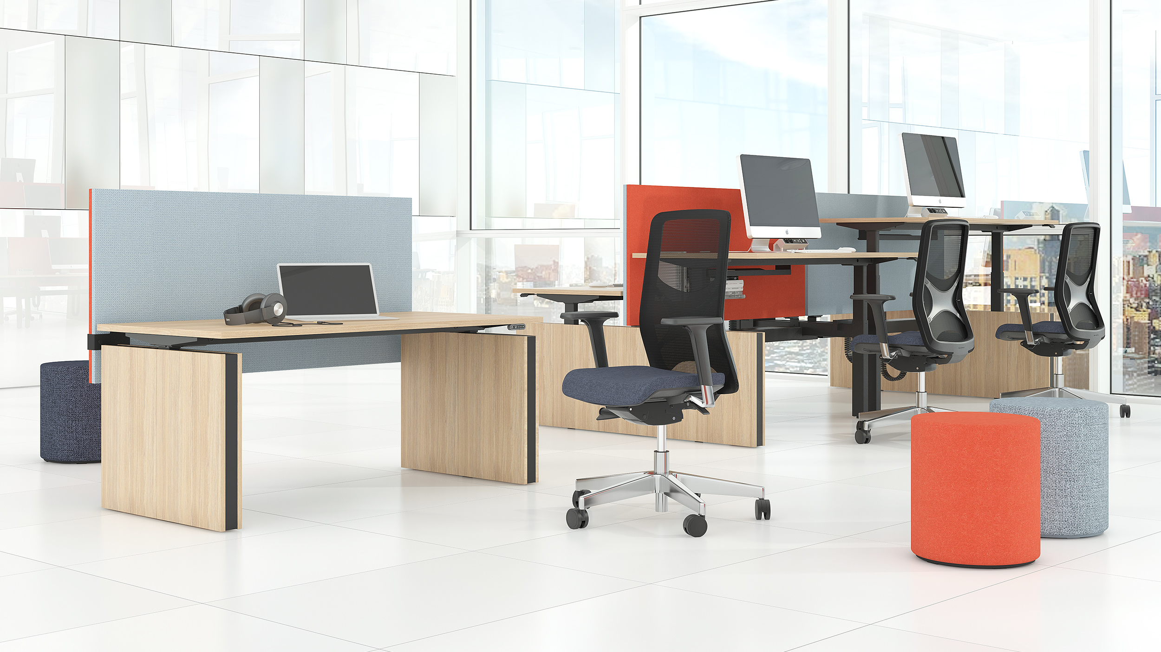
Electric height adjustable desking system for more dynamic and healthy work style

Slide 3
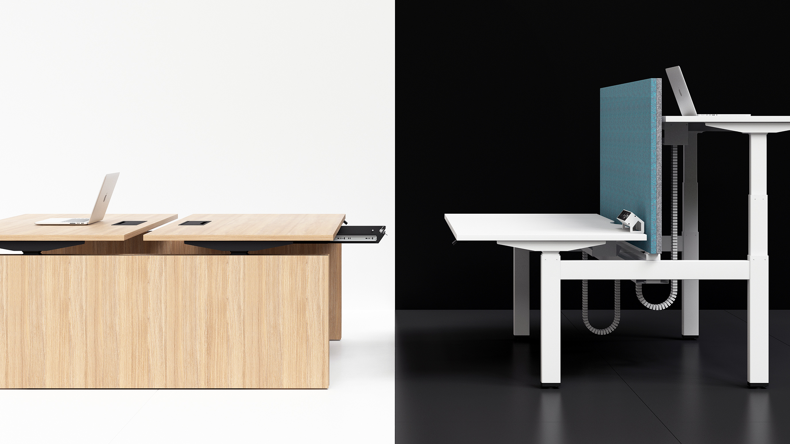
Smart solutions to meet everyday needs in the workplace

Slide 4
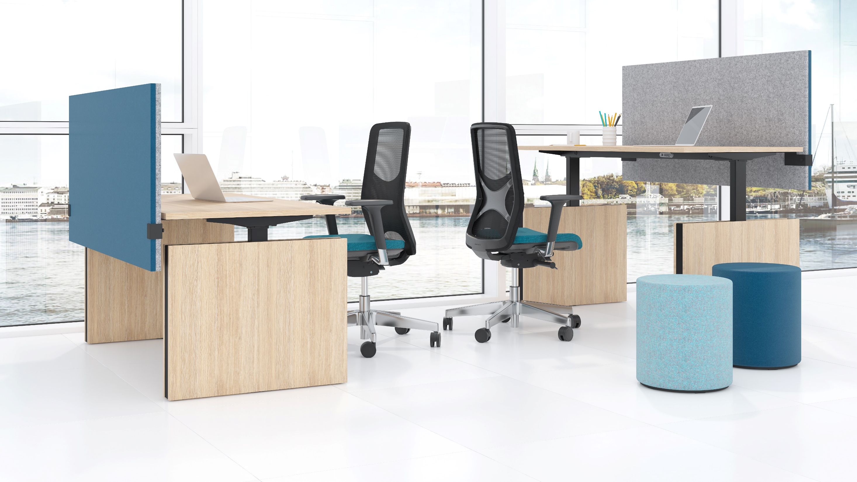
Single desks

Slide 5
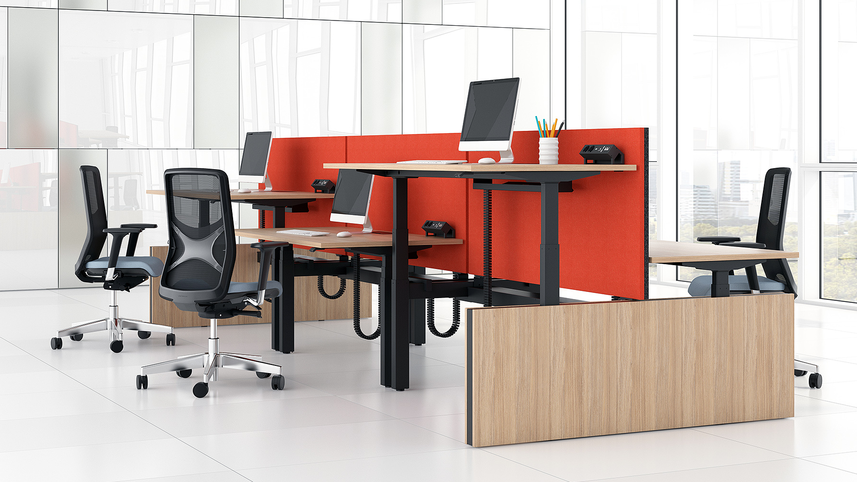
Bench desks

Slide 6
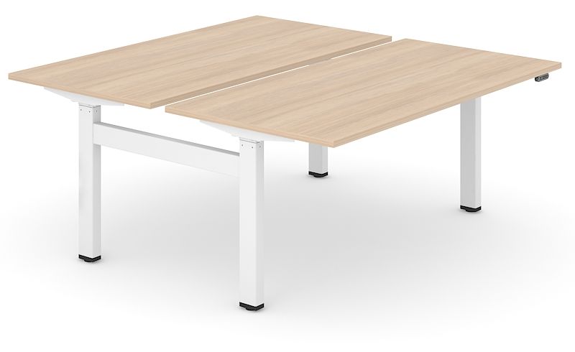
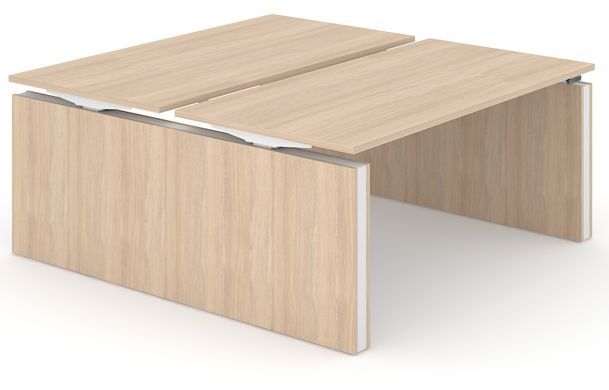
Choose from two types of table legs
H type metal legs gives the additional free space for moving and storing things.
Panel legs are an option for those who prefer more privacy. This type of legs visually covers the space under the desk and creates an aesthetic office look.

Slide 7
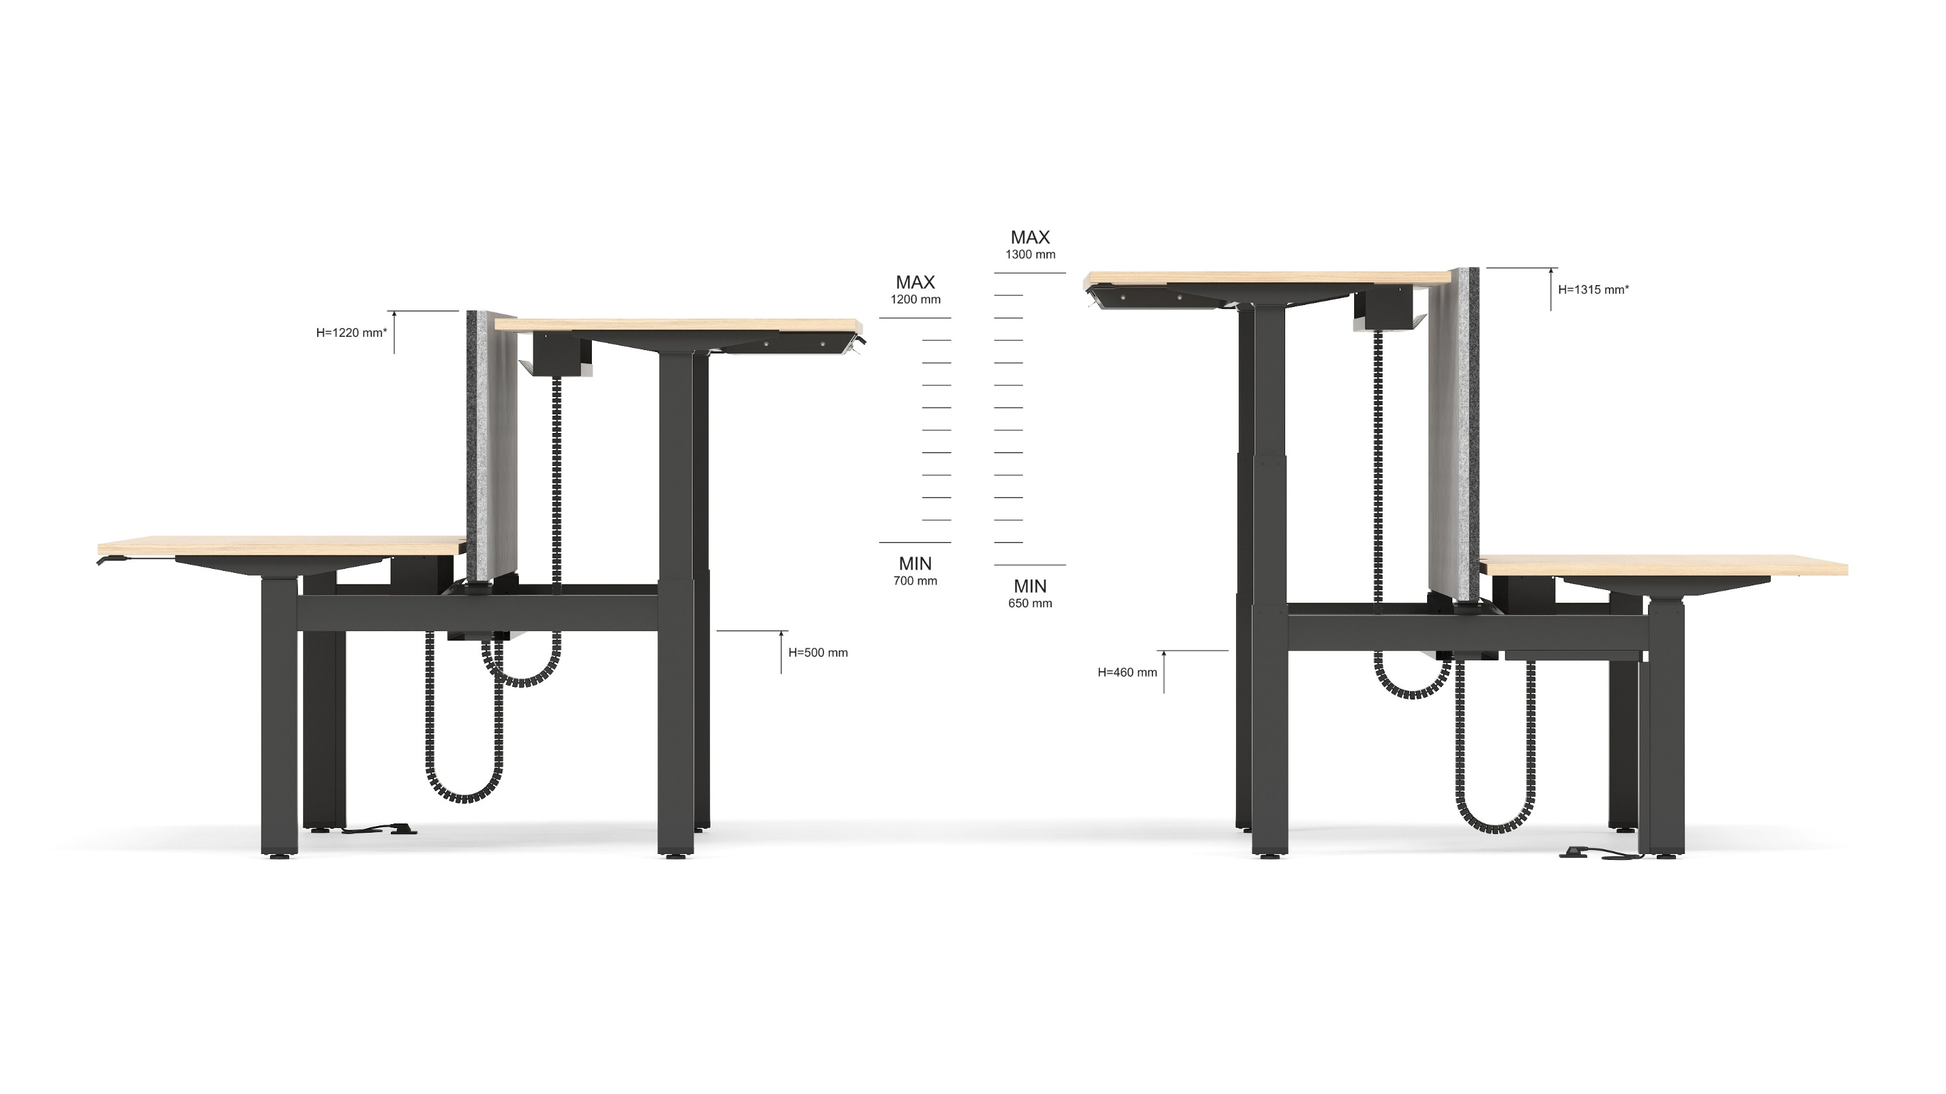
Height differences
2 columns
3 columns
* With MODUS C class screens

Slide 8
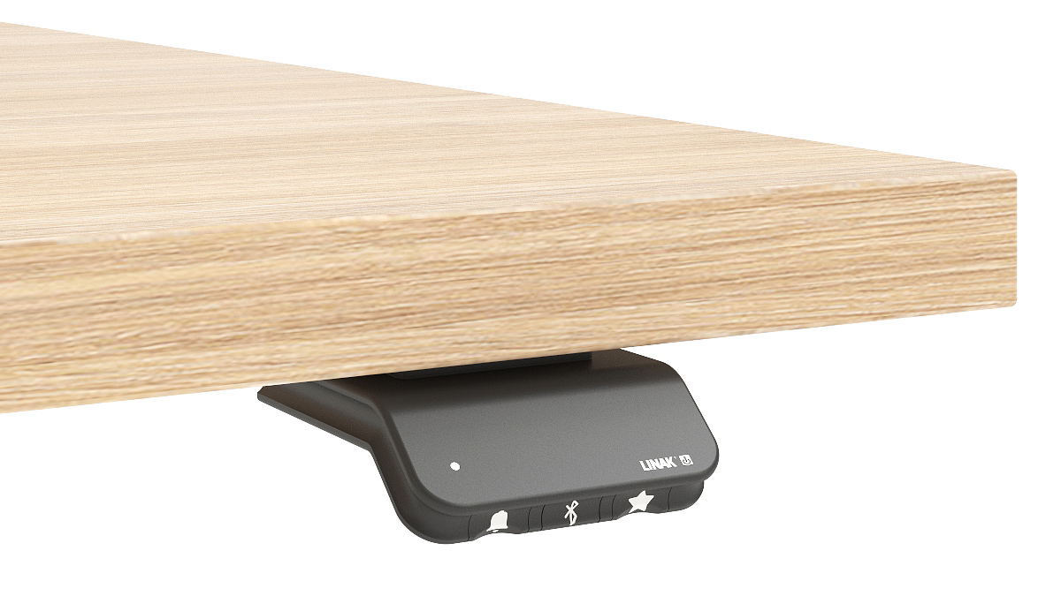
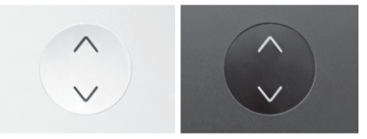
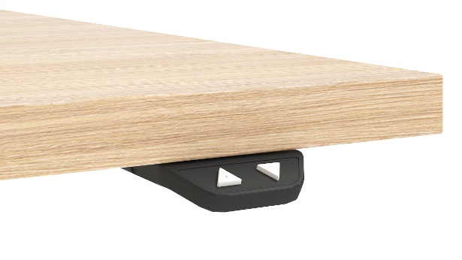
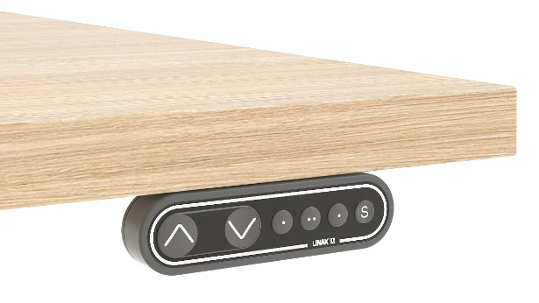
Height adjustment with memory function, Bluetooth and LED reminder
Other options:

Slide 9
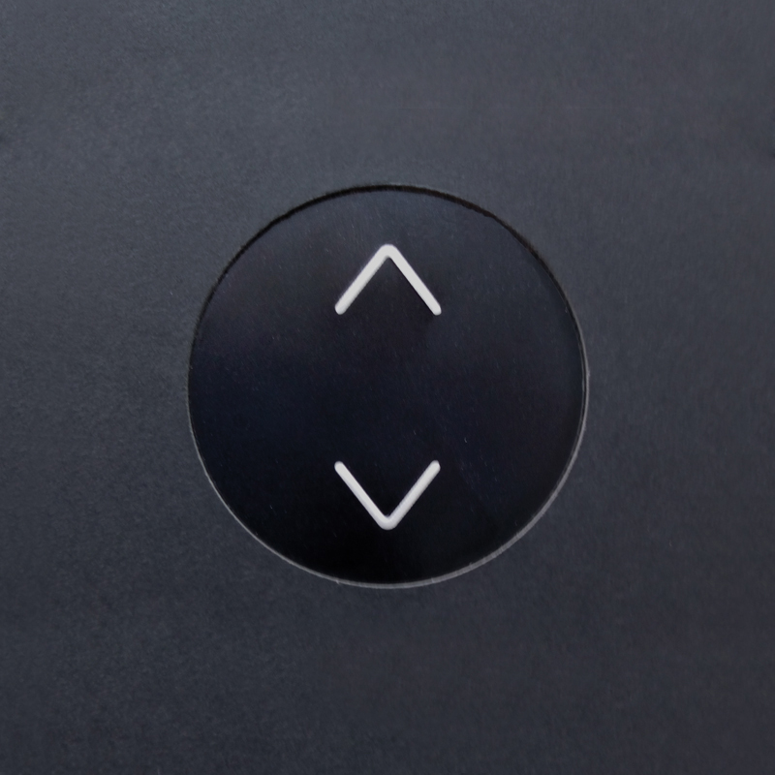
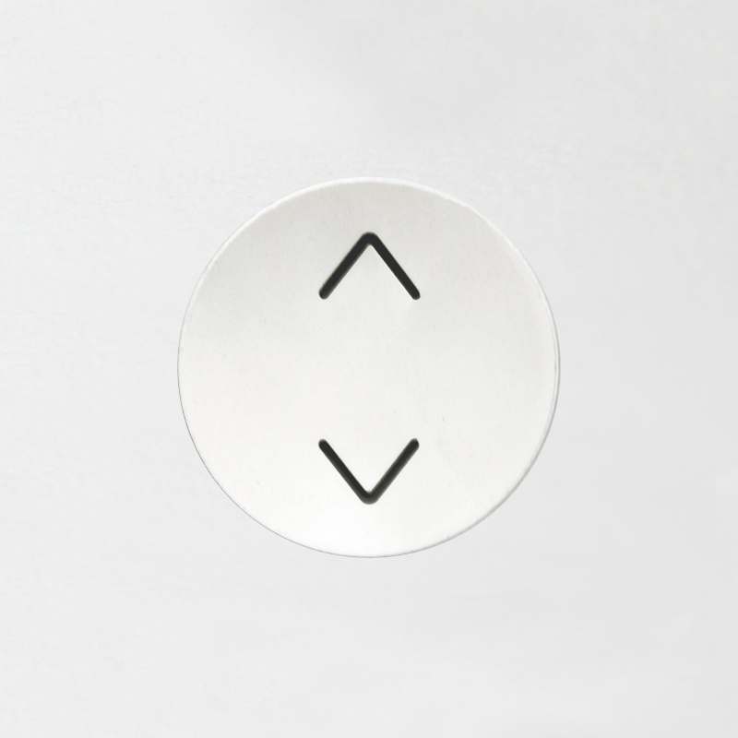
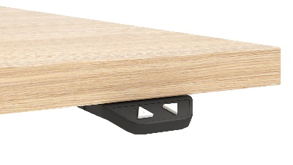


Comparison of buttons
Type of button |  | Up / Down | Memory positions | Control with application via Bluetooth | Options | Systems
 | TA (black) TE (white) | + | None or 2 with Bluetooth adapter ZZZ051 | Only with Bluetooth adapter ZZZ051 | - | MOTION EASY
 | BA (black) | + | None or 2 with Bluetooth adapter ZZZ051 | Only with Bluetooth adapter ZZZ051 | - | MOTION EASY
 | MA (black) | + | 3 | Only with Bluetooth adapter ZZZ051 | - | MOTION EASY
 | LA (black) | + | 2 | Integrated | Automatic drive on memory positions; Customised logo on front; Reminder via LED or LINAK app to change your position | MOTION EASY

Slide 10
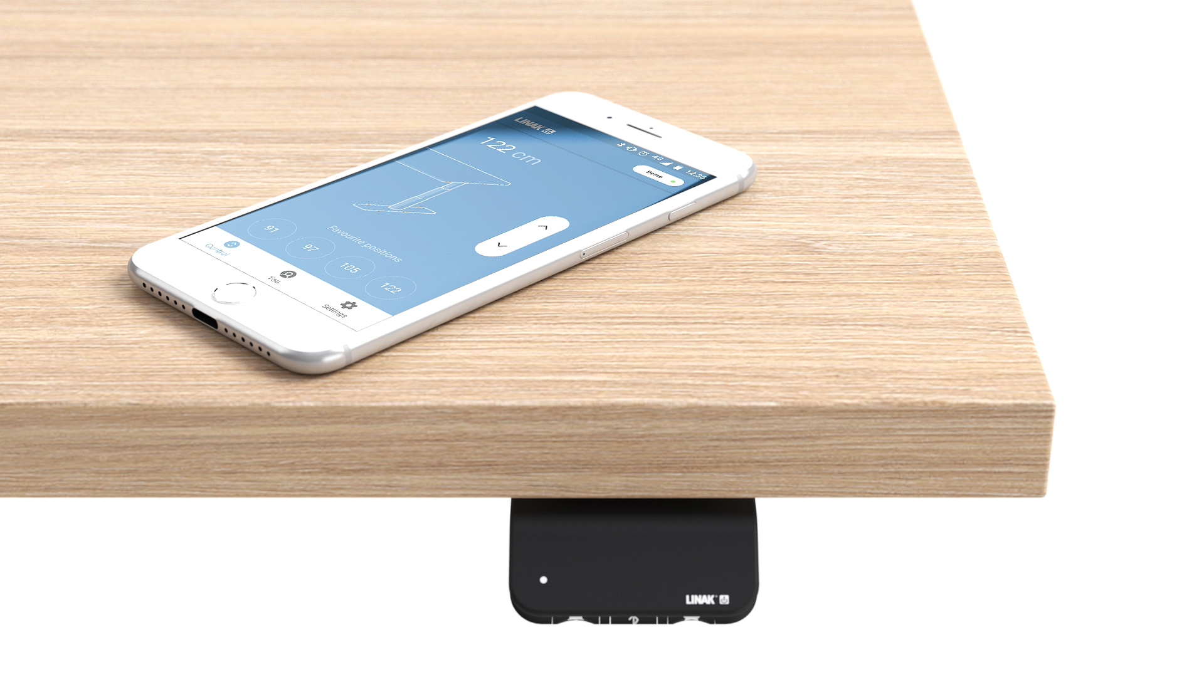
Adjust your desk height with remote control application via Bluetooth (Android, iOS)
Up and down drive;
Displays actual height;
Easy support;
2-4 memory positions;
Possibility to enable automatic drive on memory positions;
Available in English, German, French, Spanish, Italian, Korean, Chinese and Japanese.

Slide 11
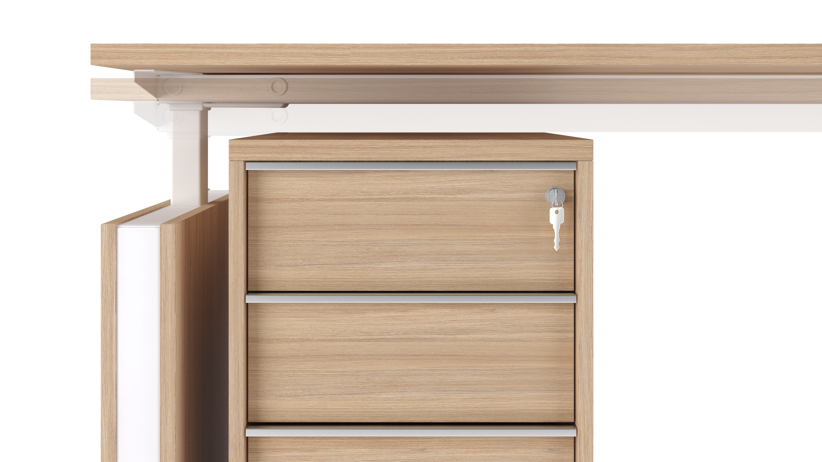
Anti-collision solution
Hardware based anti-collision PIEZO solution limits material damages in case desk collides with a solid object.
Note:
only desks with 3 columns have anti-collision function;
system is less sensitive if the collision happens close to a column or at high load.

Slide 12
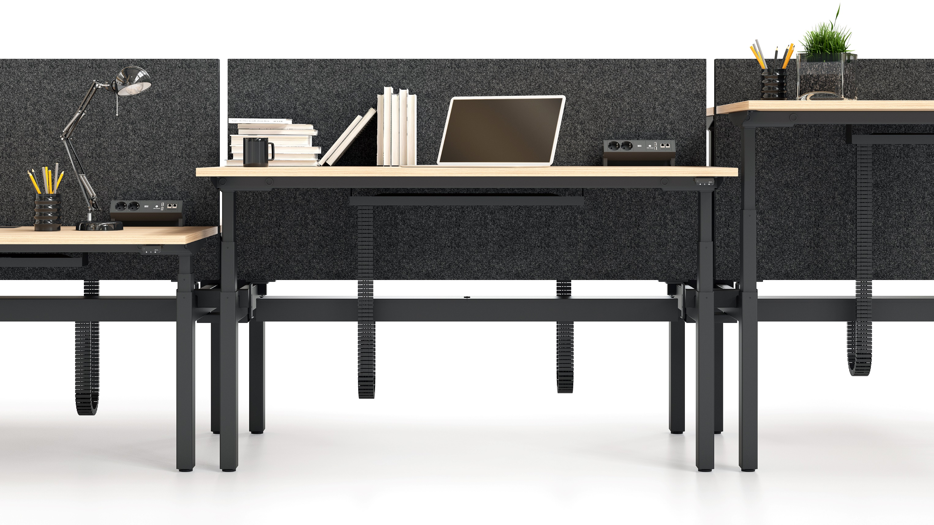
Fixed height acoustic screens MODUS for bench desks
Improve acoustic comfort, avoid chaos and maintain the neat office look. Choose from 2 acoustic class: D or C.

Slide 13
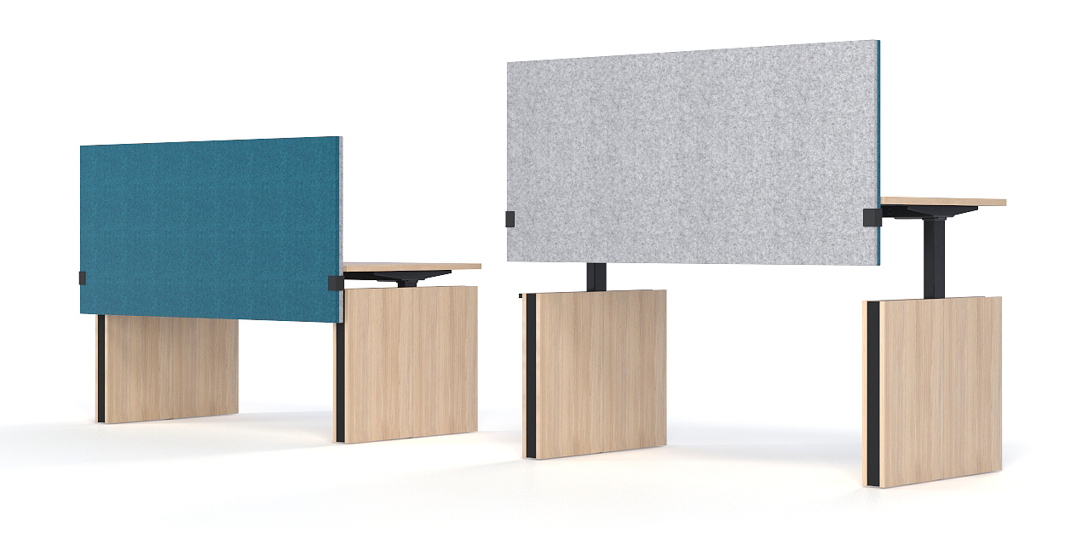
Acoustic screens MODUS for single desks

Slide 14
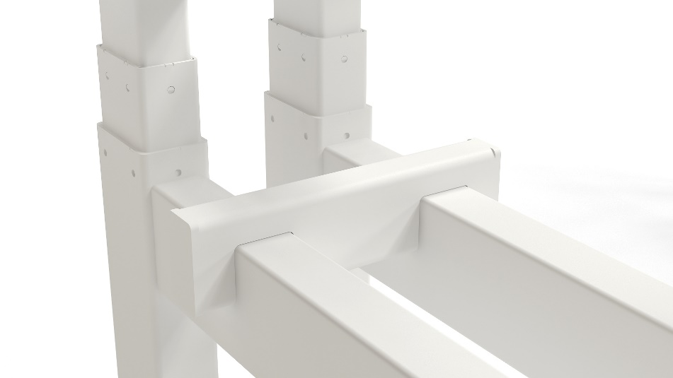
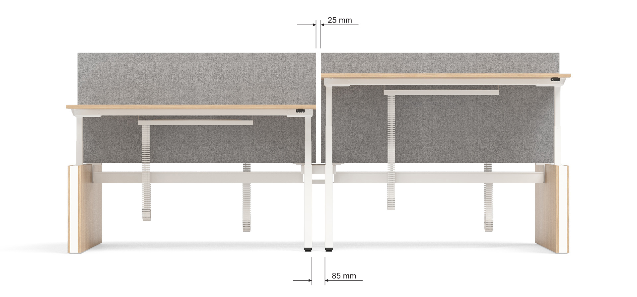
Easy to join desks
Assembling without screws by using metal connecting parts.
Colour of the connecting parts matches the columns and frame.

Slide 15
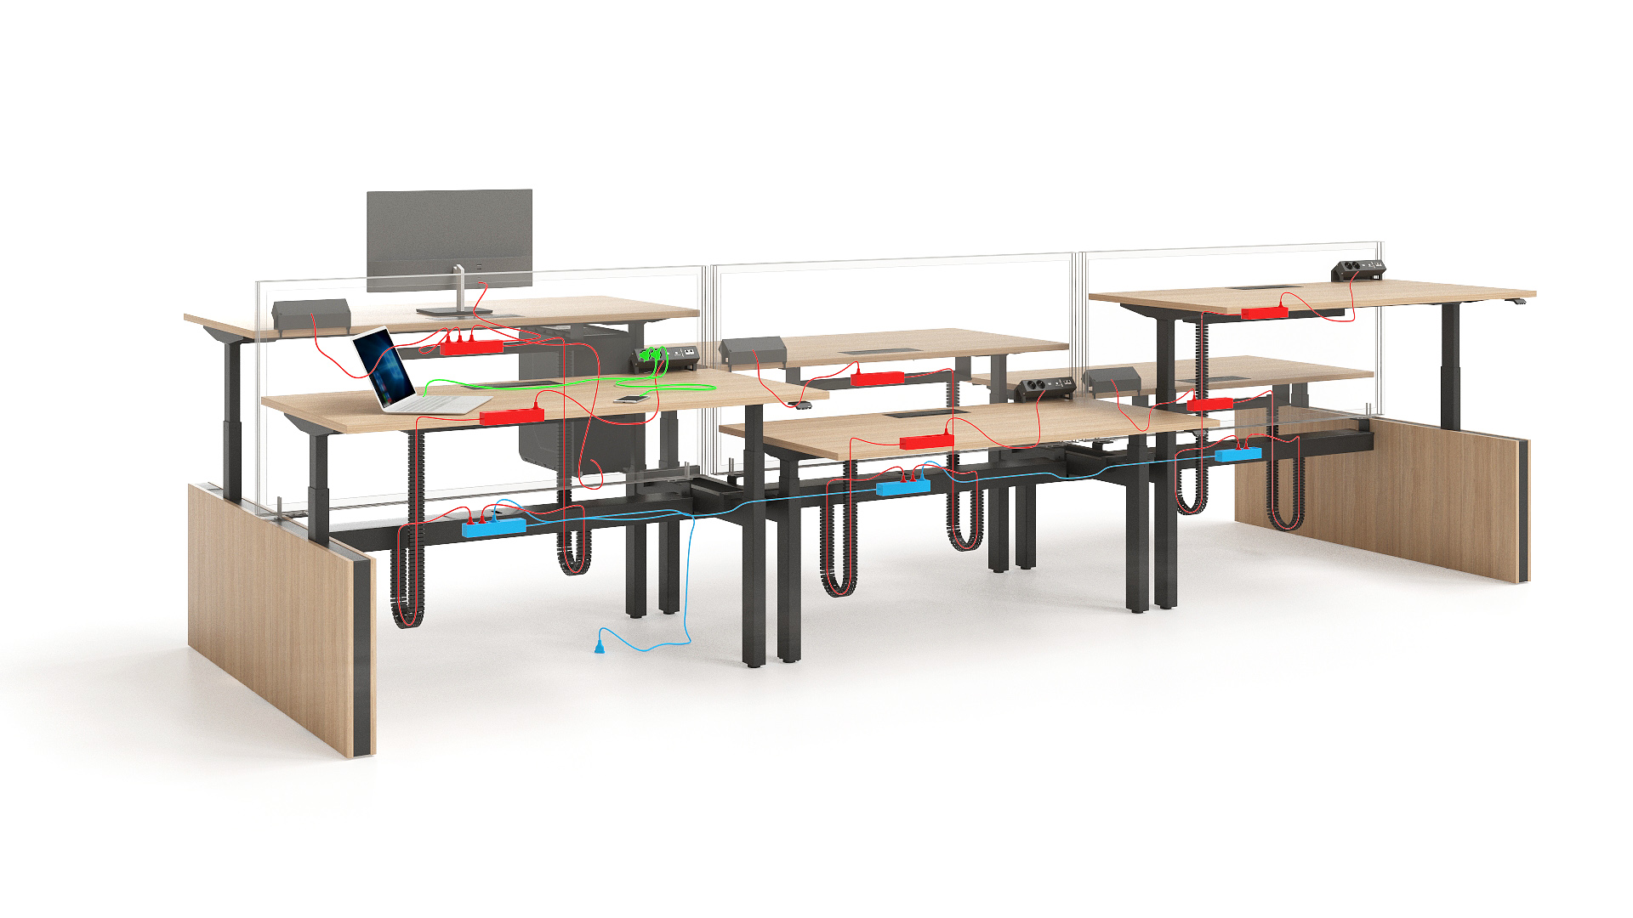
Smart cable management solutions
Can be adapted to individual needs

Slide 16
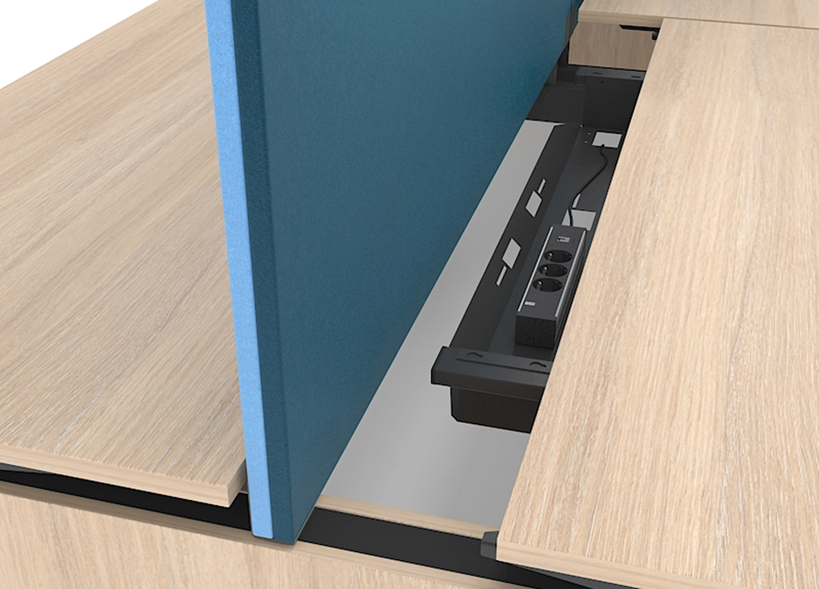
4 types of desktop
Fixed;
Sliding (for bench desks);
With cut-out (scallop) for wire management;
With cut-out for grommet.
Sliding desktop for convenient wiring of all the IT cables you might need at your work space. When the table top is pulled, the cable storage opens up; when the table top is pushed, the storage closes. It takes only one simple push/pull movement.

Slide 17
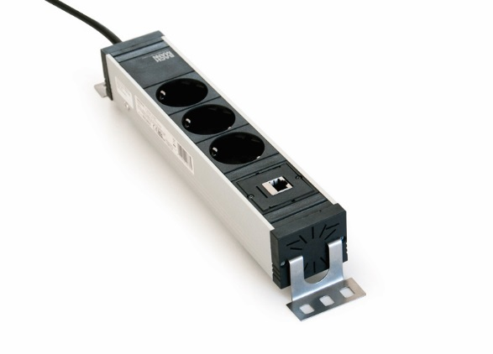

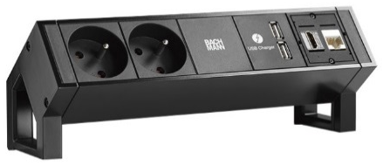
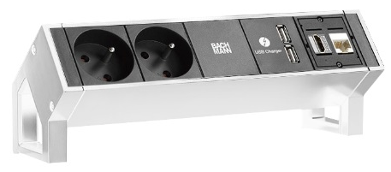
Power socket types
Power socket block
1 / 2 LAN ports and 3 sockets
colour
External power socket block
2 sockets; 2 LAN; 2 USB charging sockets
colour
Meet EU, UK, FR standards

Slide 18
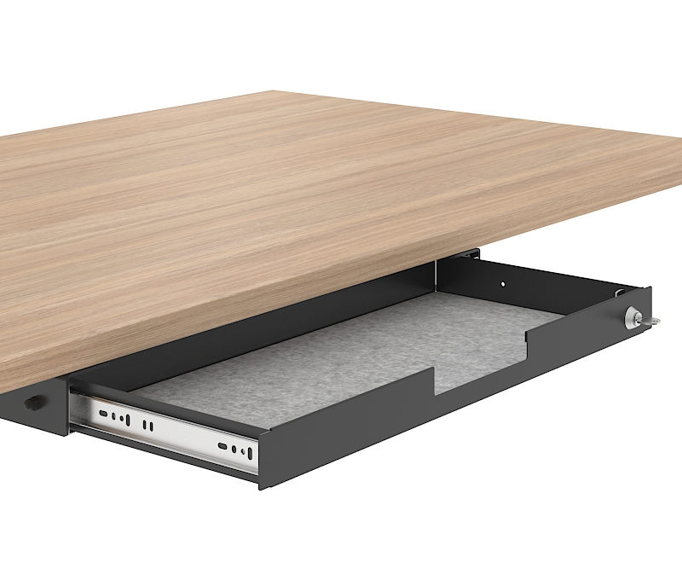
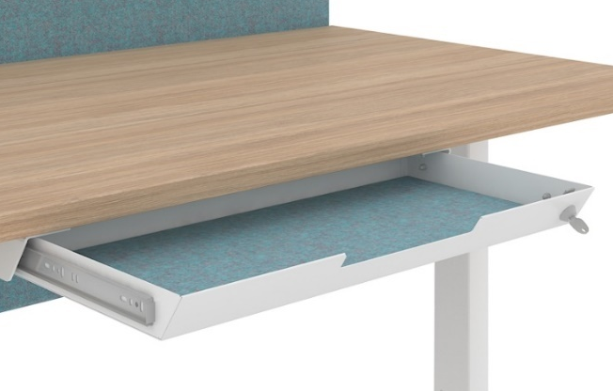
2 options of fabric-lined metal drawers with lock
NEW

Slide 19







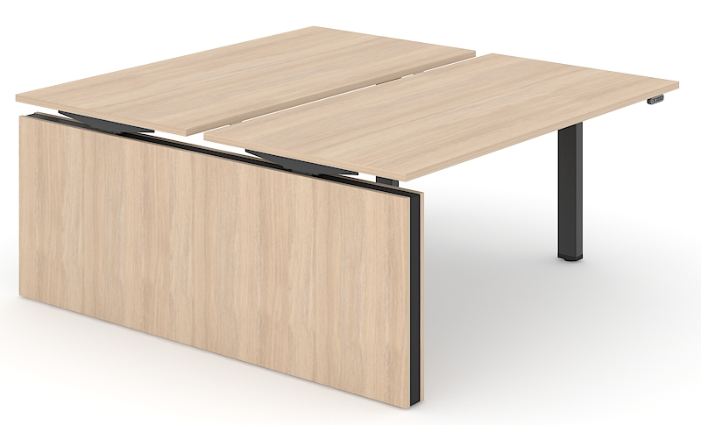
Possibility to choose
Desktop and side panel cover
Side panel insert colour
Metal colour

Slide 20
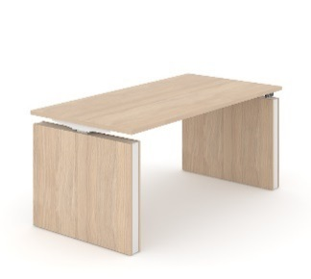
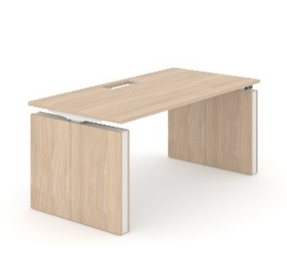


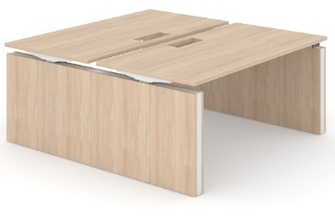


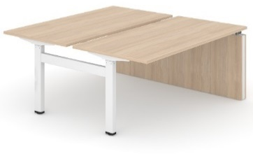



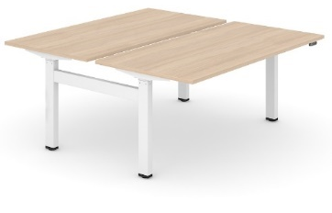
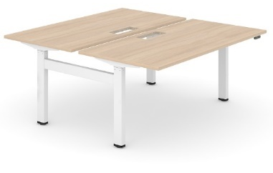
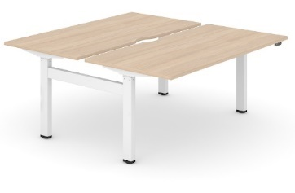
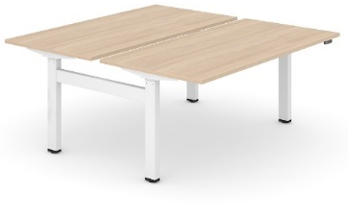
Fixed desktop
Desktop with cut-out for grommet
Desktop with cut-out (scallop) for wire management
Sliding desktop
Panel legs
Panel and
H type metal legs
H type metal legs
! Desk length 1400 / 1600 / 1800 mm (except sliding desktop)

Slide 21
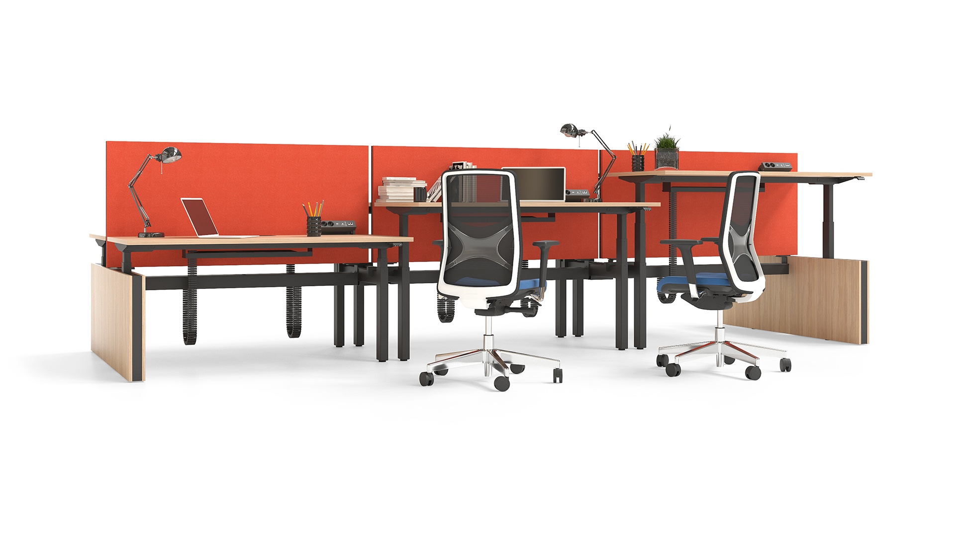
Set yourself in MOTION!

