Slide 1
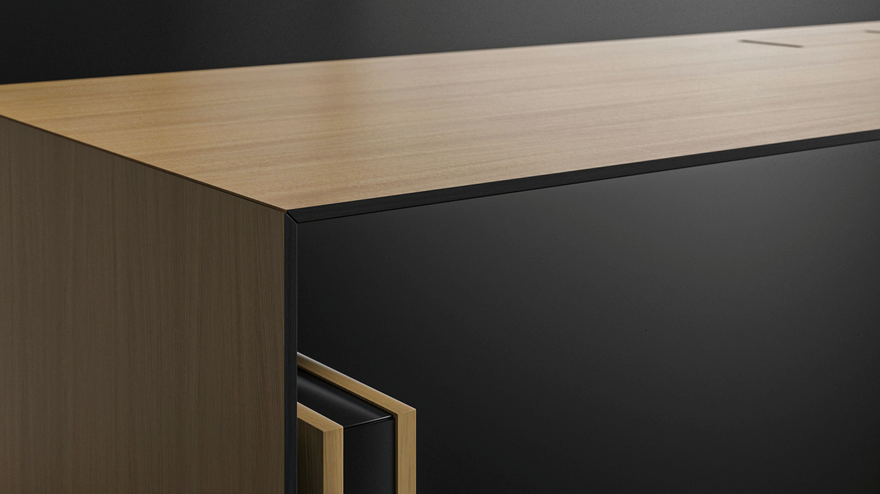
MOTION EXECUTIVE
For an active leader

Slide 2
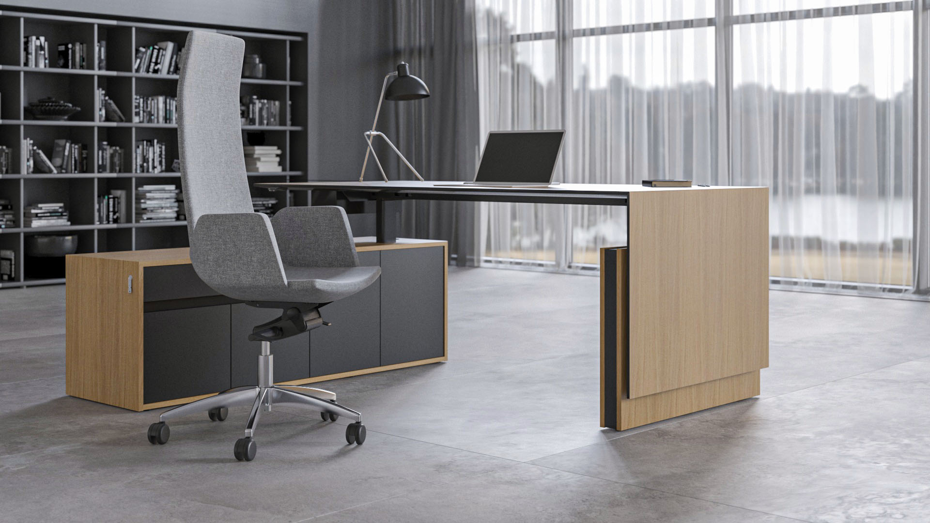
MOTION EXECUTIVE is an electric height-adjustable desk range, intended for a dynamic executive workspace
Notes:
Modern work desk for an active leader
MOTION EXECUTIVE is an electric height-adjustable desk range, intended for a dynamic executive workspace. This desking range is a combination of modern solidness and well-thought-out functionality.
The ability to stay active at work is a great benefit to our health. Changing one’s posture regularly is important for feeling good and staying focused, while a tidy and ergonomic working area improves our emotional wellbeing. That is exactly what a modern leader needs – focus for making decisions and a great mood, which can directly influence the entire team.

Slide 3
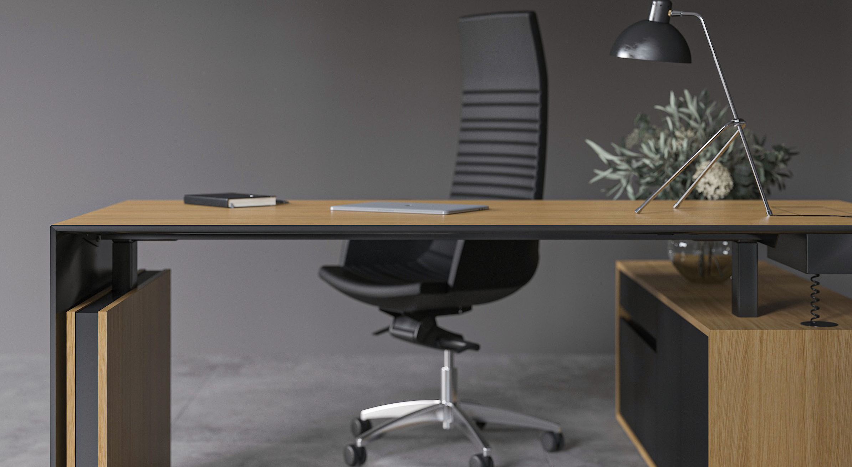
EXCEPTIONAL CHARACTER

Slide 4
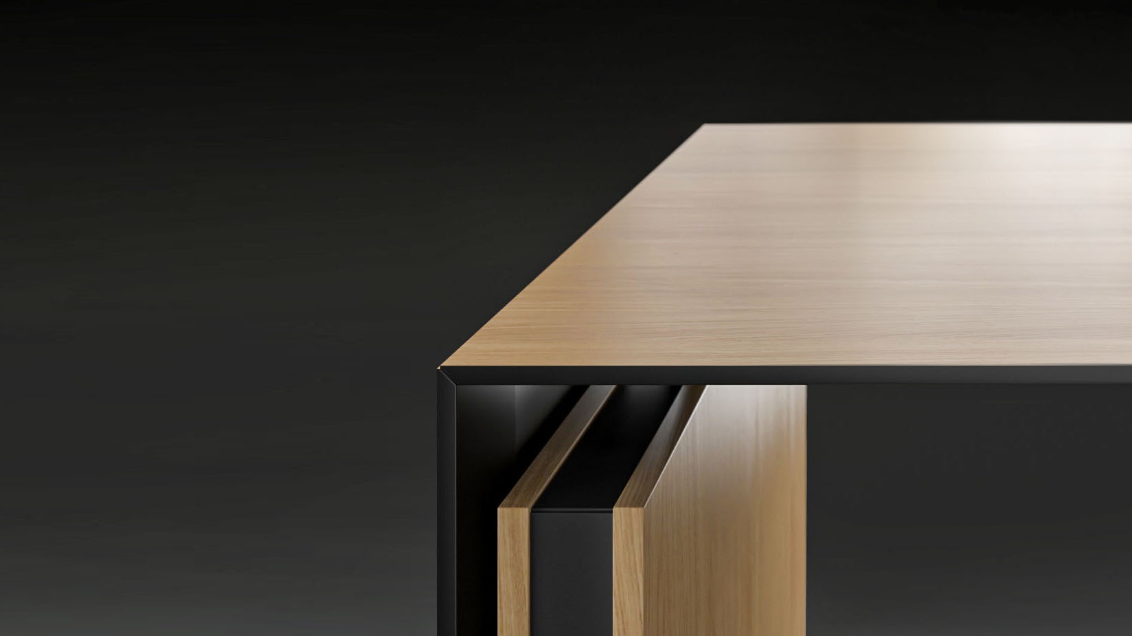
MODERN SOLIDNESS
Motion Executive features a contemporary, yet solid design
The image of solidness is further enhanced by the large surface area, which allows for extra comfort while working
Side panels create an image of continuity
Notes:
Modern solidness
Panel legs cover the underside of the desk, thus granting privacy to the user. The image of solidness is further enhanced by the large surface area, which allows for extra comfort while working. Depending on your needs you can choose between two MOTION Executive models, which differ both structurally, as well as in their finish options.

Slide 5
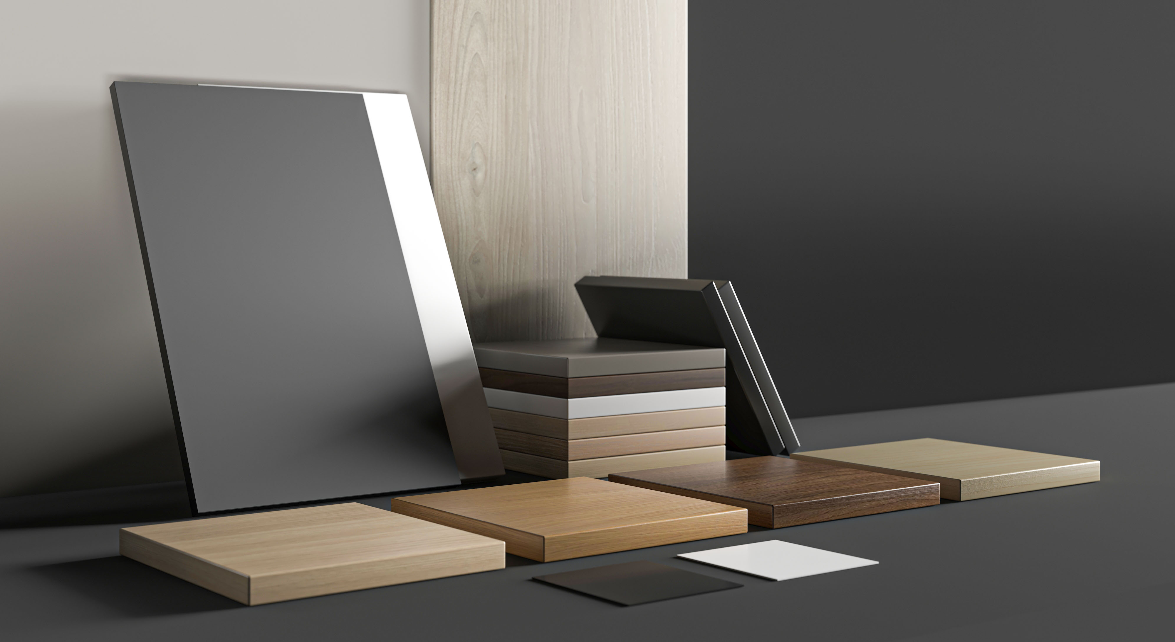
Reveal your own style and individuality
Notes:
Reveal your own style and individuality
Design a desk that would befit your office interior and your personality.
To emphasize solidness and evoke the image of luxury, choose a natural finish. Panel leg inserts could be in white HPL, or black or grey Fenix HPL.
An MFC arrangement would have a choice between 8 desktop colours, while the panel leg inserts could be in white, black or pearl grey.
The desktop is available in 4 different veneer and 8 different Melamine finishes
Inserts are available in 3 colours on a veneer desk and 3 colours on an Melamine desk.
The modesty panel is available in 4 different veneers and 3 HPL colours on a veneer desk, or 9 Melamine colours on an Melamine desk.

Slide 6
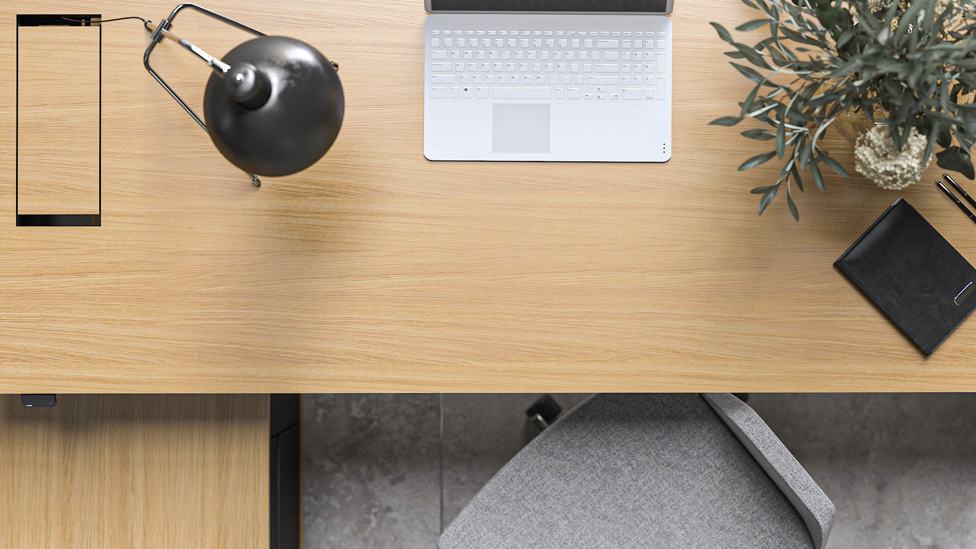
WORKSPACE SOLUTIONS
Notes:
Private room or open space – MOTION suits both!
A MOTION Executive desk can both take a leading role in a closed and private executive room, as well as integrate itself seamlessly into an open-plan office arrangement. The latter would allow a leader to work in the same space as the rest of their team, bearing witness to the multitude of daily tasks they go through. In order to maintain a unified and visually harmonic style throughout the office, we recommend pairing MOTION Executive desks with MOTION height-adjustable single and back-to-back workstations.

Slide 7
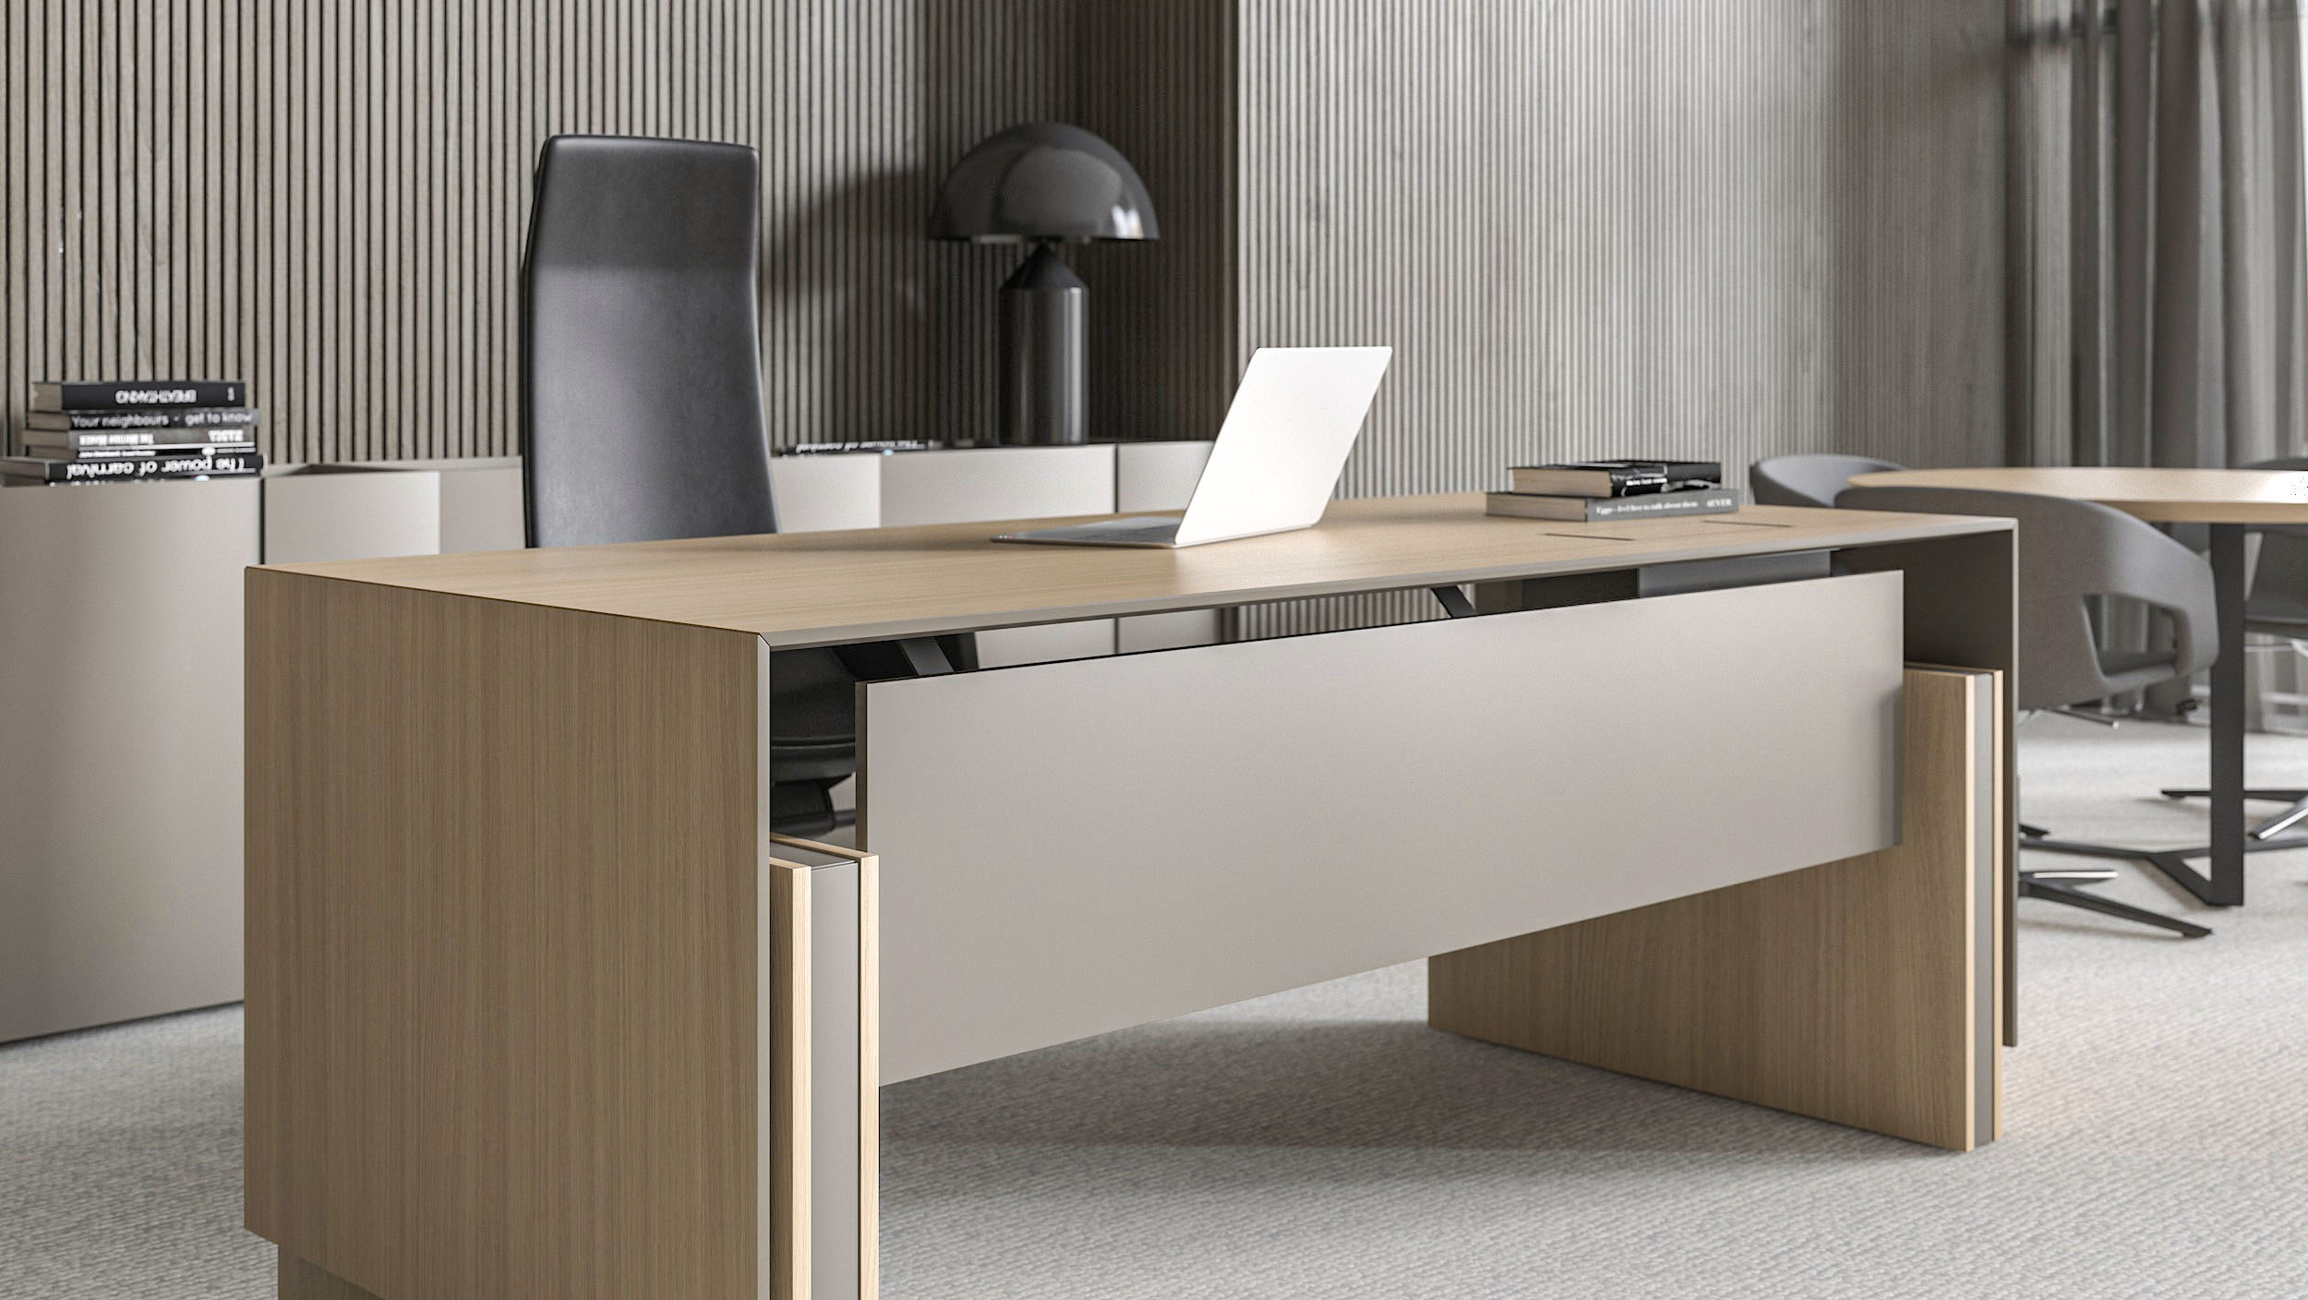
Notes:
Private room or open space – MOTION suits both!
A MOTION Executive desk can both take a leading role in a closed and private executive room, as well as integrate itself seamlessly into an open-plan office arrangement. The latter would allow a leader to work in the same space as the rest of their team, bearing witness to the multitude of daily tasks they go through. In order to maintain a unified and visually harmonic style throughout the office, we recommend pairing MOTION Executive desks with MOTION height-adjustable single and back-to-back workstations.

Slide 8
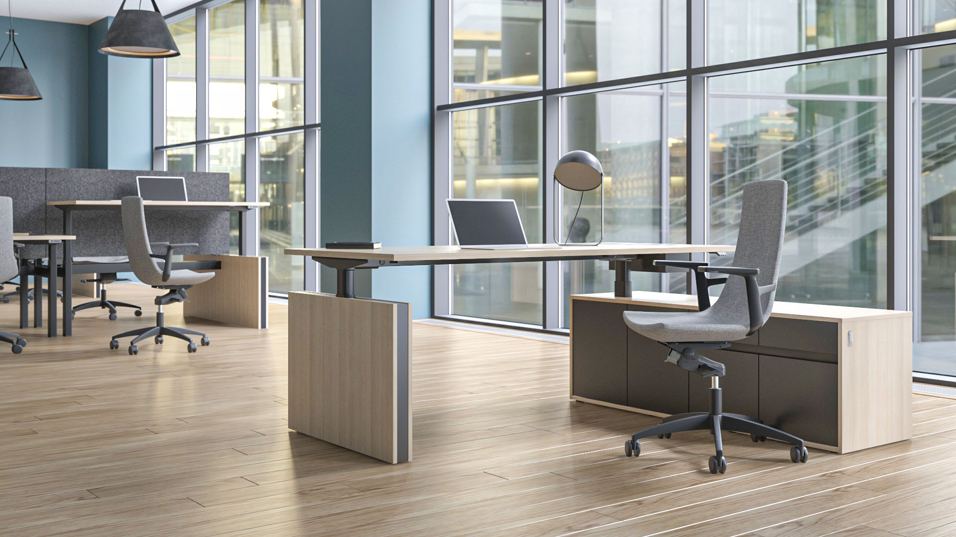
Notes:
Private room or open space – MOTION suits both!
A MOTION Executive desk can both take a leading role in a closed and private executive room, as well as integrate itself seamlessly into an open-plan office arrangement. The latter would allow a leader to work in the same space as the rest of their team, bearing witness to the multitude of daily tasks they go through. In order to maintain a unified and visually harmonic style throughout the office, we recommend pairing MOTION Executive desks with MOTION height-adjustable single and back-to-back workstations.

Slide 9
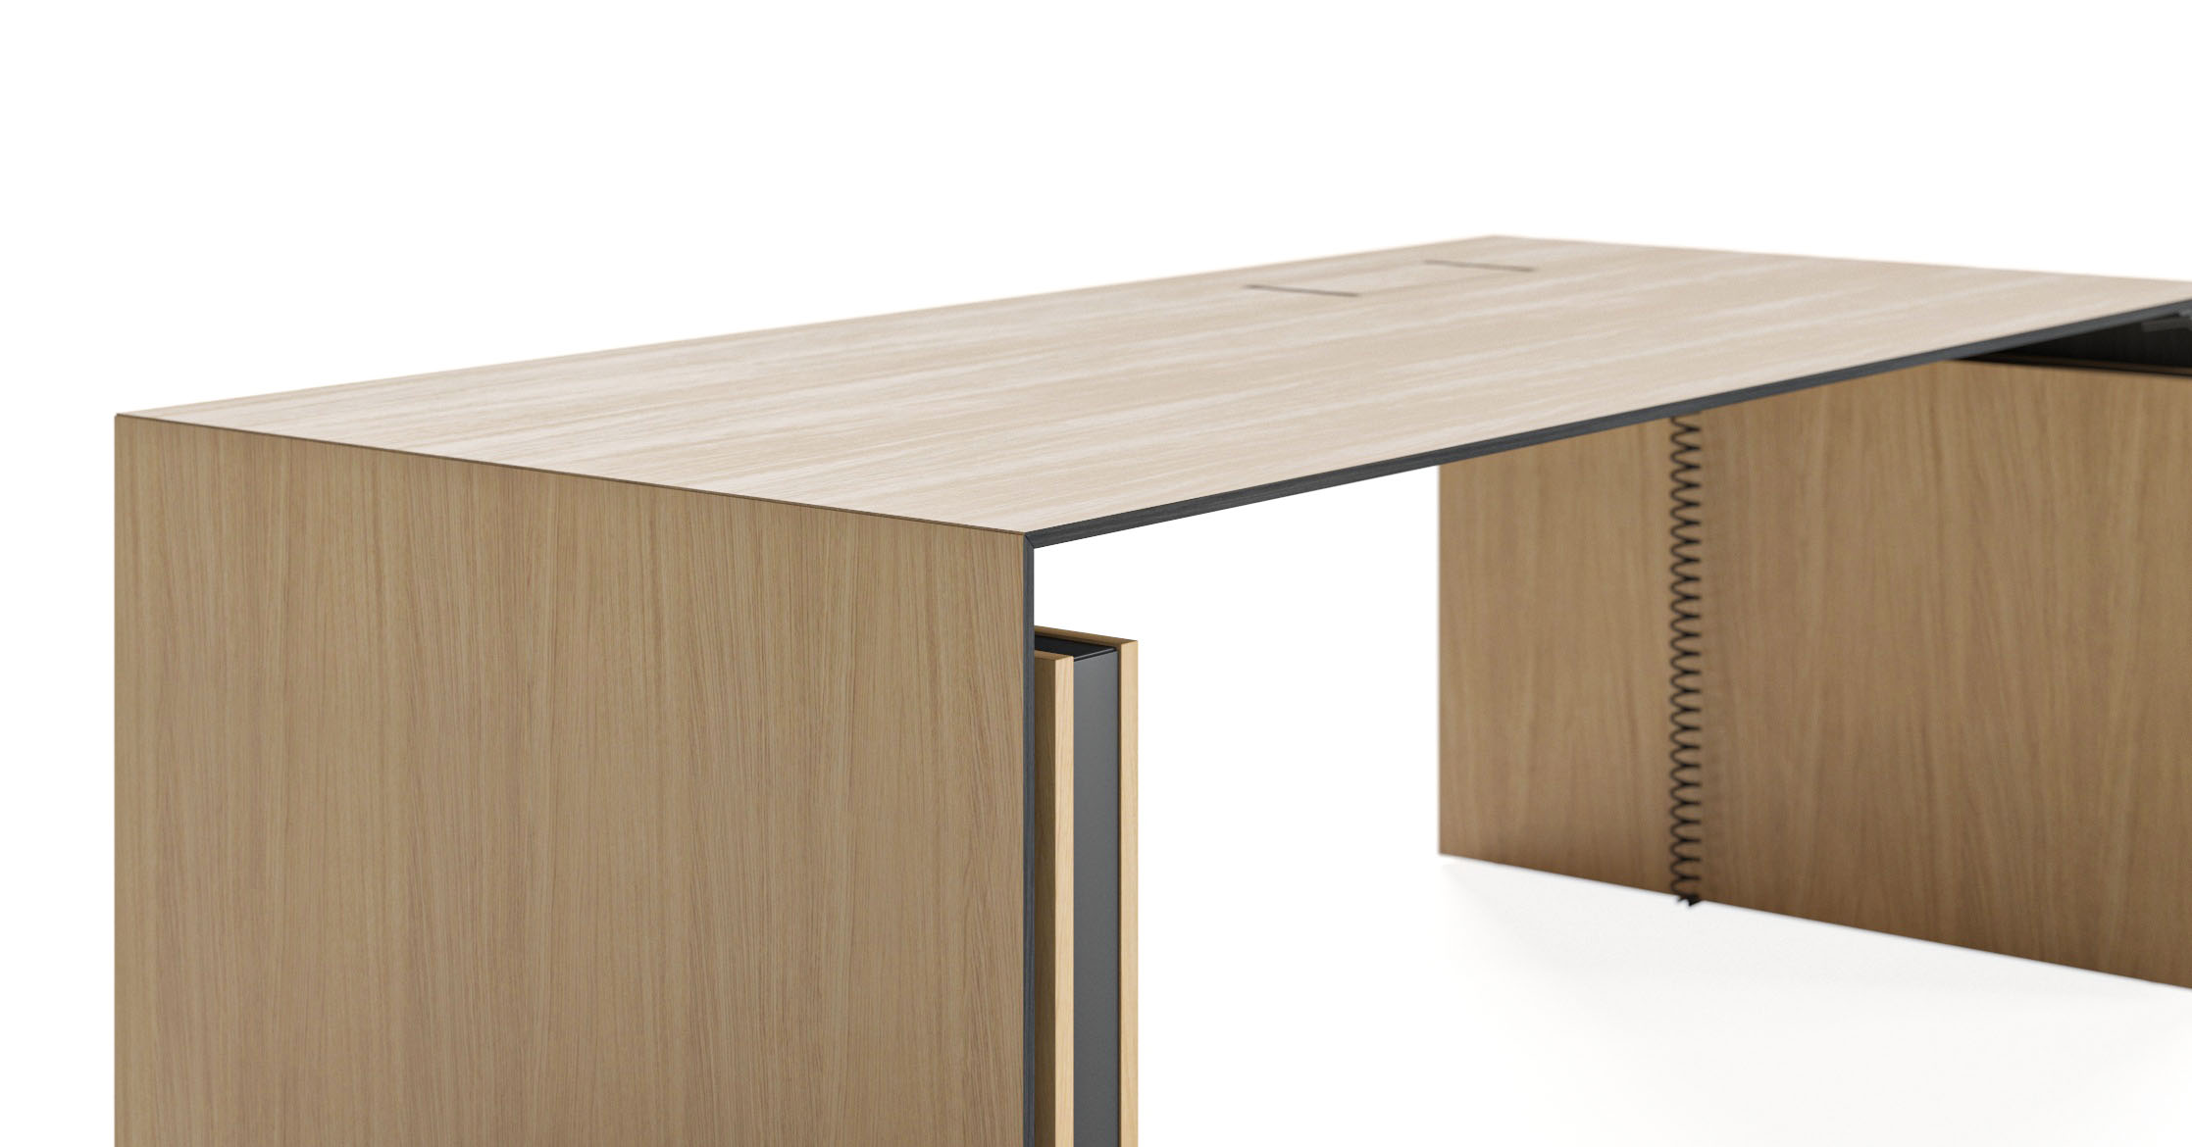
Natural Elegance
Notes:
Natural elegance
Executive desk in wood veneer looks solid and is aimed at those who value a natural look. The desktop is subtly chamfered, while the side panel encompasses the entire arrangement, giving off an impression of solidness and style.
Cosiness in simplicity
MOTION Executive in MFC finishes does not have a side panel and is more restrained. Unlike its chamfered veneer counterpart, this desktop has a straight ABS edge. This choice evokes an image of cosiness due to its simplicity.

Slide 10
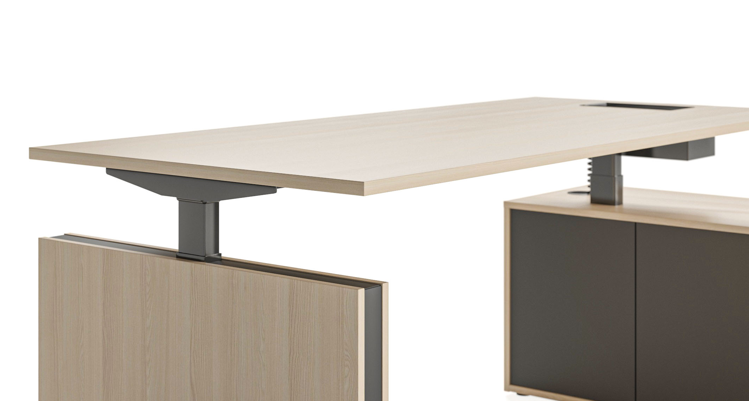
Cosiness in simplicity
Notes:
Natural elegance
Executive desk in wood veneer looks solid and is aimed at those who value a natural look. The desktop is subtly chamfered, while the side panel encompasses the entire arrangement, giving off an impression of solidness and style.
Cosiness in simplicity
MOTION Executive in MFC finishes does not have a side panel and is more restrained. Unlike its chamfered veneer counterpart, this desktop has a straight ABS edge. This choice evokes an image of cosiness due to its simplicity.

Slide 11
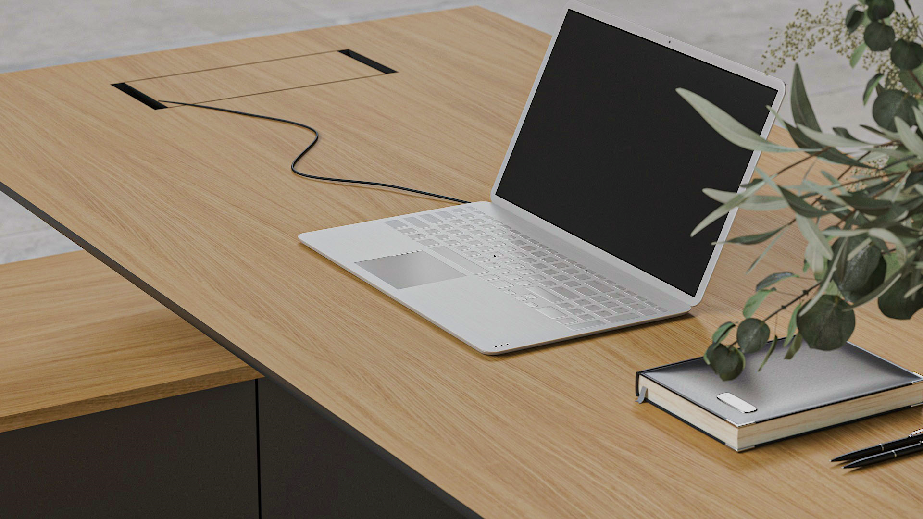
SIMPLE AND CONVENIENT USAGE

Slide 12
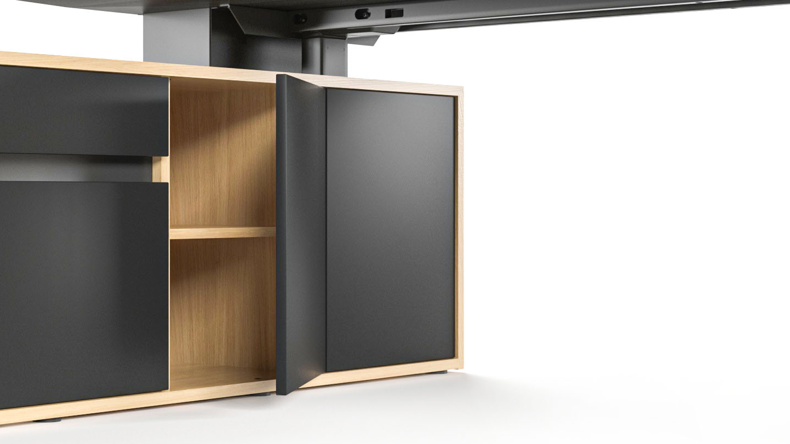
MINIMALISTIC CABINET DESIGN
Convenient push-open mechanism
Inset drawer handles
Adjustable shelf
Notes:
Functional item storage
MOTION Executive storage area is comprised of multiple different cabinets and drawers. The largest cabinet has a convenient push-open mechanism and includes a height-adjustable shelf. The other cabinets are also easy to open even without handles, which preserves the image or an orderly workspace. In addition, you can order metal rails for hanging files.
The easily accessible top drawer is optimal for storing valuable items and can be locked via a side lock to ensure security. As an option, you can also order felt-lining in various colours, which will add to the feeling of cosiness.

Slide 13
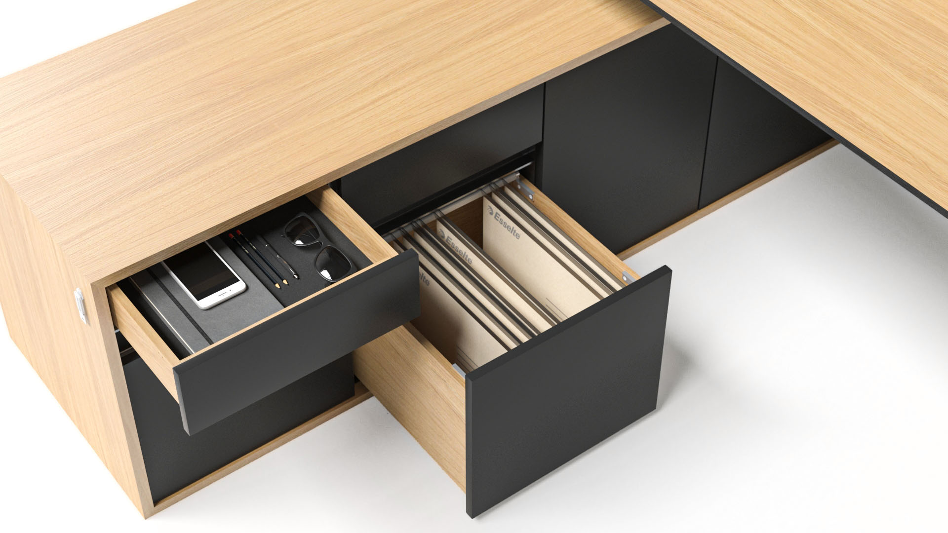
Functional item storage
Notes:
Functional item storage
MOTION Executive storage area is comprised of multiple different cabinets and drawers. The largest cabinet has a convenient push-open mechanism and includes a height-adjustable shelf. The other cabinets are also easy to open even without handles, which preserves the image or an orderly workspace. In addition, you can order metal rails for hanging files.
The easily accessible top drawer is optimal for storing valuable items and can be locked via a side lock to ensure security. As an option, you can also order felt-lining in various colours, which will add to the feeling of cosiness.

Slide 14
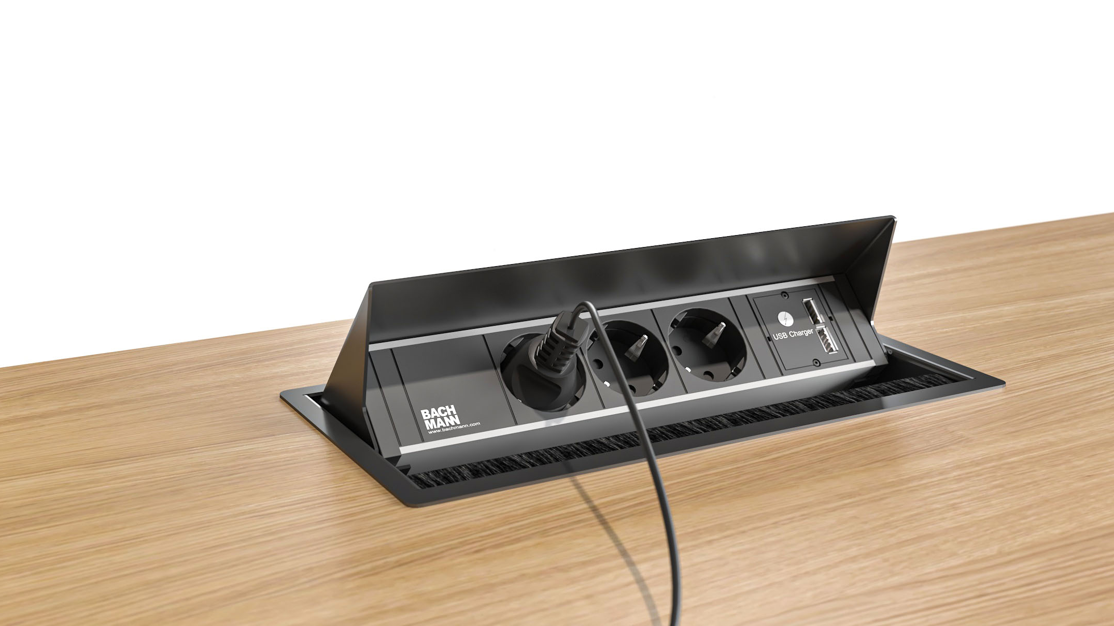
Convenient electric solutions
Notes:
Convenient electric solutions
Usually, power and ethernet cables clutter the workspace and ruin the image. In order to prevent that, we paid significant attention to functional cable management and electric solutions while designing MOTION Executive.
The orderly image is accentuated by a spiral cable. You can also choose your preferred method of access to integrated power – either a flip-up grommet with power sockets mounted underneath it, or a simple flip-up grommet, with the power bank placed into the box below..

Slide 15
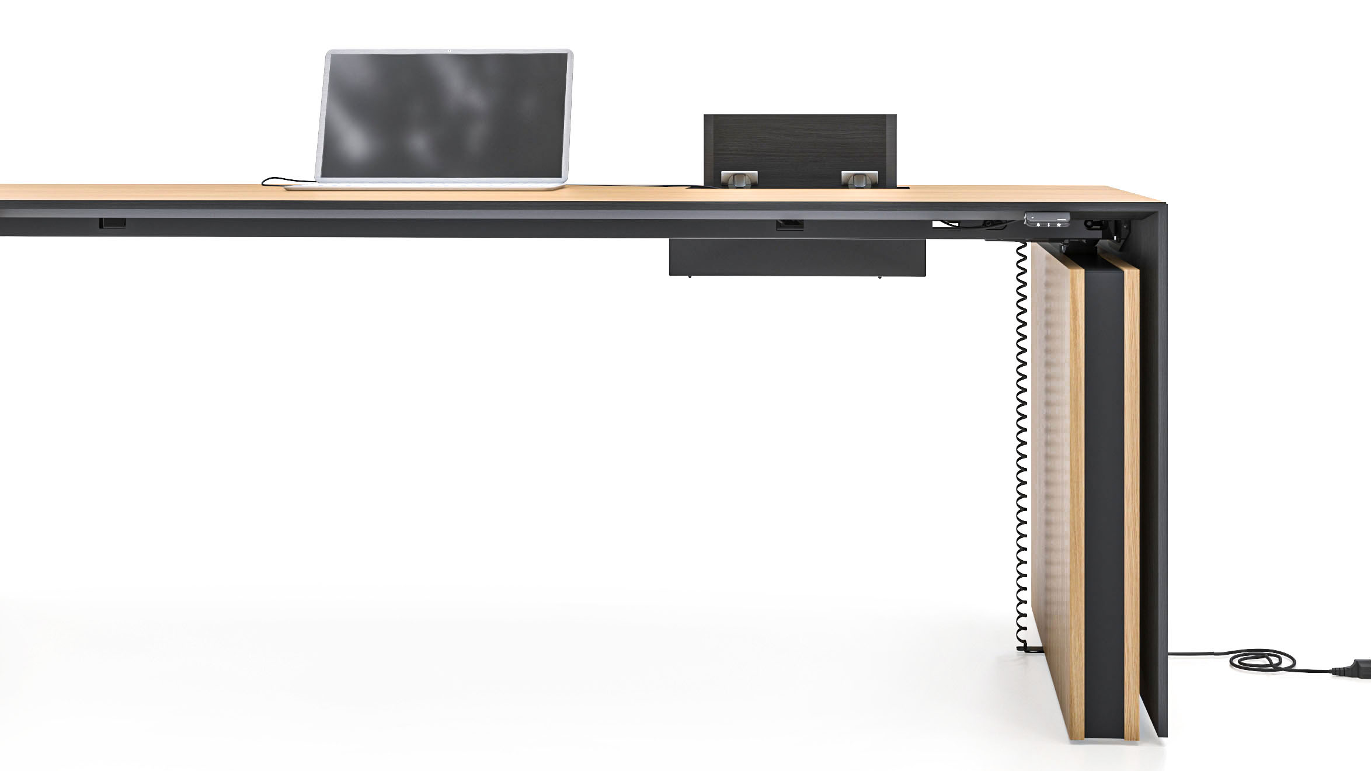
Convenient electric solutions
Notes:
Convenient electric solutions
Usually, power and ethernet cables clutter the workspace and ruin the image. In order to prevent that, we paid significant attention to functional cable management and electric solutions while designing MOTION Executive.
The orderly image is accentuated by a spiral cable. You can also choose your preferred method of access to integrated power – either a flip-up grommet with power sockets mounted underneath it, or a simple flip-up grommet, with the power bank placed into the box below..

Slide 16
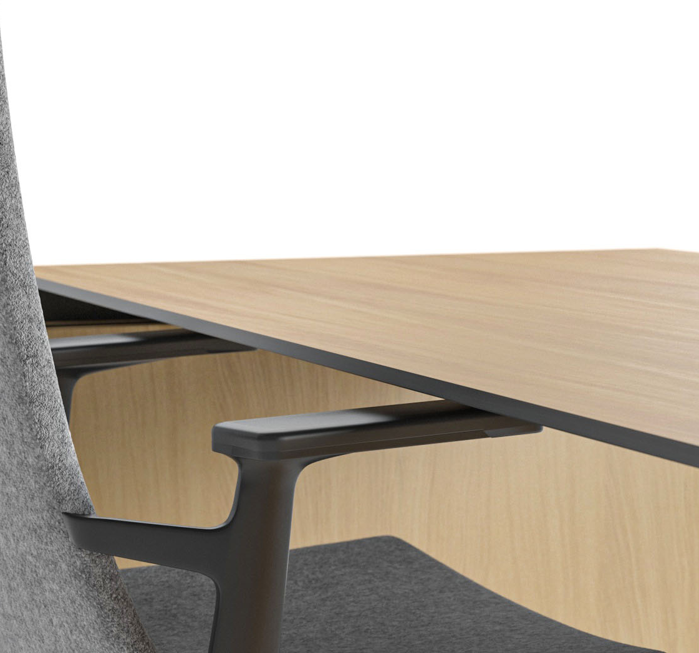
ANTI-COLLISION TECHNOLOGY
MOTION Executive desks include an exceptionally sensitive gyroscope-based anti-collision function.
This technology helps reduce damage in case the desk encountered an obstacle during vertical movement.
Notes:
Anti-collision technology
MOTION Executive desks include a gyroscope-based anti-collision function. An extremely sensitive sensor reacts to both hard and soft objects, as well as detecting even the tiniest desktop tilt during its vertical movement. This technology helps reduce damage in case the desk encountered an obstacle during vertical movement.

Slide 17
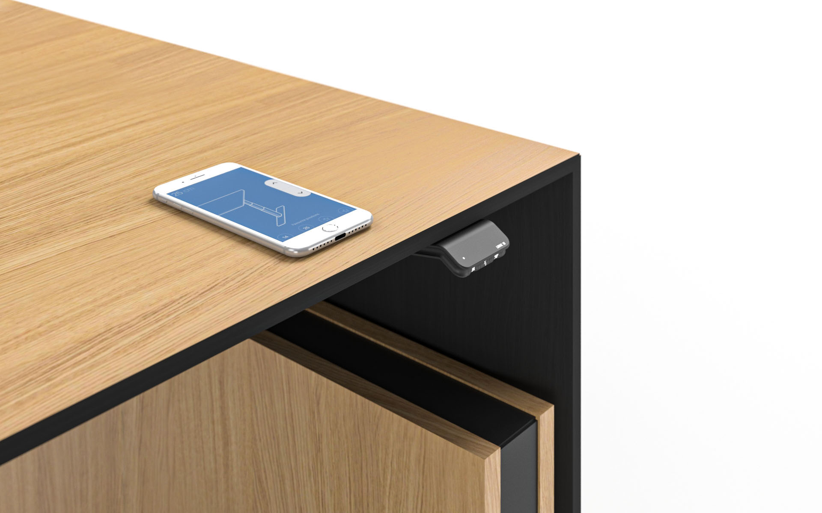
SIMPLE CONTROL
Convenient height control via button or remotely (via Bluetooth, through a smartphone app)
Memory function
Reminders to change one’s posture
Notes:
Simple control
Oftentimes, a work desk will be surrounded by other objects. While adjusting the desk height, you might accidentally lower it too much and hit a pedestal. This is avoidable.
The range of movement on a MOTION Executive desk is between 700mm at its lowest and 1200mm at its highest position. The desired desk height can be set via a button or remotely – using a Bluetooth-based app on your smartphone. The most convenient desk positions can be saved. The LINAK app can also send you a reminder that it’s time to change your body posture from sitting to standing – and vice versa.

Slide 18
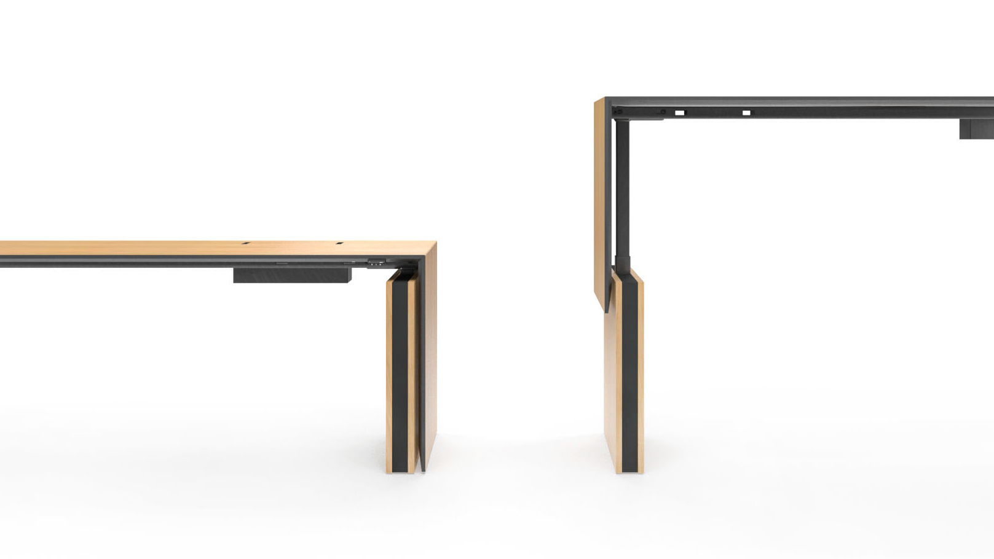
Range of
movement
MAX
1200 MM
MIN
700 MM

Slide 19
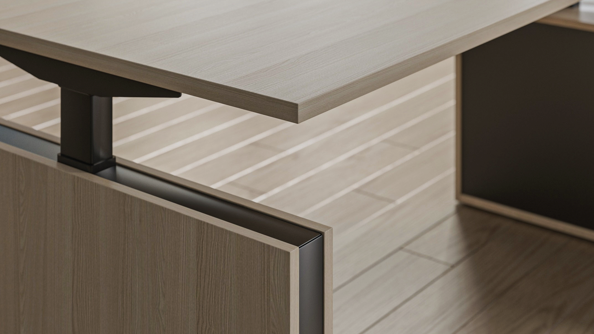
RANGE

Slide 20
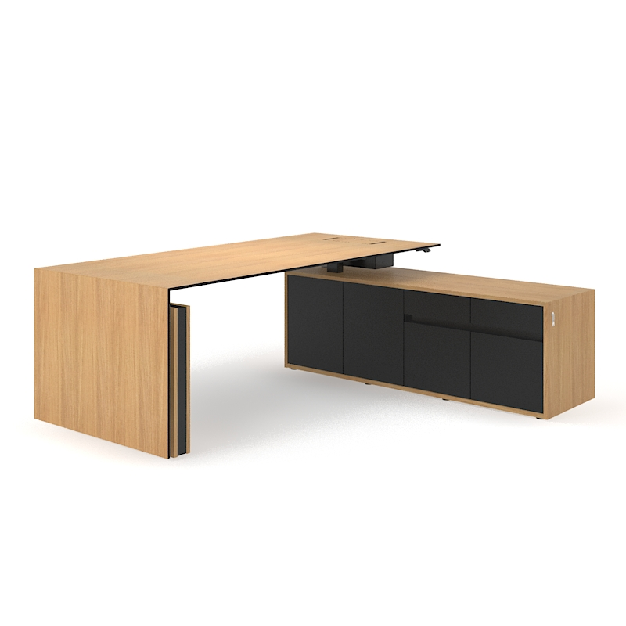
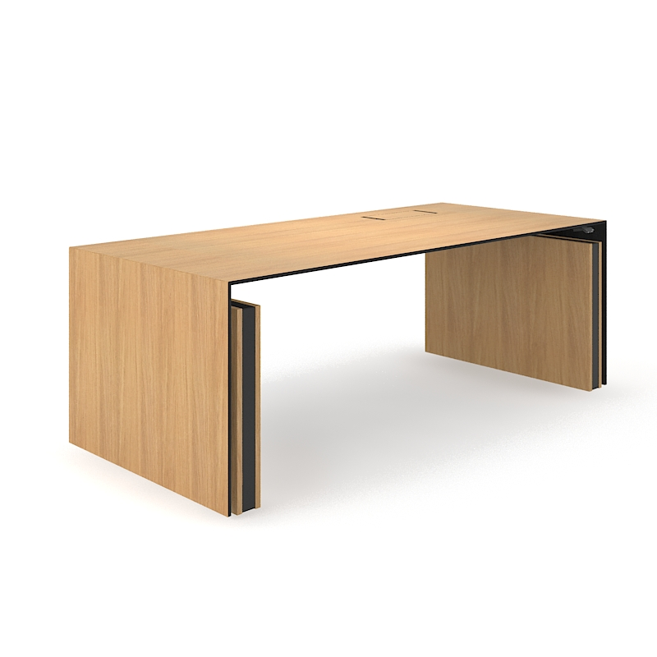
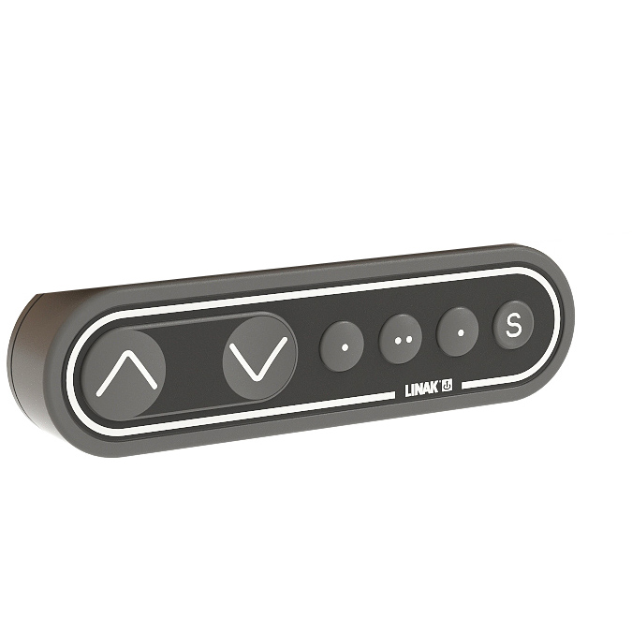
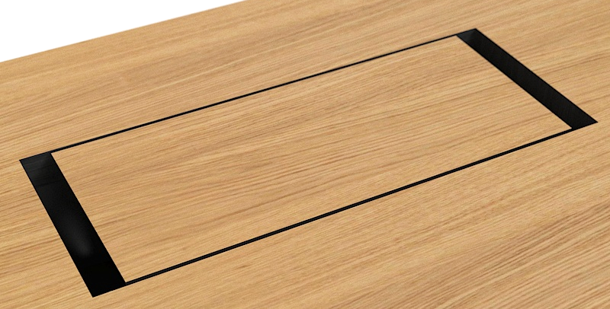
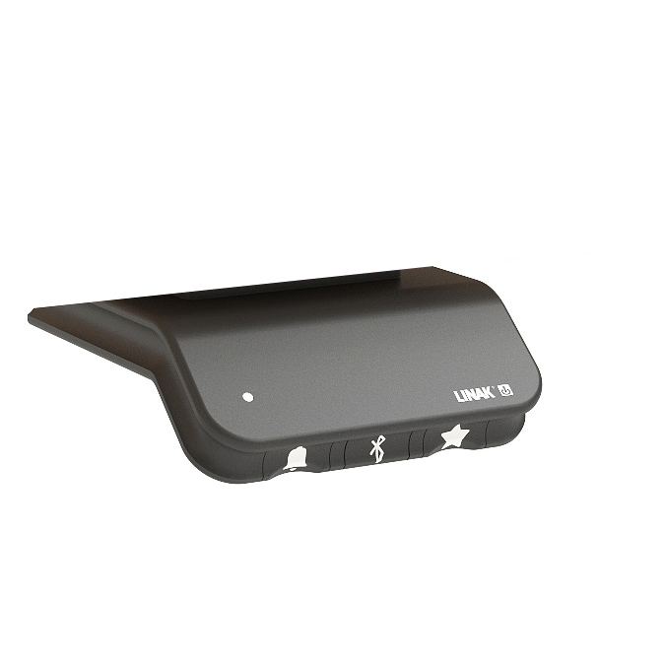
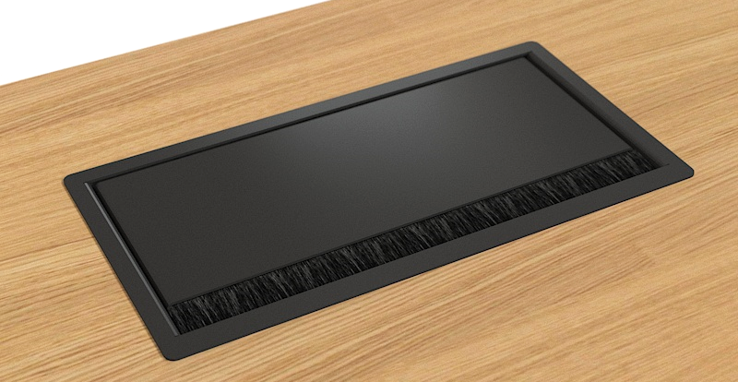
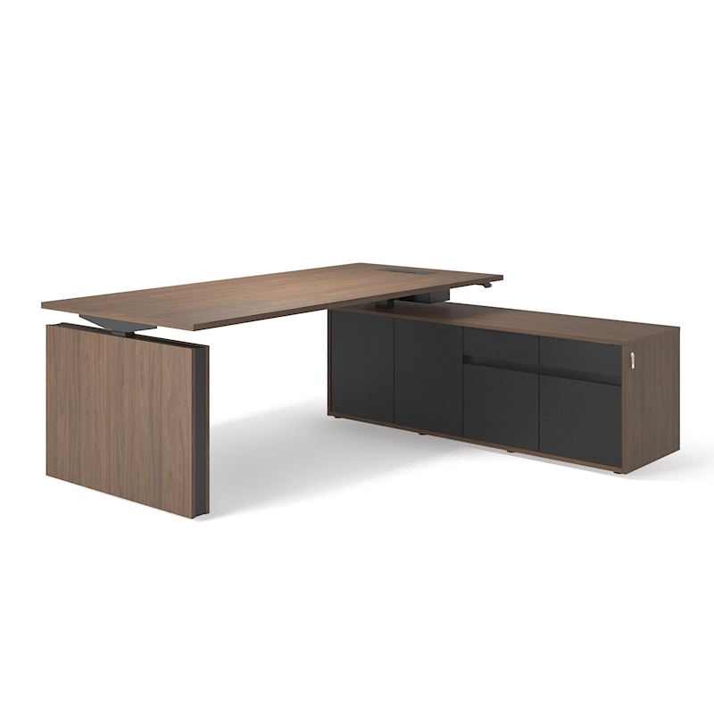
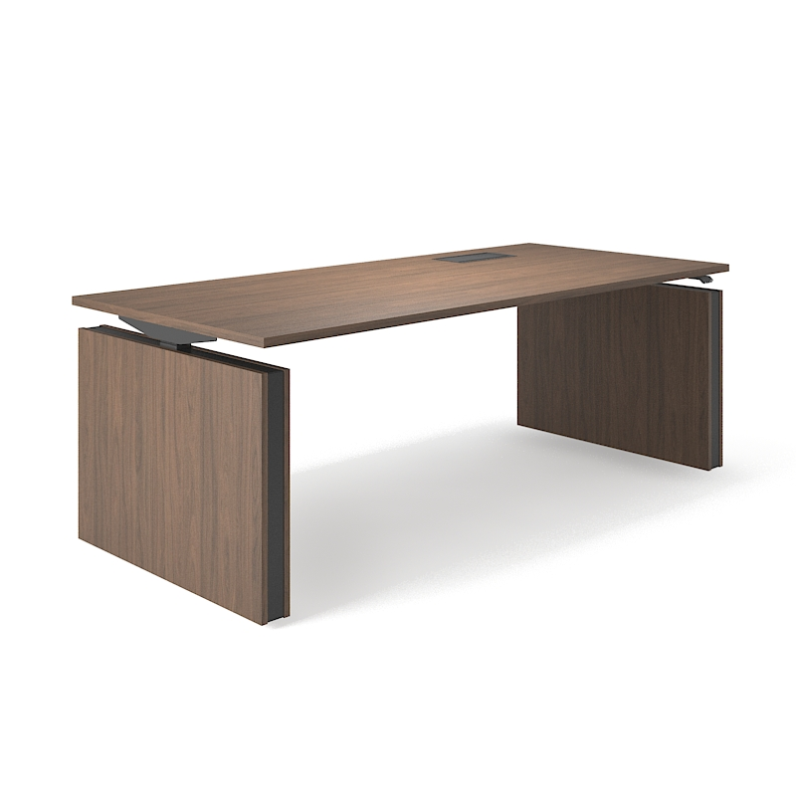
DESK WITHOUT CABINETS
DESK WITH CABINETS
GROMMET TYPES
BUTTONS
2000X900 MIN H-700 MAX H-1200
2000X1800 MIN H-700 MAX H-1200
WOOD GROMMET
MA
WOOD VENEER
METAL GROMMET WITH FLIP-UP POWER SOCKETS
LA
2000X900 MIN H-700 MAX H-1200
2000X1800 MIN H-700 MAX H-1200
METAL GROMMET
MA
MELAMINE
METAL GROMMET WITH FLIP-UP POWER SOCKETS
LA

Slide 21
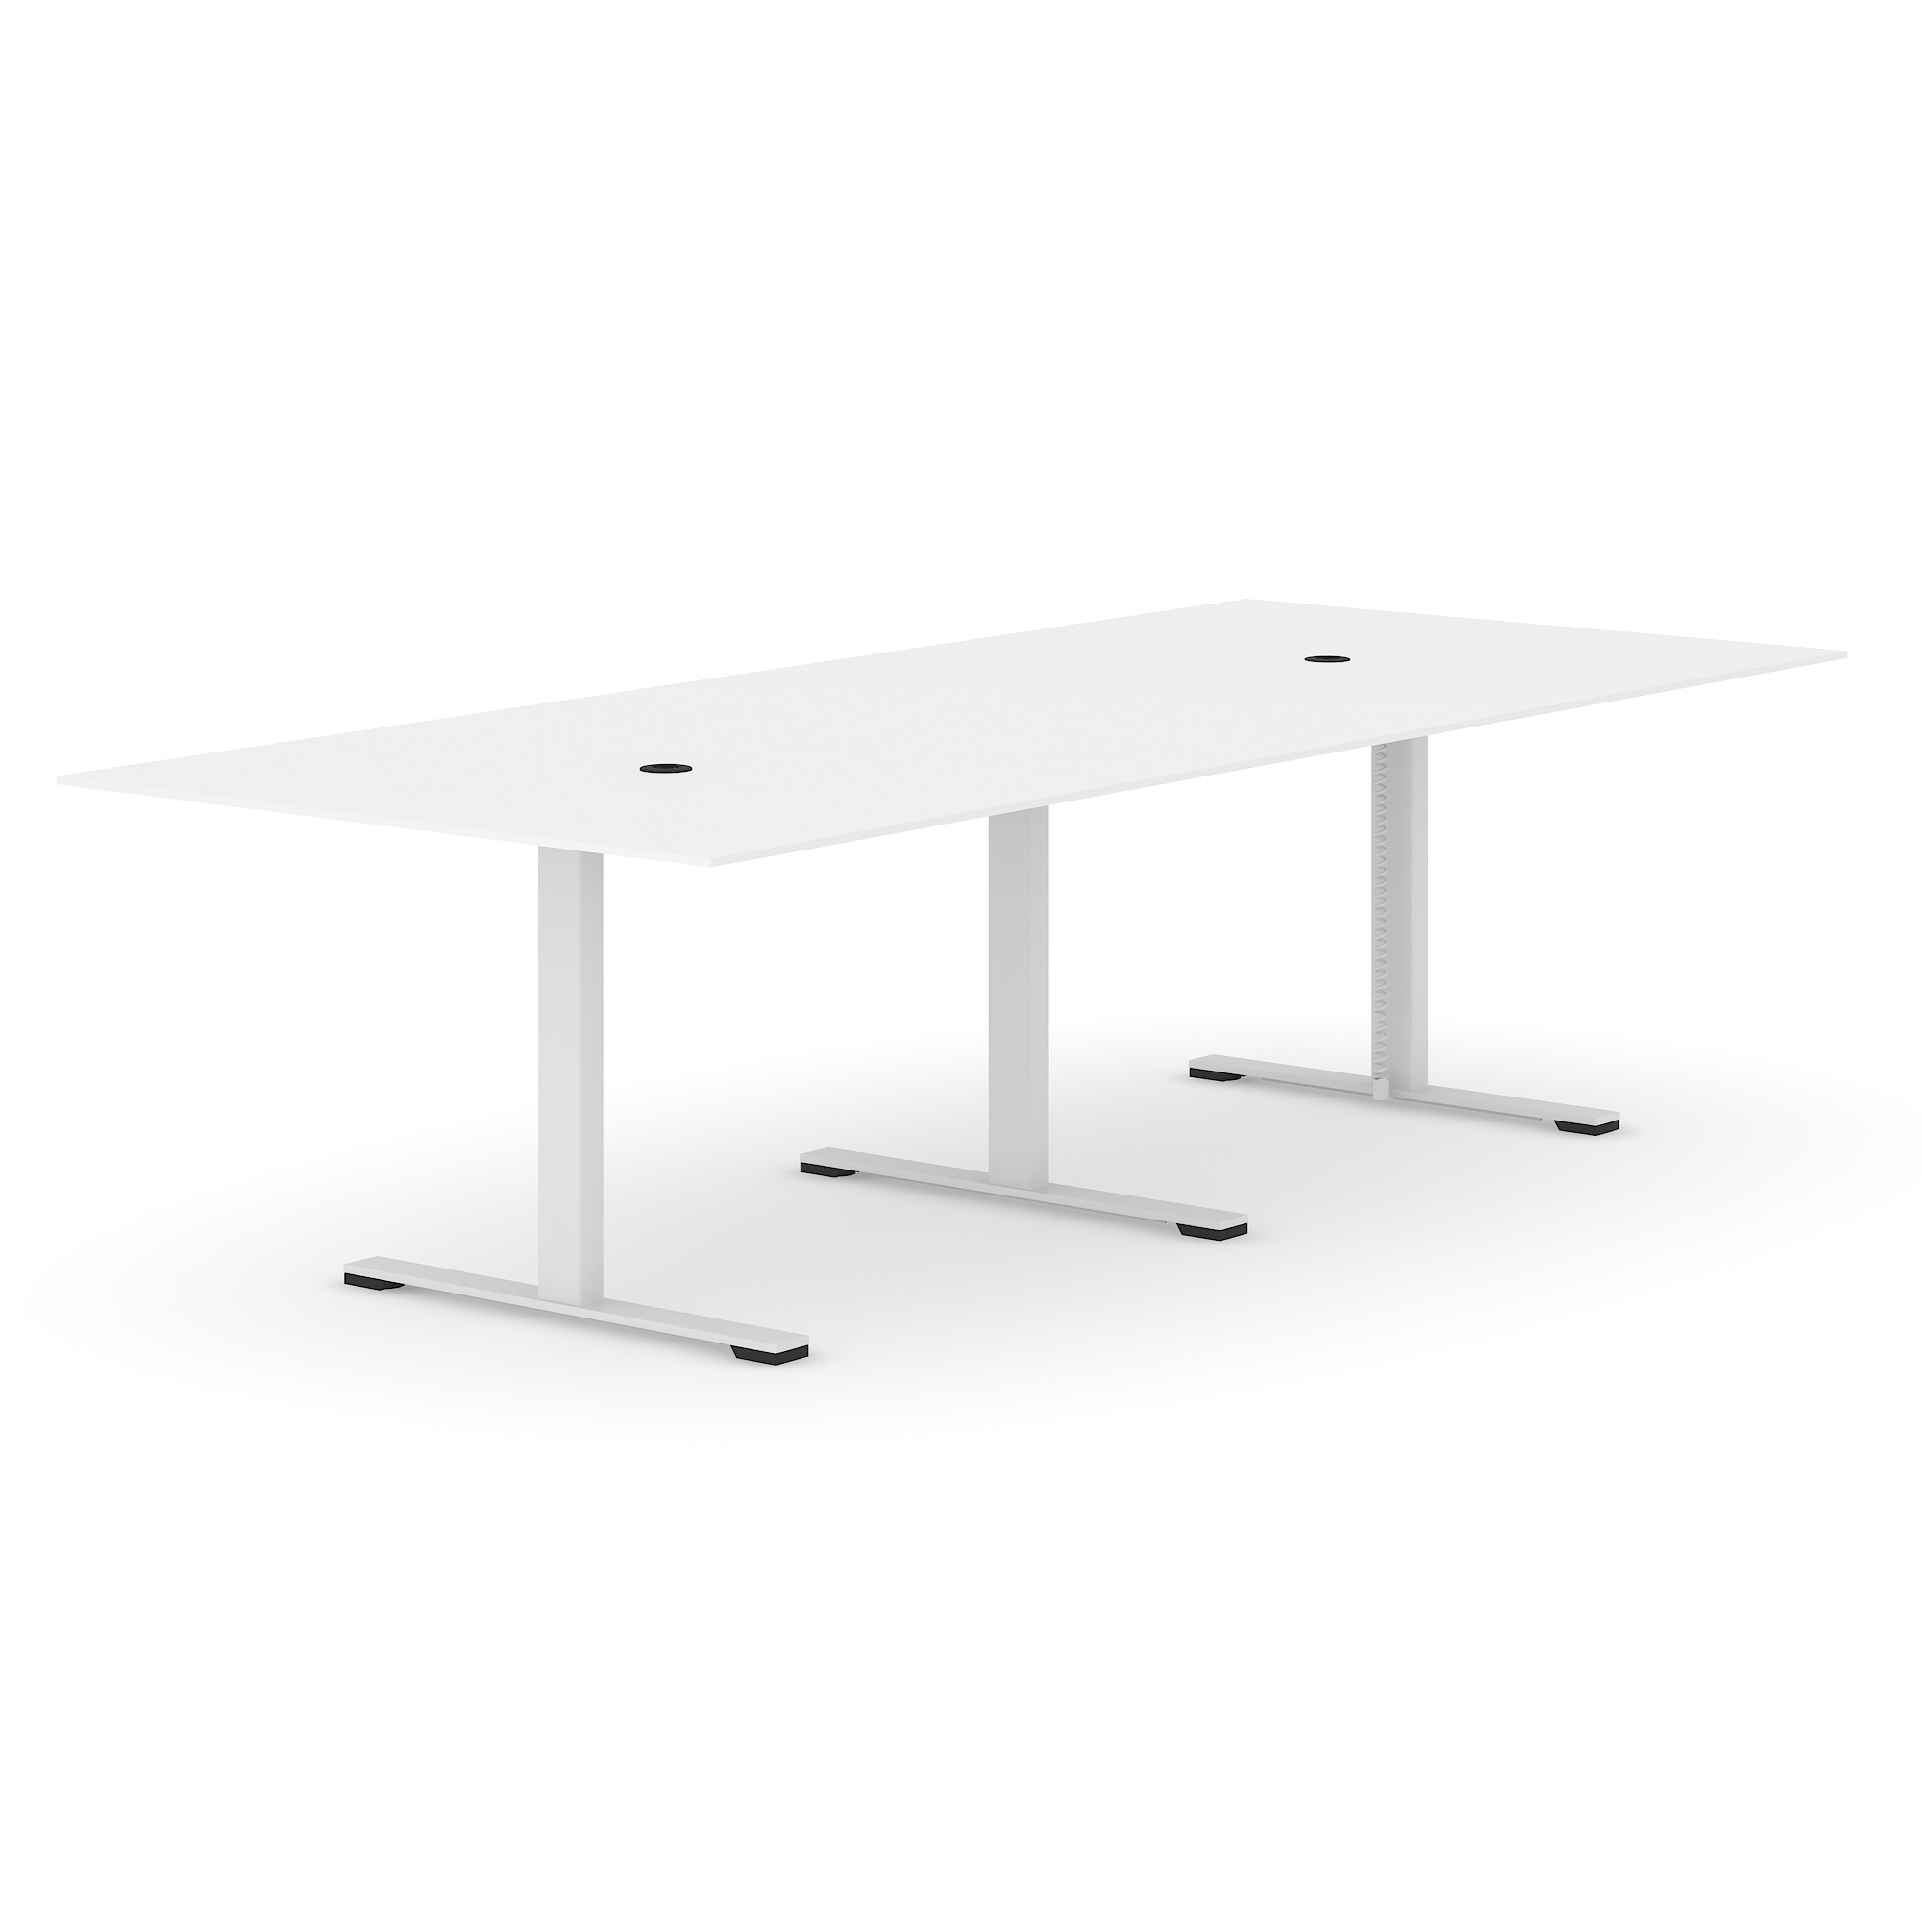
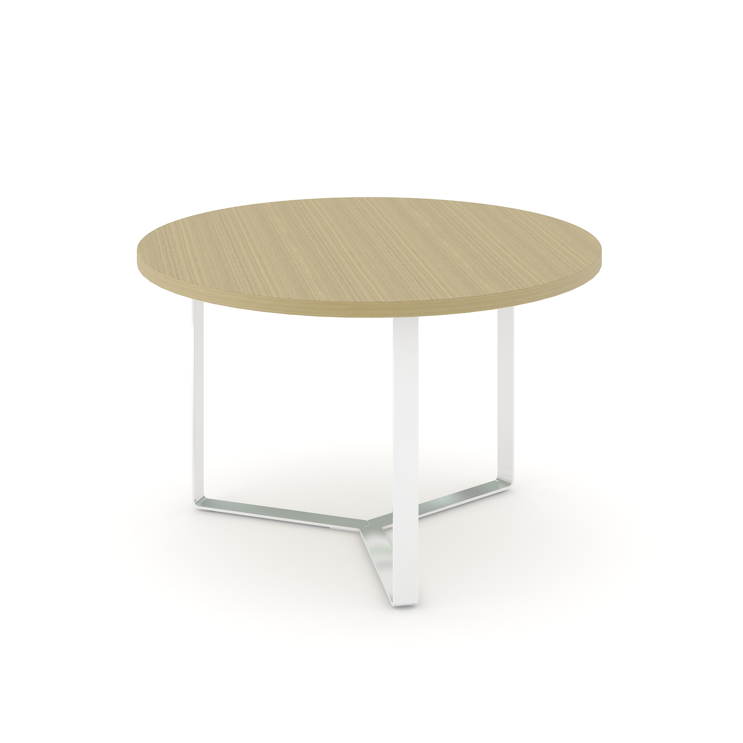
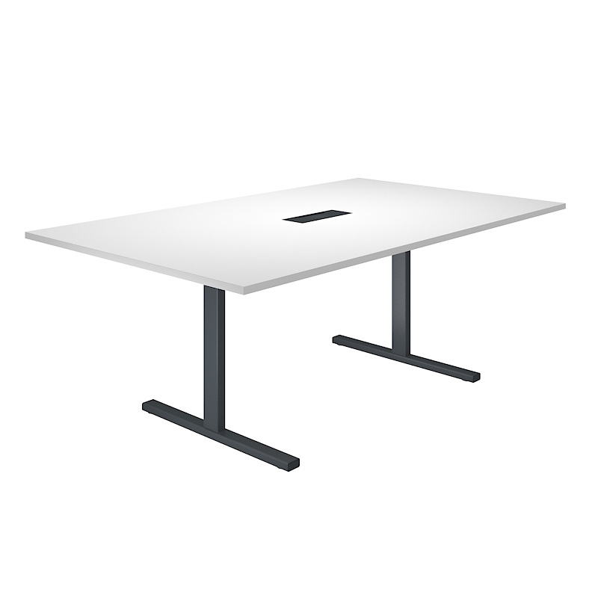
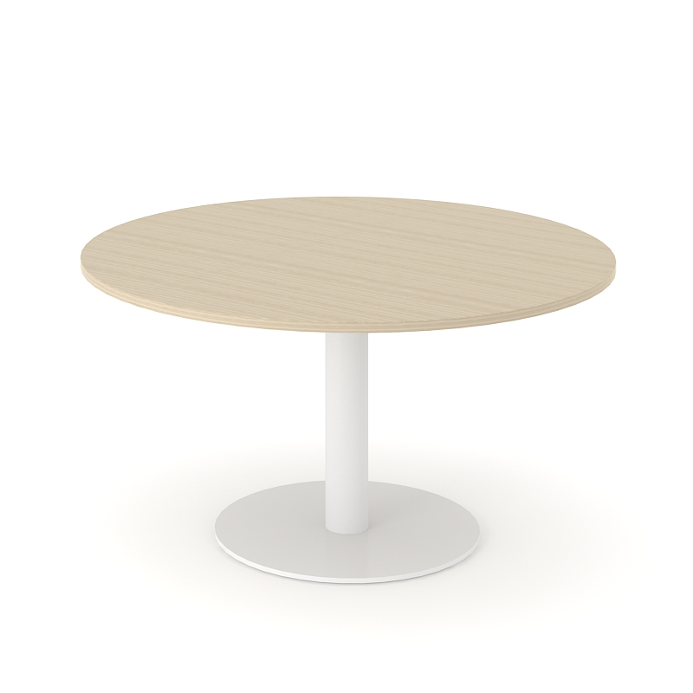
Suggested product ranges to combine with
CONFERENCE & MEETING TABLES
T- EASY
JAZZ
FORUM
PLANA

Slide 22
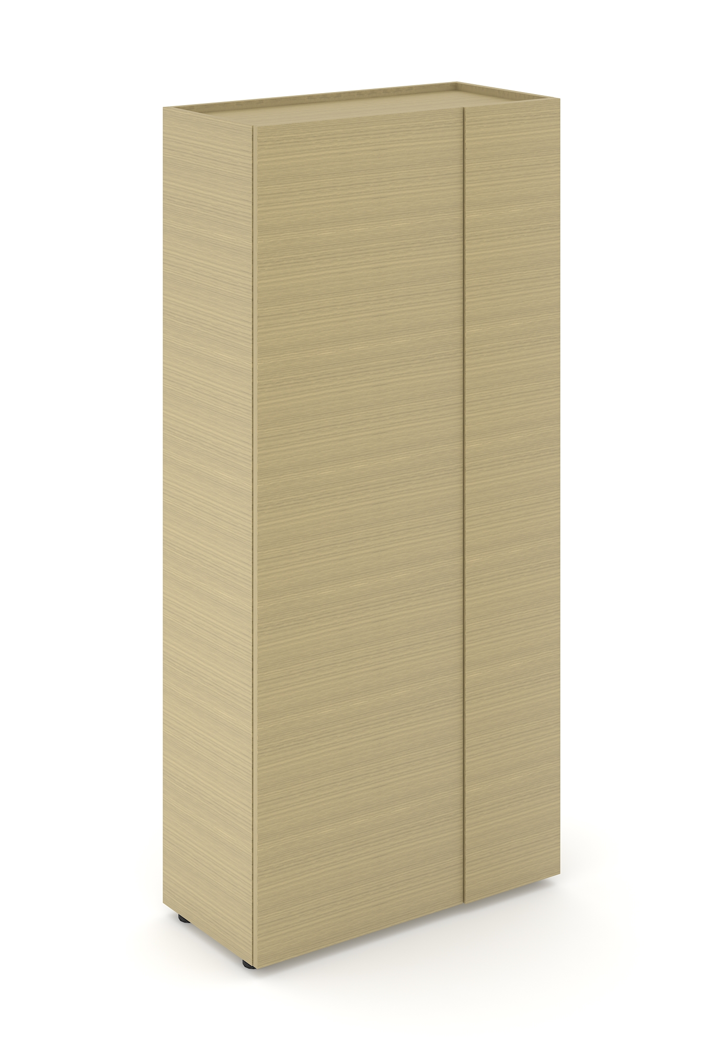
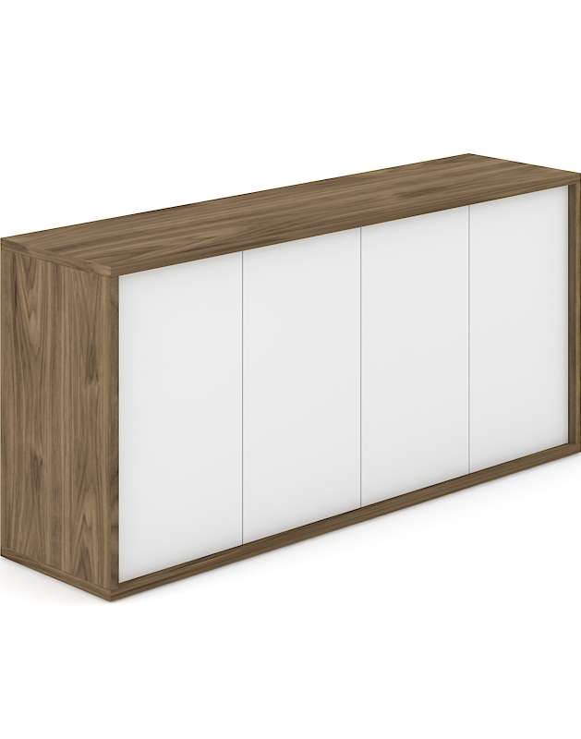
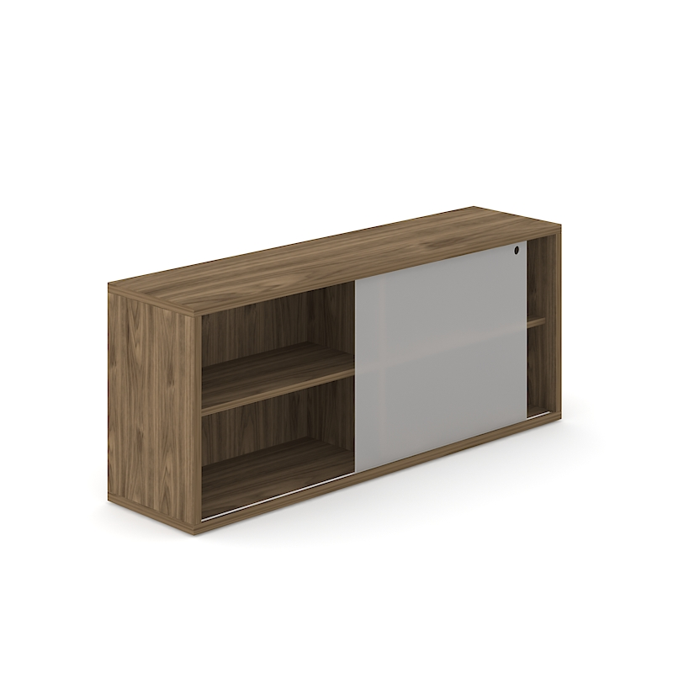
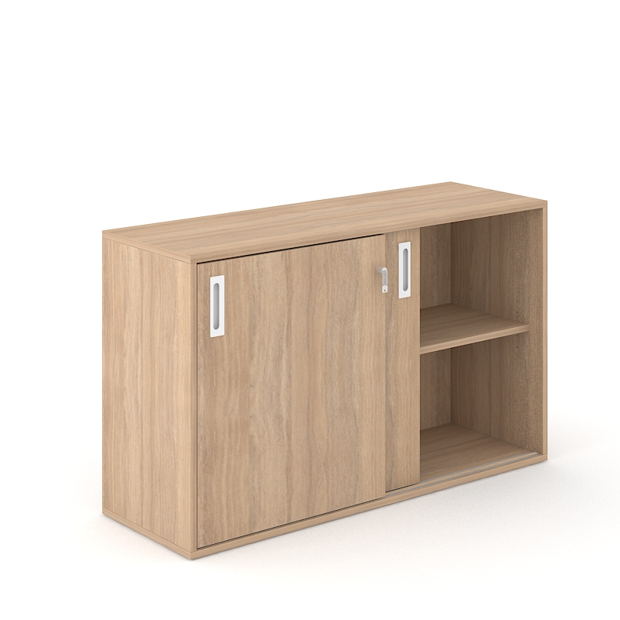
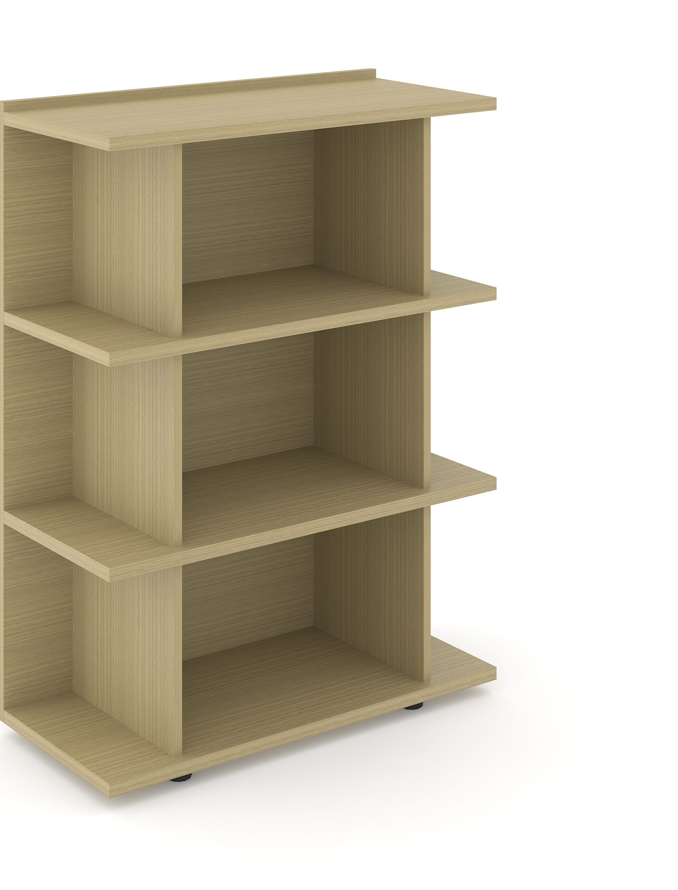
Suggested product ranges to combine with
CABINETS, PEDESTALS & WARDROBES
NOVA EXECUTIVE
CHOICE
PLANA

