Slide 1
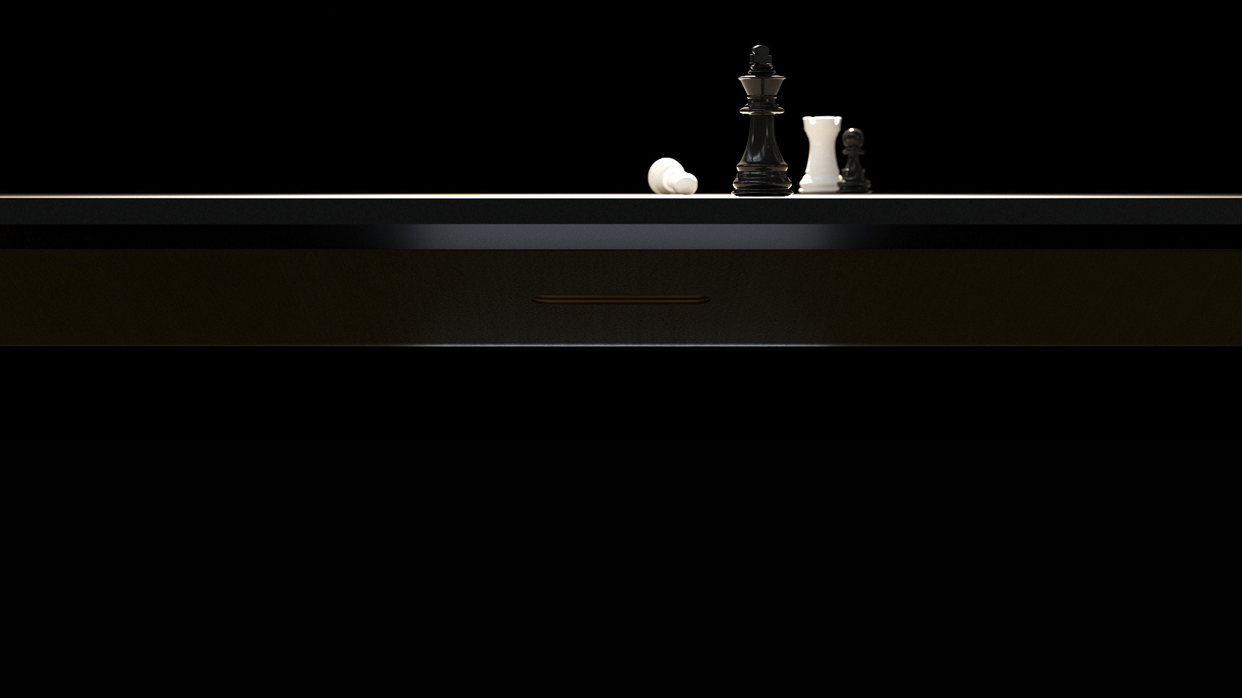
MOVE
Your best MOVE!

Slide 2
„
Move! is a slogan of today's people that represents the victory of modern mobility against stagnation, indolence and negativity. A true modern leader is driven and open to innovation, a cosmopolitan dictating healthy lifestyle and a teacher building the environment with honor.
Gediminas JUŠKA
Designer

Slide 3
STAY ON THE MOVE!

Slide 4
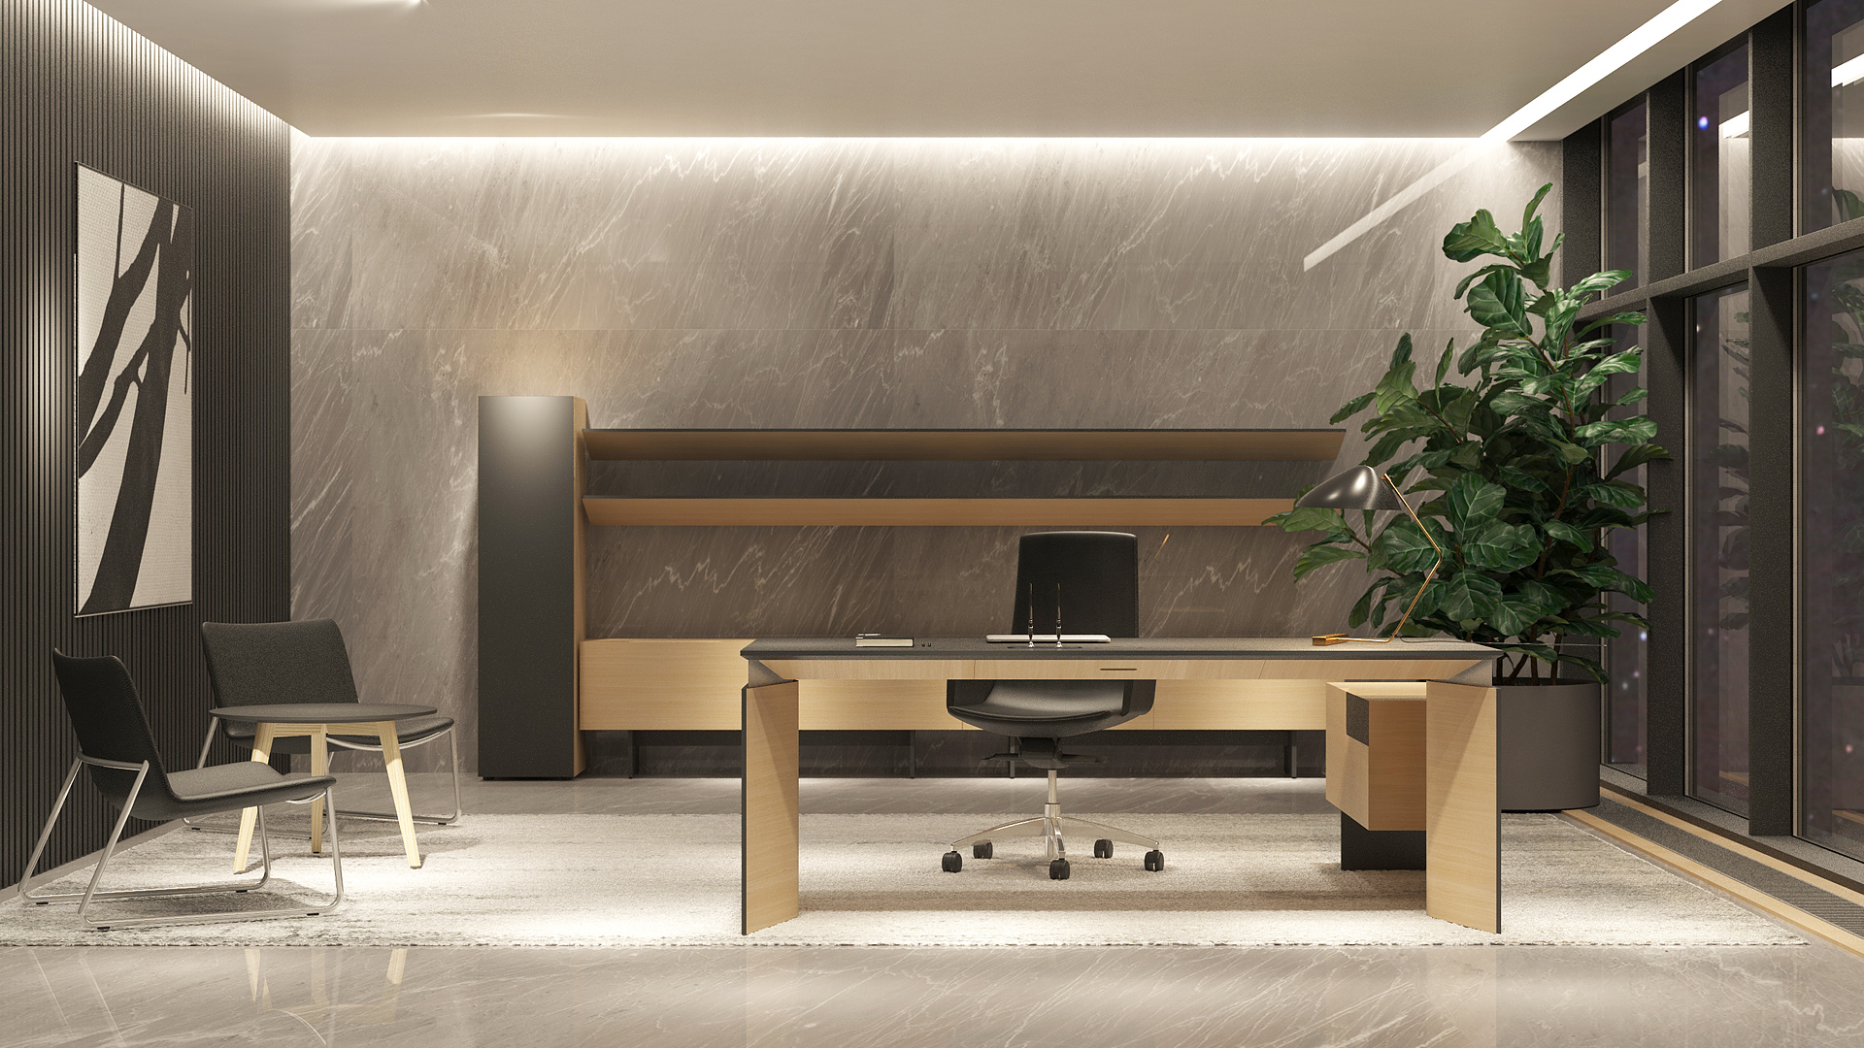
Notes:
MOVE is a minimalist, elegant and functional executive office furniture system for a modern leader. It helps to stay on the move and be active even at a work desk. Keep moving, stay healthy and productive.

Slide 5
HEALTH MEANS STATUS

Slide 6
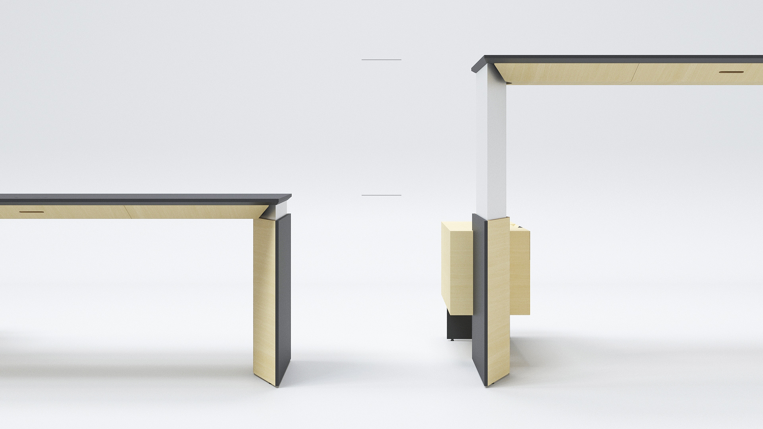
MAX
1300 MM
MIN
740 MM
Notes:
Living a healthy life is part of being successful. Strategic thinking, good reputation, self-confidence and bold decisions are all important qualities of a successful leader, but that alone is not enough to become one. A healthy living philosophy that creates the need for ergonomic solutions has become synonymous with a modern office environment and executive spaces. A modern leader is a role model who has the ability to inspire and guide his or her colleagues. MOVE executive office furniture system combines the best in ergonomics and cutting-edge technology and is designed for active leaders.

Slide 7
MINIMALISM IS NEW LUXURY

Slide 8
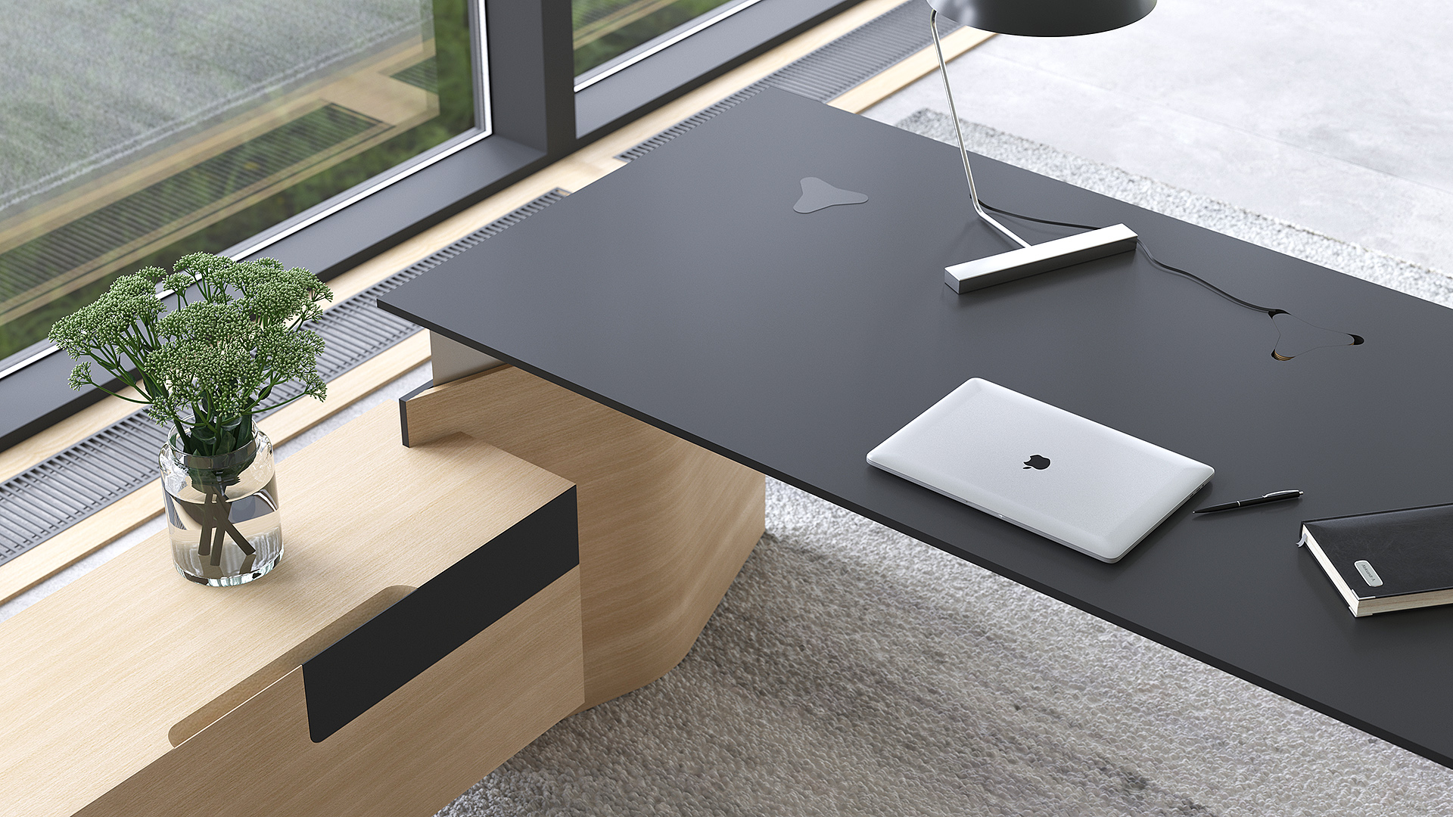
Notes:
A distinct feature of MOVE executive furniture is its mature and minimalist design. Clean, elegant lines, smooth transitions and subtle combinations of materials are guaranteed to make a strong visual impact in any office. HPL Fenix finish, natural oak, ash or walnut veneer and polished stainless steel surfaces form a harmonious whole and create a sense of subtle luxury.

Slide 9
ONLY THE BEST OF THE BEST

Slide 10
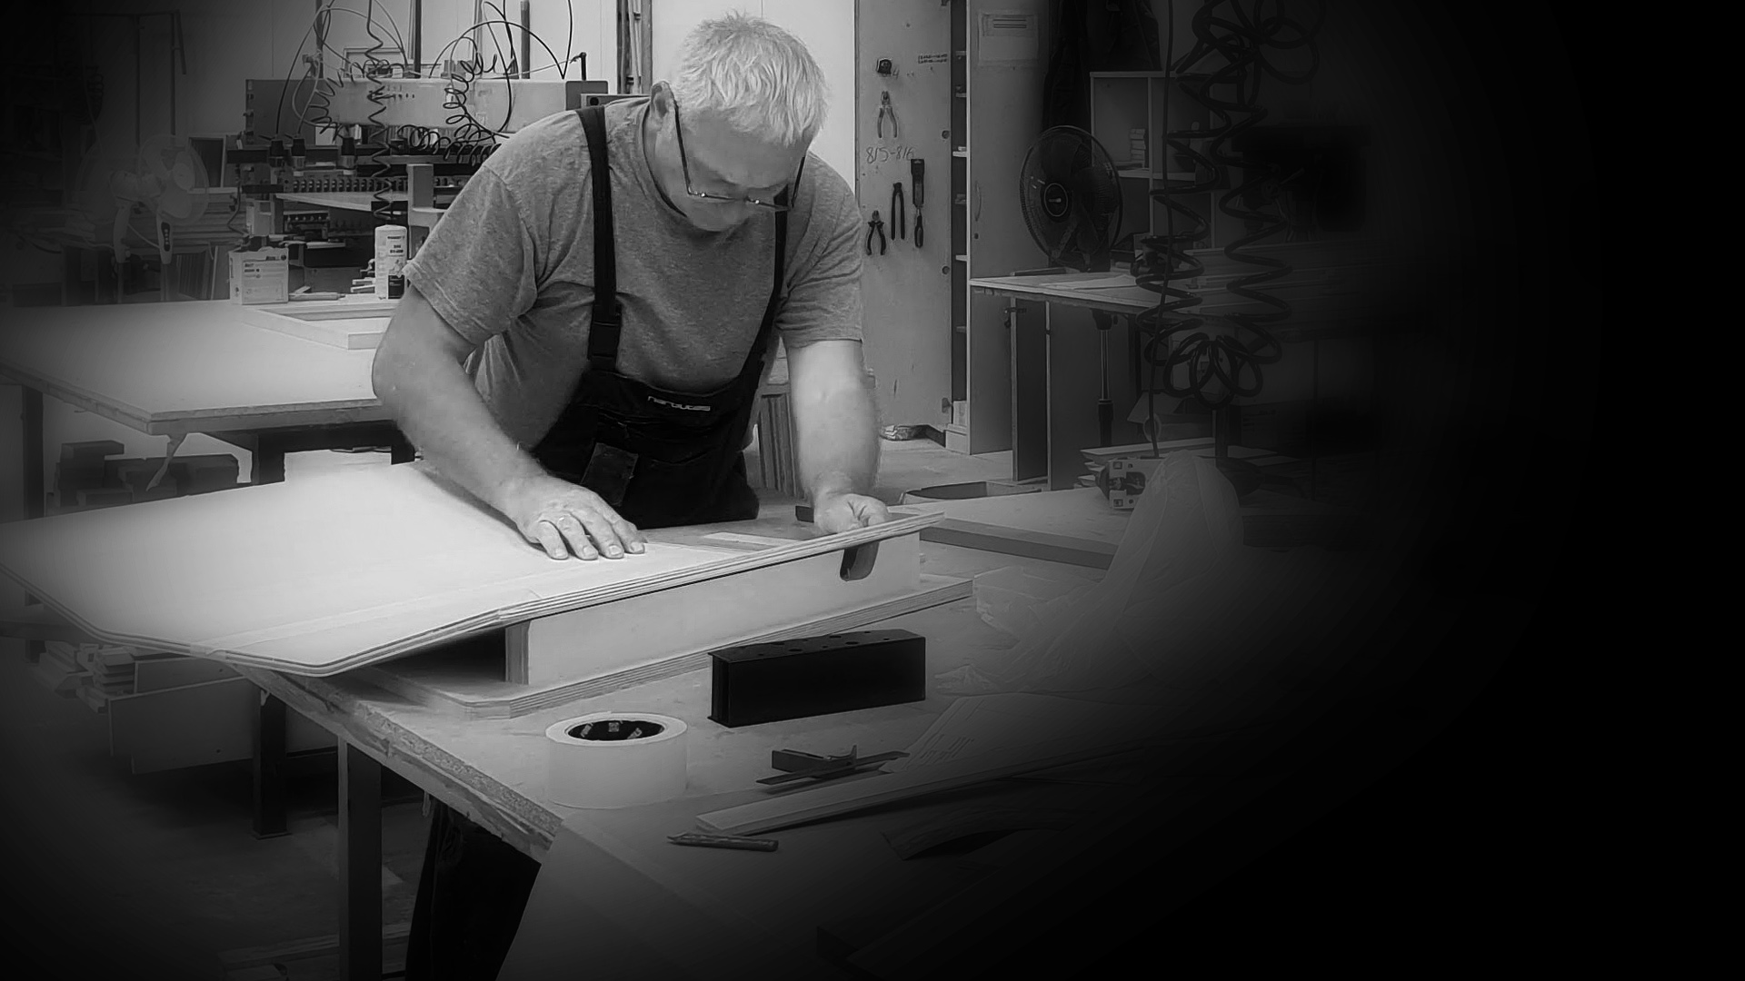
MOVE is a top-quality product which stands out for its uncompromising standards of excellence in craftsmanship.
Notes:
MOVE furniture stands out not only for its cutting-edge technology and a subtle minimalist look but also for its uncompromising standards of excellence in craftsmanship. Curved wooden surfaces are shaped employing traditional manufacturing methods and following highest quality standards. Parts of different materials are joined together with every detail in mind.

Slide 11
EVERY DETAIL MATTERS

Slide 12
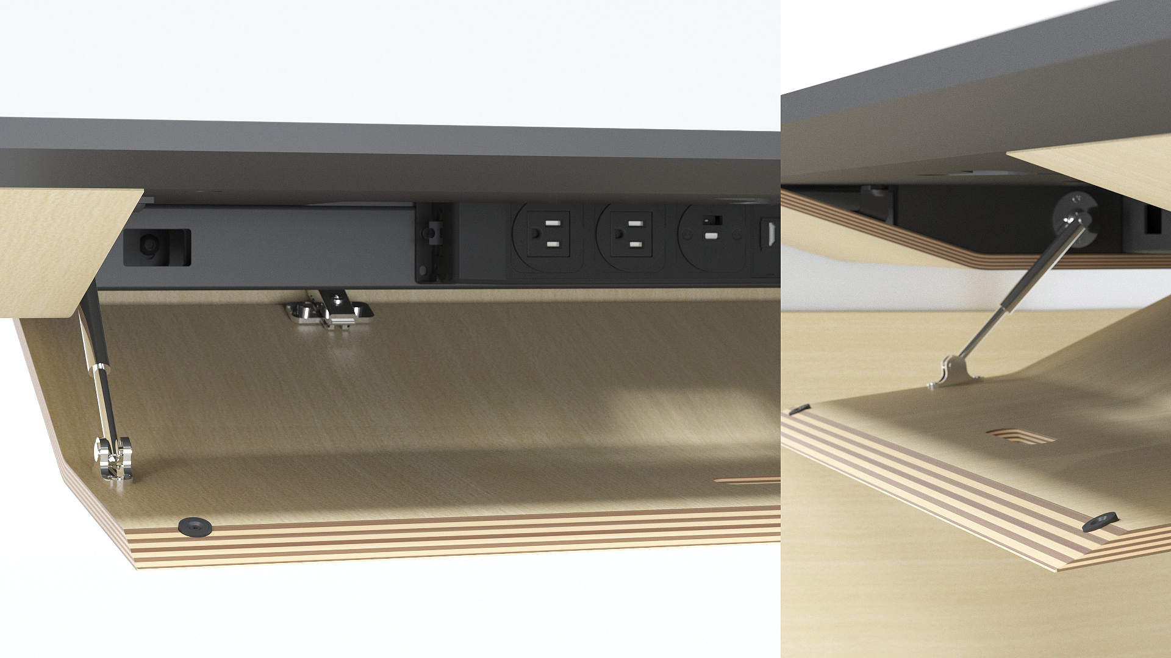
Notes:
MOVE desk has a built-in 110-230V AC power unit. The hidden wires can be accessed by opening an elegant minimalist lid.

Slide 13
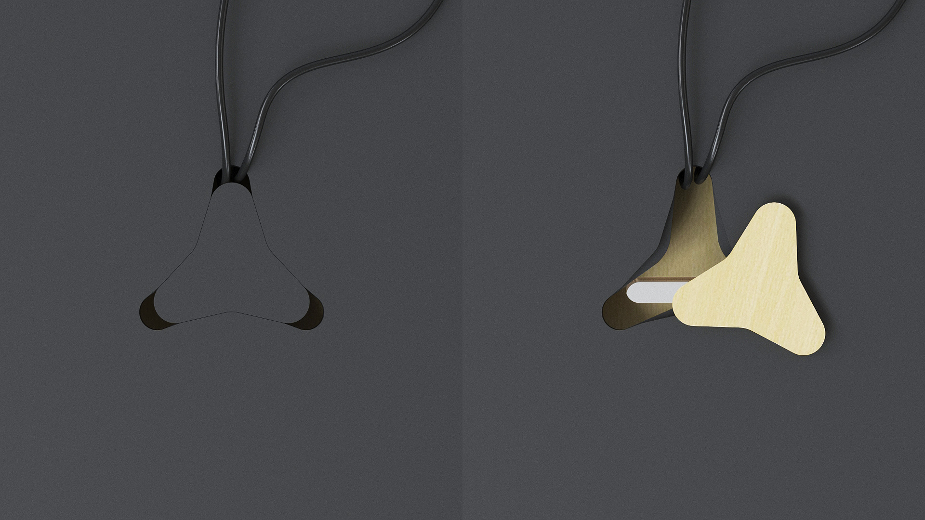
Notes:
Wires and cables are routed through a subtle triangular-shaped hole with an original cover in a colour that matches that of the desktop or natural wood.

Slide 14
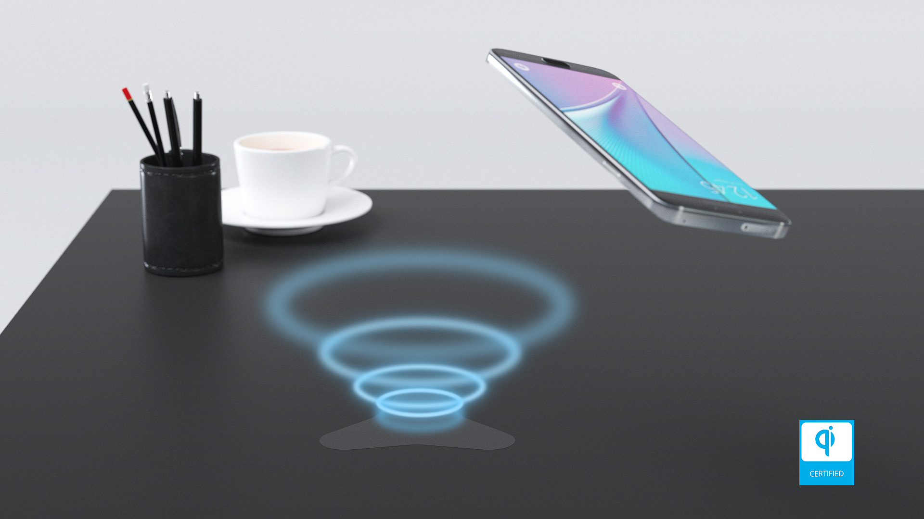
Notes:
MOVE desk also has an in-built best-in-class Qi wireless charger (15W) for your smart devices.

Slide 15
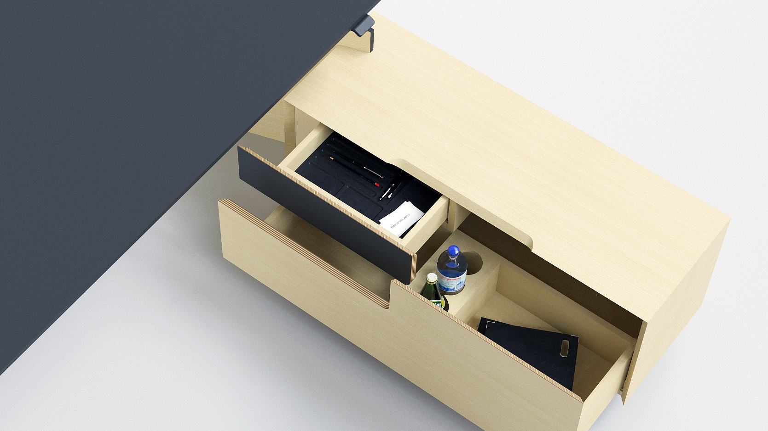
Notes:
The desk cabinet drawers come with special inserts which ensure your workspace stays well-organised and give your furniture a more refined look.

Slide 16
RANGE

Slide 17
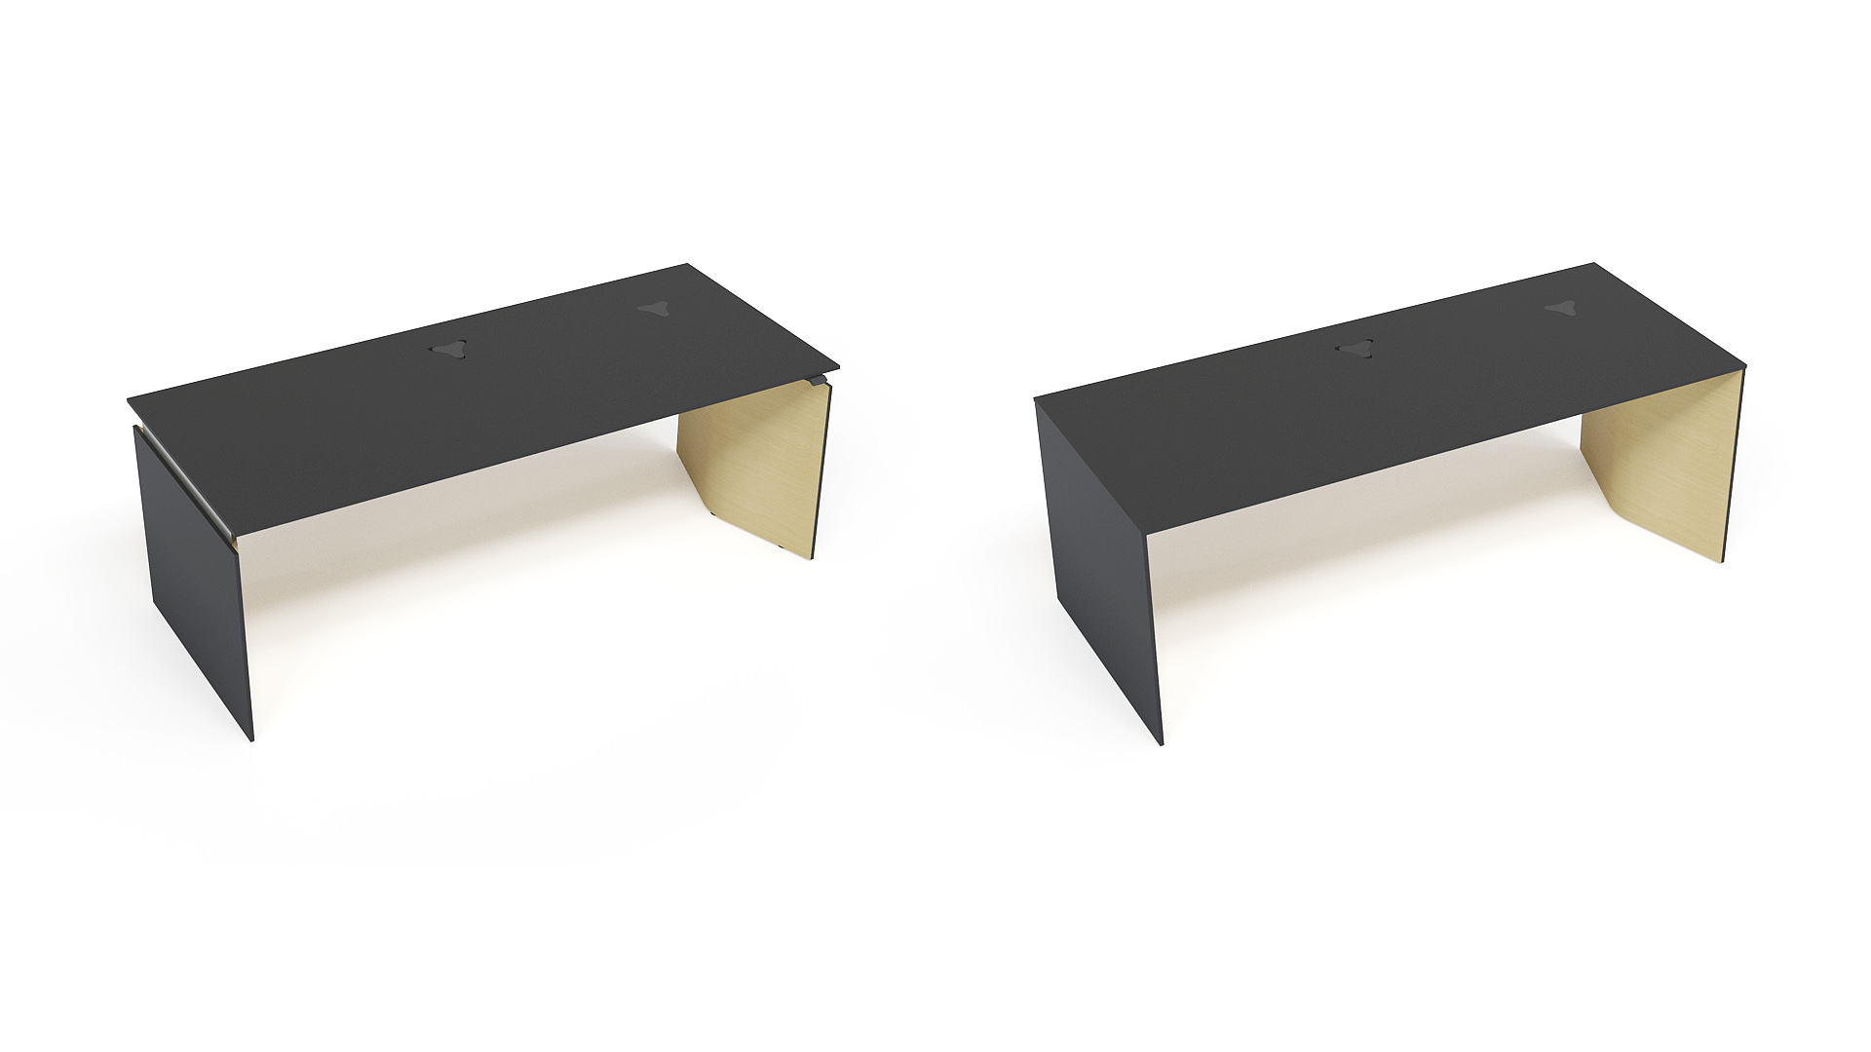
Sit-stand table
1800/2000x850
Fixed height table
1800/2000x850

Slide 18
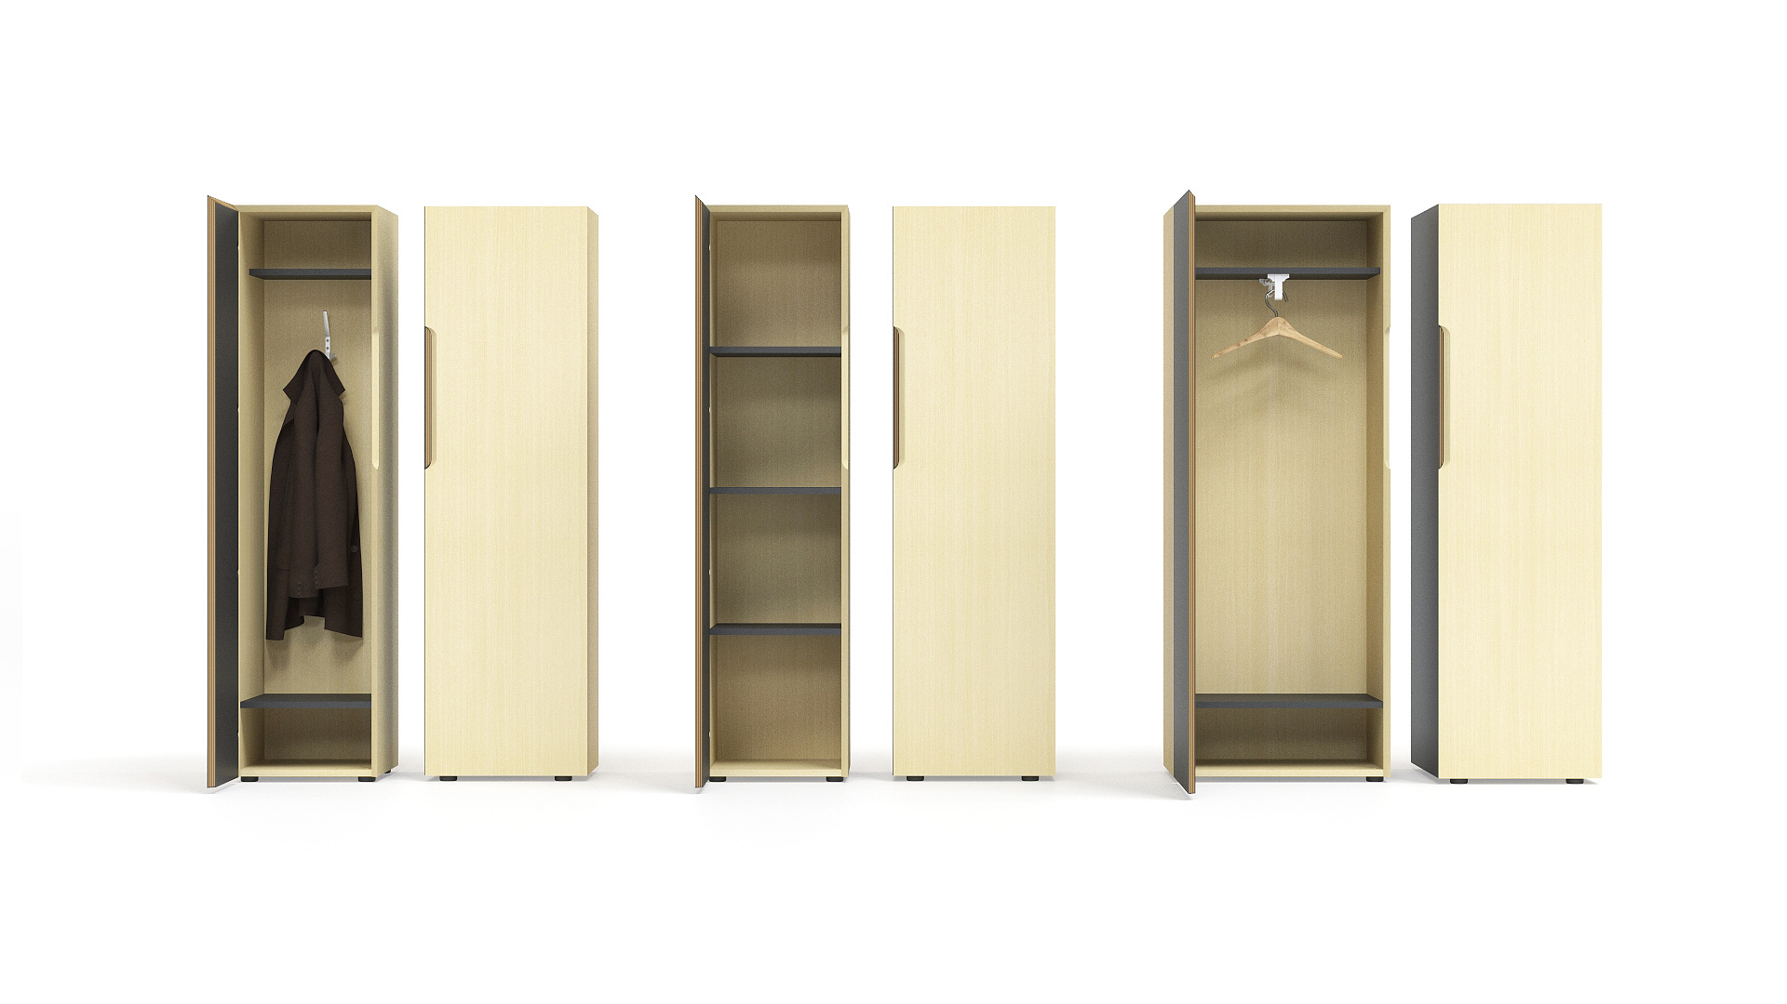
Wardrobe with hook
400x450, H=1600, L/R
Cabinet with 4 fixed shelves
400x450, H=1600, L/R
Wardrobe with pull out rail
600x450, H=1600, L/R

Slide 19
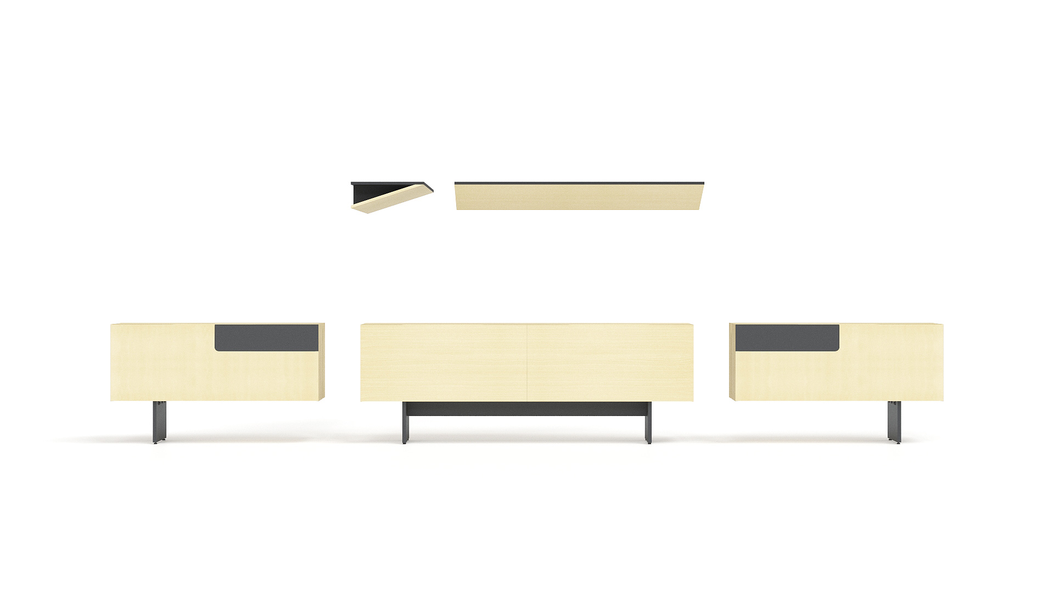
Wall shelfs
1200/1600x350
Left fixed pedestal
1000x350, H=580
Pedestal
1600x350, H=580
Right fixed pedestal
1000x350, H=580

Slide 20
Your best MOVE!

