Slide 1
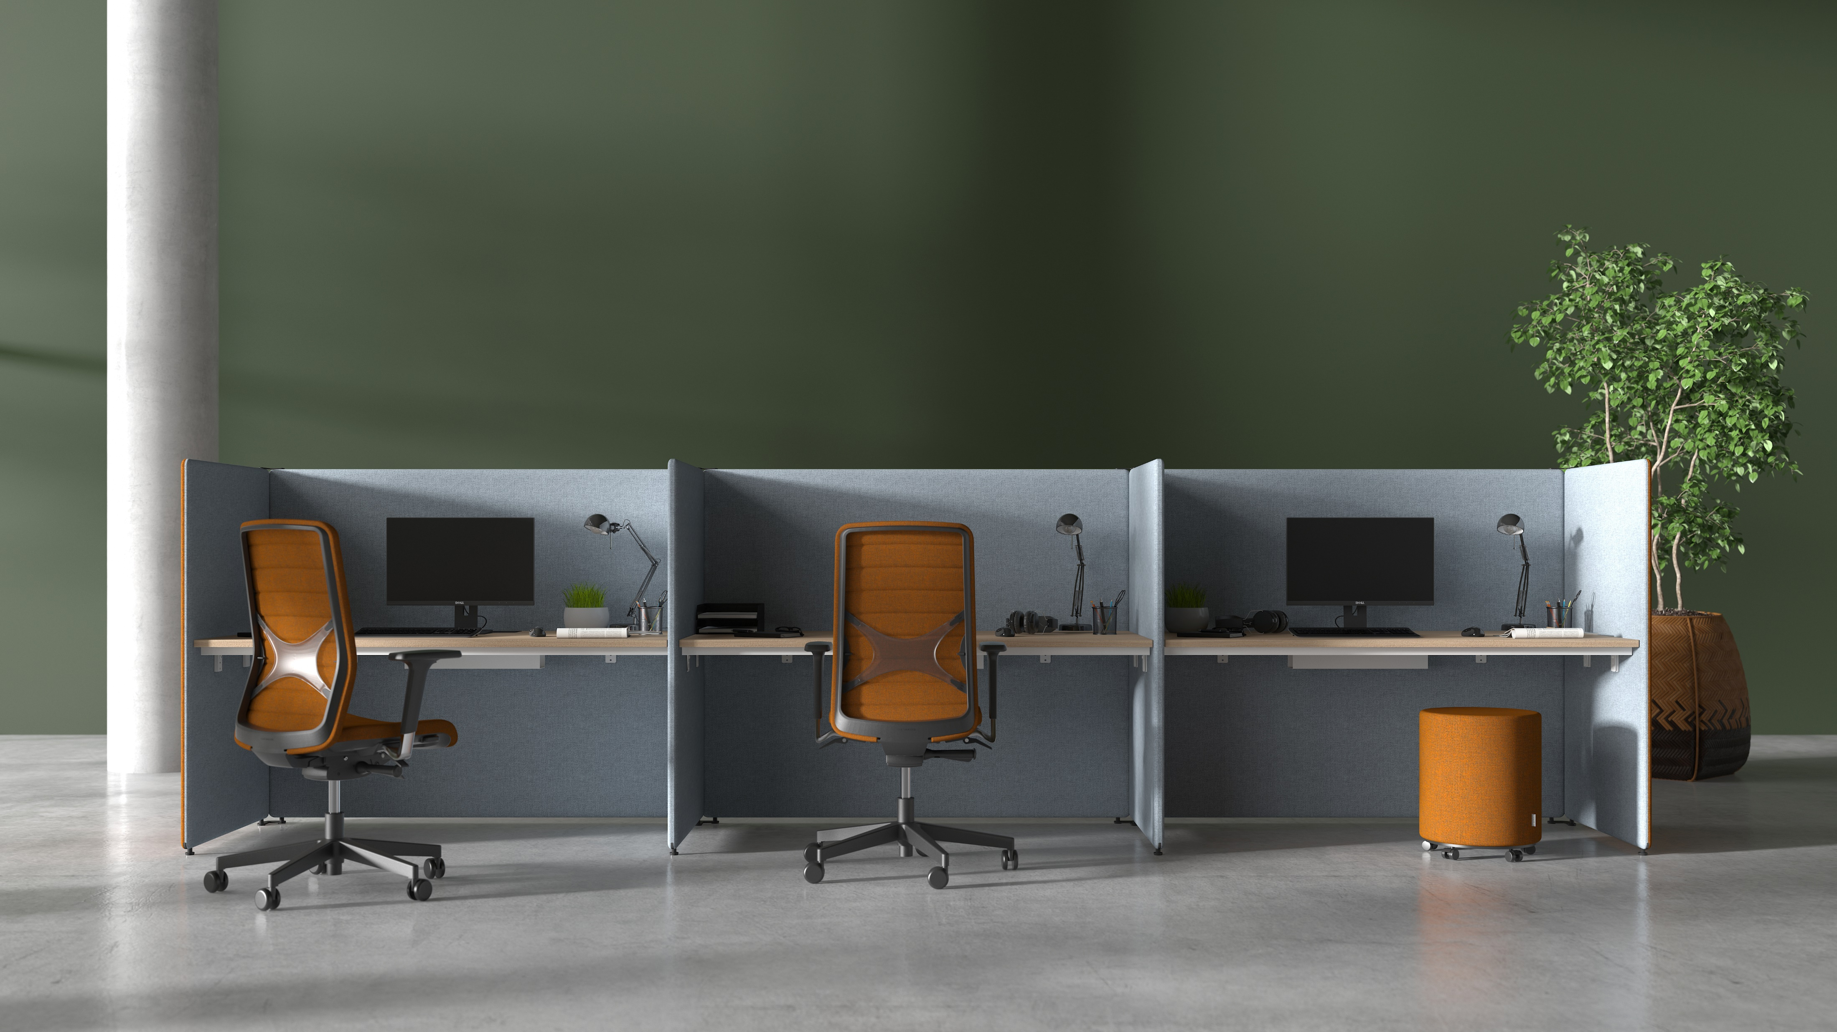
Create your space with
MY SPACE

Slide 2
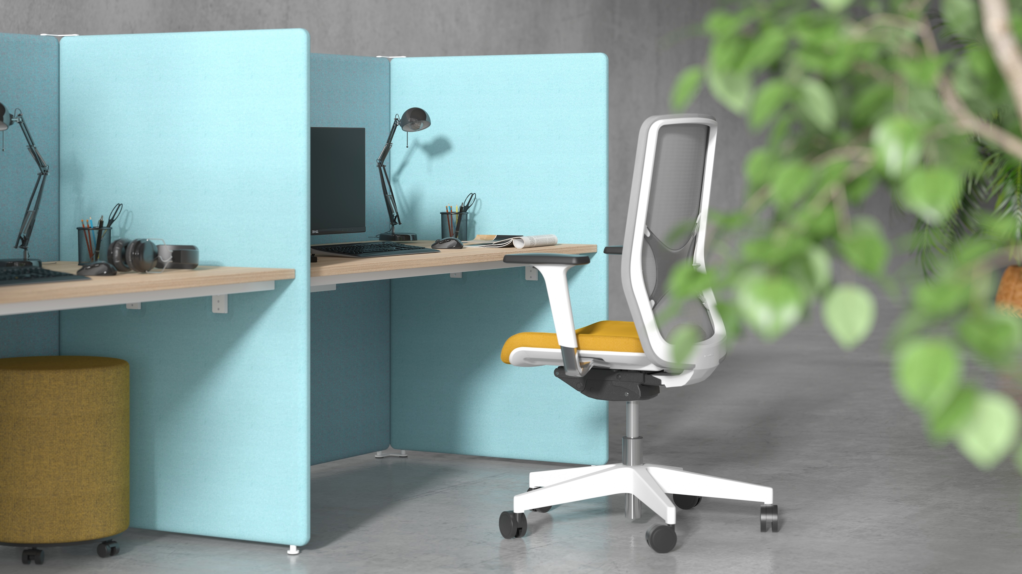

Slide 3
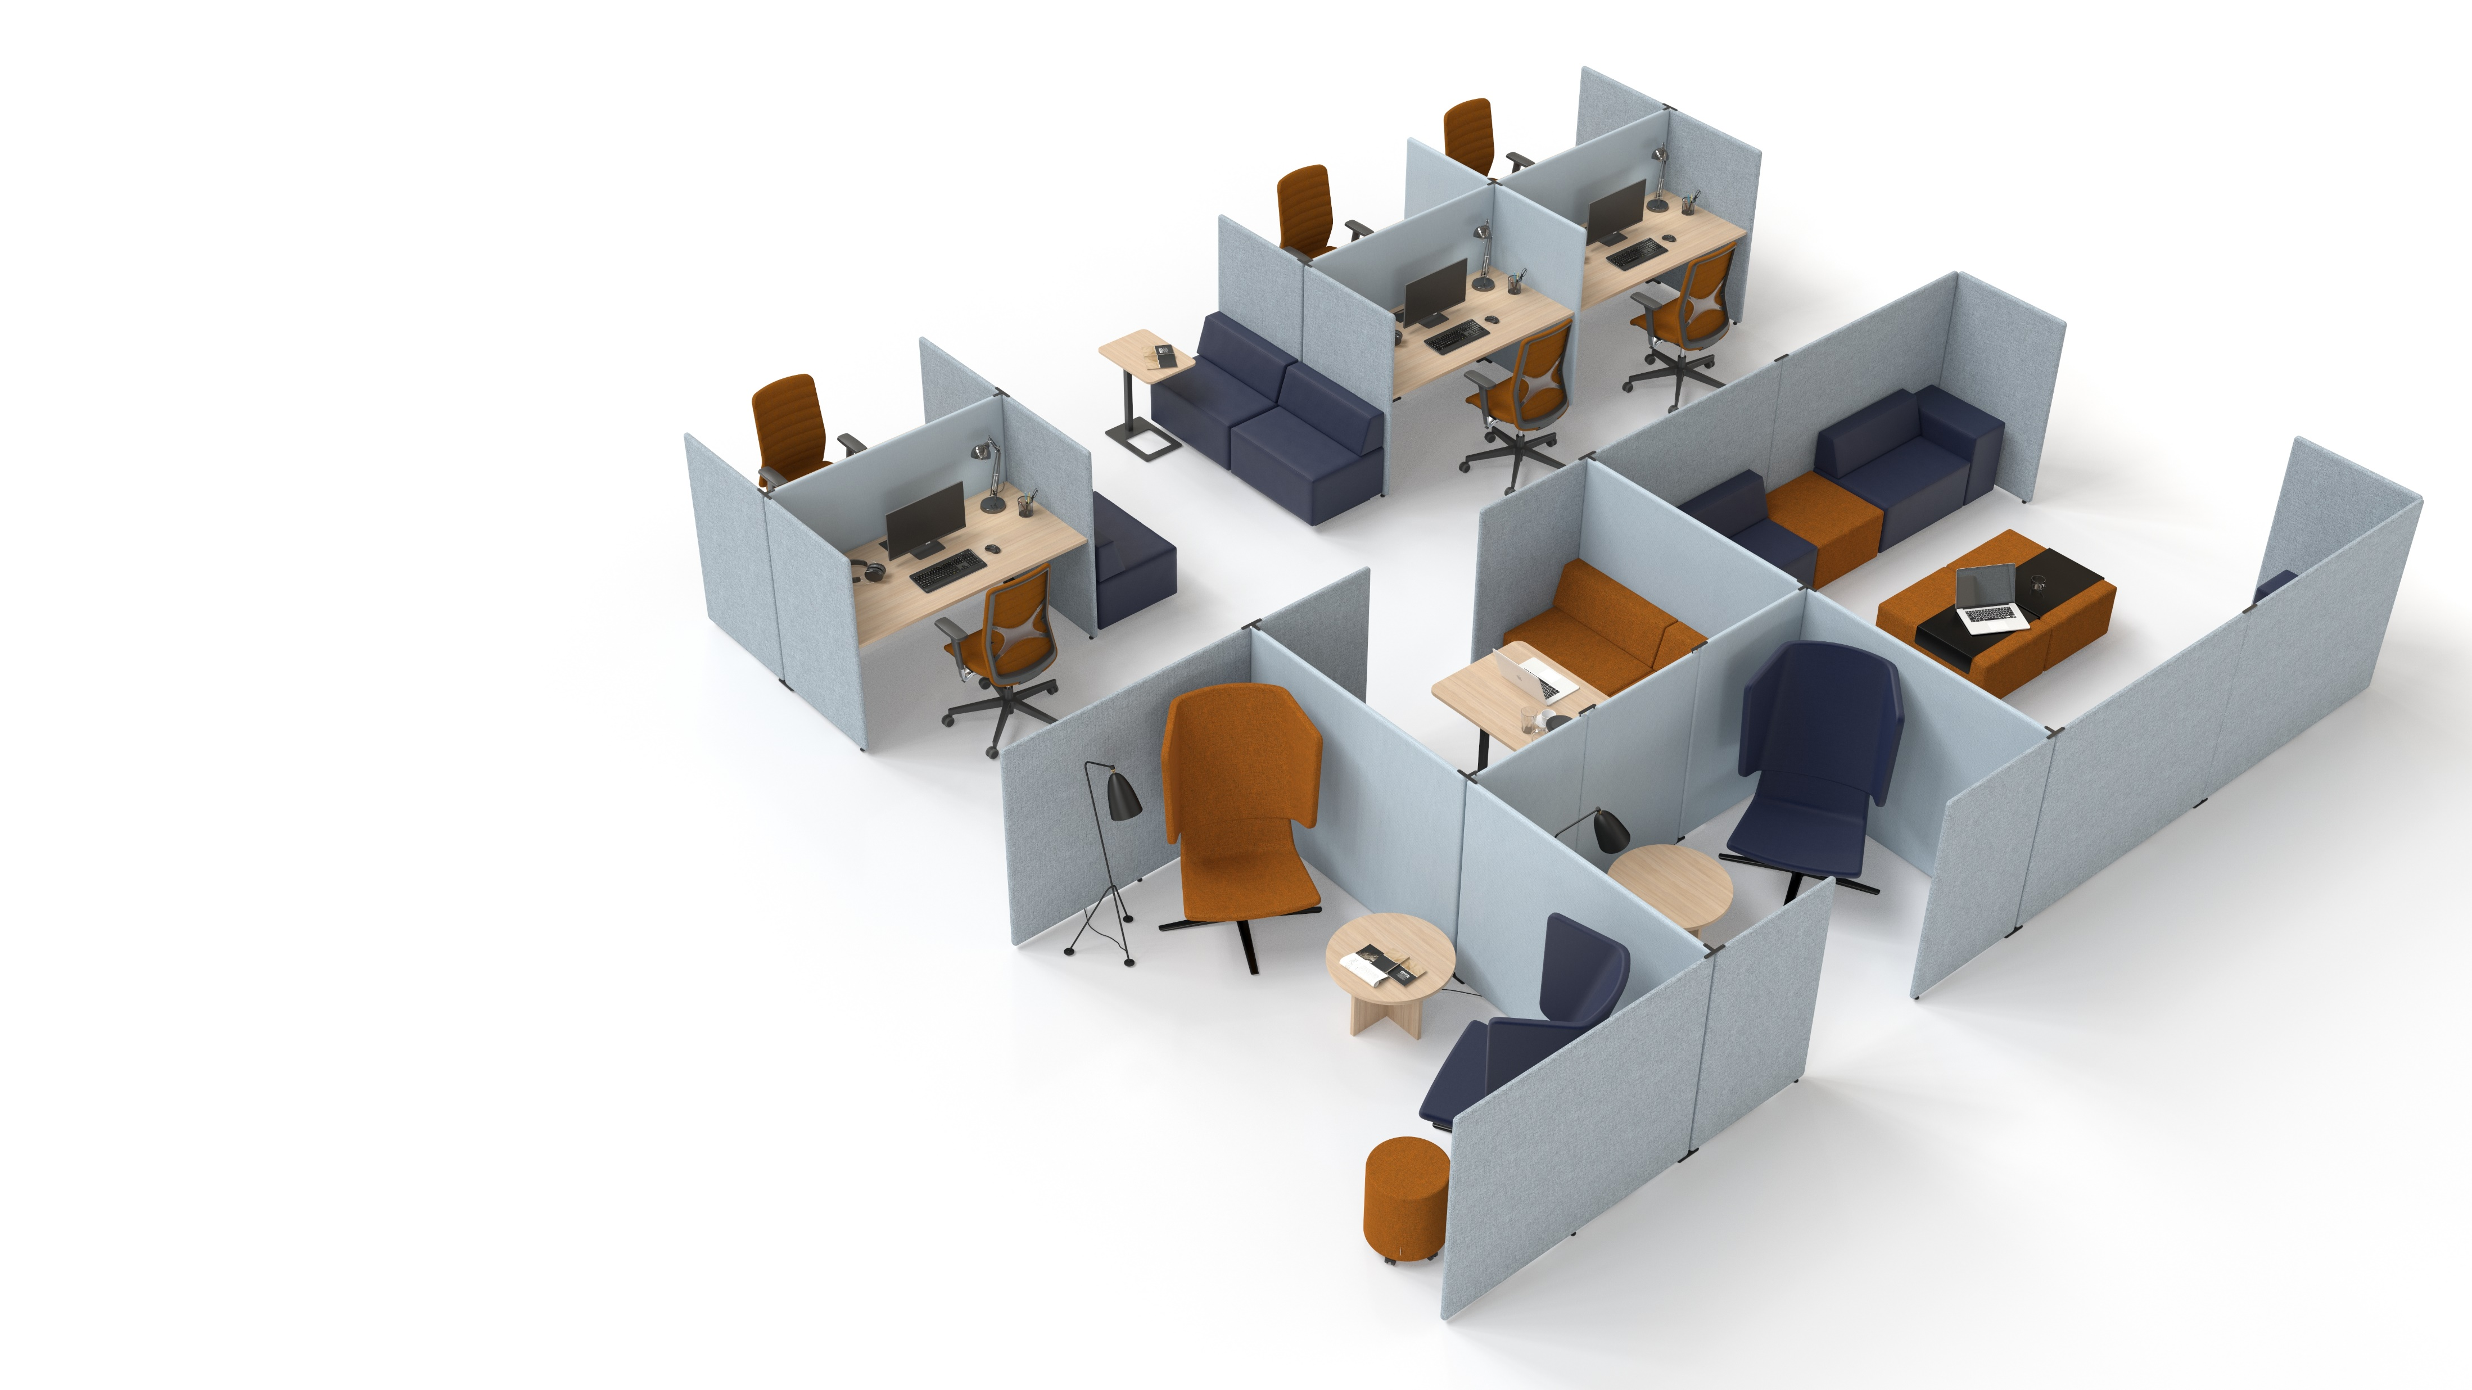
A MUST-HAVE MODERN OFFICE SOLUTION
MY SPACE is a universal modular screen system with excellent acoustic properties designed to shape unique office spaces. This system is the ideal solution for agile, activity-based and open-plan offices.
Notes:
A must-have modern office solution
MY SPACE is a universal modular system with excellent acoustic properties designed to shape unique office spaces. This system is the ideal solution for agile, activity-based and open-plan offices.

Slide 4
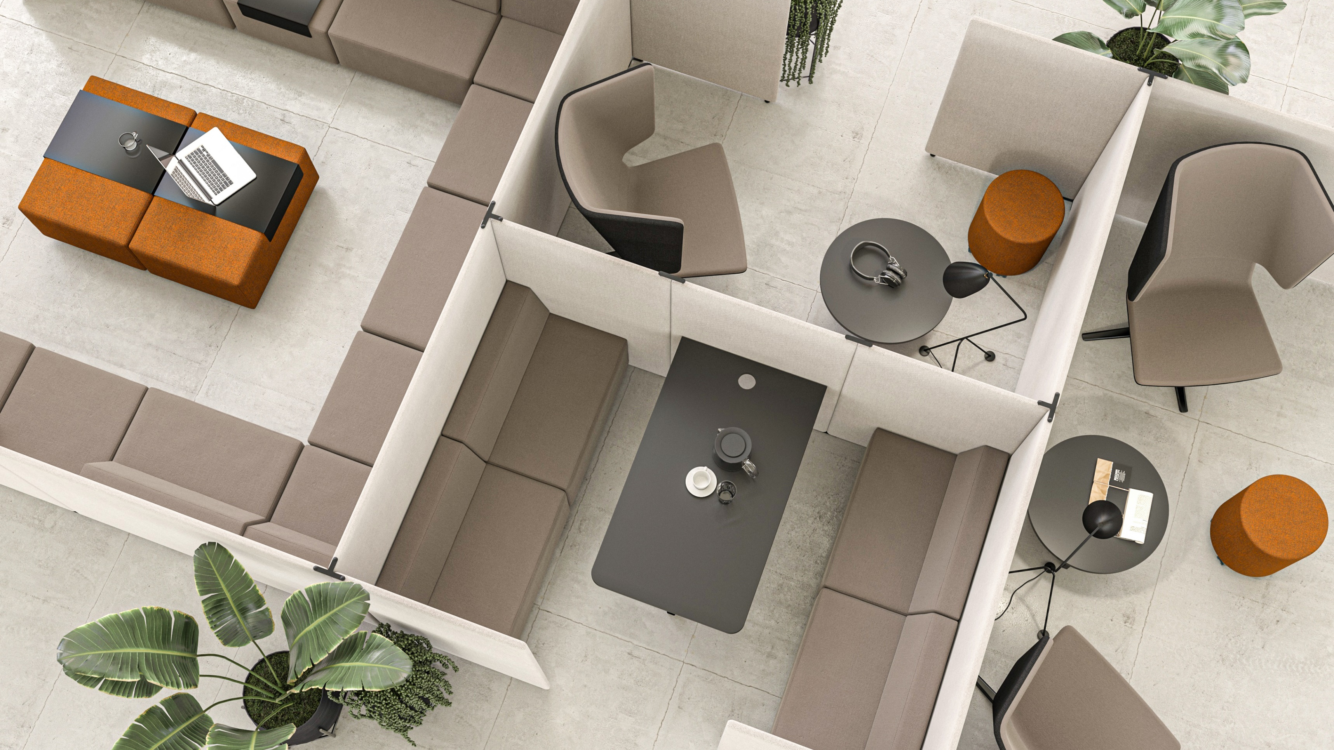

Slide 5
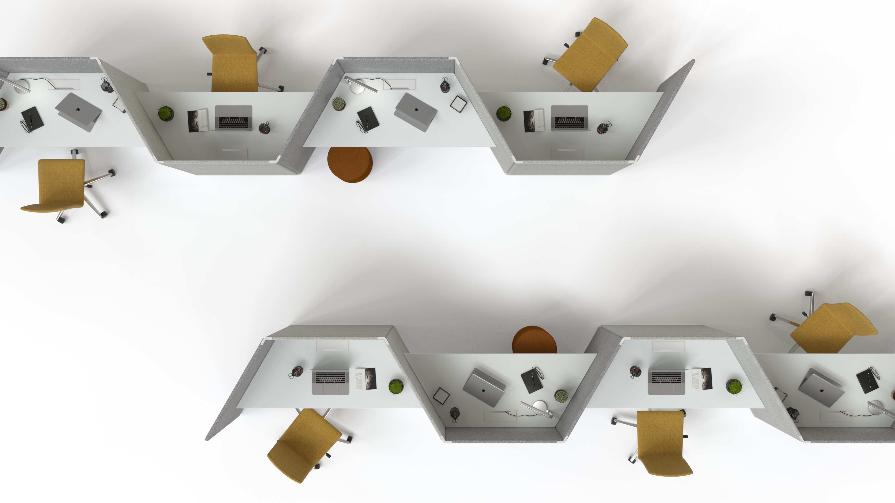
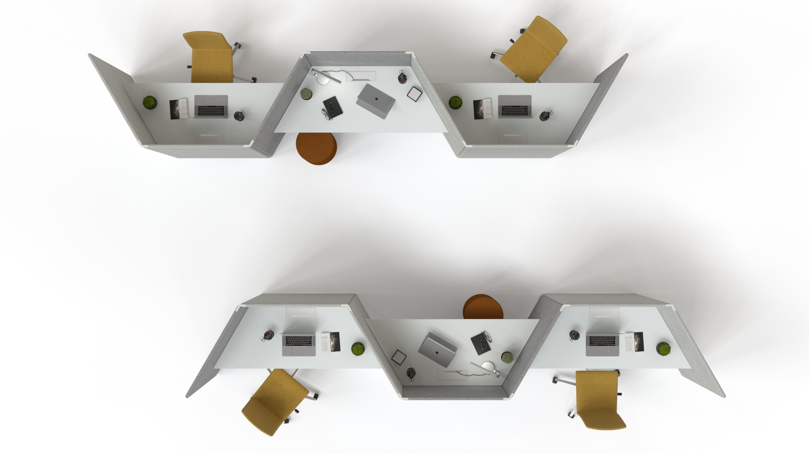
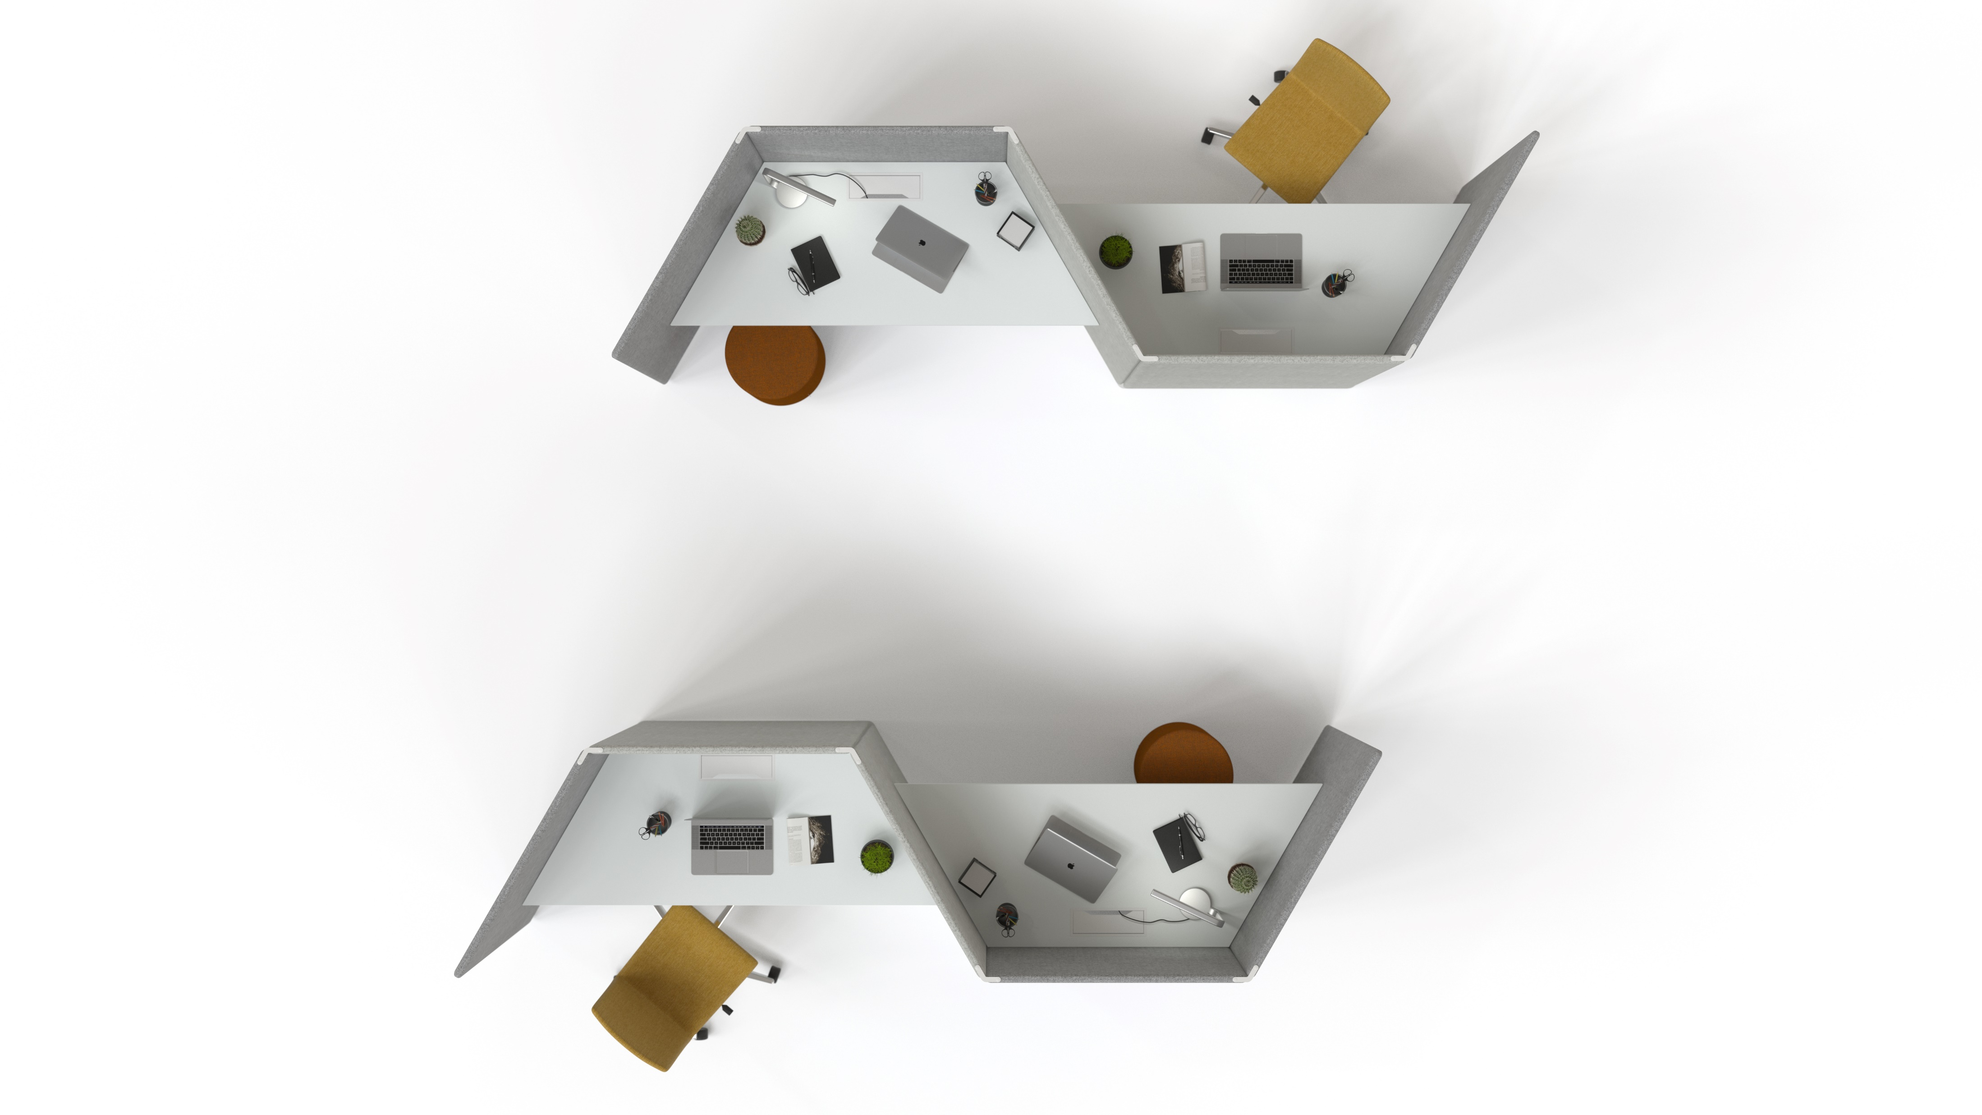
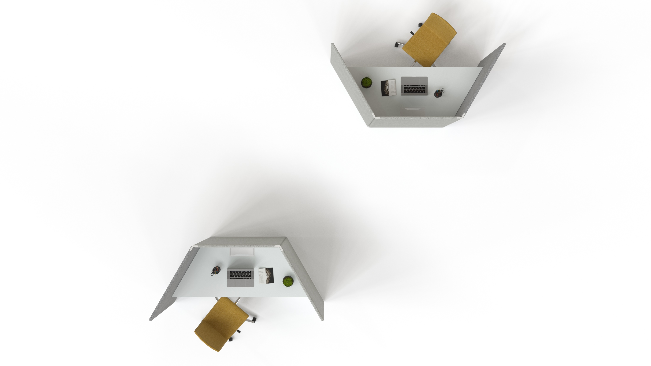
ENDLESS OPPORTUNITIES FOR SPACE CREATION

Slide 6
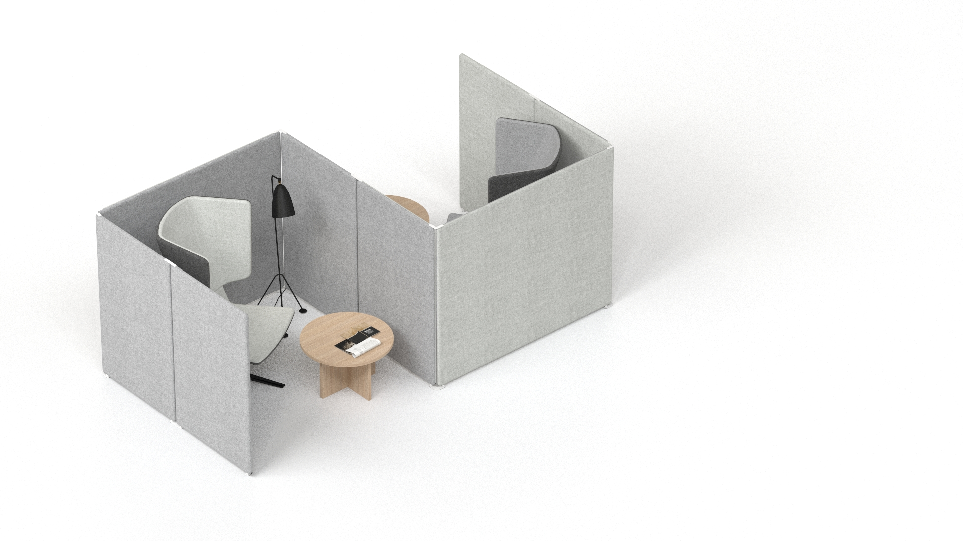
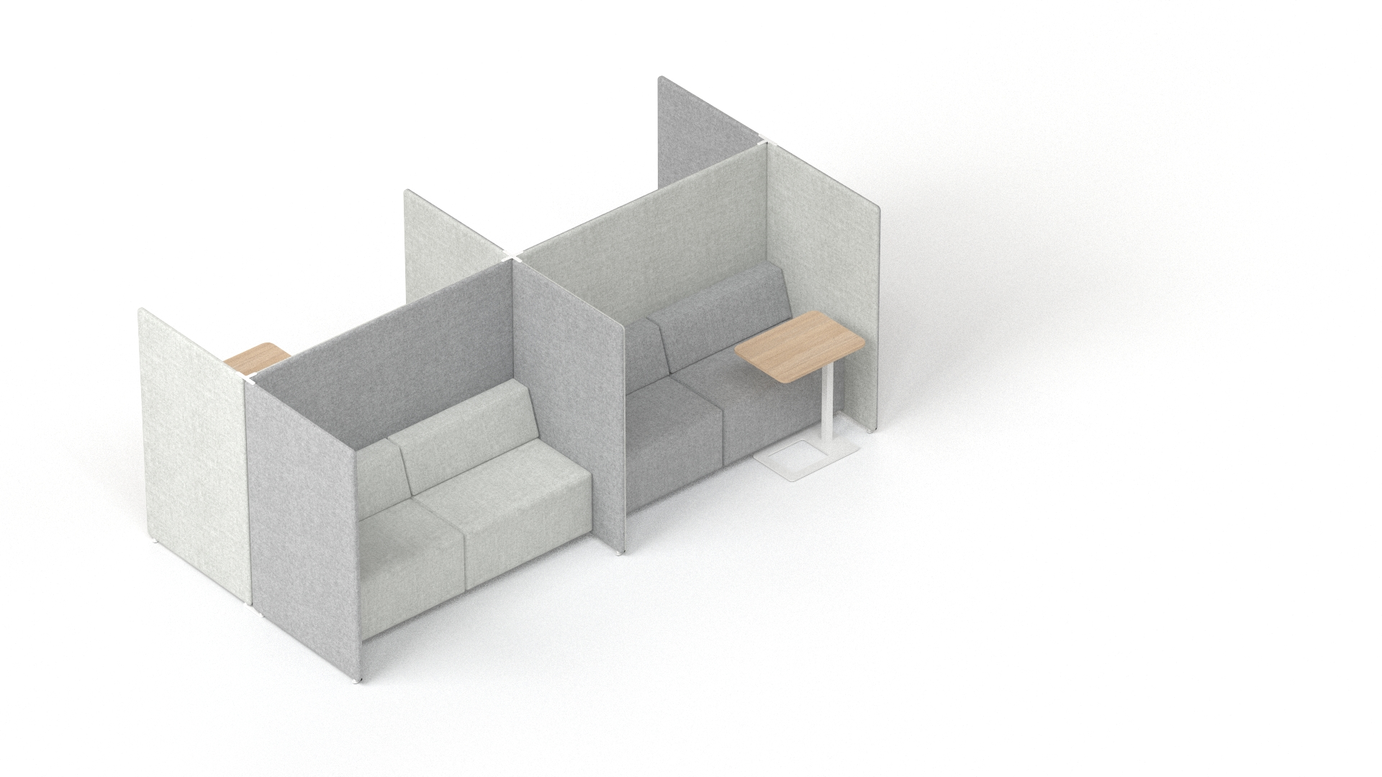
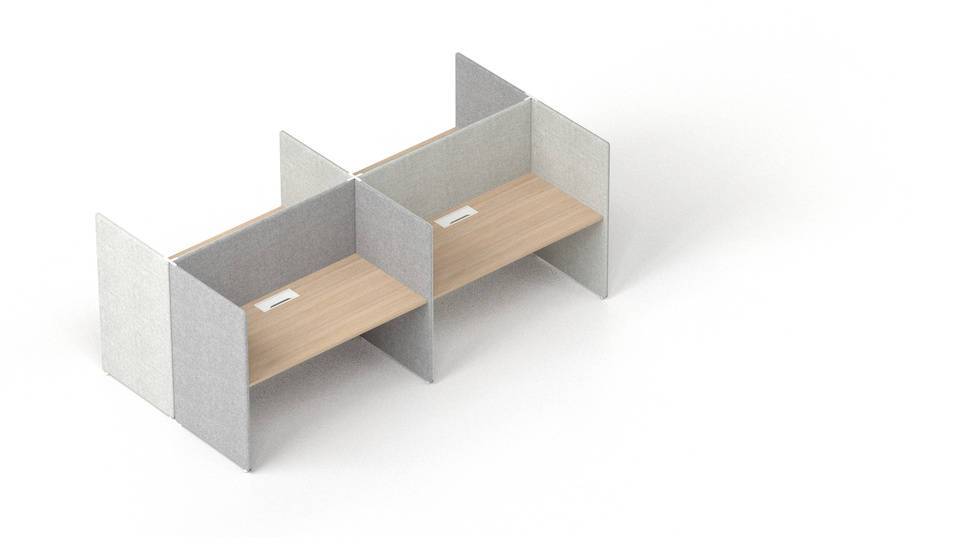
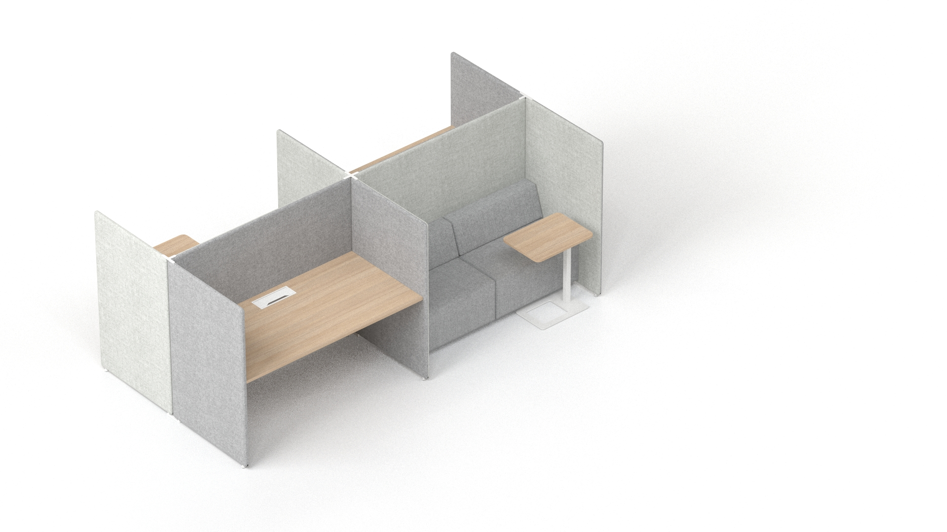
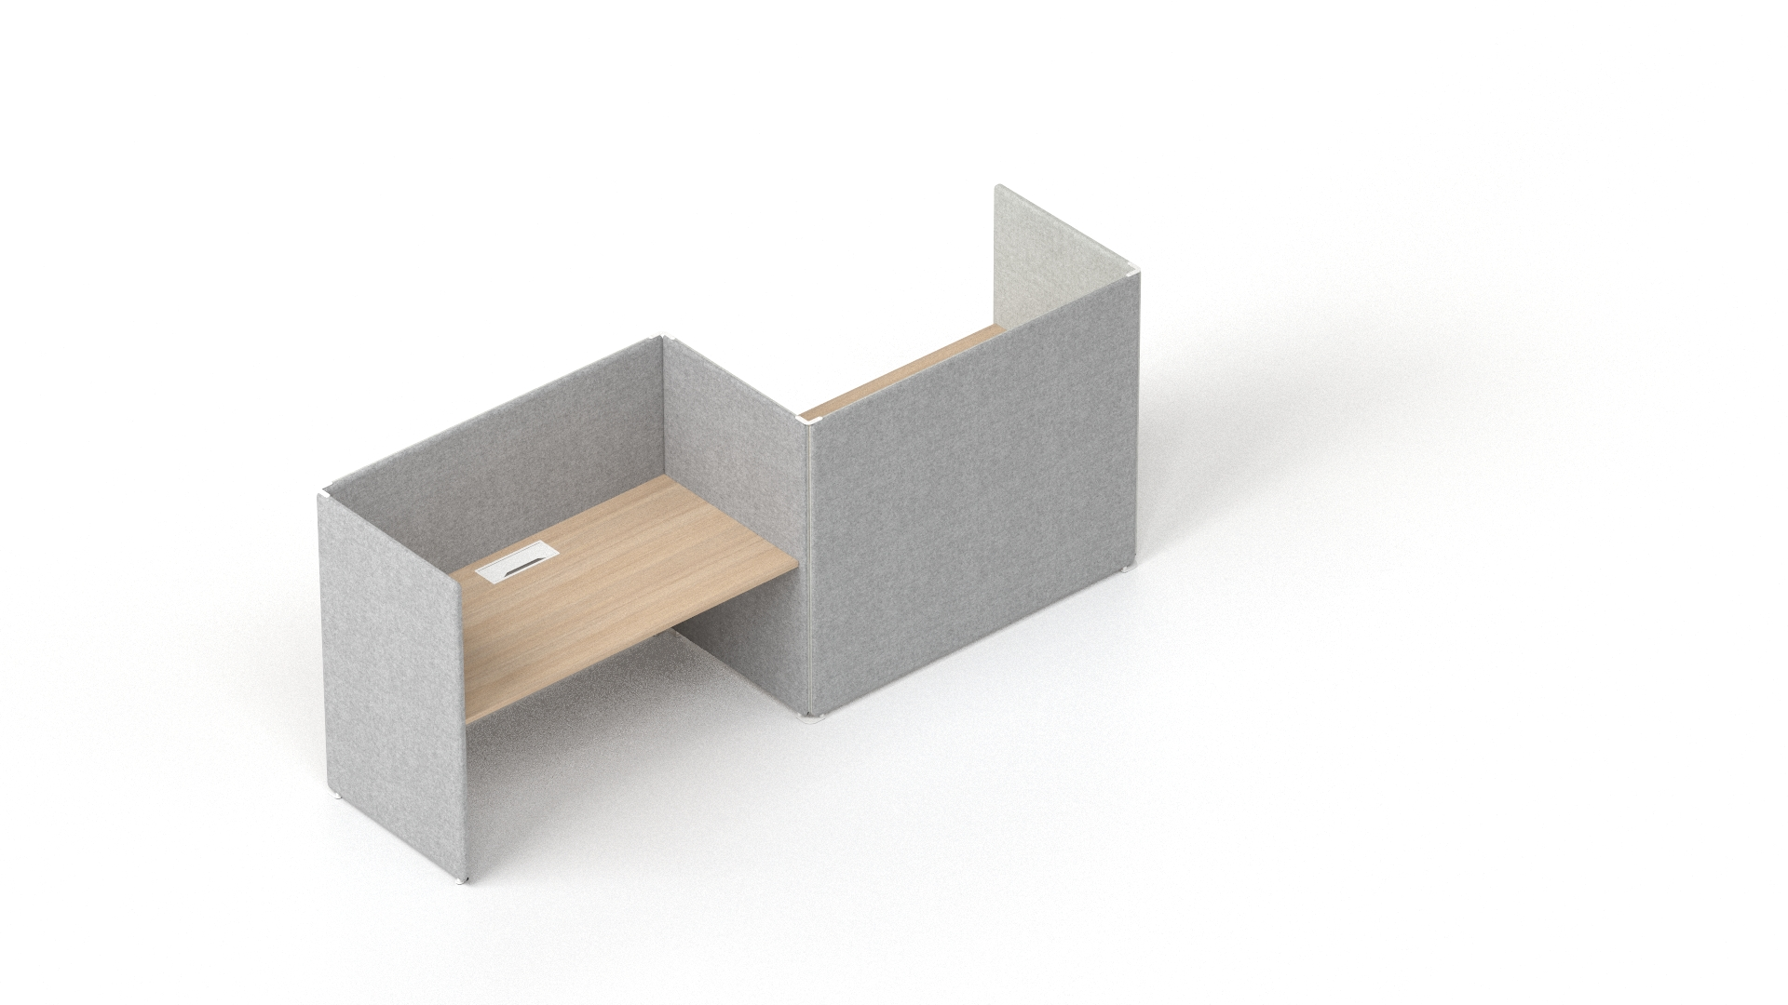
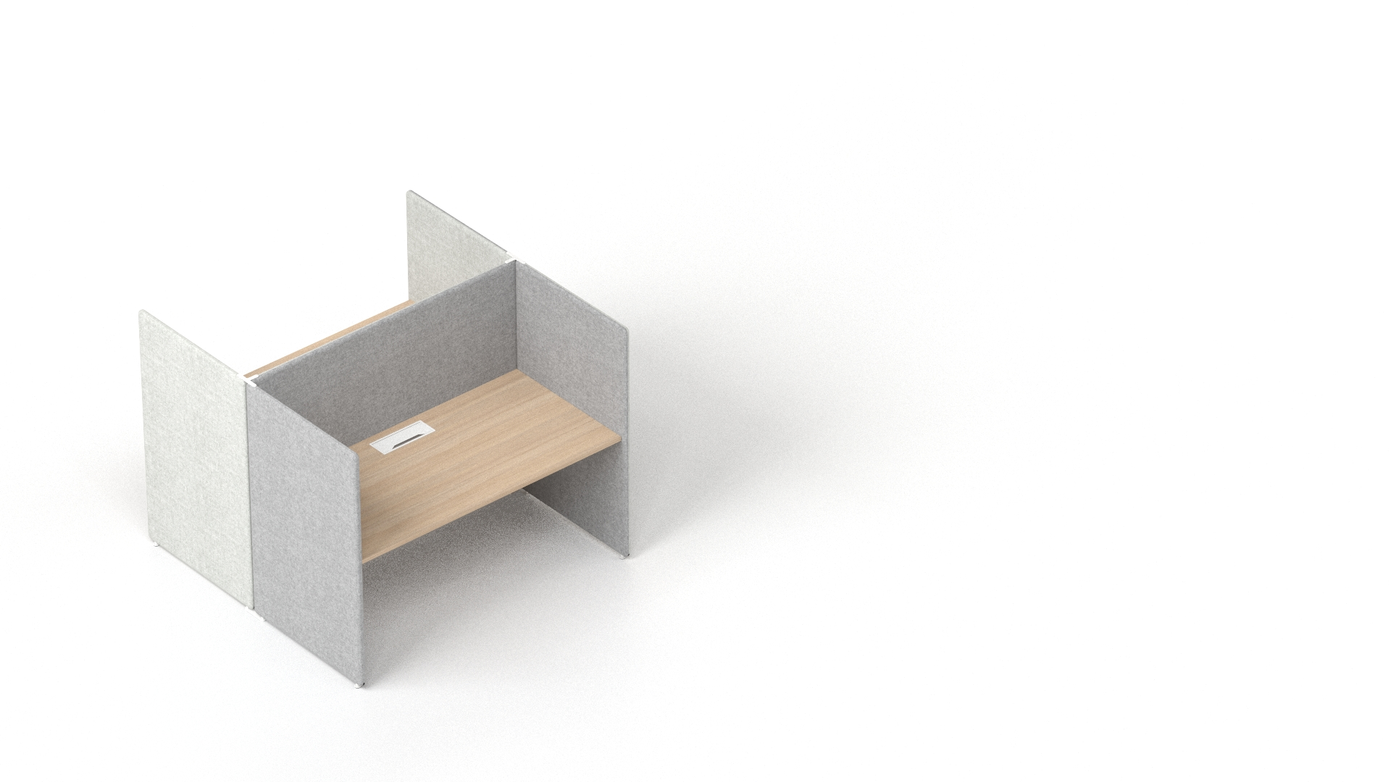
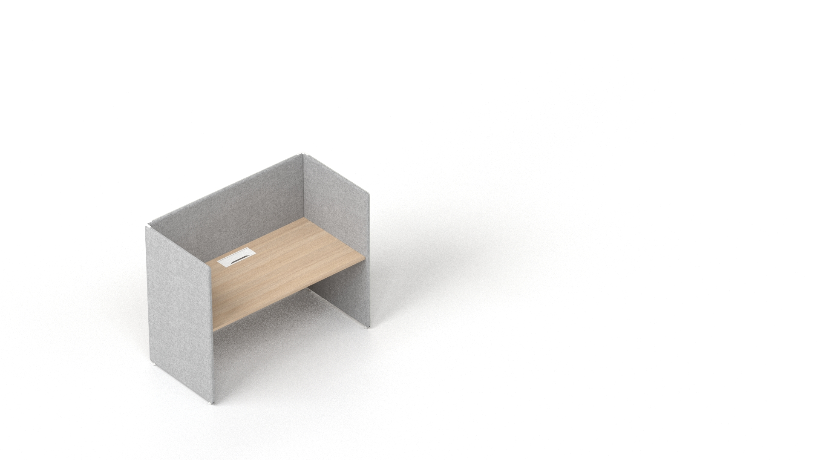
FROM PRIVATE MINI-ROOM TO COLLABORATION AREAS
A wide range of applications and configurations of these modular acoustic screens let you easily adapt the furniture to various office planning needs and working situations.
Notes:
A wide range of applications and configurations of these modular acoustic screens lets you easily adapt the furniture to various office planning needs and working situations. From private mini-rooms for concentration to collaboration areas for teamwork, this system provides a comfortable workplace, allows you to distance yourself from ambient noise, and opens up new "office-within-office" possibilities.
A variety of acoustic screen joints allows you to build different structures and gives freedom to form almost any desired workspace.

Slide 7
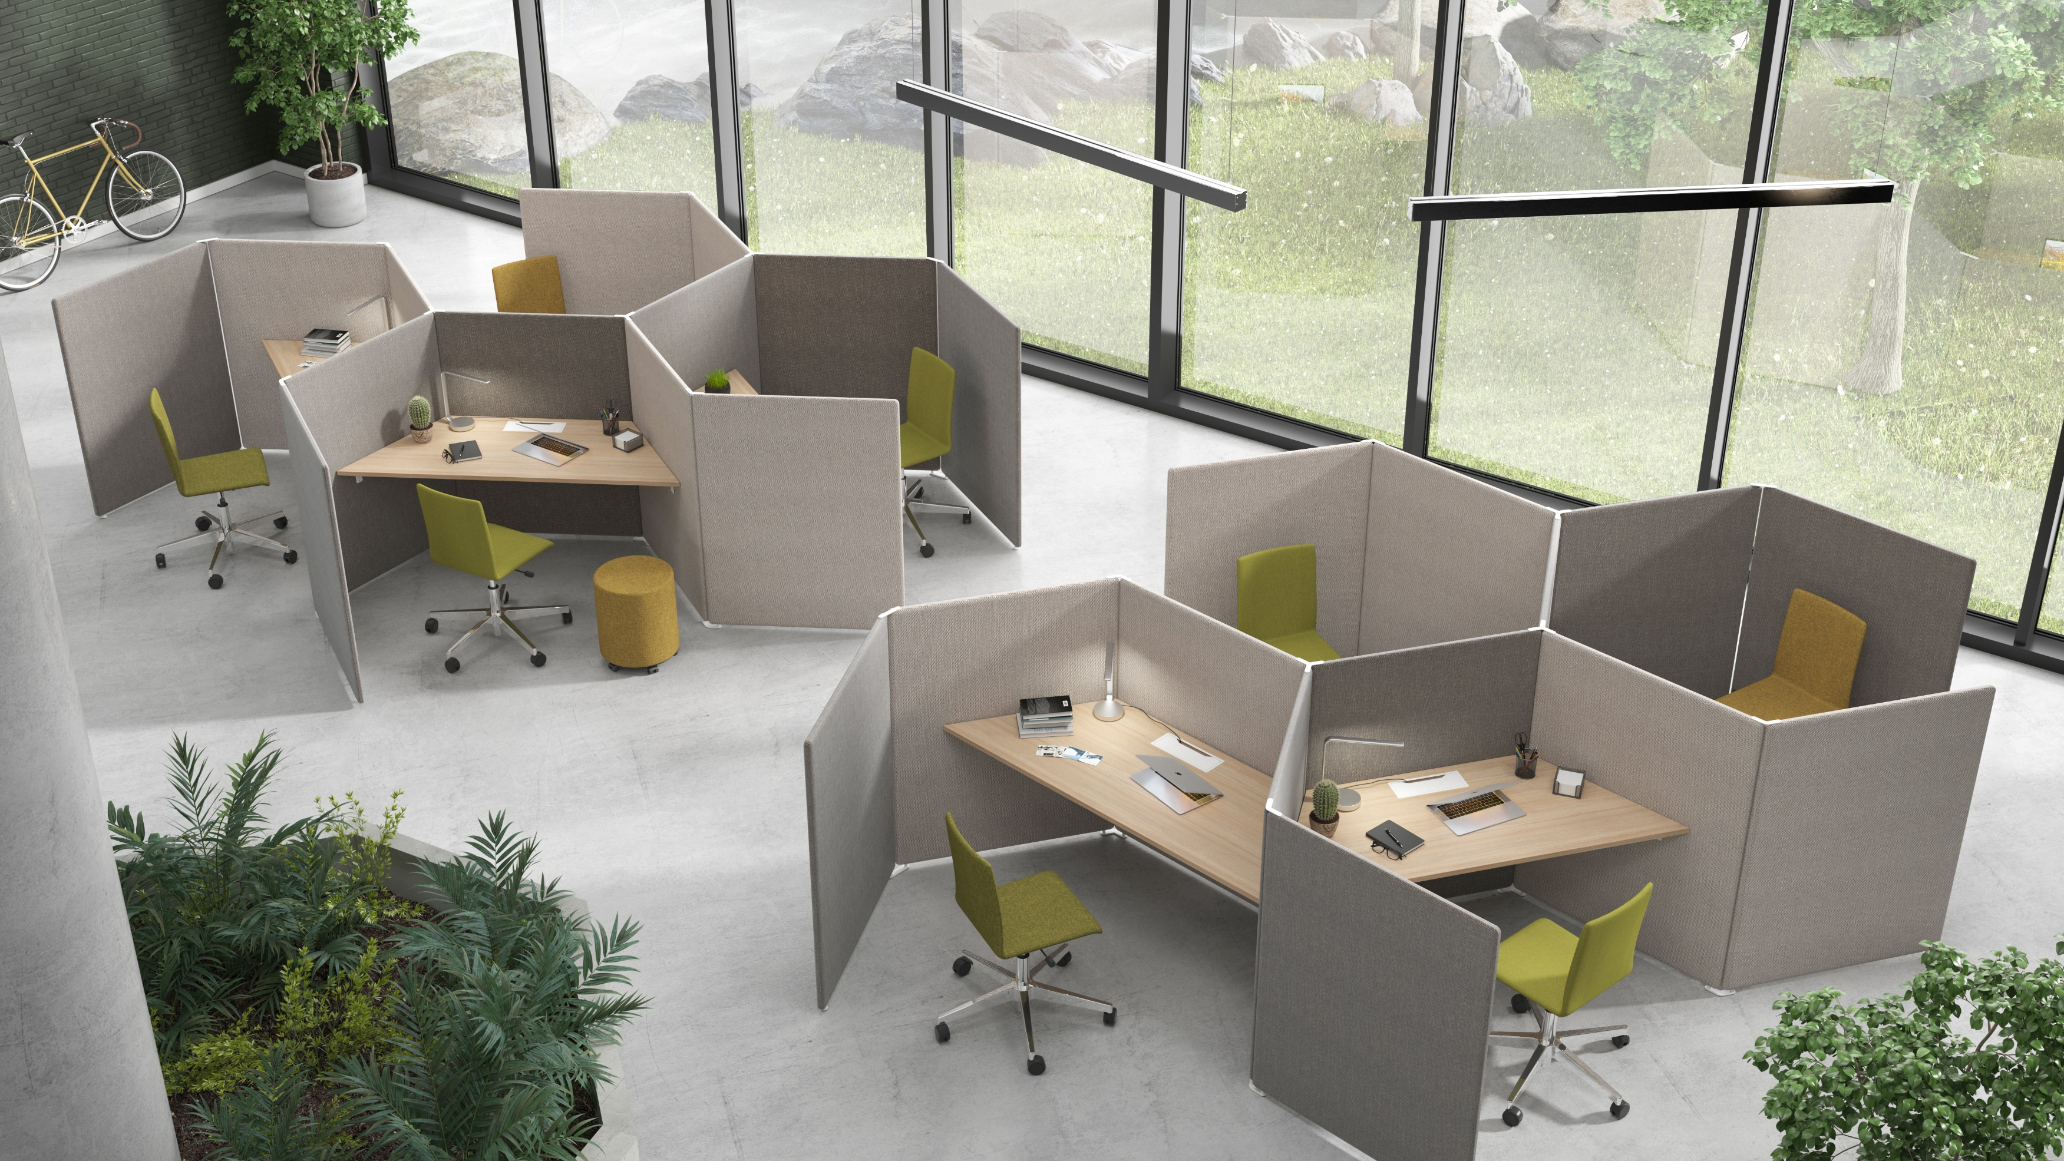

Slide 8
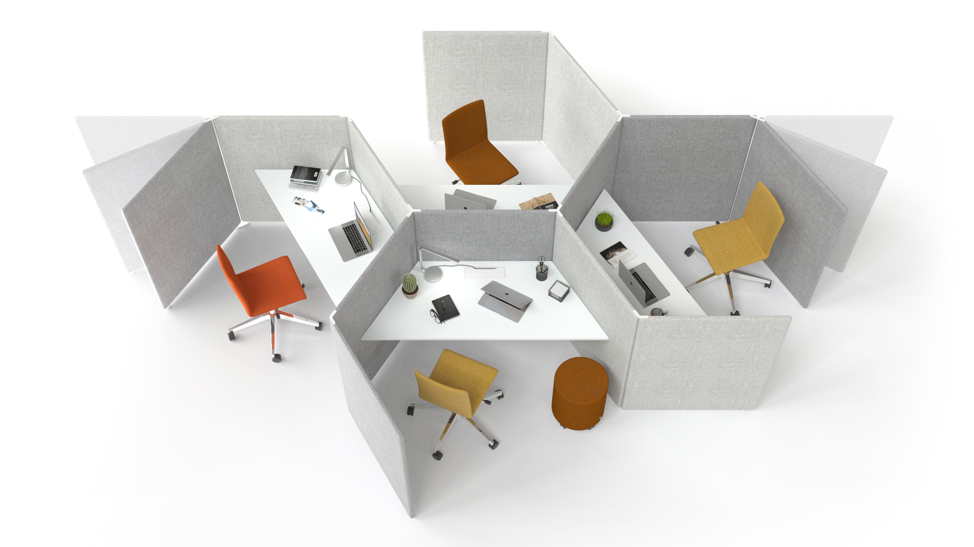
PRIVACY NEEDS
Depending on your chosen combination, you can create a spaces with different level of privacy

Slide 9
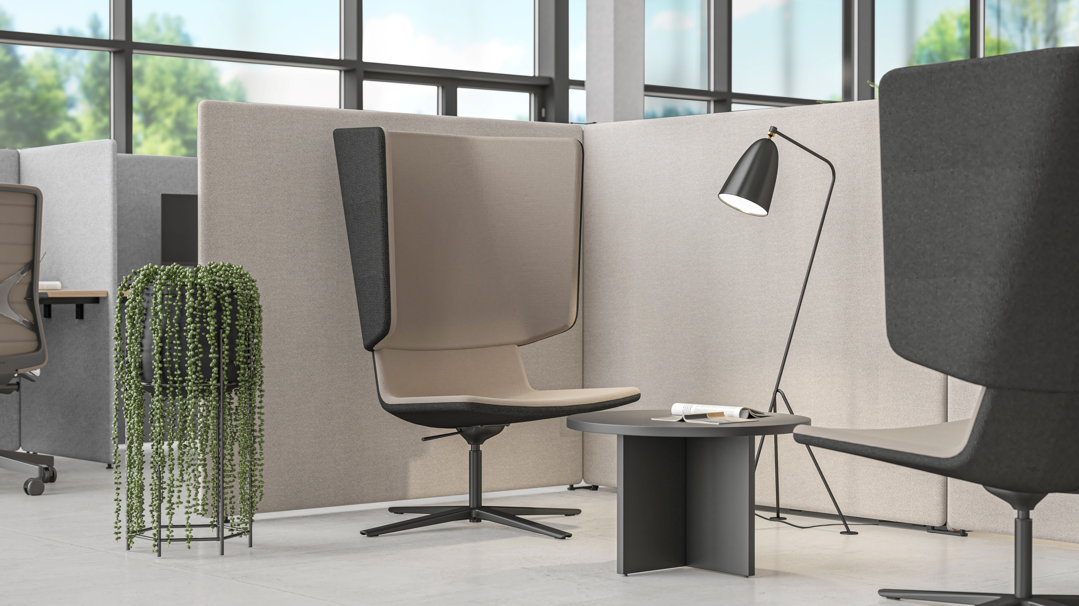

Slide 10
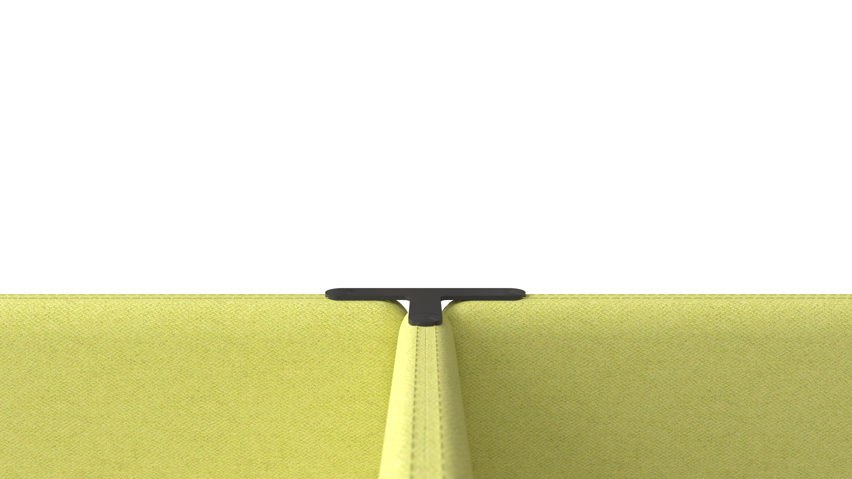
ACOUSTIC FEATURES FOR BETTER CONCENTRATION
MY SPACE allows you to concentrate or your work as you hear less distracting noises from the surrounding environmet, yet you hear what is happening around and do not feel separated.
Notes:
Proven acoustic characteristics
MY SPACE is a great choice to reduce the overall noise level of the office as the acoustic screens are filled with a special sound-absorbing foam and covered with upholstery of your choice. This product complies with acoustic class C and has been tested by an independent acoustics laboratory.

Slide 11
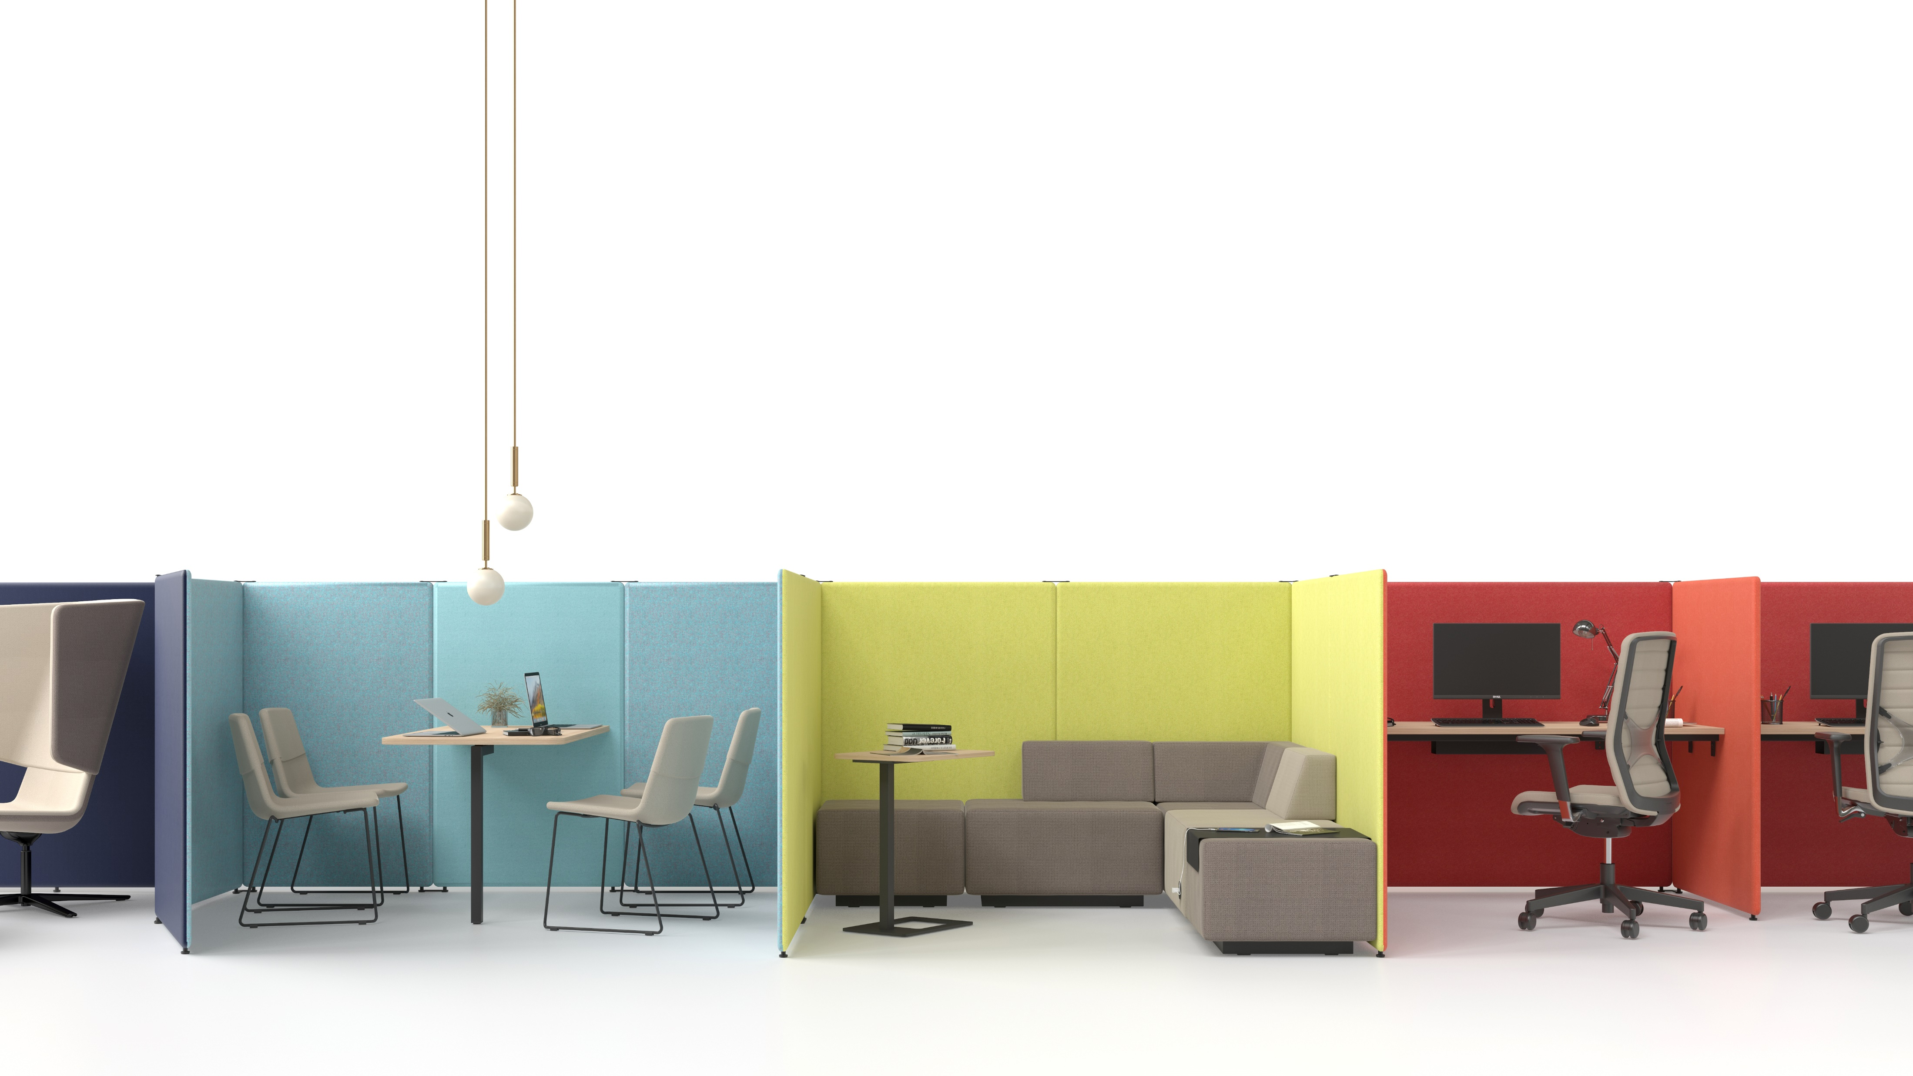
COLOURS WITH PURPOSE
Use your desired colour combinations to create individual spaces or indicate group workspaces.
Using different colours for individual workplaces, collaboration and socialization areas will serve different purposes: the need to be focused and productive, or the opposite, relaxed.
Notes:
Make your office stand out
Now you can choose different interior and exterior colors for MY SPACE screens. Use your desired color combinations to create individual spaces or group workspaces.

Slide 12
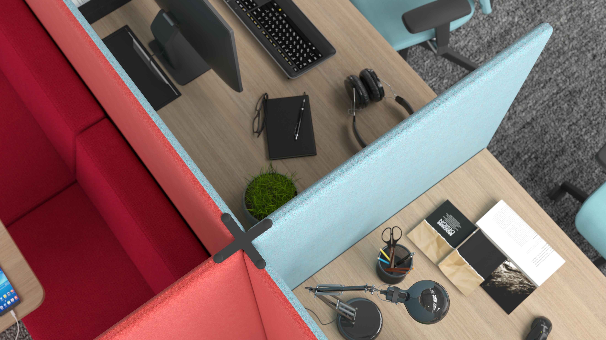

Slide 13
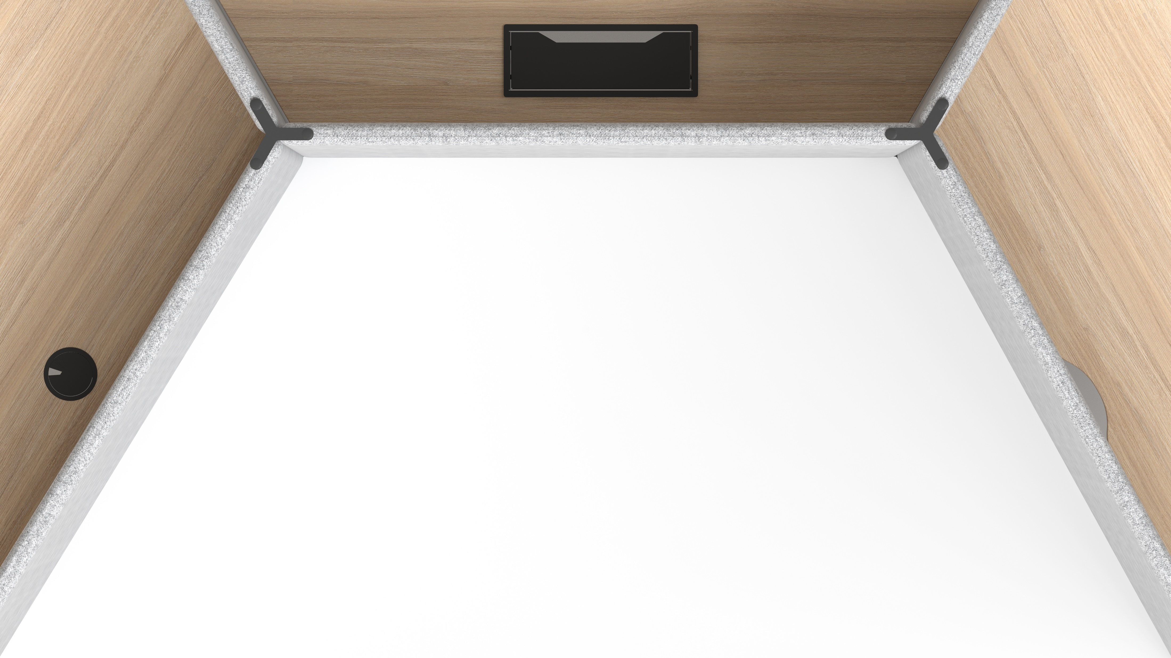
A WIDE SELECTION OF DEKSTOPS
Different size and shape desktops make MY SPACE a flexible solution for almost any working environment while height-adjustment function helps create a convenient workplace for individual tasks.
Notes:
A wide selection of desktops
Different size and shape desktops make MY SPACE a flexible solution for almost any working environment while height-adjustment function helps create a convenient workplace for individual tasks.

Slide 14
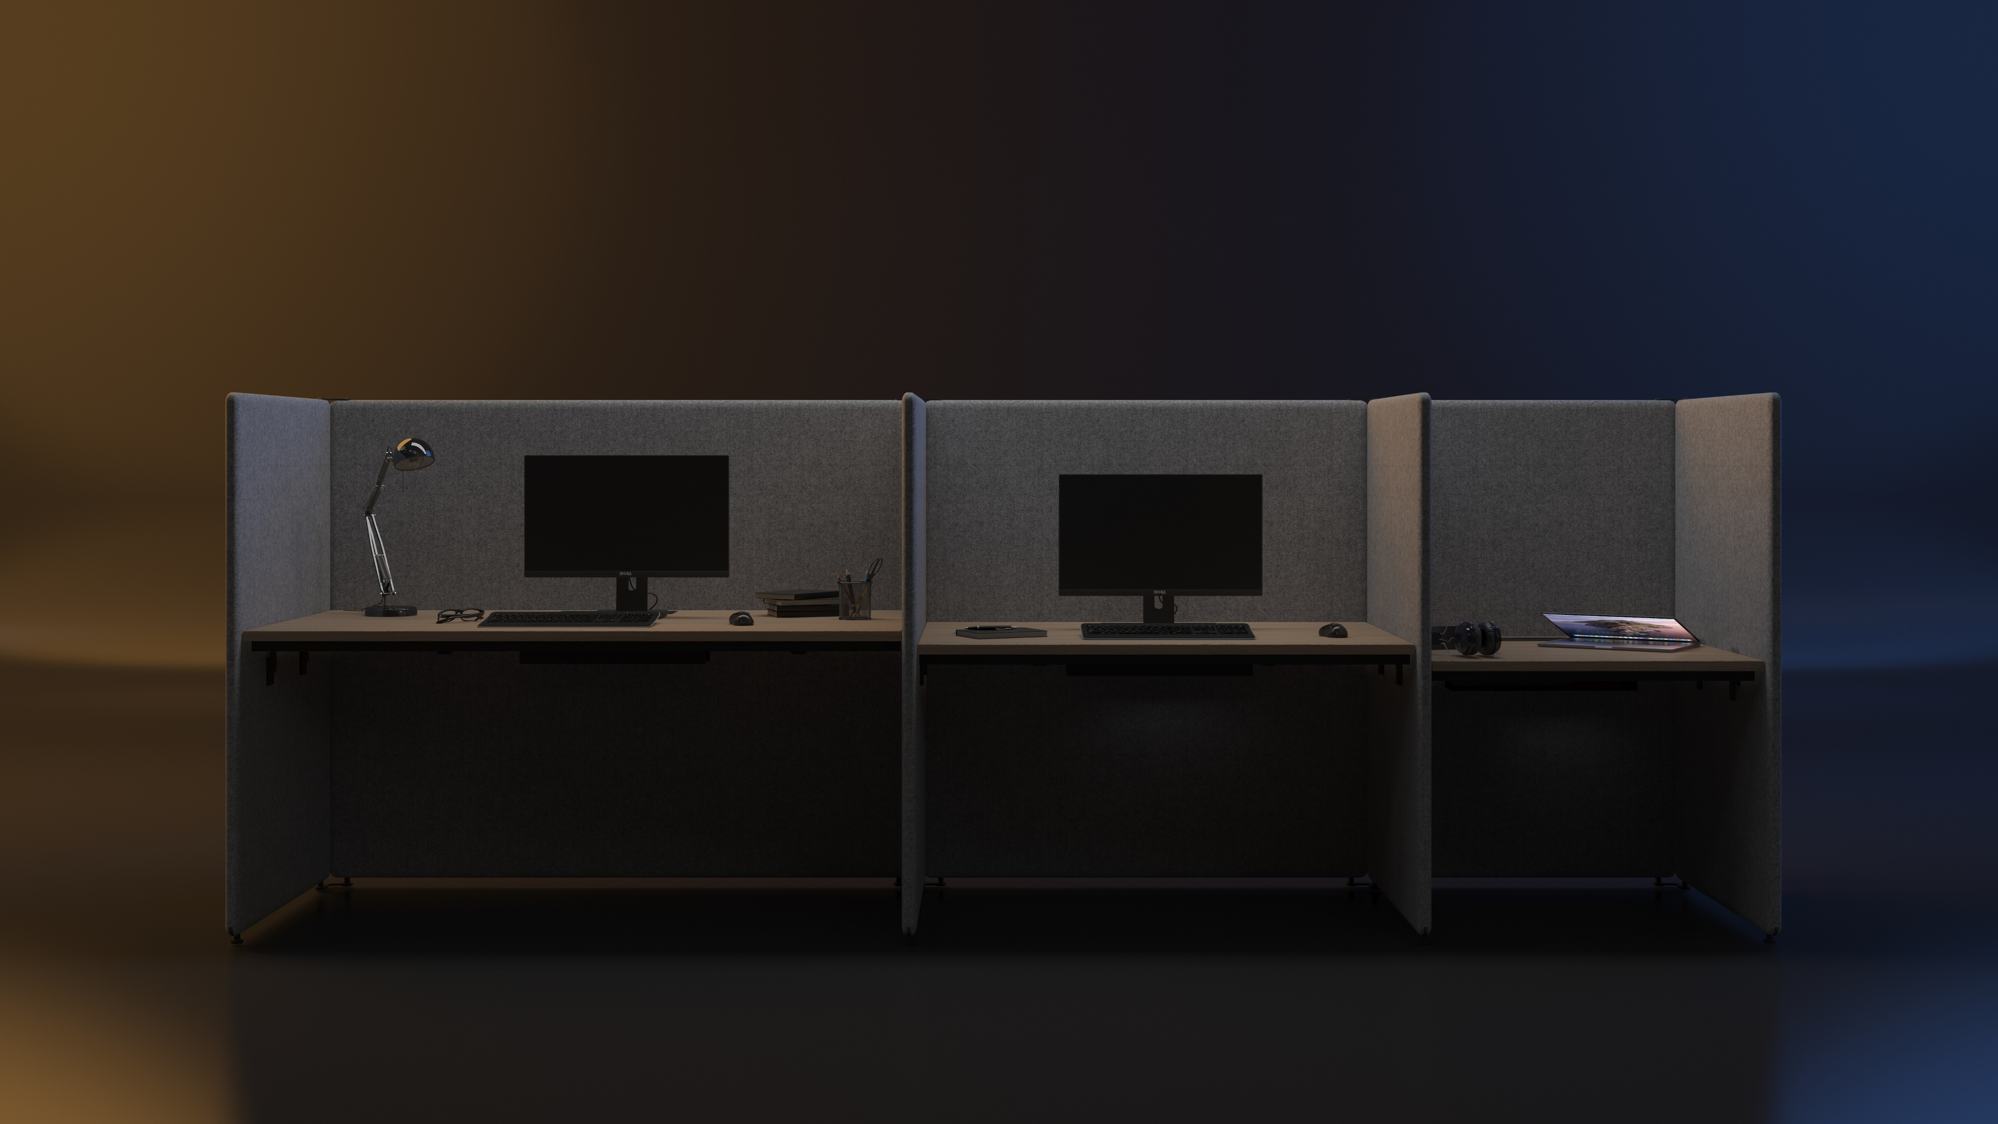
DIFFERENT SIZE FOR DIFFERENT APPLICATIONS
Notes:
MY SPACE acoustic screens are available in 5 different width (800mm, 1000mm, 1200mm, 1400mm, 1600mm) and 2 different height (1320mm, 1620mm) options.

Slide 15
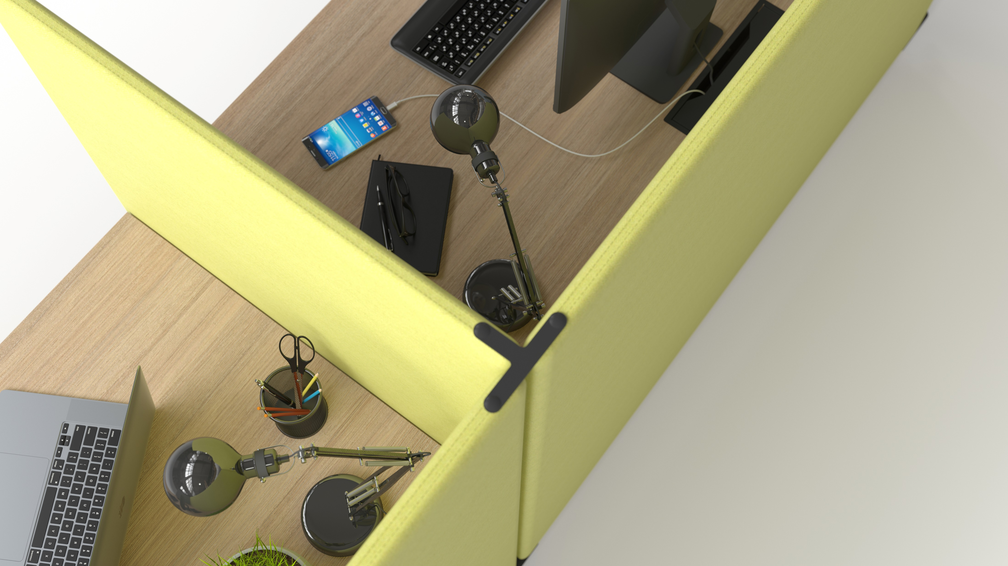
Expanded connectivity
Thanks to the modular construction, this acoustic furniture allows you to electrify up to 6 workplaces with a single power socket.
Notes:
Thanks to the modular construction, this acoustic furniture allows you to electrify up to 6 workplaces with a single power socket. In order to keep the working process as effective as possible, MY SPACE is available with a 3 socket power unit that can be used for standard power supply, USB, or LAN connection in different configurations.

Slide 16
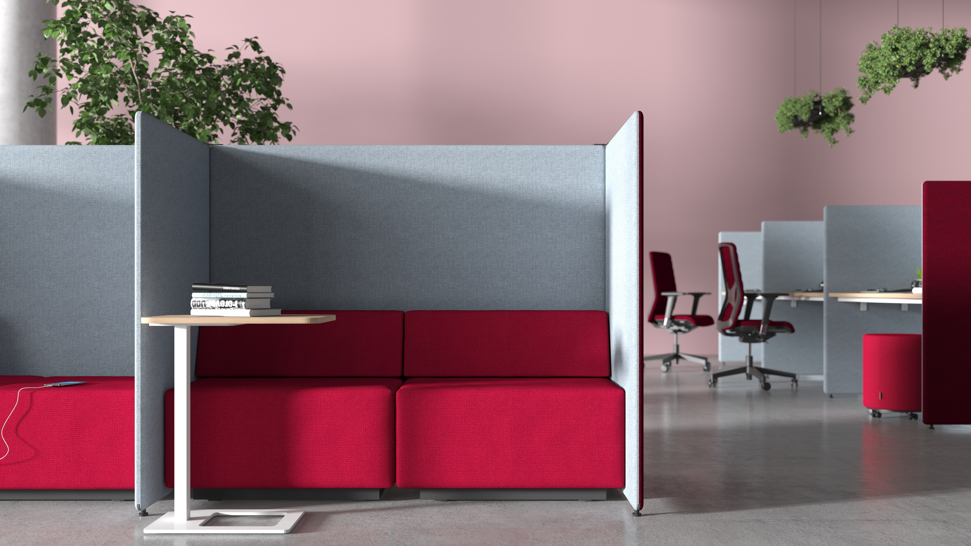

Slide 17
