Slide 1
OFY
Exceptionally cosy design embracing office spaces

Slide 2
OFY
Alegre Design
The creative philosophy of the studio is to inspire change through innovations and design, think and create not only what is expected today but also anticipate what people will need in the nearest future.
Notes:
The OFY chair collection was designed by the studio Alegre Design, whose creative philosophy is to inspire changes through innovations and design, to think and create not only what is expected today but also anticipate what people will need in the nearest future.
OFY is the first joint project between NARBUTAS and this studio. We particularly value the long-time experience of Alegre Design. We share common values and a responsible approach to the products we create. The studio sees design as a global concept that goes beyond style and can help create realistic solutions for a product’s life cycle, from the production process itself, the use of environmentally friendly materials, the sustainability of its manufacture to the efficiency of its use and the user experience.

Slide 3
OFY
Concept inspired by the resimercial design trend
Notes:
The idea for OFY was born in Marcelo Alegre’s head back in 2018, when the designer sensed a shift in the office seating market towards softer furnished spaces. With this intuition, Alegre Design started working on a new concept for a chair that would be easily adaptable to a variety of workspaces, while meeting the highest standards for the well-being of people and the planet. Creating a new type of office seating was no easy task. To achieve this, the design studio combined classic products, such as the traditional Michael Thonet Model Number 3 chair, with electronic products that use technological materials and technical fabrics, and added its signature style, which can be seen in the unique details. Alegre Design’s co-creation process with NARBUTAS has produced an excellent result – the OFY chair collection which is now more relevant than ever.
People want their workplace to feel like home, which is why resimercial design, combining two concepts: residential and commercial, is becoming popular in offices. Such interiors incorporate different design elements and are mainly aimed at creating a more comfortable and cosy office atmosphere. OFY successfully bridges this gap and creates a cosy environment that responds to changing workplace design preferences and improves the overall well-being and productivity of employees. With its delicate, soft shapes, cosy upholstery and excellent ergonomic qualities, the chair collection perfectly reflects this trend.

Slide 4
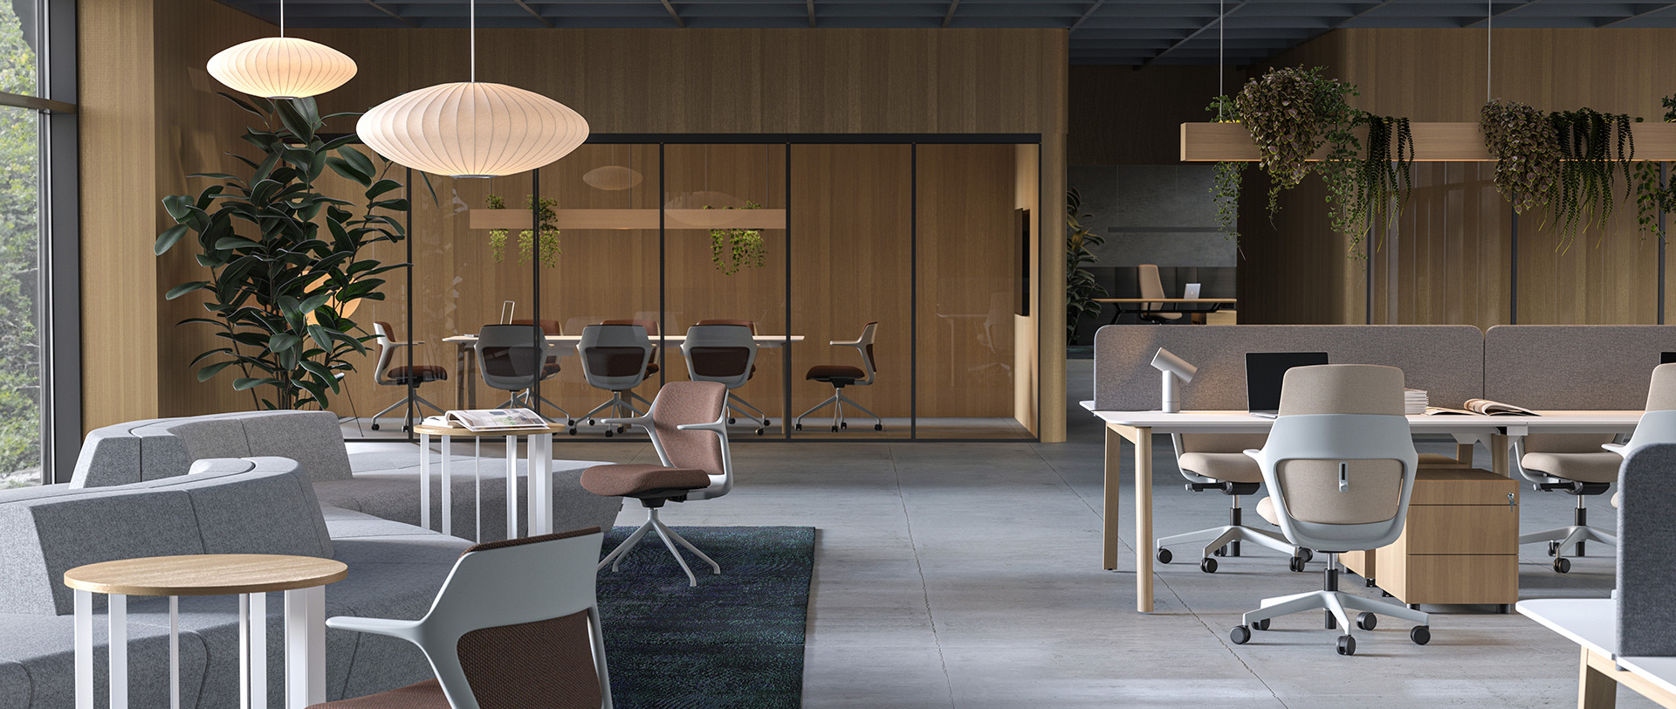
OFY is a wide collection of chairs with an exceptionally cosy design
Notes:
OFY is a wide collection of chairs with an exceptionally cosy design that meets the needs of a modern employee in different office spaces.

Slide 5
OFY
The chair collection consists of
Executive chairs
Task chairs
Visitor chairs
Notes:
The OFY collection consists of a very wide range of chairs – executive chairs, task chairs, low-back task chairs and visitor chairs.

Slide 6
Key features of the OFY chairs:
Exceptionally cosy design.
Wide range of applications in the office.
Meet the most important ergonomic needs.
Notes:
OFY’s design concept is, therefore, a synthesis of cosiness and adaptability to different environments. This collection meets the most important ergonomic needs of the modern workplace.

Slide 7
Exceptionally cosy design
Notes:
OFY was designed with great attention to detail.

Slide 8
OFY
Cosiness through synthesis of design elements
Notes:
Every detail has been chosen to contribute to a feeling of cosiness. Unlike most of our office chairs, OFY does not use a mesh for the backrest. The synthesis of the upholstered backrest and the soft, rounded-shape seat creates a sense of cosiness.

Slide 9
OFY
Recognisable collection thanks to its unique backrest frame
Notes:
All chairs in the OFY collection share a sculptural backrest frame that seems to embrace the chair from behind. This makes them easy to mix and match in different spaces while maintaining a consistent style.

Slide 10
OFY
Frame, armrests and base form a seamless look
Notes:
The frame of the OFY chair comes in two colours – black and grey. It can be paired the armrests and base in the same colour, giving the chair a seamless look. You can also create any mood you want by choosing fabrics for the upholstered part, and you can match the chairs to other upholstered furniture in the office, such as desk screens and soft furniture.

Slide 11
Wide range of applications in the office
Notes:
The main challenge for the designer in designing and developing OFY was to create such a wide range of chairs that would suit different environments and people.

Slide 12
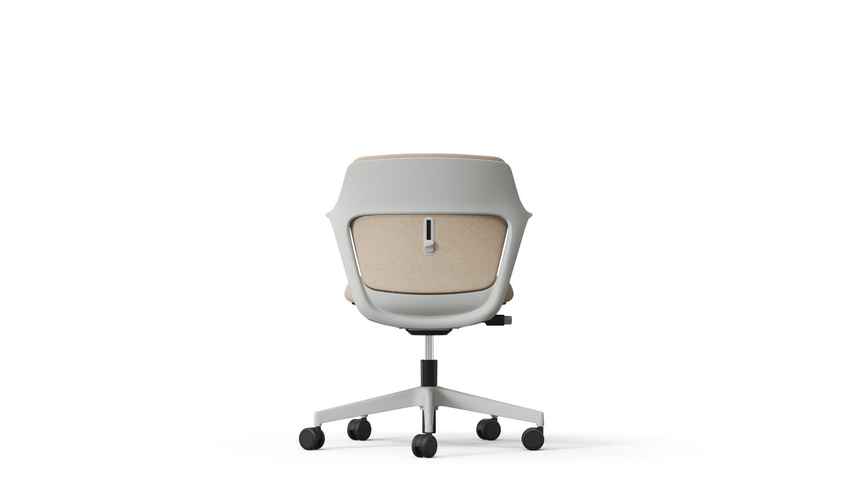
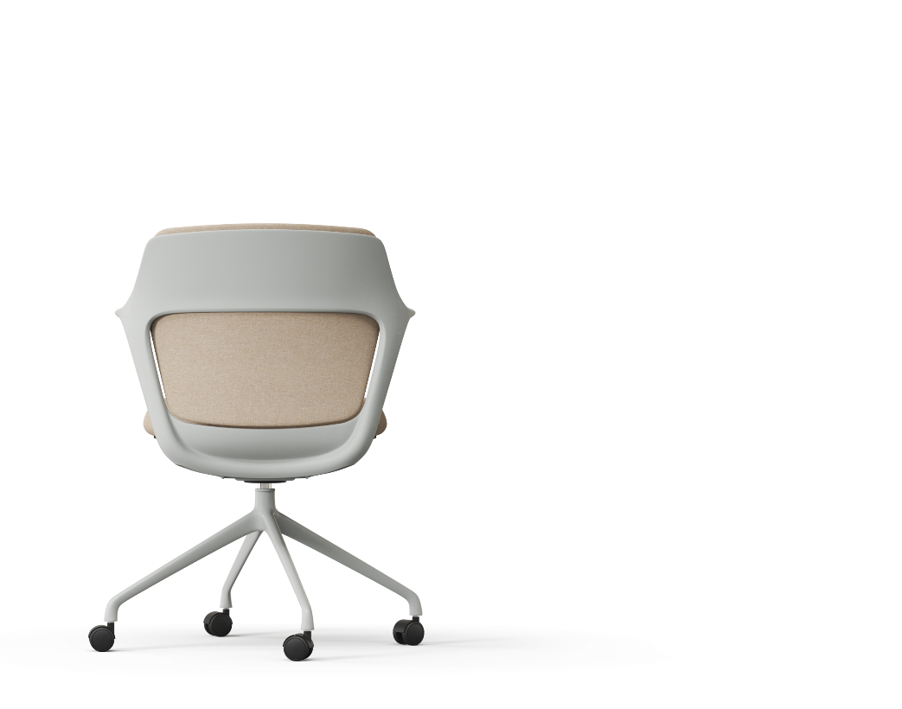
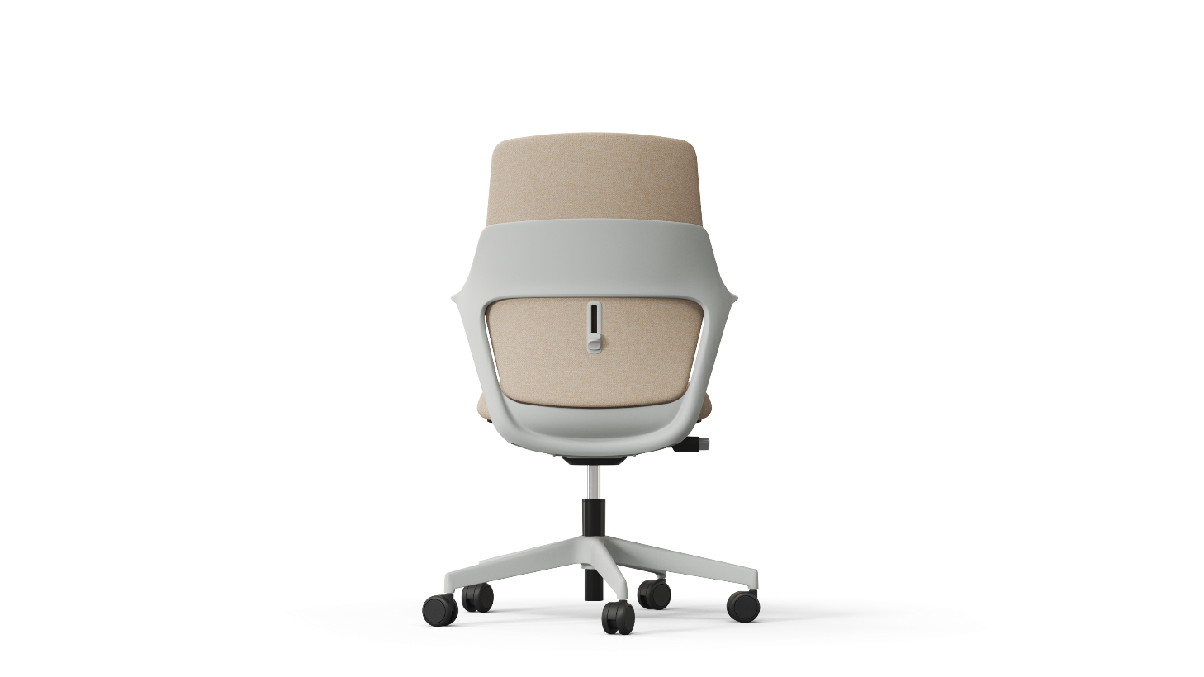
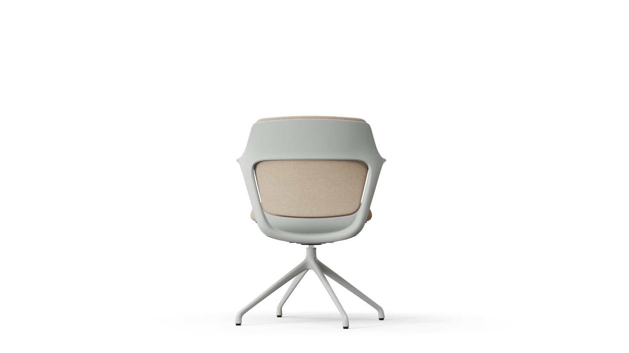
OFY
The chair that flows through any space
Notes:
A simple, minimalist frame characterises the entire collection. The same frame is suitable for chairs in three heights.
The collection includes two types of task chairs – with a traditional backrest and a low backrest – as well as an executive chair and visitor chairs that have a pyramid-shaped base with glides or castors. With such a wide choice, the OFY collection can be used in many different spaces.

Slide 13
OFY
Notes:
The OFY task chairs with a traditional backrest are ideal for team workplaces in open-plan offices,

Slide 14
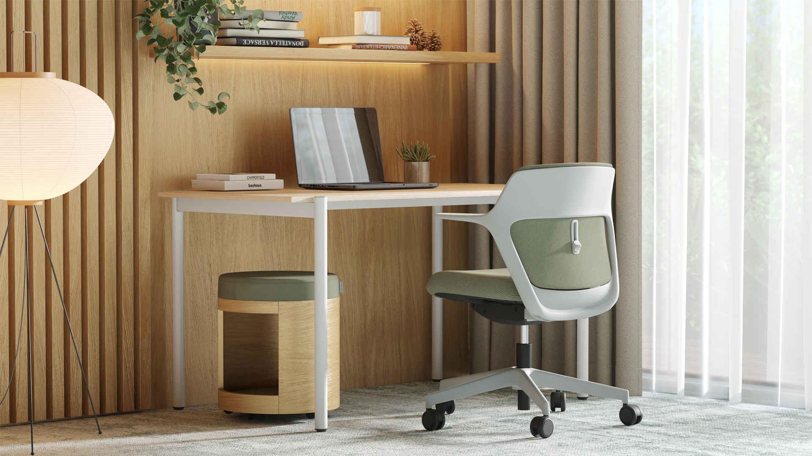
OFY
Notes:
while the low-back task chairs are a good choice for smaller boutique-style offices where a sense of cosiness is essential.

Slide 15
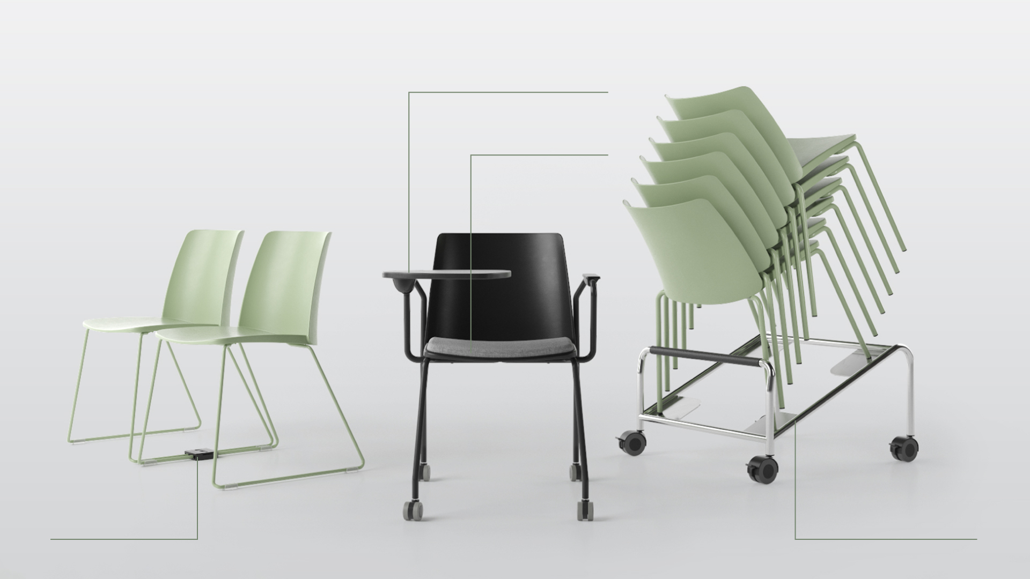
OFY
POLYTONE
Notes:
For the manager’s workspace, you can use different types of chairs, i.e. not only an executive chair, but also visitor chairs with a pyramid-shaped base with glides, because guests sit here for a short time and do not have a need for greater mobility.

Slide 16
OFY
OFY
Notes:
Visitor chairs with castors are ideal for meeting rooms, allowing employees to enjoy greater freedom of movement, as they sometimes spend several hours there. You can also mix and match different OFY task and executive chairs if it is needed.

Slide 17
OFY

Slide 18
Meeting the most important ergonomic needs
Notes:
OFY is more than just a chair with a distinctive design, easily adaptable to different interiors. It has all the essential features to meet today’s ergonomic needs. Each user is able to choose the most suitable chair components to achieve the desired level of comfort.

Slide 19
OFY
Easy adjustment of the task chair
Adjustable lumbar support;
Seat depth adjustment;
1D/3D adjustable armrests;
Synchronous mechanism;
Weight-sensitive mechanism.
Notes:
The OFY task chair has all the necessary functions which are easy to use.

Slide 20
OFY
Prioritising health and comfort
Synchronous mechanism that automatically adjusts to the body weight.
Fixed or depth-adjustable seat.
Five lockable backrest positions.
Notes:
When designing this chair, we took into account what is most needed to feel comfortable when sitting for extended periods of time. An integrated synchronous mechanism that automatically adjusts to the body weight helps ensure an ergonomic sitting position. You can choose a chair with a fixed or depth-adjustable seat. The user can also lock the five most comfortable backrest positions.

Slide 21
OFY
Subtly integrated adjustable lumbar support
Notes:
To give your spine even more support and enable you adjust the chair to your comfort level, we have subtly integrated an adjustable lumbar support into the executive and task chairs. The smooth-moving lumbar support can be adjusted with a minimalist button.

Slide 22
OFY
For the comfort of office visitors and meeting participants
The tilt mechanism ensures easy and comfortable reclining and the backrest’s smooth return to the vertical position when the user does not lean back or stands up.
Notes:
Although we usually spend less time in visitor and conference chairs than in task chairs, we made sure that you will be just as comfortable when you do. The OFY visitor and conference chairs have a built-in tilt mechanism that allows the user to sway gently and feel more relaxed.

Slide 23
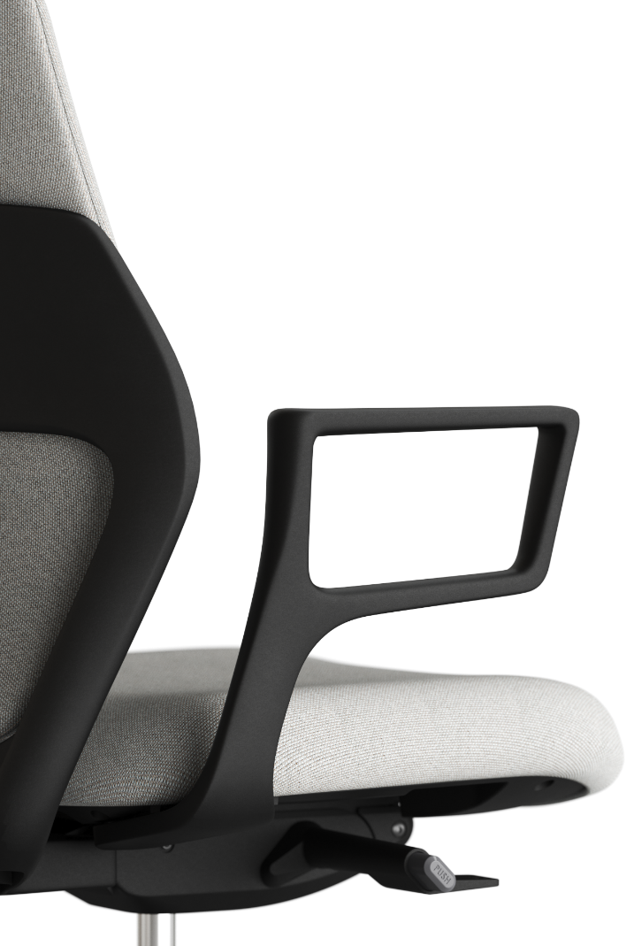
OFY
Armrests with different designs and functionalities
Non-adjustable
Non-adjustable
Adjustable 1D/3D
Notes:
A broad selection of armrests will make it easy to find the right solution for different workspaces. The two types of non-adjustable armrests have a graceful and elegant design. They are available with all types of chairs. If you want to be able to adjust the armchairs to find the most comfortable position for your arms, you can choose between 1D (moves up/down) and 3D (moves up/down, forwards and backwards, sideways up to 30°) adjustable armrests. These armrests are available with executive and task chairs.

Slide 24
Sustainability
Notes:
Sustainability is one of NARBUTAS long-term strategic directions. The OFY chairs are manufactured in a modern factory using 100% green, that is renewable, energy.

Slide 25
OFY
Green facts
Certified upholsteries
All of the upholsteries we use are certified according to environmental certifications – the Oeko-Tex Standard 100 and EU Ecolabel.
Sustainable product end-of-life management
Up to 90% of the chair’s components can be disassembled, sorted and recycled.
Notes:
Let’s talk briefly about the key sustainability indicators for the OFY chair. The OFY chair is made using 8–28% recycled materials. The upholsteries used to cover the chair are certified according to environmental certifications – the Oeko-Tex Standard 100 and EU Ecolabel. We designed OFY to be long lasting, and the fact that the chair has the basic adjustments ensures that it will be comfortable and used for a long time. However, when the chair becomes no longer needed, you can ensure its sustainable end-of-life management by disassembling it up to 90% and recycling its parts.

Slide 26
Range

Slide 27
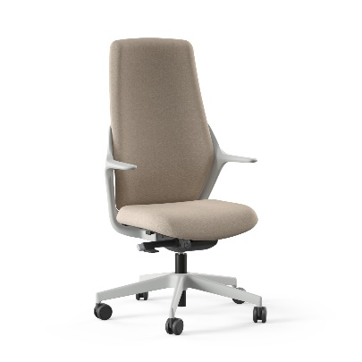
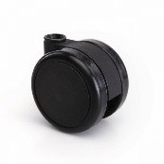
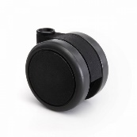
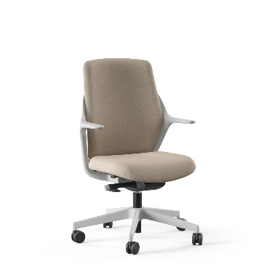
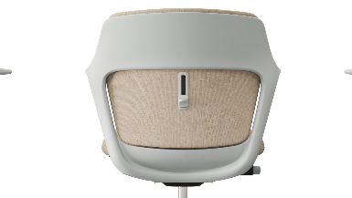
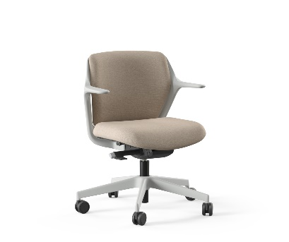
OFY
Chair | Frame colour | Base | Lumbar support | Armrests (optional) | Castors
With brakes
Plastic five star
Integrated
Executive chairs
Cast polished aluminium five star
For soft floors
For hard floors
With integrated back support
Without brakes
Fixed
Task chairs
Plastic five star
For soft floors
For hard floors
Cast polished aluminium five star
Adjustable 1D/3D
Low-back task chairs

Slide 28
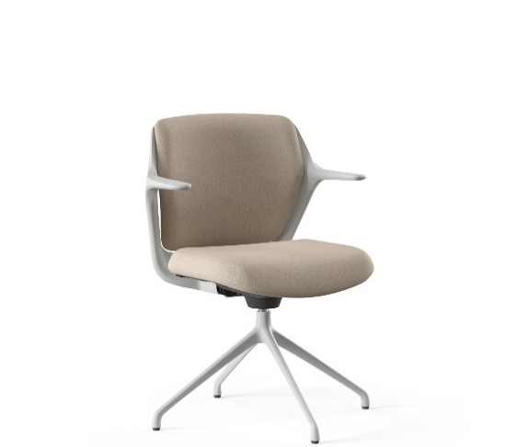
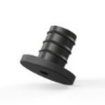
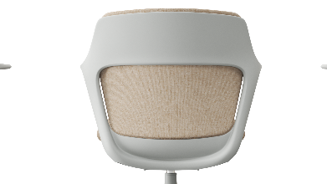
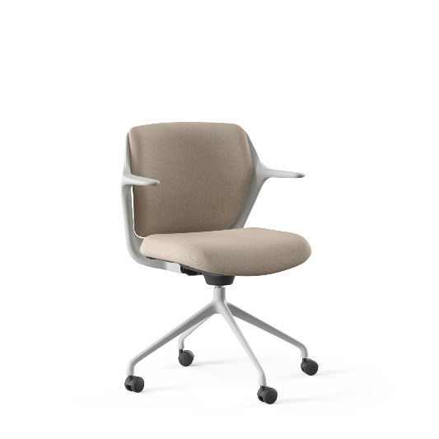
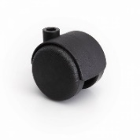
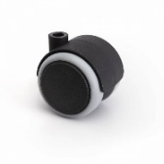
OFY
Chair | Frame colour | Base | Lumbar support | Armrests (optional) | Castors
Glides
Powder-coated pyramid-shaped aluminium base
For soft floors
For hard floors
Integrated
Without integrated back support
Without brakes
Powder-coated pyramid-shaped aluminium base
Fixed
For soft floors
For hard floors
Visitor and conference chairs

Slide 29
OFY
OFY stands for ‘Only For You’. When designing the chair, we tried to ensure that it could be used by different companies in different architectural spaces and that each employee could have ‘their own’ chair.
Marcelo Alegre

Slide 30
narbutas.com

