Slide 1
PLANA
Executive Collection

Slide 2
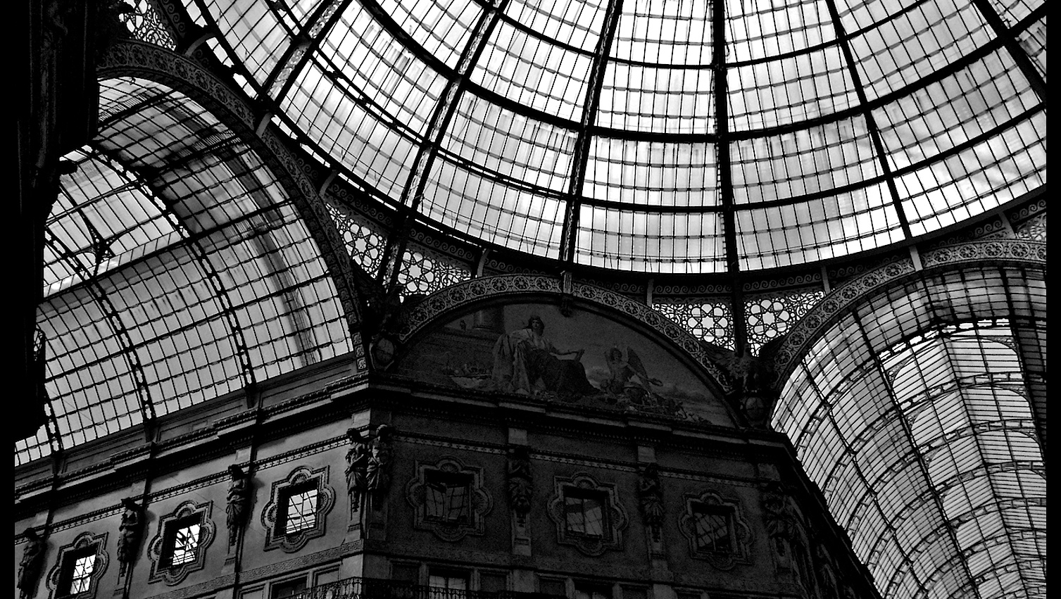
PLANA
character

Slide 3
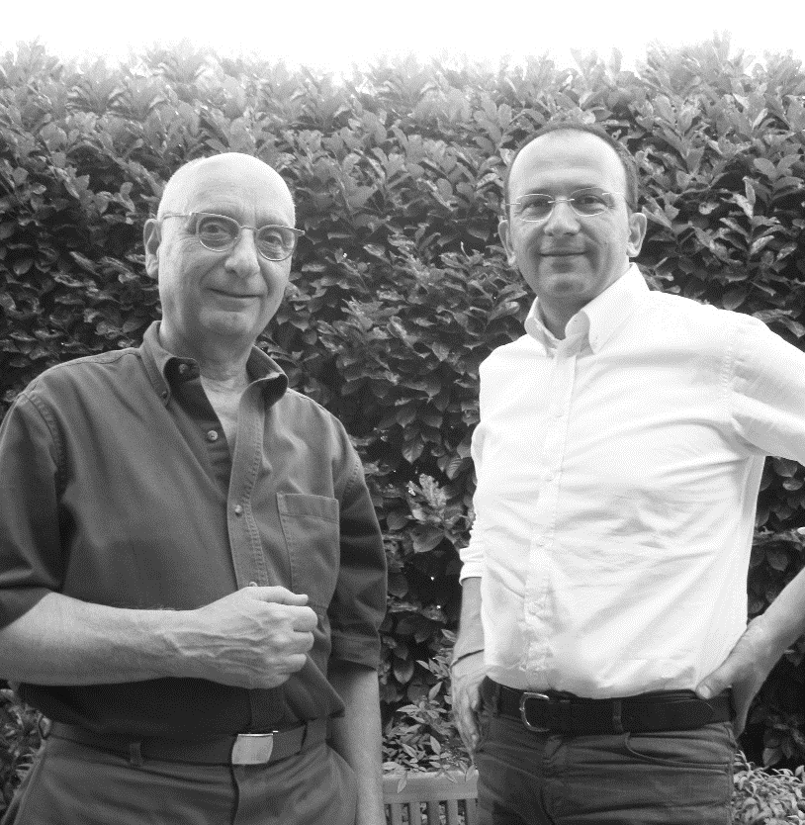
LUCCI & PAMPANONI
Authors - Italian design masters
Roberto Lucci and Paolo Pampanoni
‘Straight lines, squared shapes, different thicknesses, warm, refined materials and finishings.
PLANA IS A CLEAN, SELECTIVE COLLECTION.
An essential design approach that meets aesthetic and functional choices.’

Slide 4
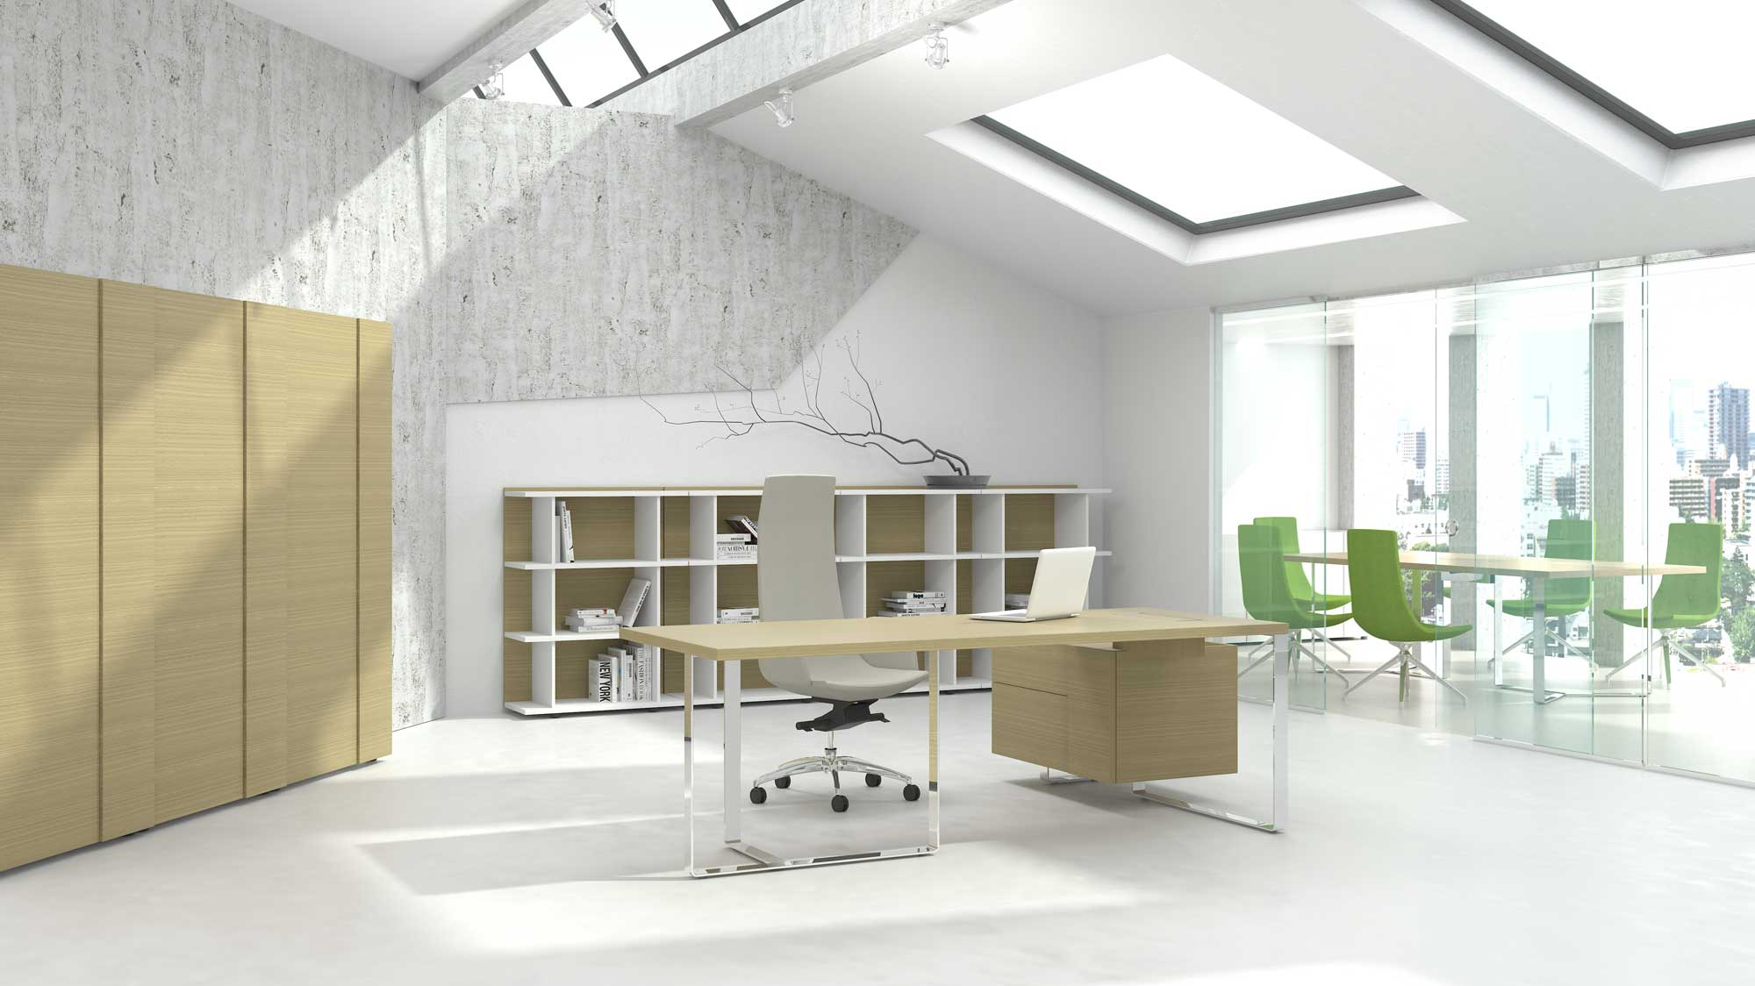
PLANA –
a modern, selective high-quality furniture collection.

Slide 5
Outstanding character of PLANA
‘Professional, aesthetic and functional design solutions create a sense of luxury.’
Squared shapes
Combinations of different thicknesses
Harmony of straight and curved lines
Wide choice of textures and combinations
Warm, refined materials and finishes
Exceptional attention to details
Modern, clean design
PLANA is created for those who appreciate modern luxury and high quality.

Slide 6
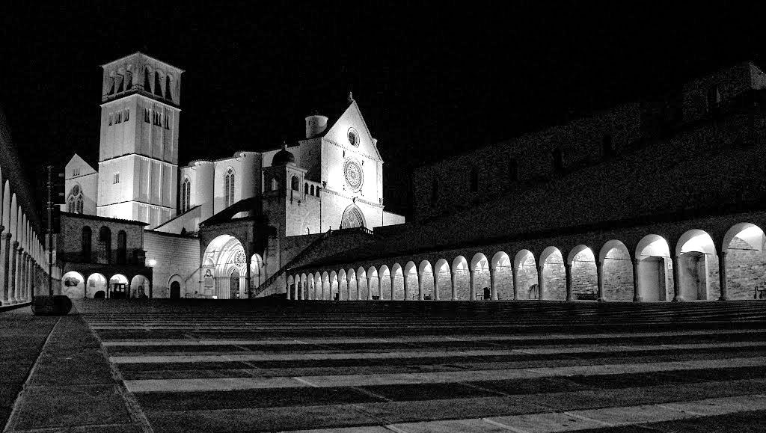
PLANA
collection

Slide 7
PLANA selective collection - range
A wide range allows to satisfy various demands offering different furniture combinations and creating a comfortable executive work space.
Types of furniture:
EXECUTIVE TABLES (8 versions)
SUPLEMENTARY UNIT
PEDESTALS (4 versions)
OPEN SHELF UNITS (3 versions)
STORAGE CABINETS (3 versions)
WARDROBE
MEETING TABLES (3 versions)

Slide 8
Executive tables
Solid, 36/37 mm thick tabletop. High quality wood veneer or impact-resistant melamine, combinations.
1800/2200 x 900 mm, height H = 750 mm.
L/H (left) or R/H (right).
Elegant bended steel band legs painted using the powder-coating technology or covered in chrome.
Grommet with soft closing, metal frame
and box for wire management.
Option with fixed 900 mm length pedestal.
Optional supplementary unit.
PLANA

Slide 9
Executive tables
R/H (right)
1800x900, H=750
(BPA180)
2200x900, H=750
(BPA220)
L/H (left)
1800x900, H=750
(BPA181)
2200x900, H=750
(BPA221)
R/H (right) with
modesty panel
1800x900, H=750
(BPA182)
2200x900, H=750
(BPA222)
L/H (left) with
modesty panel
1800x900, H=750
(BPA183)
2200x900, H=750
(BPA223)

Slide 10
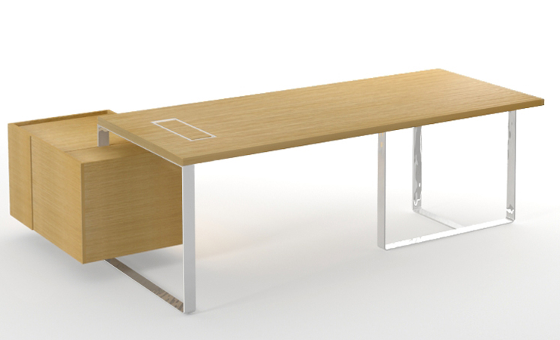
Executive tables with fixed pedestal
R/H (right)
(as BPF900)
2040x1500, H=750
(BPA200)
2440x1500, H=750
(BPA240)
L/H (left)
(as BPF901)
2040x1500, H=750
(BPA201)
2440x1500, H=750
(BPA241)
R/H (right) with
modesty panel
(as BPF900)
2040x1500, H=750
(BPA202)
2440x1500, H=750
(BPA242)
L/H (left) with
modesty panel
(as BPF901)
2040x1500, H=750
(BPA203)
2440x1500, H=750
(BPA243)

Slide 11
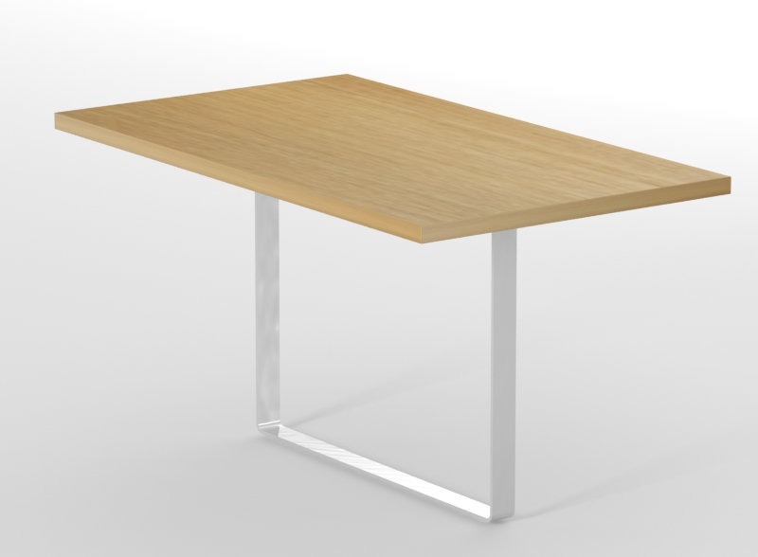
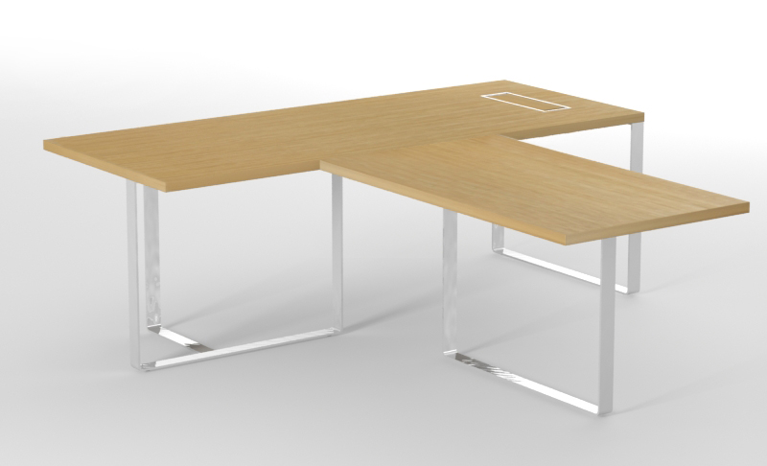
Supplementary unit for executive table
Supplementary unit connected to the table top
1400x800, H=750
(BPD140)
Possibility to combine the unit with executive and meeting tables, affixed with plates to the longer edge of the table top.

Slide 12
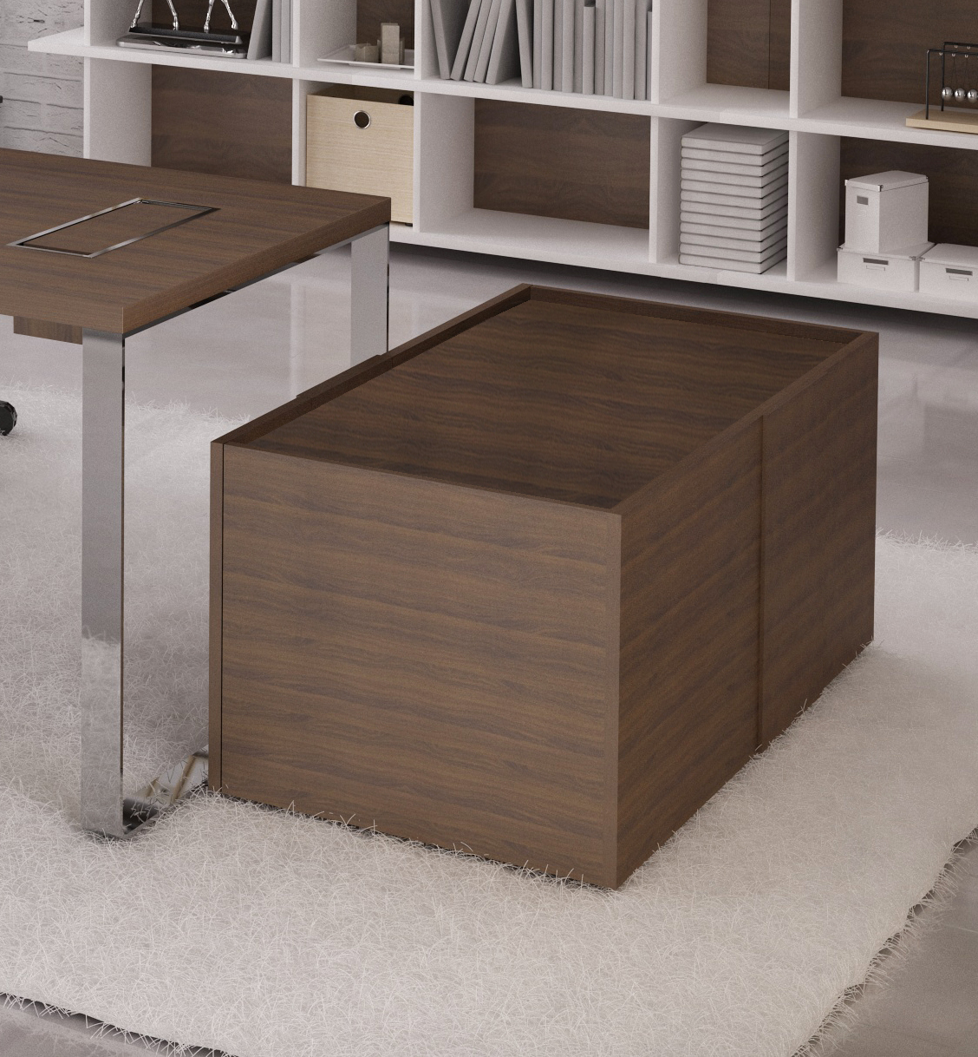
Pedestals
High quality wood veneer or impact-resistant melamine, combinations.
Original design details - different door and back panel thickness combinations, lowered top panel.
L/H (left) or R/H (right).
900 x 600 mm pedestal with two drawers and a pull-out drawer for suitcase, handbag or computer case.
1200 x 600 mm pedestal with two drawers and height adjustable shelf with doors.
The inside of the top drawer is coated with black natural leather.
PLANA

Slide 13
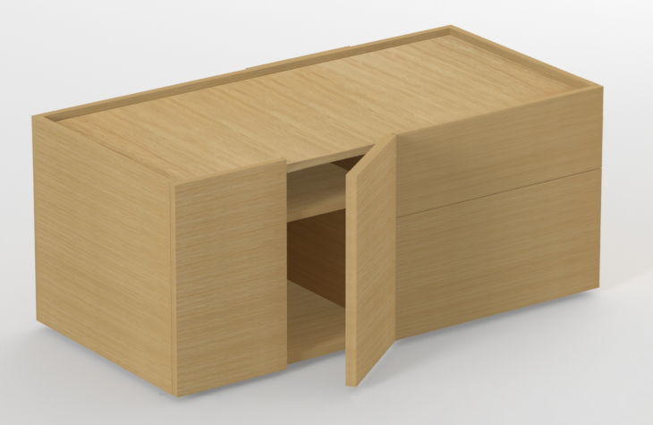
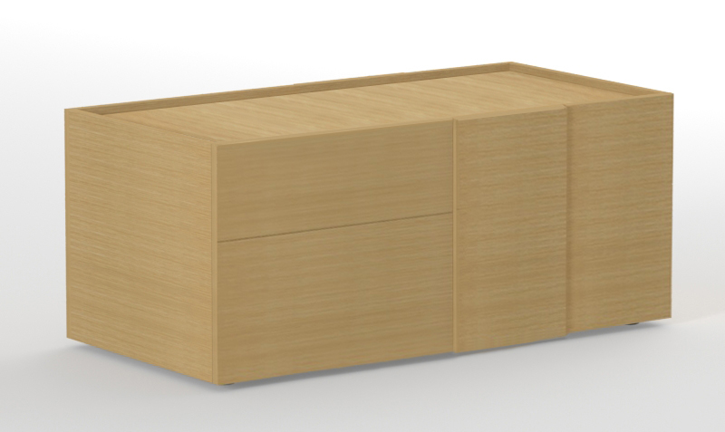
Pedestals
Cabinet with a pull-out drawer on the left, two drawers on the right
900x600, H=517
(BPF900)
Cabinet with a pull-out drawer on the right, two drawers on the left
900x600, H=517
(BPF901)
1 adjustable shelf on the left, 2 drawers on the right
1200x600, H=517
(BPF120)
1 adjustable shelf on the right, 2 drawers on the left
1200x600, H=517
(BPF121)

Slide 14
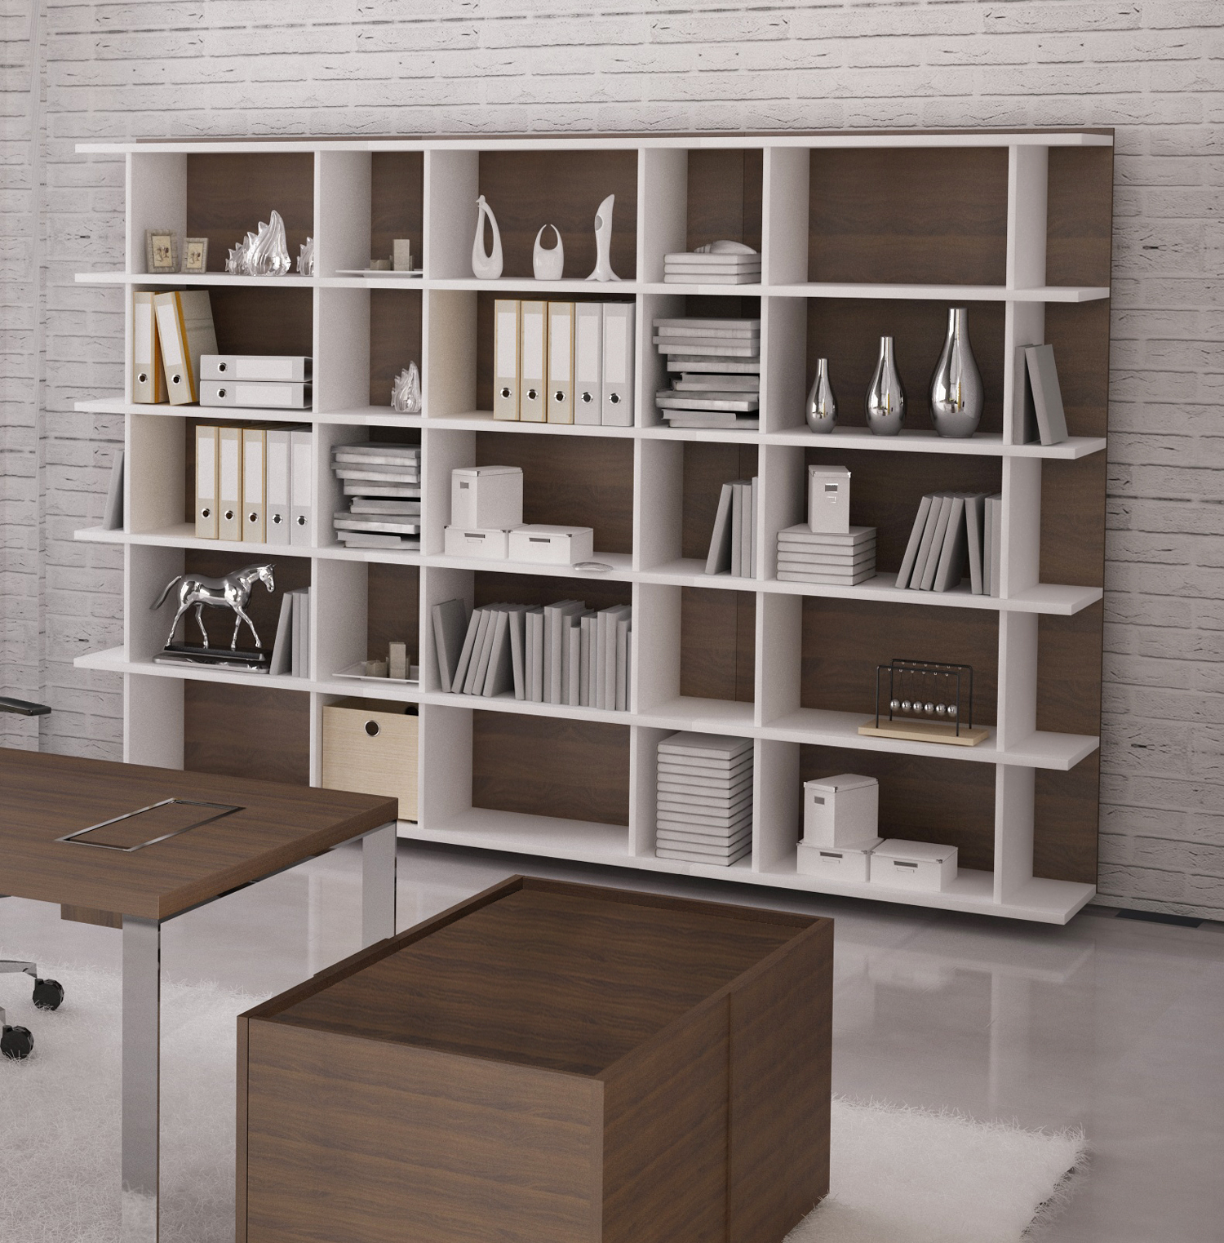
Open shelf units
High quality wood veneer or impact-resistant melamine, combinations.
Original design - combination of different panel thickness.
Solid 25 mm thick shelves.
18/19 mm thick back and vertical panels.
3 height levels - 2H / 3H / 5H.
Dimensions: 900 x 400 mm,
H = 814 / 1190 / 1942 mm.

Slide 15
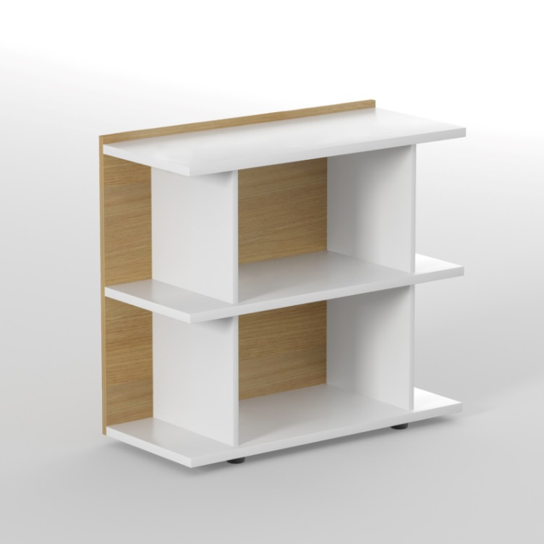
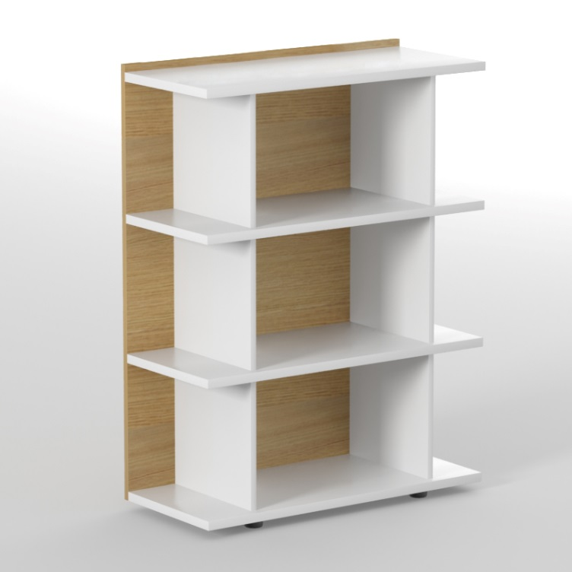
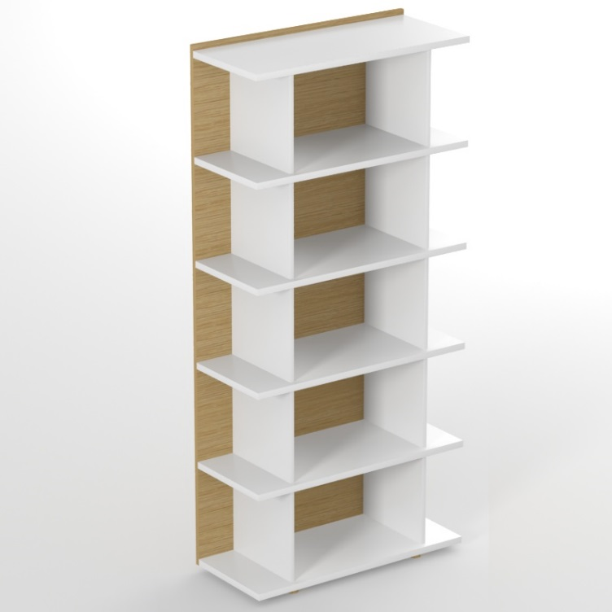
Open shelf units
2 level unit (2H)
900x400, H=814
(BPE090)
3 level unit (3H)
900x400, H=1190
(BPE091)
5 level unit (5H)
900x400, H=1942
(BPE092)

Slide 16
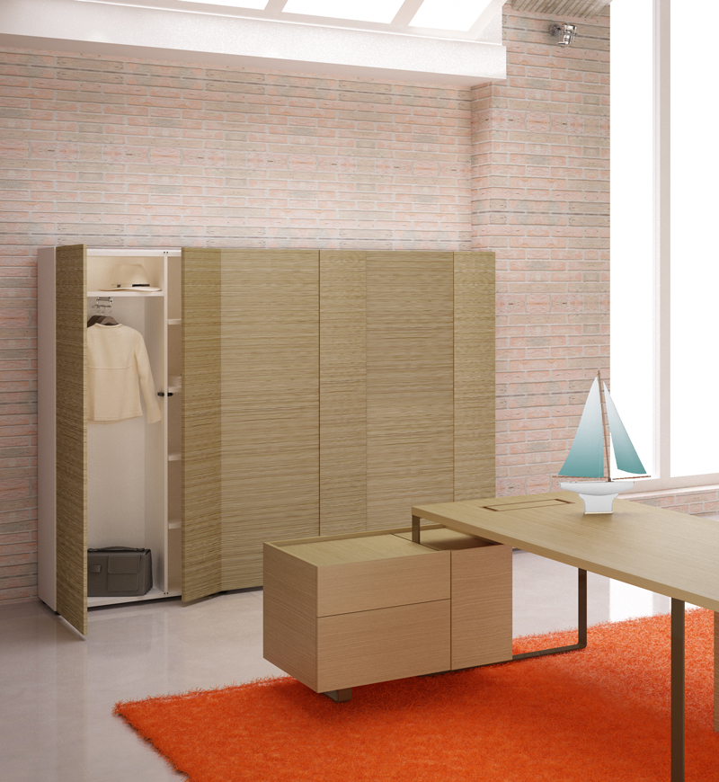
Storage cabinets
High quality wood veneer or impact-resistant melamine, combinations.
Original design - different door thickness and lowered top panel.
3 height levels - 2H / 3H / 5H.
Solid 25 mm thick shelves.
Hinged doors with no handles.
Dimensions: 900 x 400 mm,
H = 814 / 1190 / 1942 mm.
The wardrobe for clothes and accessories is also available.
PLANA

Slide 17
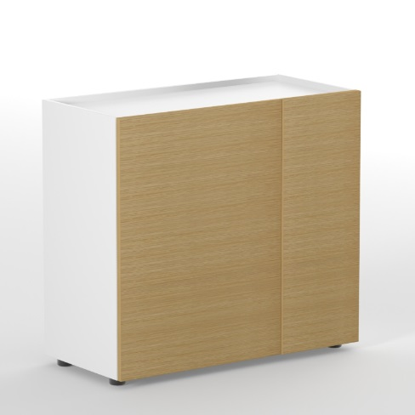
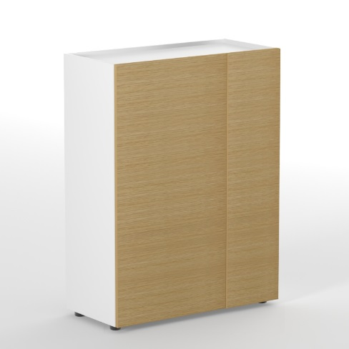
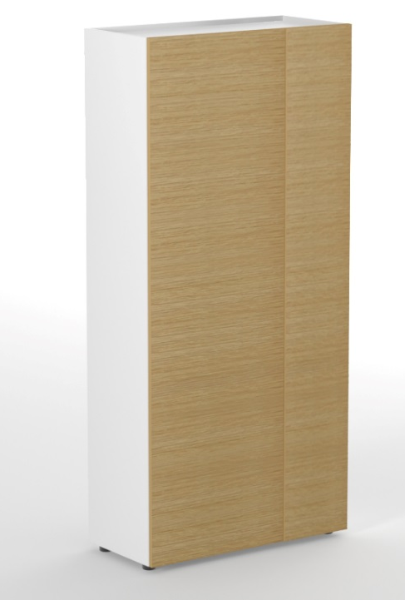
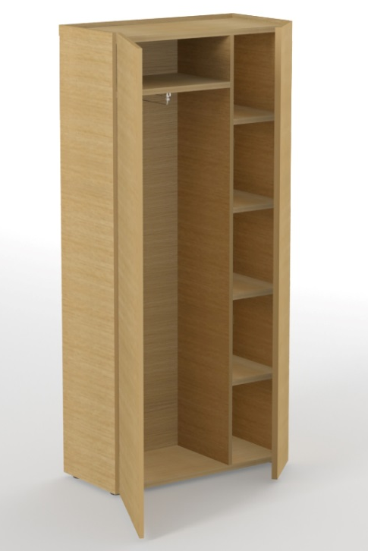
Storage cabinets
2 level cabinet
(2H, 1 shelf)
900x400, H=814
(BPE093)
3 level cabinet
(3H, 2 shelves)
900x400, H=1190
(BPE094)
Wardrobe
(metal pull-out hanging rail and one shelf on the left, 4 shelves on the right)
900x400, H=1942
(BPE096)
5 level cabinet
(5H, 4 shelves)
900x400, H=1942
(BPE095)

Slide 18
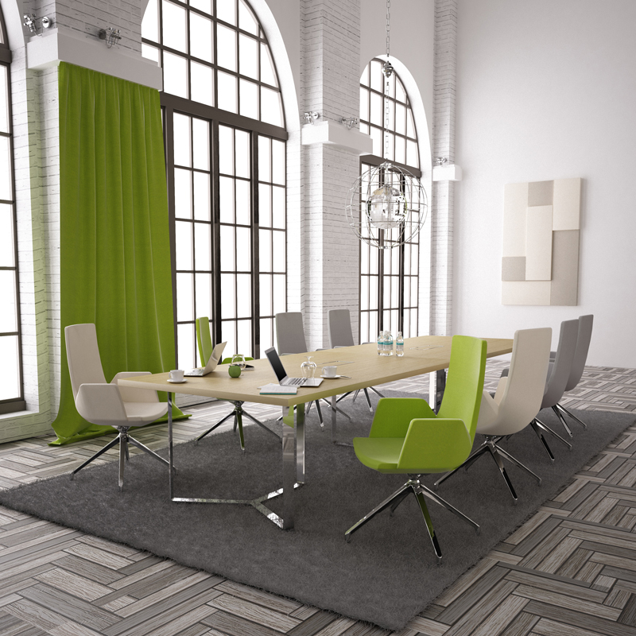
Meeting tables
Solid, 36/37 mm thick tabletop. High quality wood veneer or impact-resistant melamine, combinations.
Elegant three-part bended steel band legs painted using the powder-coating technology or covered in chrome.
Grommet with soft closing, metal frame and box for wire management (except round table).
PLANA

Slide 19
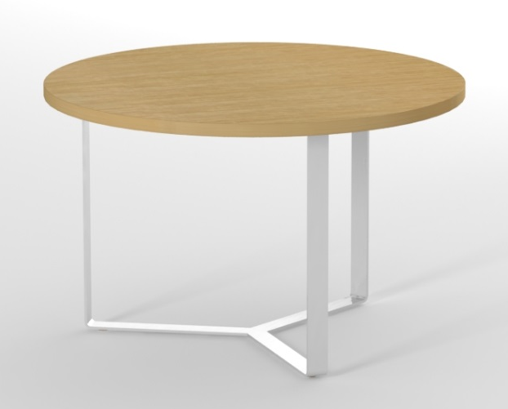
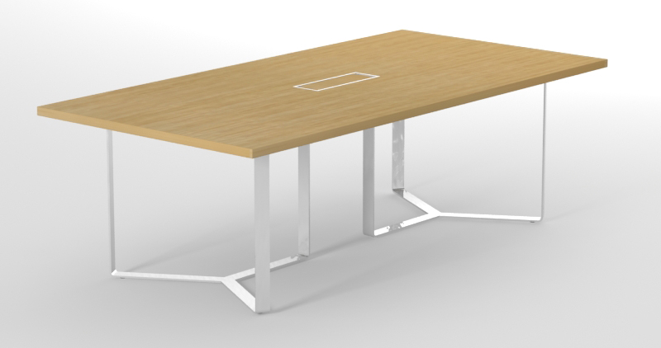
Meeting / conference tables
8 places
2400 x 1200 mm,
H = 750 mm
(CPM240)
14 places
4200 x 1200 mm,
H = 750 mm
(CPM420)
Round, 3 places
Diameter Ø =1200 mm,
H = 750 mm
(CPM120)

Slide 20
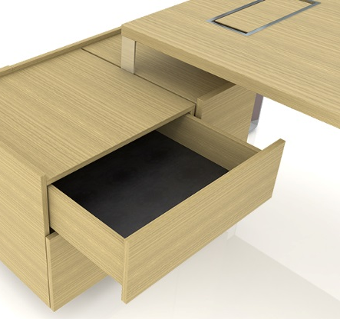
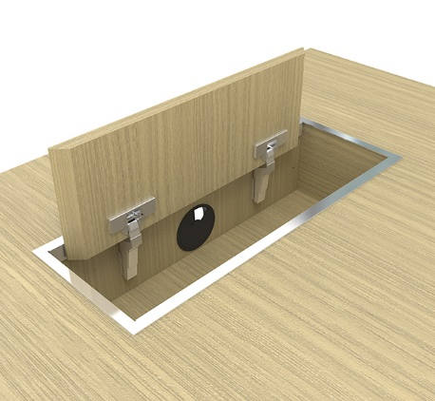
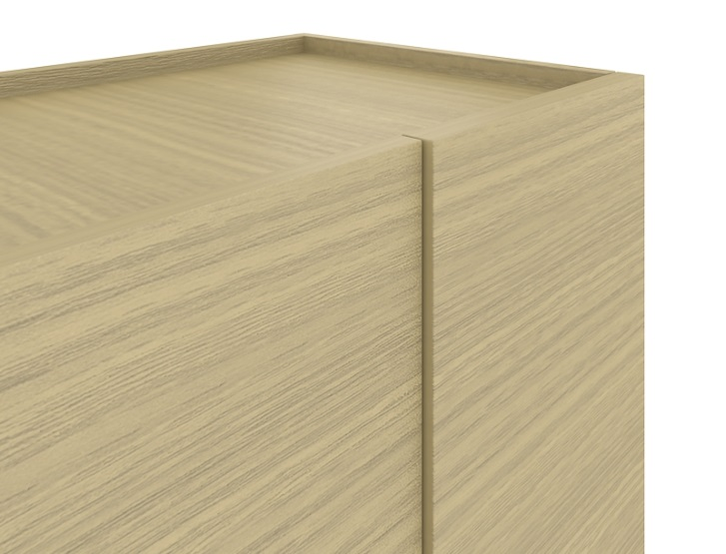
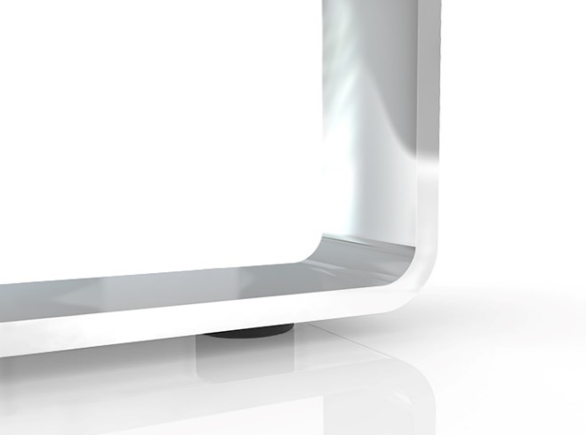
Details / accents
The inside of the top drawer is coated with black natural leather.
Grommet with soft closing, metal frame
and box for wire management.
Different panel thickness combinations, lowered top panel.
Bended steel legs – chromed or powder coated.

Slide 21
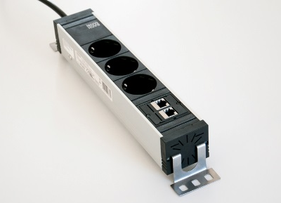
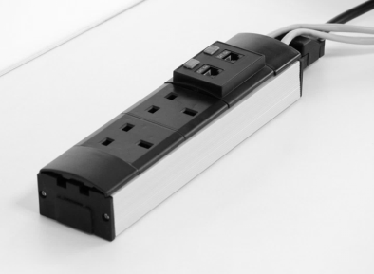
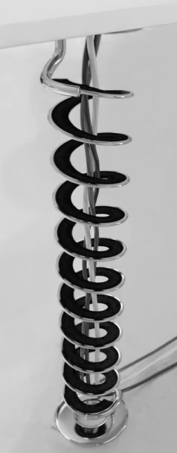
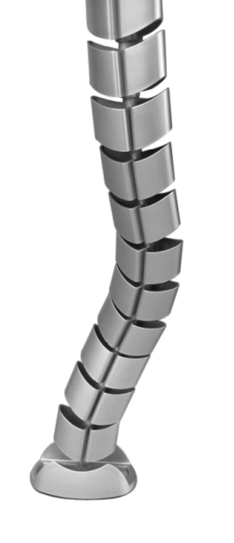
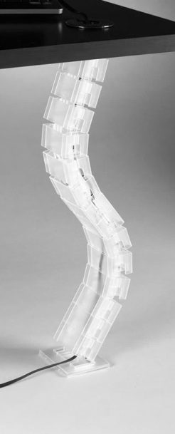
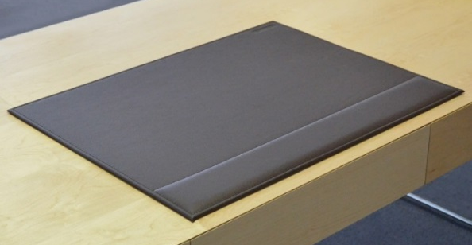
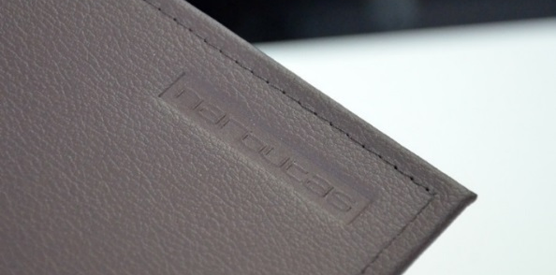
Accessories
4 types of power socket blocks
3 types of vertical cable ducts
Leather table mats
Natural leather
(D81, D86, D87, D88)

Slide 22
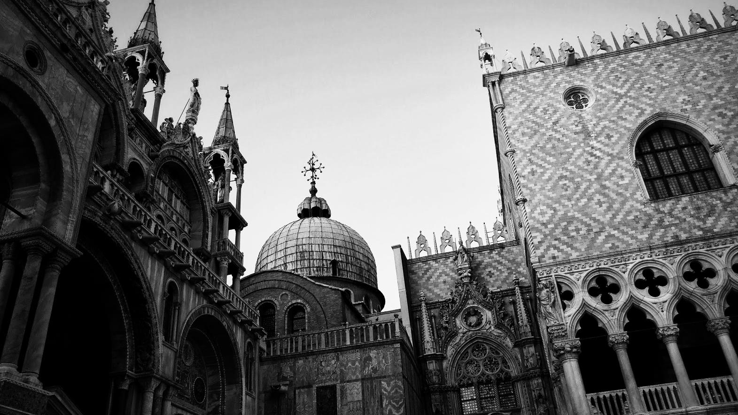
PLANA
materials and textures

Slide 23
Textures
Special for PLANA we use 2 exclusive textures:
Natural Oak
(wood veneer panels)
Deep Bronze
(metal coating)

Slide 24
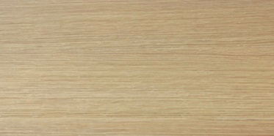
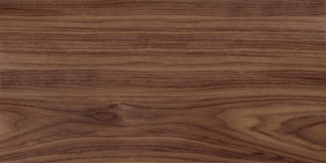
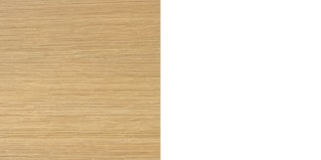
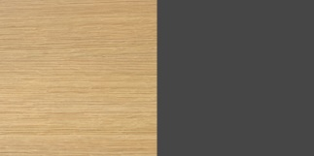
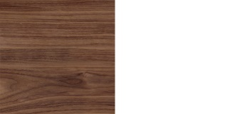
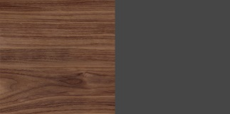
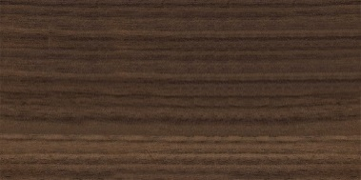
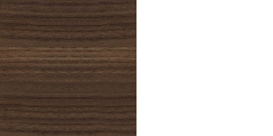
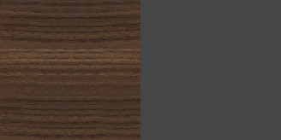
Textures and combinations
Natural wood veneer / melamine combinations
Natural wood veneer
A - oak
R - walnut
AAM1
AAN1
Melamine
RRM1
RRN1
M1 - white
N1 – dark grey
U - walnut
D1 – whitened
oak
Metal
D1M1
D1N1
E - white
T1 – dark grey
S1 – deep
bronze
H – chrome
UUM1
UUN1

Slide 25
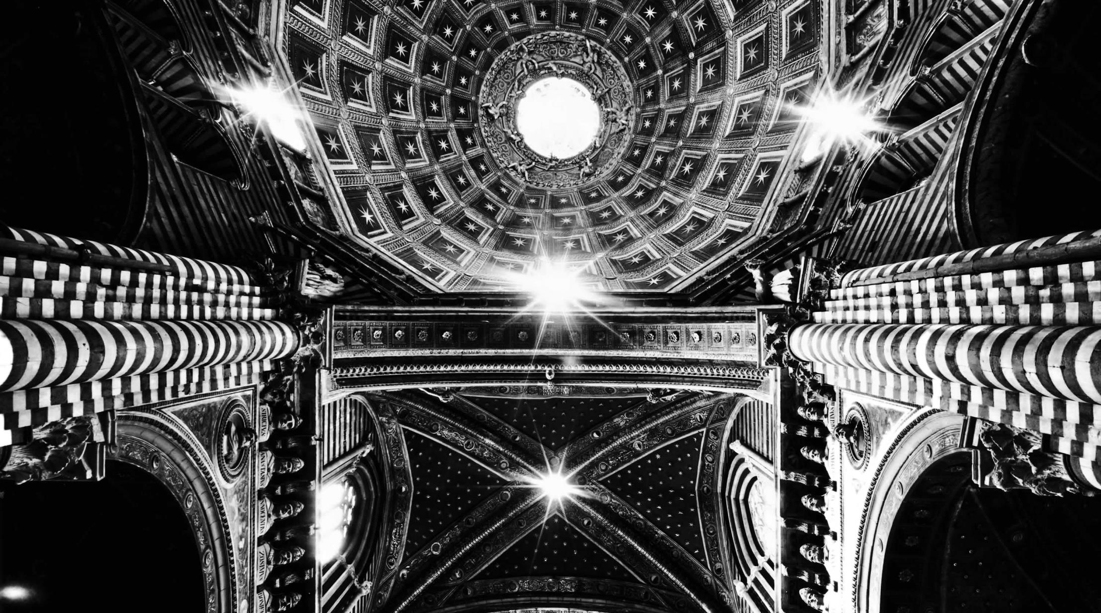
PLANA
in the interiors

Slide 26
Plana
walnut veneer I white melamine I chrome

Slide 27
Plana
walnut veneer I white melamine | chrome | dark grey

Slide 28
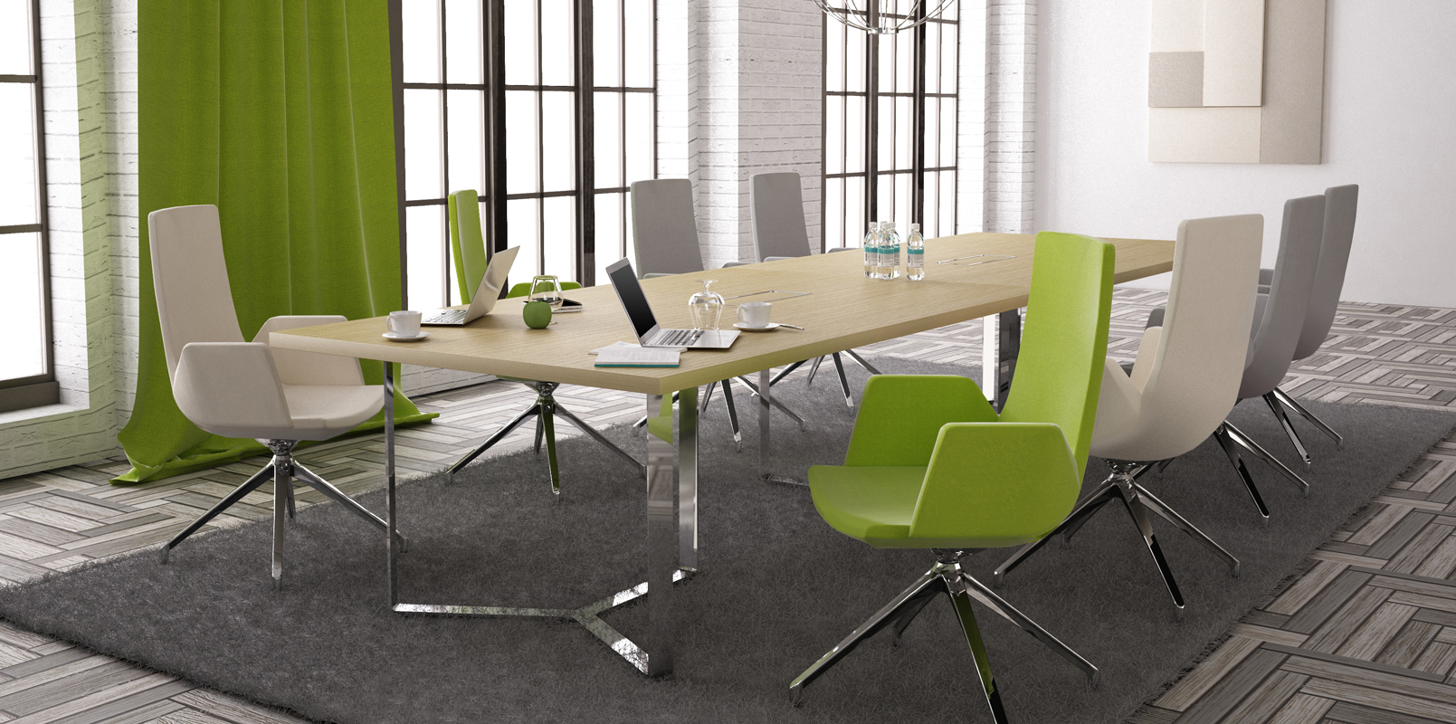
Plana
oak veneer I chrome

Slide 29
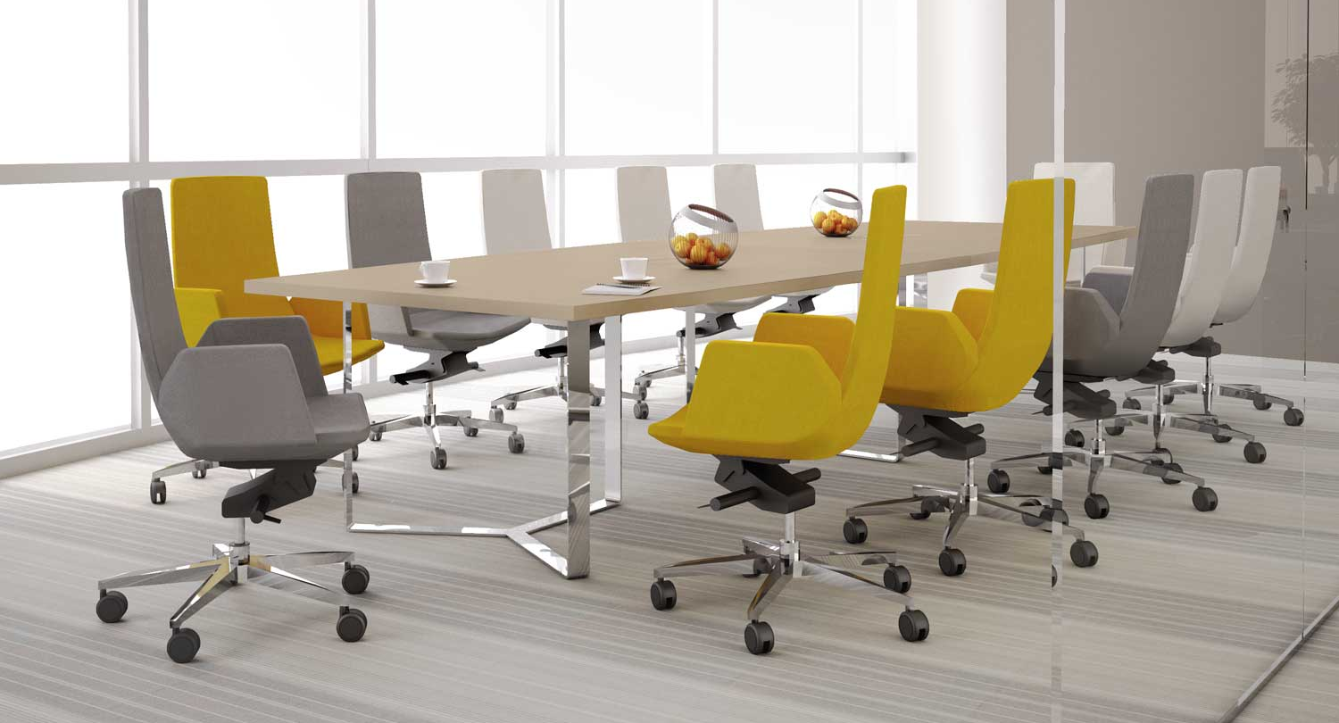
Plana
whitened oak melamine I chrome

Slide 30
PLANA
The values of modern luxury and quality.

