Slide 1
ROUND
Multipurpose
Designed for every work scenario

Slide 2
ROUND Multipurpose
The need for greater flexibility and mobility in the work environment
The popularity of remote work, flexible working schedules and the shifted nature of work have influence in shaping the modern office. The line between spaces for different functions – individual work, meetings and relaxation – in the same place is blurring.
Notes:
This requires offices to be increasingly flexible and mobile. Workplaces need to keep up with the dynamic way of working, providing employees with spaces that can quickly adapt to different tasks, spontaneous meetings and collaboration. These changes are also reflected in the design trends of modern office furniture.

Slide 3
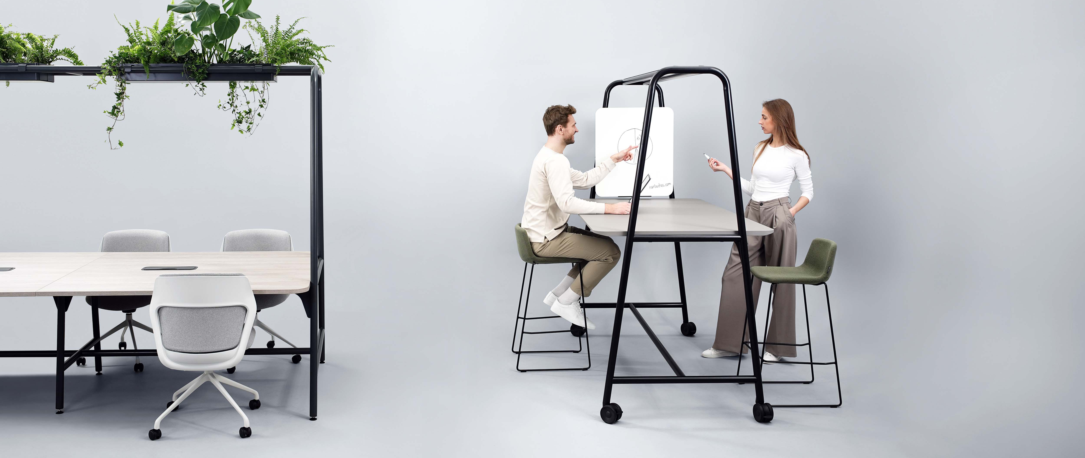
ROUND Multipurpose
ROUND Multipurpose – designed for every work scenario
Notes:
ROUND Multipurpose is a system of tables designed for all types of meetings, team- or individual work and provides mobility. These tables were created with the aim of meeting the need for flexible office furniture suitable for various situations.

Slide 4
ROUND Multipurpose
The collection consists of high and meeting tables
H= 1050 mm
H=900 mm
H= 740 mm
Notes:
This ROUND collection has a wide range of multifunctional tables to choose from. It consists of tables in three heights and two tabletop depths, so the furniture can satisfy different needs and fulfil various visions.

Slide 5
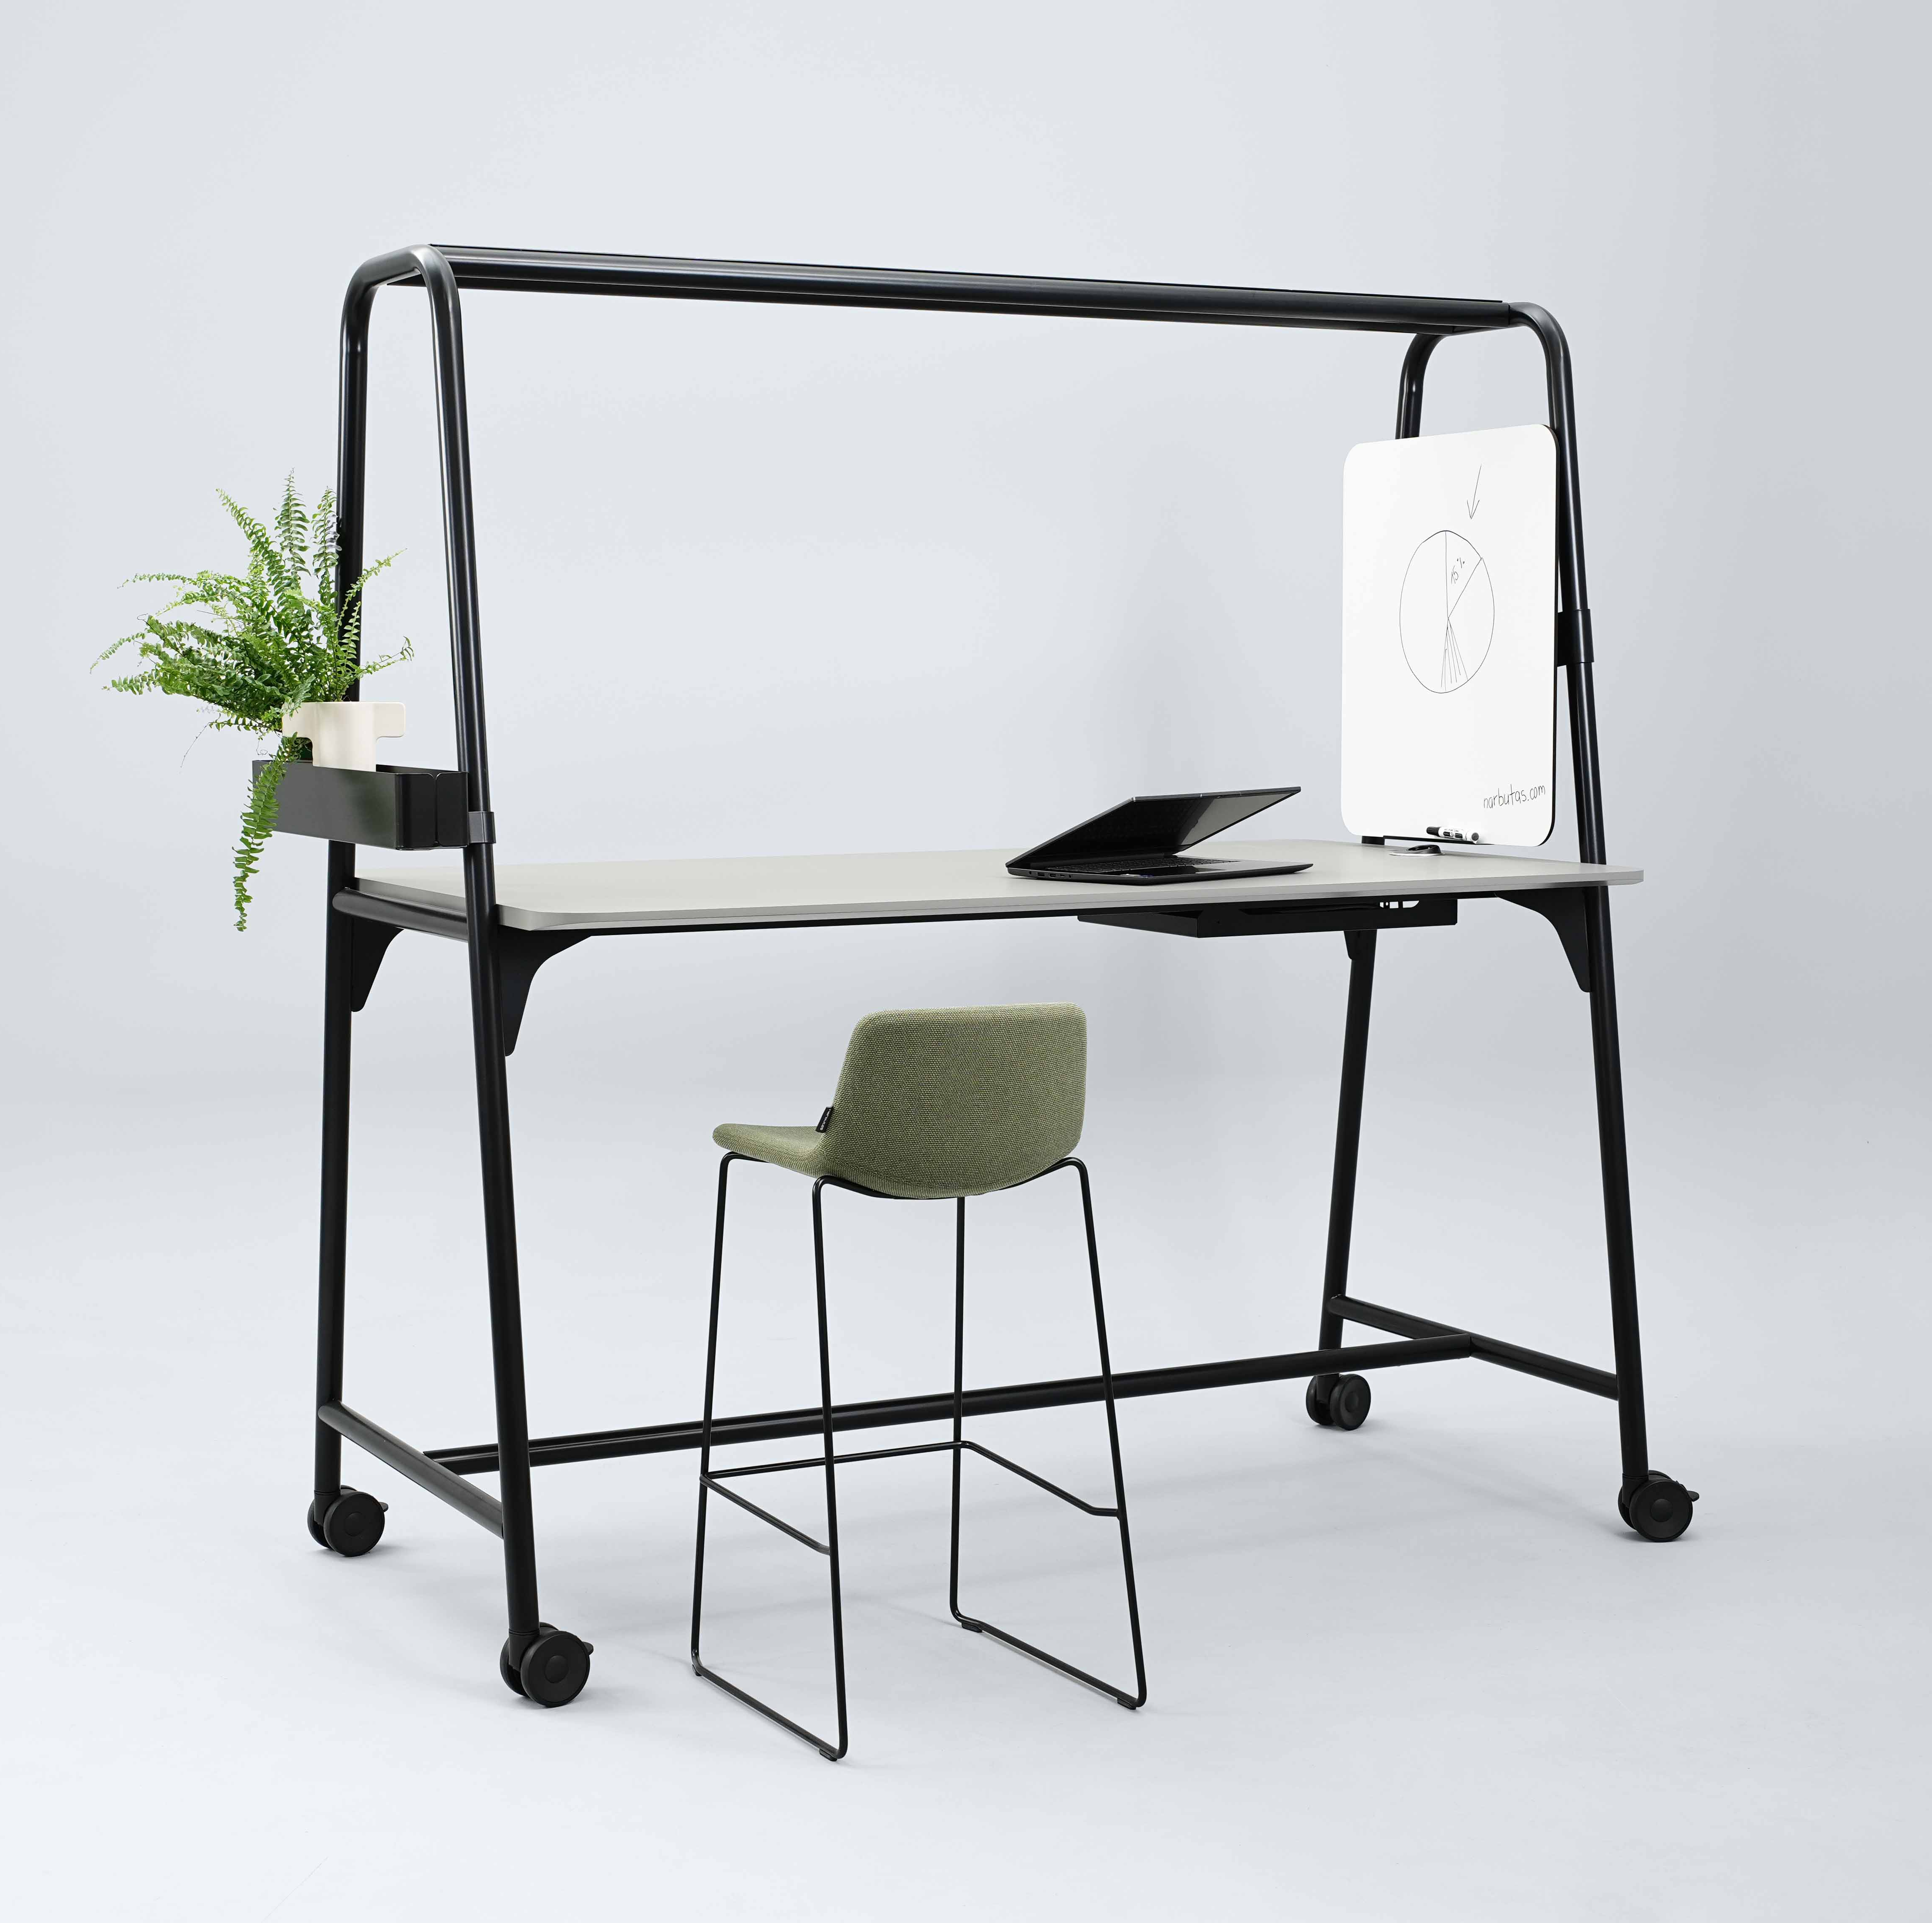
ROUND Multipurpose
Main features:
Light industrial design
Functionalities for different scenarios
Wide range of applications
Notes:
This table system features a light industrial design, functionalities for different work scenarios and a wide range of applications. These features shape the identity of this collection.

Slide 6
Light industrial design
Notes:
The ROUND Multipurpose tables were created with a particular focus on furniture design.

Slide 7
ROUND Multipurpose
“
Minimalist or decorative, industrial or biophilic design-inspired - ROUND Multipurpose system‘s design can be adapted to fit the needs of every space. We paid a lot of attention to the table‘s silhouette – it balances strict shapes and soft, rounded details, emphasising the subtle lightness of the furniture‘s character.
NARBUTAS Designer
Rytė Milišiūnaitė

Slide 8
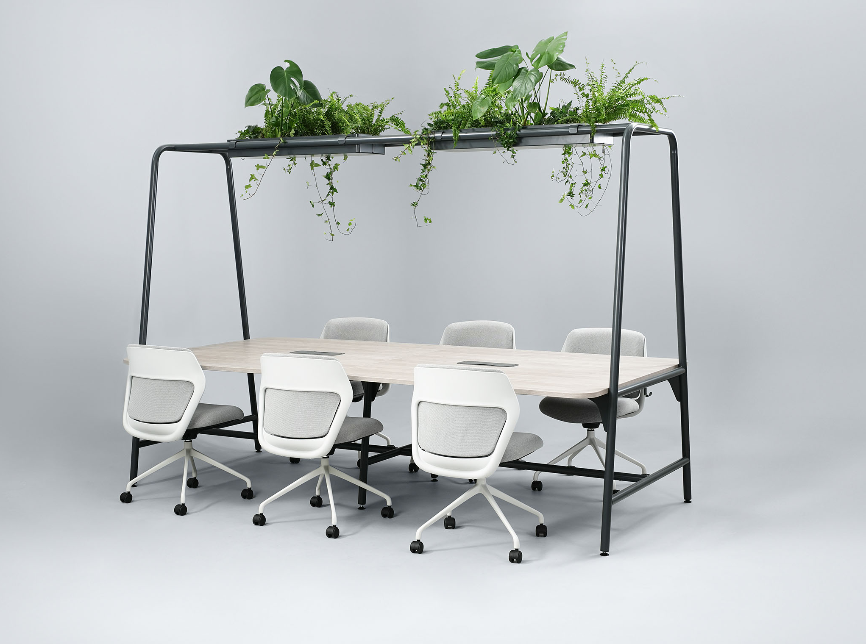
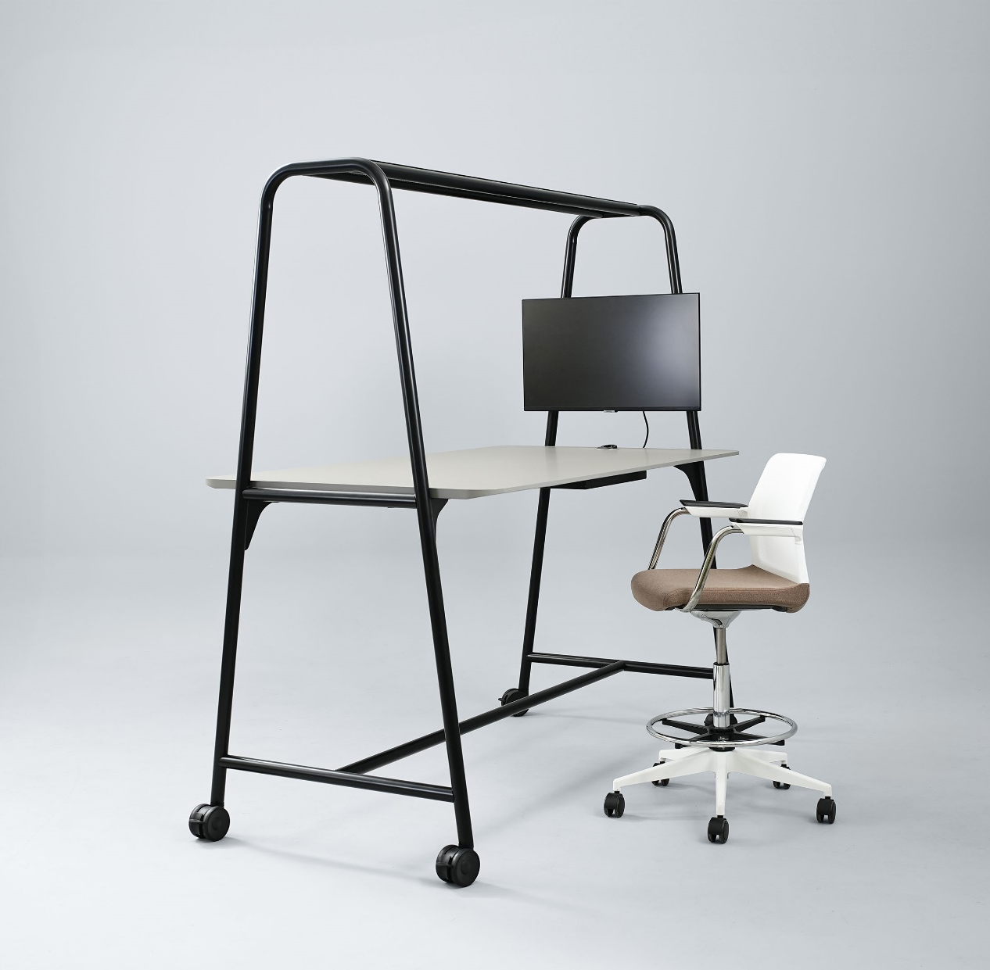
ROUND Multipurpose
Balance between industrial elements and light aesthetics
Notes:
The identity of the multifunctional ROUND tables is characterised by its light industrial design. It combines the usual characteristics of strict industrial design with soft contemporary aesthetics. This style embraces the raw beauty of industrial materials, such as metal, while prioritising practicality and wide applicability.

Slide 9
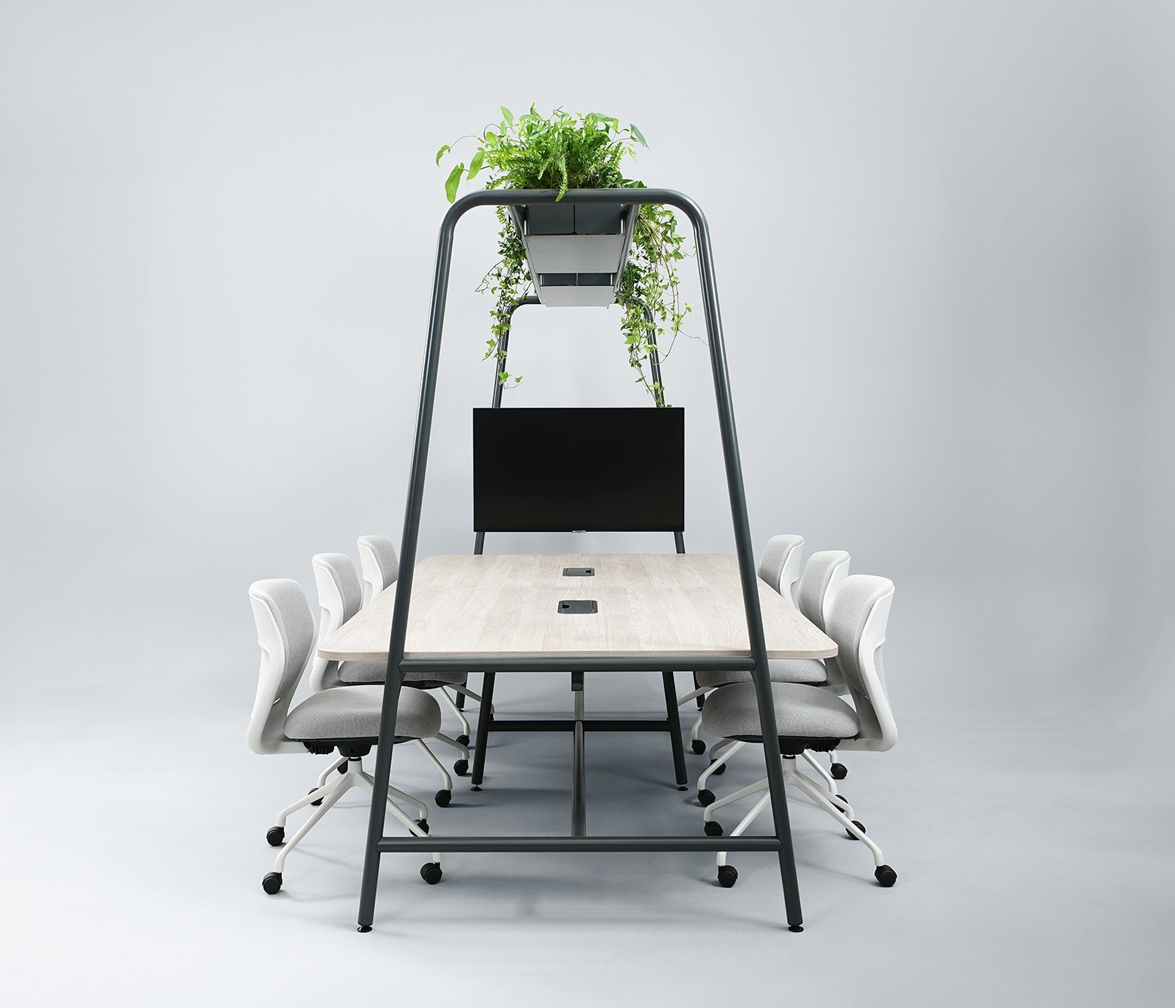
ROUND Multipurpose
Round metal tube legs as an eye-catching design element
Notes:
The round metal tube legs are a distinctive design element that adds a touch of gracefulness to the furniture and ensures its durability and longevity.

Slide 10
ROUND Multipurpose
A combination of subtly rounded shapes and lines
Notes:
Subtly rounded lines are echoed in the bent metal legs, rounded corners and chamfered edges of the tabletops. The curved shapes soften the character of the furniture, encourage pleasant conversations and efficient collaboration, and create a harmonious and cosy look of a modern office.

Slide 11
Functionalities for different work scenarios
Notes:
Practicality and aesthetics go hand in hand. When creating this collection, we have thought about everything down to the smallest detail. We made sure that the tables are not only easily adaptable in the office but also comfortable to use.

Slide 12
ROUND Multipurpose
For both individual work and various types of meetings
Notes:
The ROUND Multipurpose tables are ideal for short or longer meetings, informal discussions, creative work in a team or individual work. This furniture is designed to meet the needs for various spaces and thus can be used in all office areas. The wide range of tables and the abundance of accessories enhance the functionality of this furniture even further.

Slide 13
ROUND Multipurpose
Accessories for effective collaboration
Notes:
Make your discussions or meetings even more effective with accessories that allow you to participate comfortably in presentations and video conferences. A monitor hung on the table’s metal legs allows you to integrate technology into your meeting spaces, achieving improved collaboration, while a whiteboard will help you ensure that every idea is recorded.

Slide 14
ROUND Multipurpose
For convenient storage of office supplies
Notes:
Side shelves hung on the table’s legs are ideally suited for storing small items needed for meetings or daily tasks, while an attachable hook is perfect for hanging your bag.

Slide 15
ROUND Multipurpose
Create the look you want
Notes:
You can complete the look of your table with planter boxes that will create a cosy atmosphere when filled with plants. You can also choose the minimalist option of a perforated metal top cover. It can be used to decorate the workplace with garlands of light bulbs or plants for added style.

Slide 16
ROUND Multipurpsoe
Integrated power solutions
Notes:
Well-thought-out power solutions make working and meeting spaces even more comfortable. Round power units with different types of sockets can be integrated into 1000 mm deep tabletops for easy charging of devices. If you need more power sockets, you can order a table with a cable tray which allows you to accommodate a larger power unit. As with 1400 mm deep tabletops, power units can be hidden under a metal grommet.
Hanging cables can also be neatly accommodated in cable trays under the tabletop. The trays for 1000 mm deep tabletops are accessed from the underside of the table, while the trays for 1400 mm deep tabletops are accessed by opening the metal grommet. Convenient cable arrangement does not impede the portability of the table and is particularly useful when moving furniture from one place to another.

Slide 17
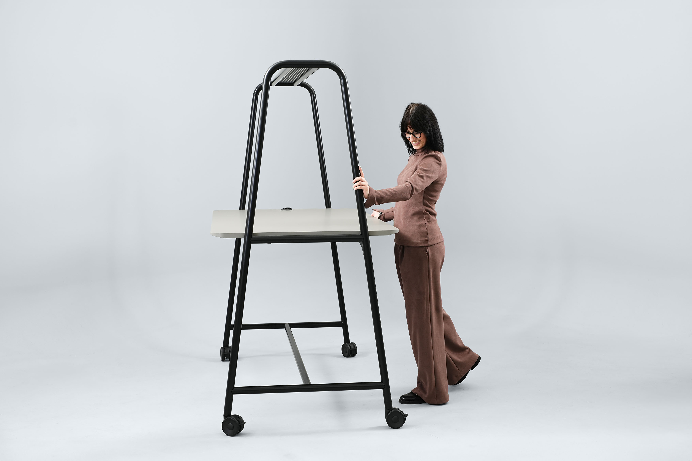
ROUND Multipurpose
Indispensable in a dynamic work environment
Notes:
The multifunctional tables with 1000 mm deep tabletops can be fitted not only with supports but also with castors. This option makes these tables indispensable in a dynamic work environment and allows them to be moved around easily.

Slide 18
ROUND Multipurpose
A table that grows with the team
Notes:
The need for more space for employees increases as the team grows. For this, the tables with 1000 mm deep tabletops can be extended using supplementary units.

Slide 19
ROUND Multipurpose
Fully complete office interior design with the ROUND collection
Notes:
The ROUND family of desks and cabinets now includes multifunctional tables. With such a wide range of choices in a single system, you can make a variety of workplace layouts, design your workspace efficiently and create a stylistically harmonious office interior.

Slide 20
Wide range of applications and space design possibilities
Notes:
This table system can be adapted to various scenarios. The versatile features of the furniture will help you create the look you want in all areas of your office.

Slide 21
ROUND Multipurpose
Notes:
The multifunctional ROUND tables are ideal for furnishing practical and modern open-plan offices

Slide 22
ROUND Multipurpose
Notes:
and can be combined with other ROUND family furniture to create a stylistically harmonious interior.

Slide 23
ROUND Multipurpose
Notes:
You can create a cosy yet modern atmosphere by decorating these tables with plants or garlands of light bulbs. By combining the collection’s light industrial design with lounge furniture and a bright interior, you will achieve the perfect look for waiting areas.

Slide 24
ROUND Multipurpose
Notes:
The ROUND Multipurpose tables bring a modern and trendy style to leisure and dining areas, inviting you to join in lively discussions.

Slide 25
Implementing the sustainability principles
Notes:
Sustainability is one of NARBUTAS’ long-term strategic directions. The ROUND Multipurpose tables are manufactured in a modern factory using 100% green, renewable energy.

Slide 26
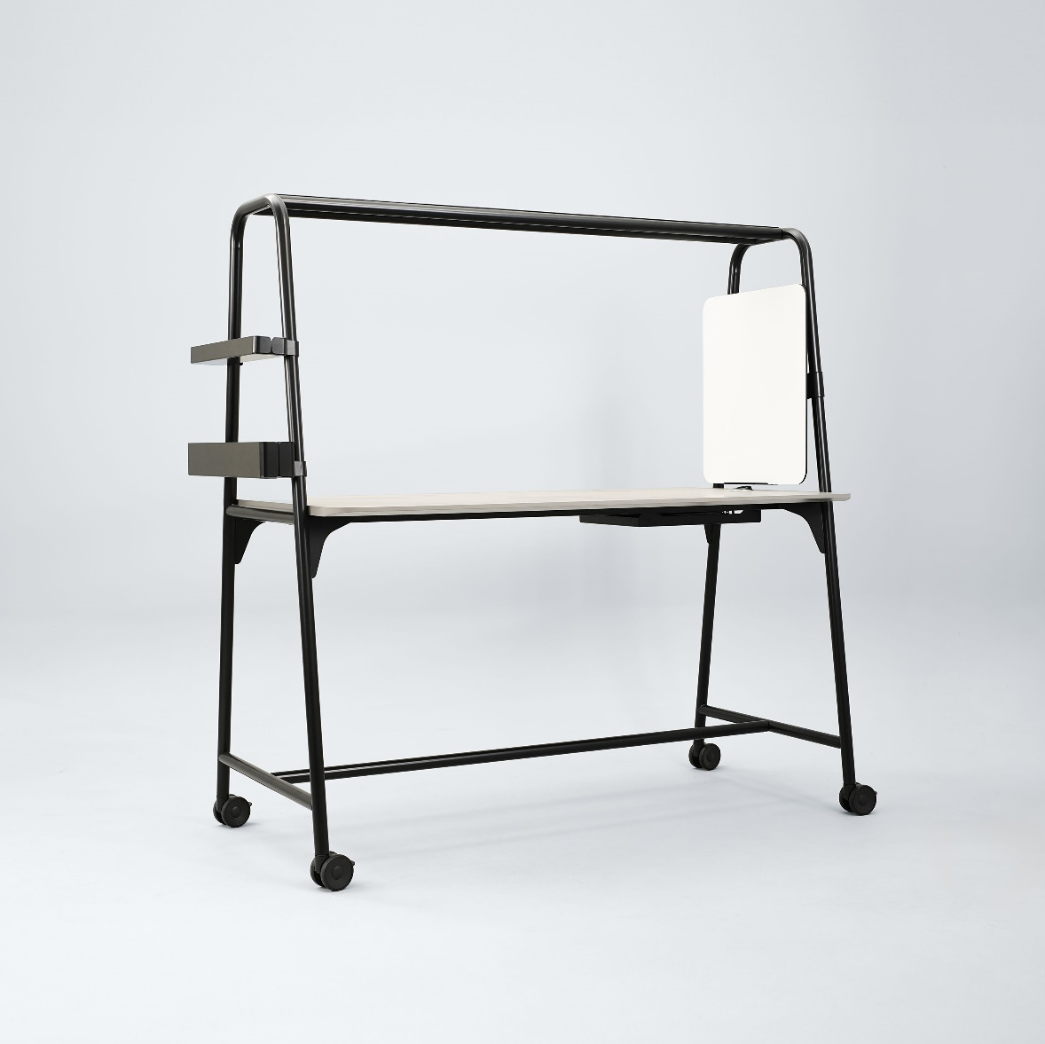
ROUND Multipurpose
Main raw materials
Metal:
Made from ~20% recycled raw materials.
Painted using powder paints with low emissions of volatile organic compounds.
Chipboard:
Made from ~20% recycled raw materials.
Low in formaldehyde and CARB 2 and E05 compliant.
MDF:
Low in formaldehyde and CARB 2 compliant, while HPL Fenix is also Greenguard Gold certified.
Notes:
The multifunctional ROUND tables are made from two main types of raw materials – metal and chipboard.
Metal is made from ~20% recycled raw materials. It is painted using powder paints with low emissions of volatile organic compounds.
The tabletop can be either melamine-faced chipboard or MDF with HPL/HPL Fenix finish. Chipboard is made from ~20% recycled raw materials, is low in formaldehyde and meets the CARB 2 and E05 standards. MDF is also low in formaldehyde and meets the strictest CARB 2 requirements. In addition, HPL Fenix meets the Greenguard Gold standards.

Slide 27
ROUND Multipurpose
Sustainability at every stage of the furniture lifecycle
Reliable and long-lasting design:
The furniture comes with a 10-year warranty.
Sustainable end of life of the product:
Up to 99% of the table’s parts can be disassembled, sorted and recycled.
Lower environmental impact:
You can meet more office needs with less furniture.
Notes:
The multifunctional ROUND tables are manufactured using a minimum of 20% recycled materials. Sustainability is important throughout the entire development and lifecycle of the furniture. When the tables are no longer in use, they can be easily disassembled, and their parts can then be recycled up to 99%.
The multifunctionality of the tables also contributes to their sustainability. A single set of furniture can be moved and used in different areas and situations. The versatility of the tables means you can meet more functional office needs with less furniture, reducing the environmental impact.

Slide 28
Range

Slide 29
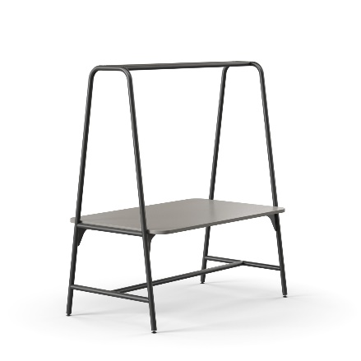
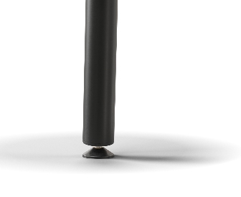
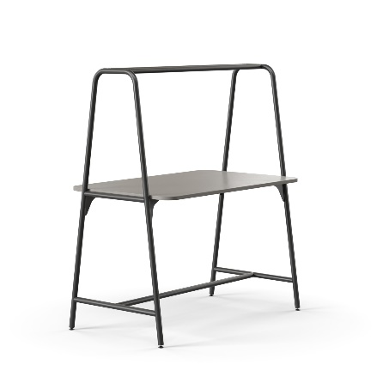
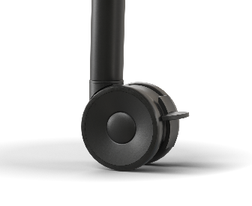
ROUND Multipurpose 1000 mm depth tables
 | W | D | H | Leg type | Electric solutions
 | 1680 (1600) | 1000 | 1940 (740) |  | -
 | 1880 (1800)
 | 1680 (1600) |  | 1940 (900)
 | 1880 (1800)
 | 1680 (1600) |  | 1940 (1050)
 | 1880 (1800)
Multipurpose table
High multipurpose table

Slide 30
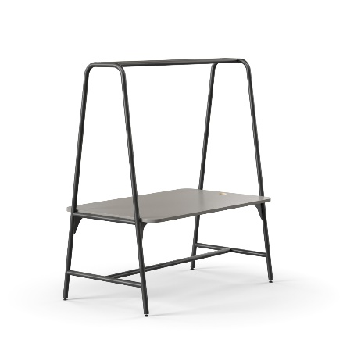
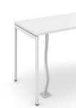
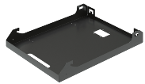
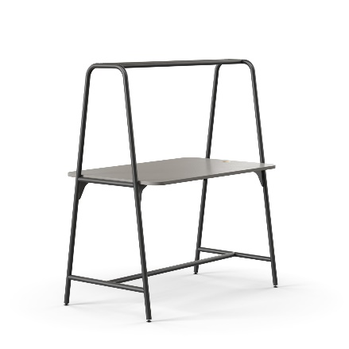
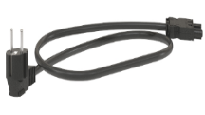
ROUND Multipurpose 1000 mm depth tables with cut-out for power socket
 | W | D | H | Leg type | Electric solutions
 | 1680 (1600) | 1000 | 1940 (740)
 | 1880 (1800)
 | 1680 (1600) |  | 1940 (900)
 | 1880 (1800)
 | 1680 (1600) |  | 1940 (1050)
 | 1880 (1800)
Multipurpose table with
cut-out for power socket
AC power socket
AC power socket and integrated USB fast charger type-A and type-C,
Cable duct
Cable tray
High multipurpose table with
cut-out for power socket
Power supply cable
Extension cable
Power unit (3 x AC power sockets)

Slide 31
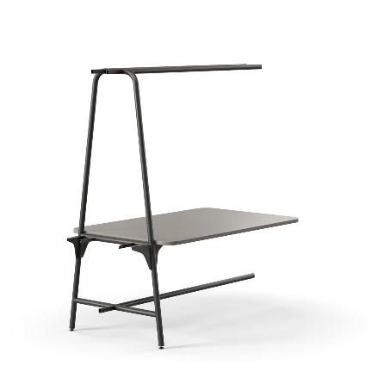
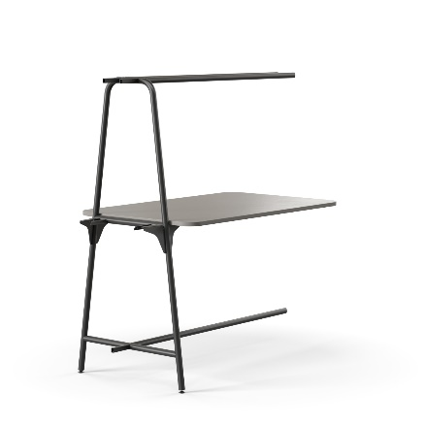
ROUND Multipurpose supplementary units for 1000 mm depth tables
 | W | D | H | Leg type | Electric solutions
 | 1680 (1600) | 1000 | 1940 (740) |  | -
 | 1880 (1800)
 | 1680 (1600) |  | 1940 (900)
 | 1880 (1800)
 | 1680 (1600) |  | 1940 (1050)
 | 1880 (1800)
Supplementary unit
for multipurpose table
Supplementary unit
for high multipurpose table

Slide 32
ROUND Multipurpose supplementary units with cut-out for power sockets for 1000 mm depth tables
 | W | D | H | Leg type | Electric solutions
 | 1680 (1600) | 1000 | 1940 (740)
 | 1880 (1800)
 | 1680 (1600) |  | 1940 (900)
 | 1880 (1800)
 | 1680 (1600) |  | 1940 (1050)
 | 1880 (1800)
Supplementary unit for
multipurpose table with
cut-out for power socket
AC power socket
AC power socket and integrated USB fast charger type-A and type-C,
Cable duct
Cable tray
Supplementary unit for
high multipurpose table with
cut-out for power socket
Power supply cable
Extension cable
Power unit (3 x AC power sockets)

Slide 33
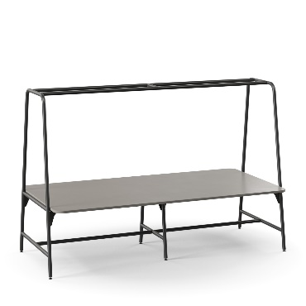
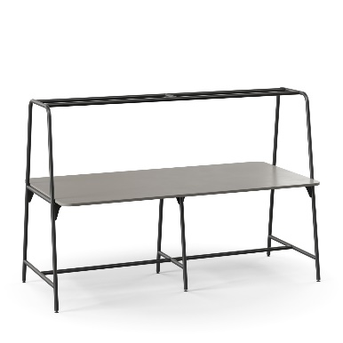
ROUND Multipurpose 1400 mm depth tables
 | W | D | H | Leg type | Electric solutions
 | 2480 (2400) | 1400 | 1940 (740) |  | -
 | 2880 (2800)
 | 2480 (2400) |  | 1940 (900)
 | 2880 (2800)
 | 2480 (2400) |  | 1940 (1050)
 | 2880 (2800)
Multipurpose table
High multipurpose table

Slide 34
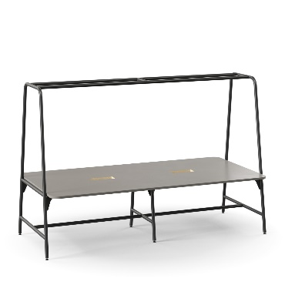
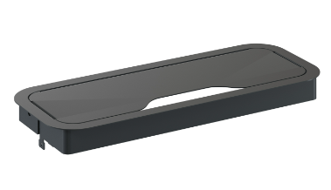
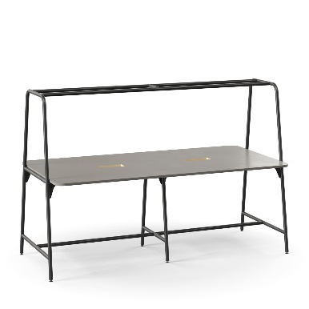
ROUND Multipurpose 1400 mm depth tables with cut-out for grommet
 | W | D | H | Leg type | Electric solutions
 | 2480 (2400) | 1400 | 1940 (740)
 | 2880 (2800)
 | 2480 (2400) |  | 1940 (900)
 | 2880 (2800)
 | 2480 (2400) |  | 1940 (1050)
 | 2880 (2800)
Multipurpose table with cut-out for grommet
Rounded metal desk grommet
Cable tray
Power unit (3 x AC power sockets)
Cable duct
High multipurpose table with cut-out for grommet
Power supply cable
Extension cable

Slide 35
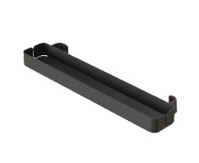
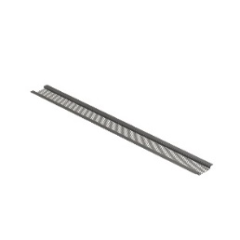
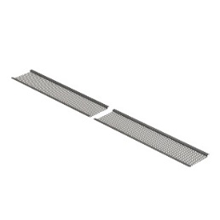
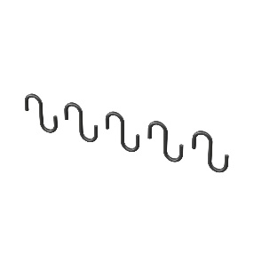
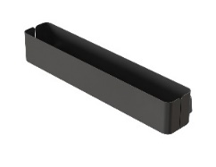
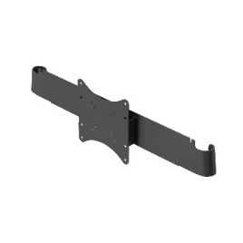
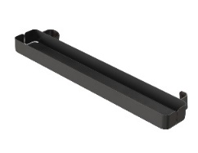
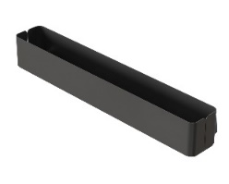
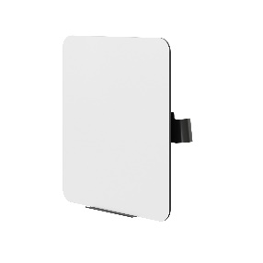
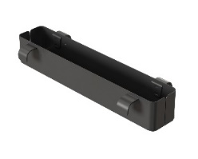
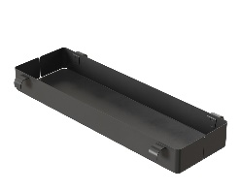
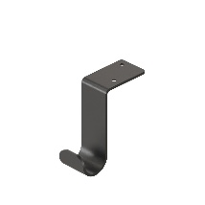
ROUND Multipurpose accessories
Top side shelf, H=50 mm
Perforated top cover
Top side shelf, H=100 mm
Set of hooks for perforated top cover (5 pcs.)
Bottom side shelf, H=50 mm
Monitor holder
Bottom side shelf, H=100 mm
HPL whiteboard with holder
Top planter box
Hook

Slide 36
narbutas.com

