Slide 1
JAZZ SILENT BOX
LOUNGE FURNITURE
2015 09 07

Slide 2
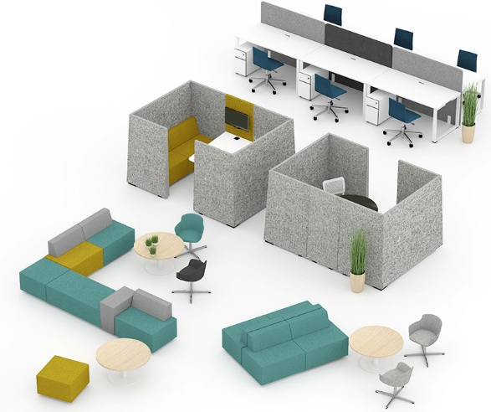
Silence zone „SILENT BOX“
JAZZ collection lounge furniture „Silent Box” – office spaces separating acoustic silence zone for meetings, development of ideas, individual work or just for recreation in
your working environment.

Slide 3
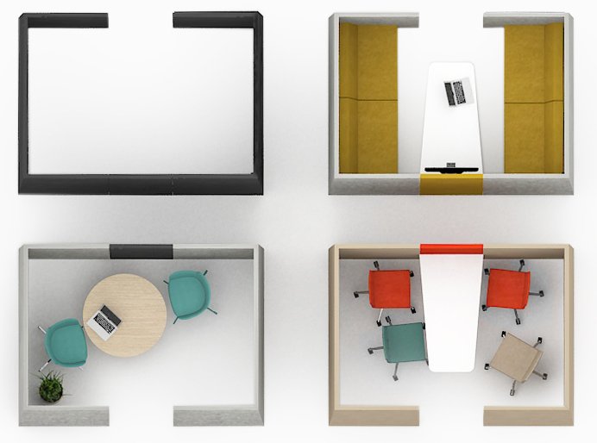
„SILENT BOX“ individual space

Slide 4
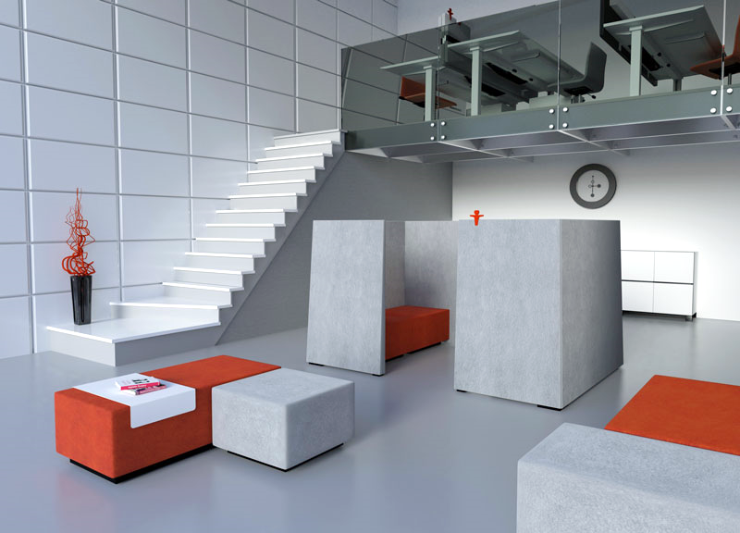
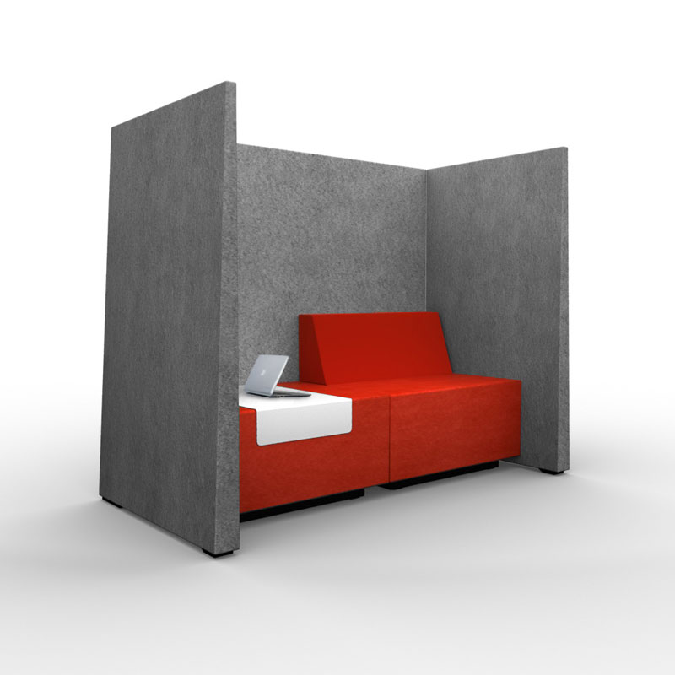
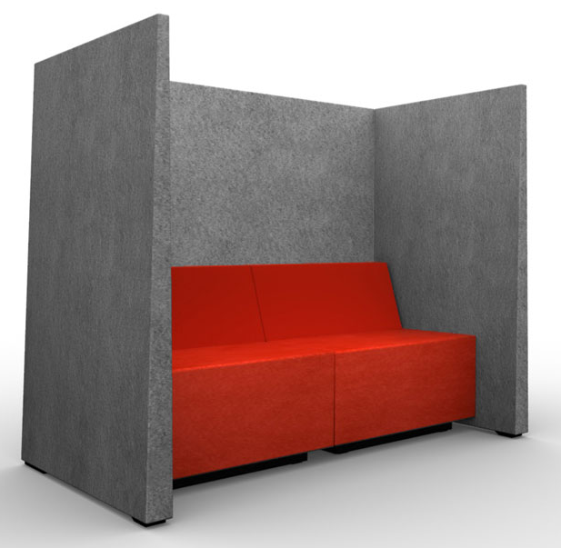
„SILENT BOX“ modern accent

Slide 5
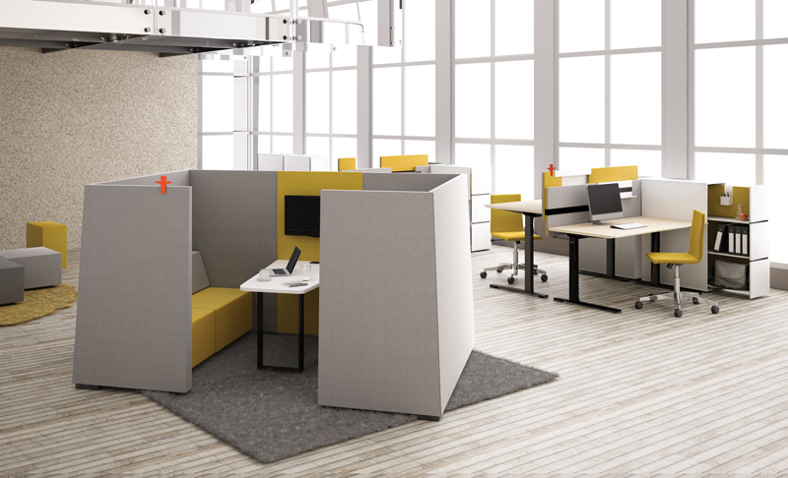
„SILENT BOX“ in work environment

Slide 6
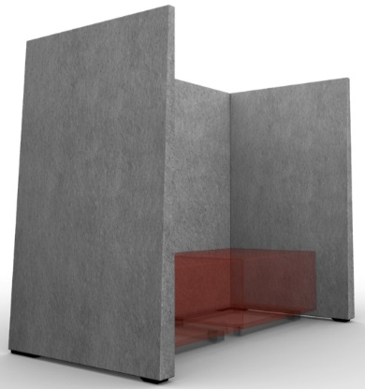
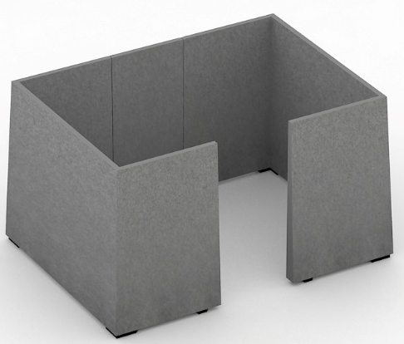
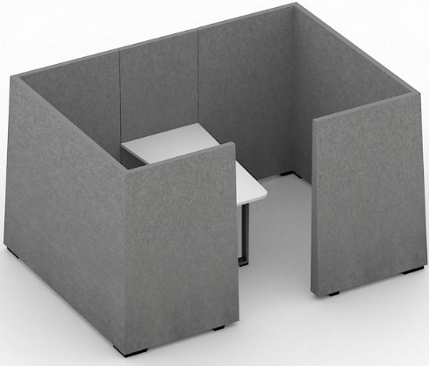

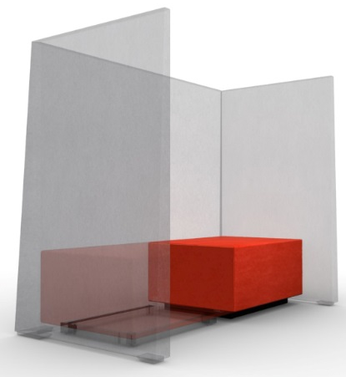
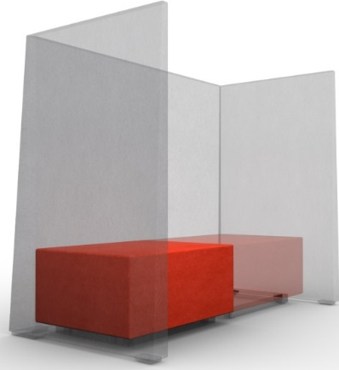
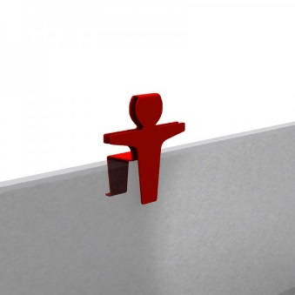
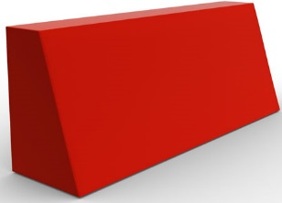
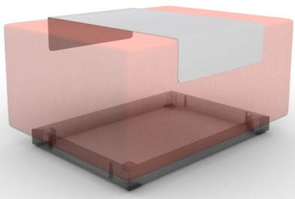
Product range
„Silent Box“ models:
AGS180
AGS181
AGS182
AGS183
Poufs:
Accessories:
SGA1L0
SGA1R0
ZGZ005
SGZ001
ZGZ003

Slide 7
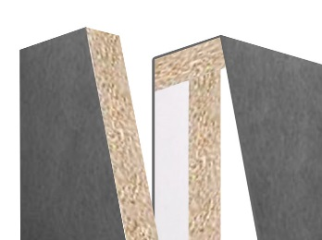
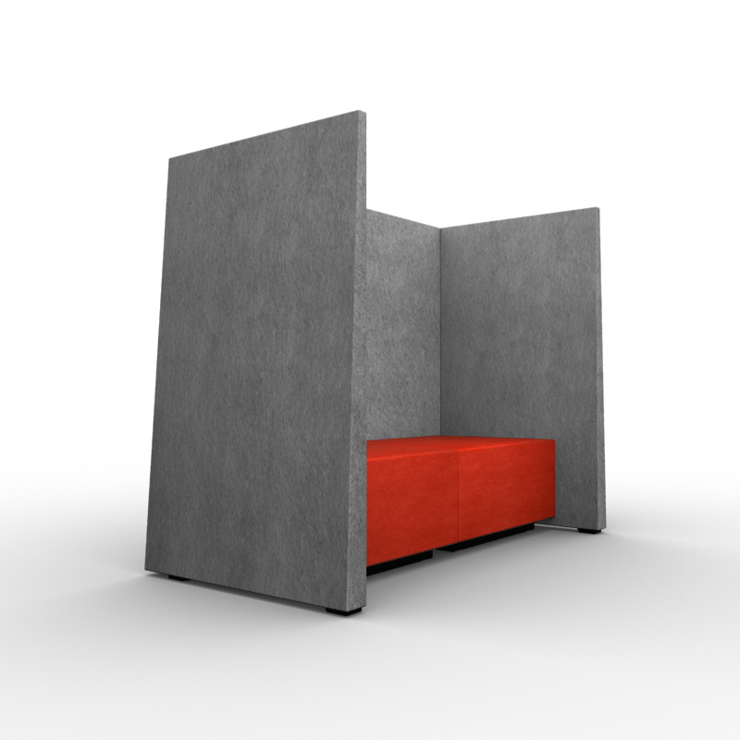
Acoustic walls
„Silent Box“ consists of acoustic sound-absorbing walls:
Frame is made of MDF (18mm) and MFC (18mm);
Frame is coated by specially shaped foam from outside and acoustic foam from the inside (see slide 15);
Dimensions (mm): 1810x925, H=1420 ;
Upholstered with felt „Velito Presto“;
Legs are made of MDF painted in black colour, H=39.
Felt (1 mm)
Acoustic wall cut
Acoustic foam (18 mm)
Foam
Raw chipboard (18 mm)

Slide 8
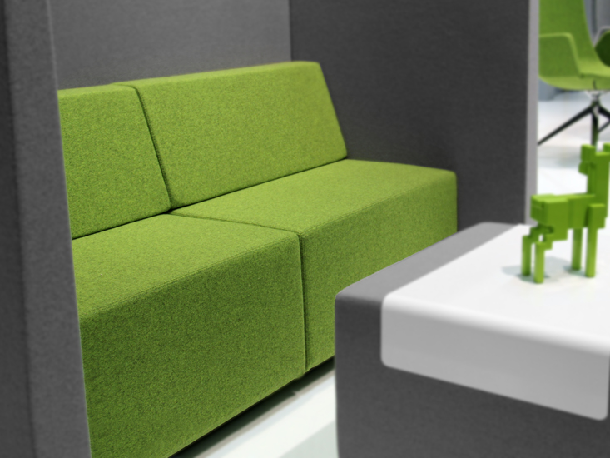
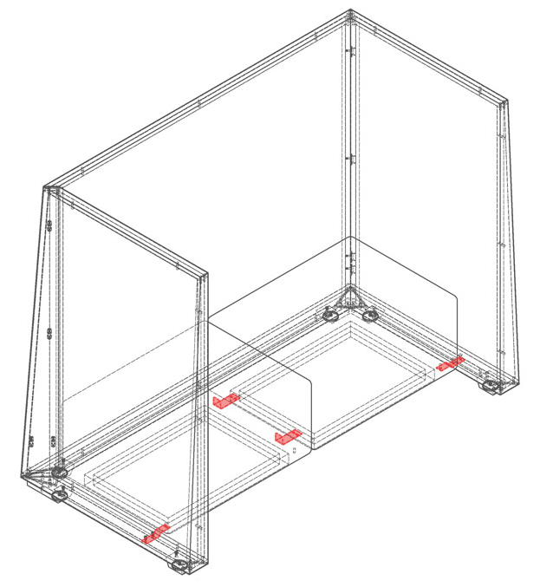
Poufs (without backrest)
Frame is made of plywood (15 mm) and MFC (15 mm);
Seat foam: upper part - 30mm thickness HR5050 (density: 48-51 kg/m³), inner part - 60 mm thickness HR3030 (density: 28-32 kg/m³);
Side foam: 20mm thickness HR3030 (density: 28-32 kg/m³);
Dimensions (mm): 800x600, H=400;
  Upholstered with felt „Velito“;
  Base is black painted metal (H=50mm) with 4 glides (H=5mm).
Linking parts (metal angles (mm): 40x45, H=113) allow to link the poufs into one line (example marked in red).

Slide 9
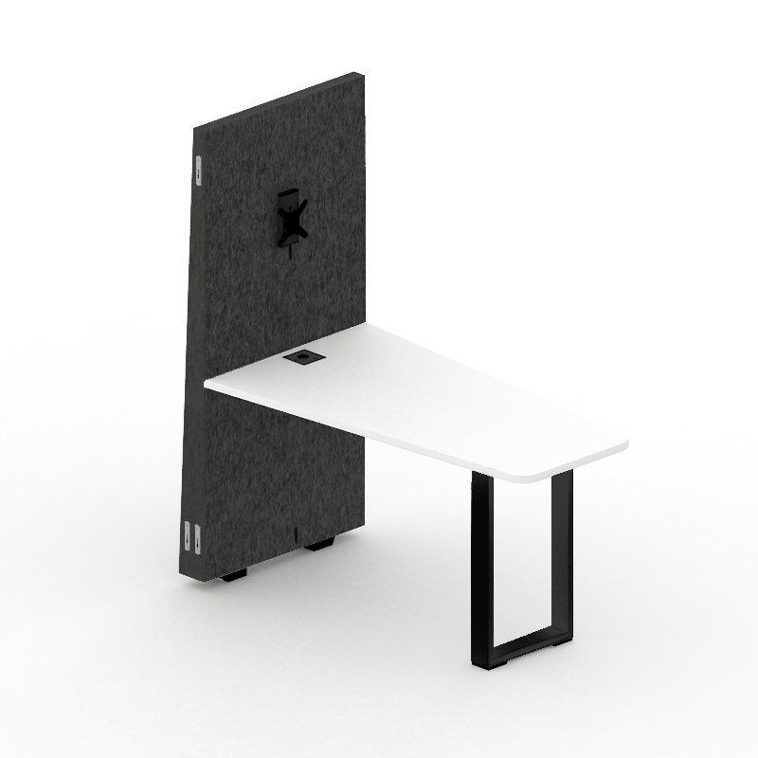
Desk and linking central wall
Desk and linking„Silent Box“ wall are combined.
Desk (1):
Desktop is made of LMDP, 25mm;
Leg is made of metal pipe (mm): 70x20x2;
Desk dimensions (mm): 1200x650, H=740;
  Black painted leg glides are made of MDF, H=16mm;
  Metal box for wire management is fixed under the desktop (mm): 185x150, H=100 (see slide 12) - if there is a power socket.
  Linking parts - metal angles (mm): 162x35x35
  (see slide 12).
  Linking central wall (2):
Frame is made of MDF (18mm) ir MFC (18 mm);
Frame is coated by specially shaped foam from outside and acoustic foam from the inside (see slide 15);
Dimensions (mm): 650x105, H=1420;
Upholstered with felt „Velito Presto“;
Black painted MDF legs, H=39;
Fittings are placed on the side to attach other walls;
Monitor holder has three height adjustable positions (see slide 13);
Space with zippers for wire management (see slide 10).
2
1

Slide 10
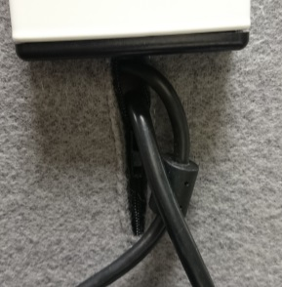
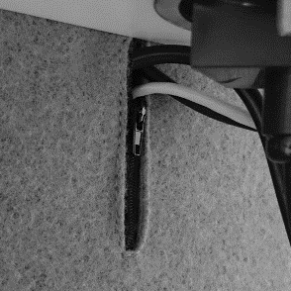
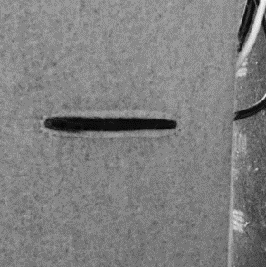
Easy wire management
There are three zippers sewn into the central wall for wire management
(only for AGS183):
Under the monitor holder;
Under the power socket;
In the lower part of the wall.
After combining all the „Silent Box“ parts the zippers become invisible.
1
2
3

Slide 11
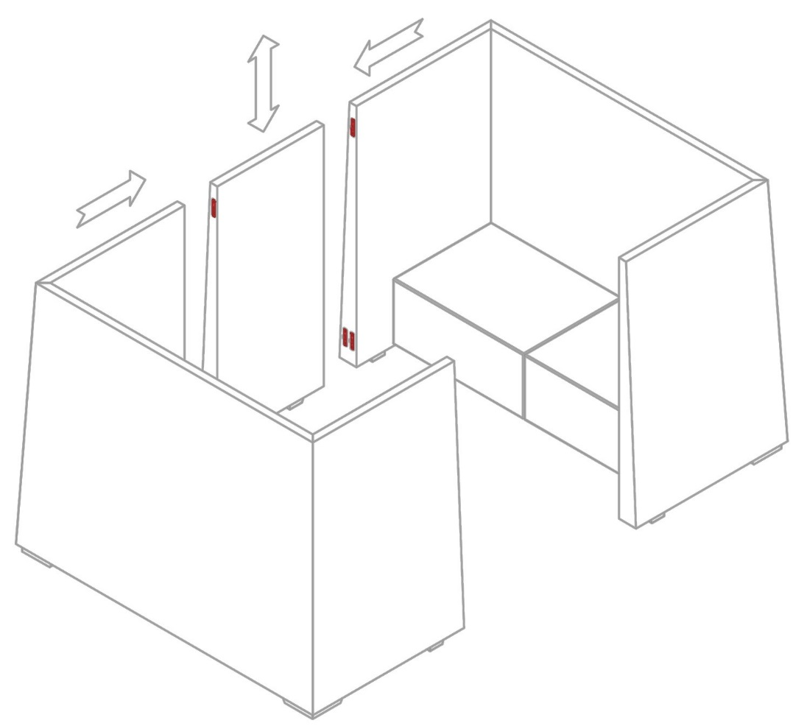
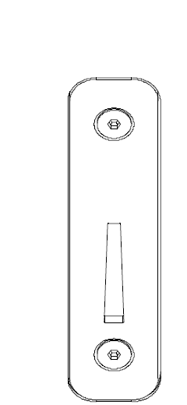
Acoustic walls interconnection
There are fittings (3 pieces per wall) on the side and central acoustic walls. By combining them we get one solid closed „Silent Box“ wall (tik AGS181, AGS182, AGS183).
Fitting

Slide 12
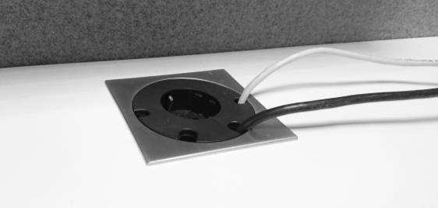
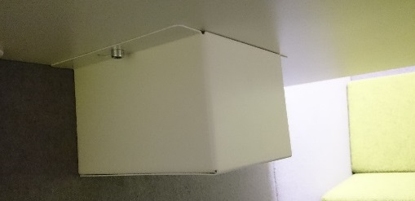
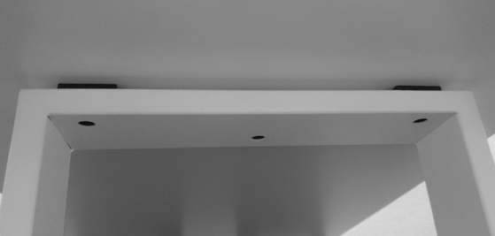
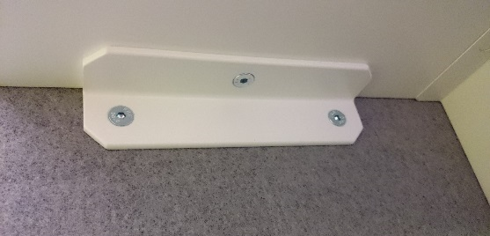
Desk details and fittings
Power socket with 4 wire management holes is mounted into the desktop (only for AGS183);
There is a metal box for wire management mounted under the desktop (mm): 185x150, H=100 (tik AGS183);
Metal leg is attached to the desktop with 3 plates and screw with 3 bolts;
Desktop is attached to center acoustic wall using connecting parts – 2 metal corners (162x35; H=35) screwed with 6 bolts.

Slide 13
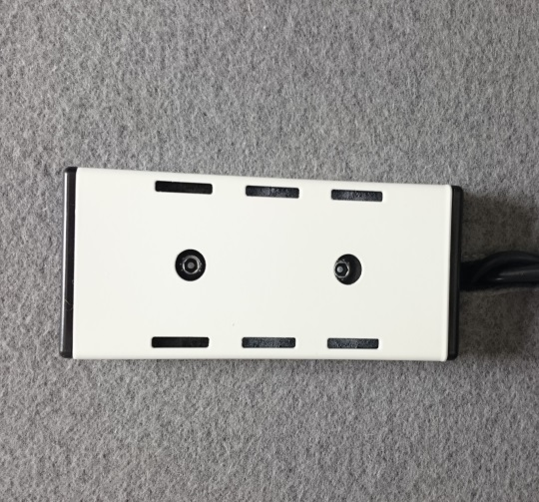
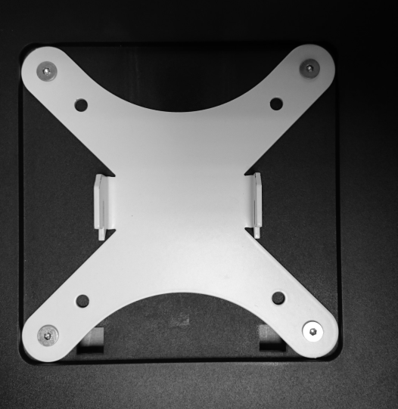
Monitor holder
Attached to the central wall and has 3 holes for height adjustment;
Load capacity up to 15 kg;
Adjusting monitor height does not require any tools;
Color is combined with desk leg (white or black).
Holder attached to the wall
Holder attached to the monitor
1
Height
adjustment
holes
2
3

Slide 14
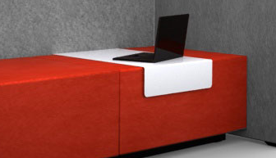

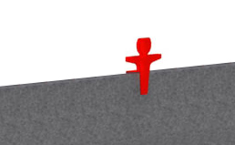
Accessories
Back cushion:
Made of foam (HR3538);
Upholstered with felt „Velito Presto“;
Zipper sewn into the lower part.
Metal table:
Dimensions: 602x400, H=122;
Colors: white, black.
100 mm
300 mm
Warning sign „Do not disturb man“ made of red color painted metal.
800 mm
200 mm

Slide 15
ACOUSTIC MATERIAL „Basotect G“
Sound absorption diagram in accordance with DIN EN ISO 11654
Absorption degree
Frequency
Sound absorption coefficient αw = 0,45
Class of the sound absorption: D

Slide 16
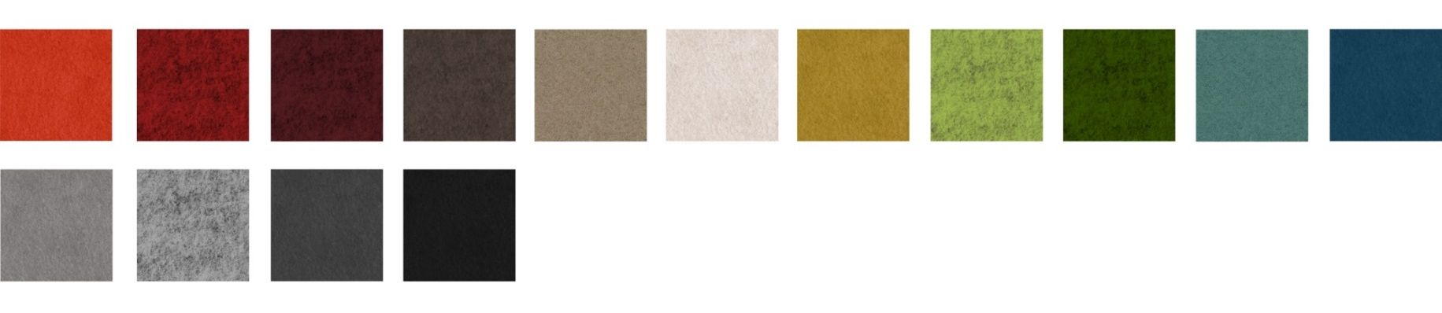

Covers
Velito Presto:
Metal part color:
Melamine:

Slide 17
Let the work flow with JAZZ...

