Slide 1

T-EASY
DESKS | MEETING TABLES

Slide 2
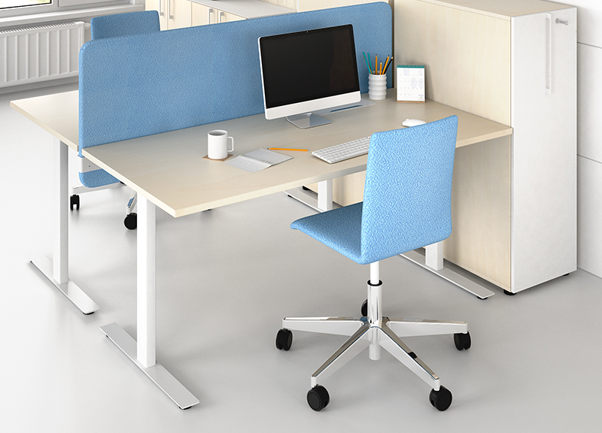
T-EASY
Desks with T-shaped legs do not restrict user‘s space and freedom of movement.

Slide 3
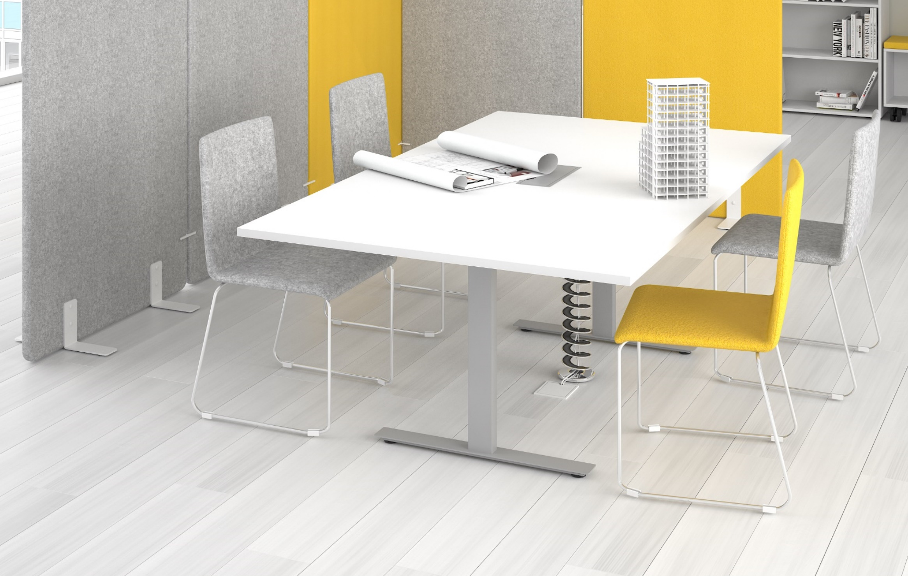
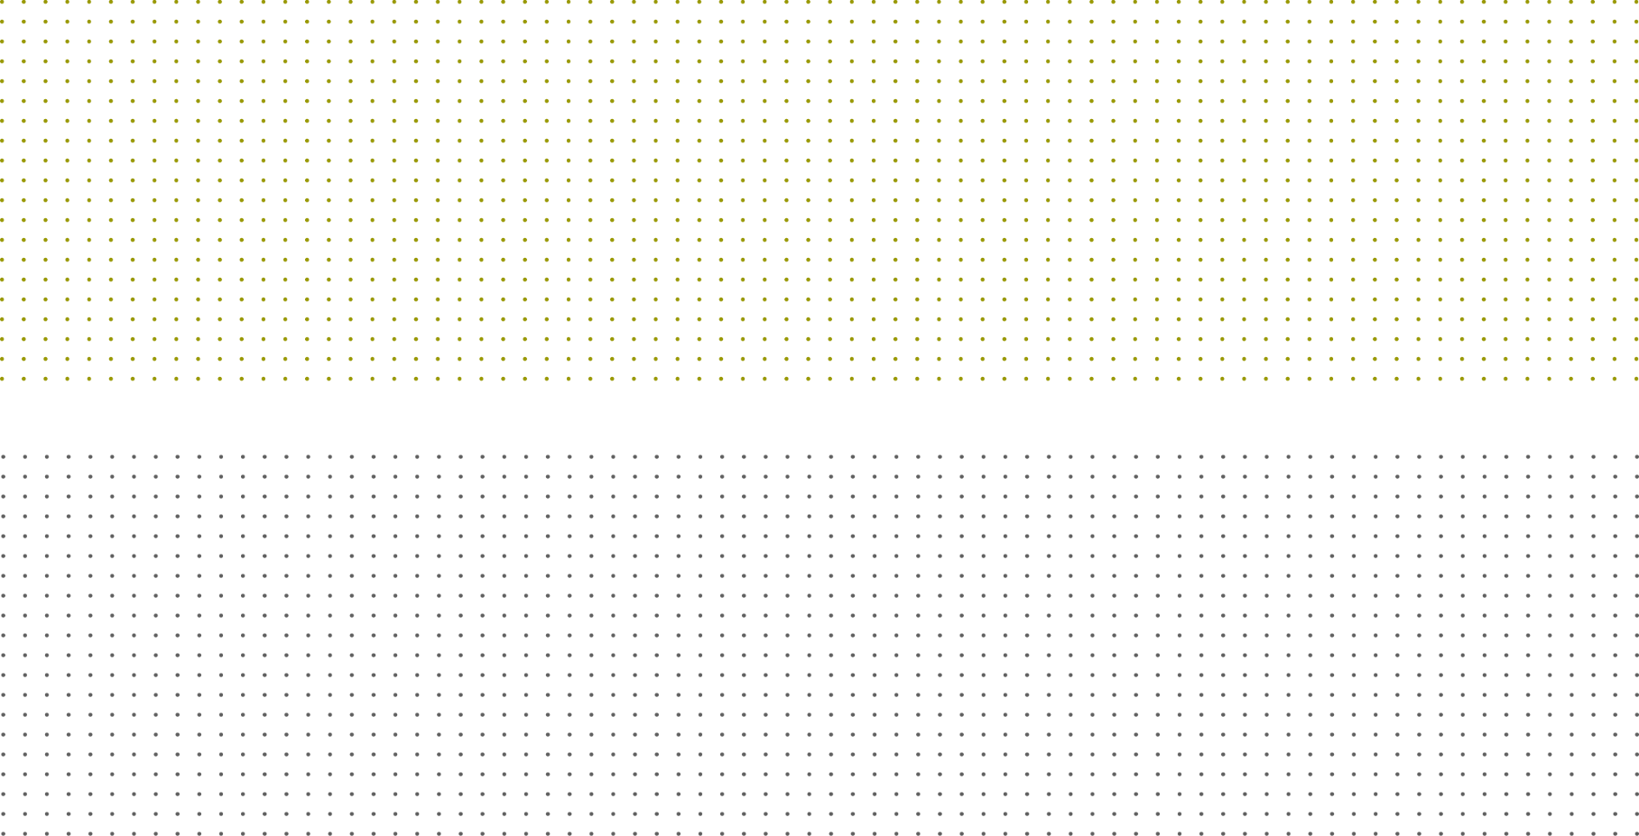

Slide 4
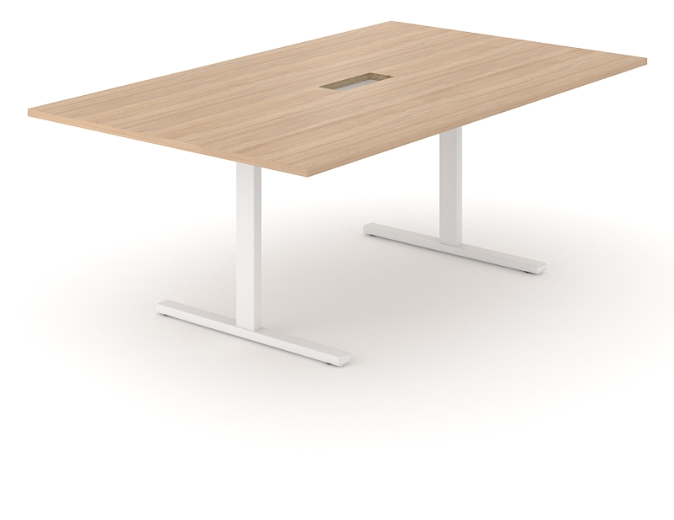
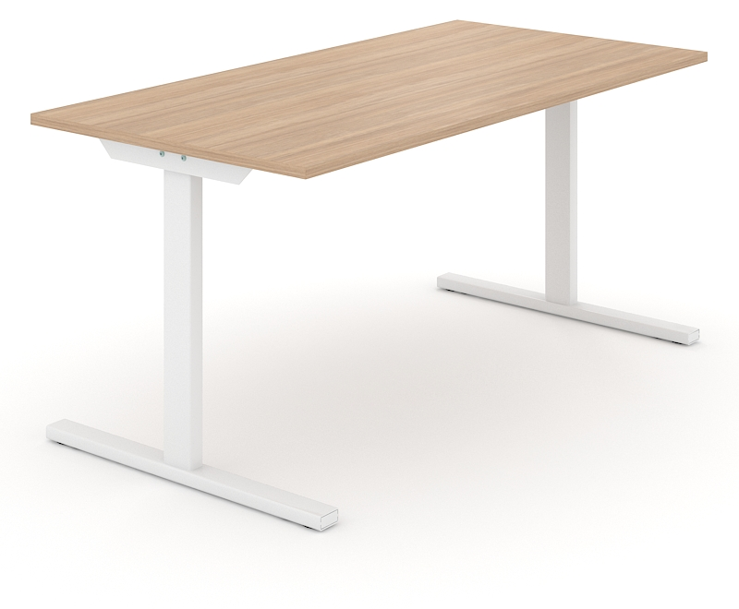
Two types of desks
Desks
Meeting tables

Slide 5
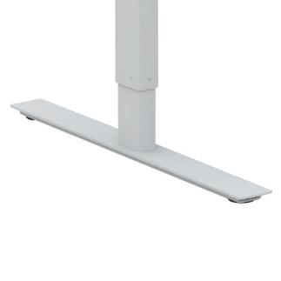
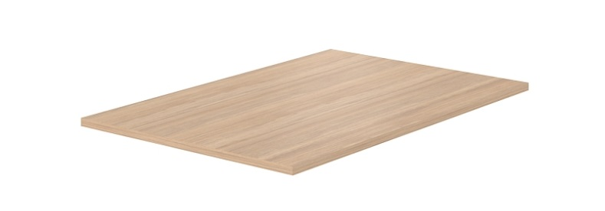
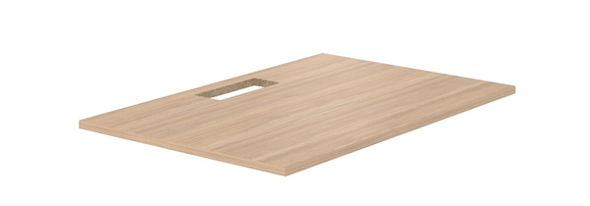
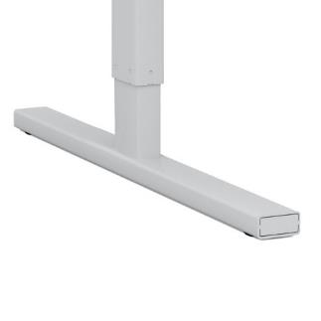
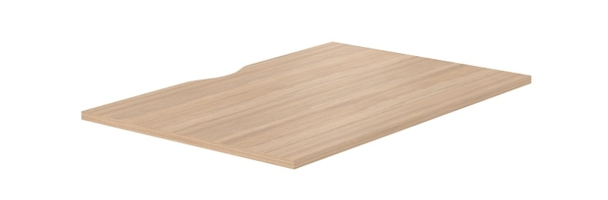
2 types of feet
3 types of desktop
Plain
W
With cut-out for grommet
I
With cut-out (scallop) for wire management

Slide 6
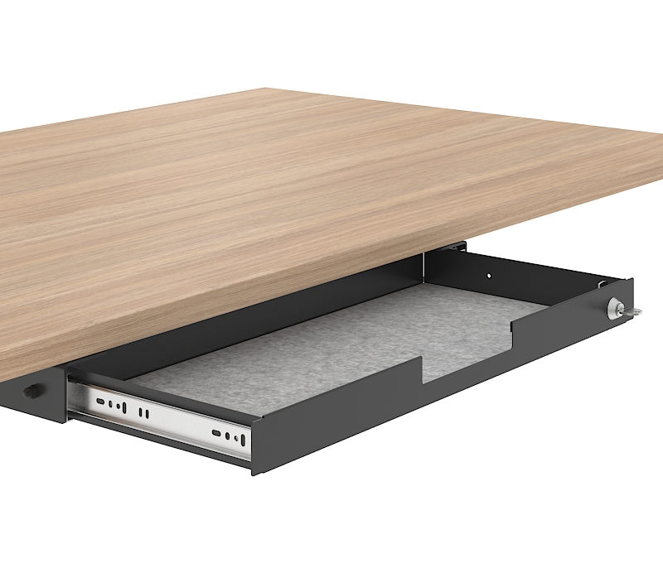
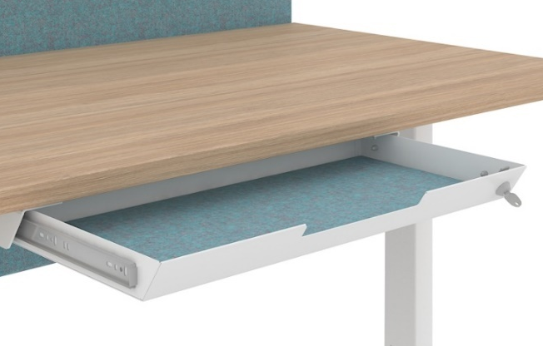
2 options of fabric-lined metal drawers with lock
NEW

Slide 7

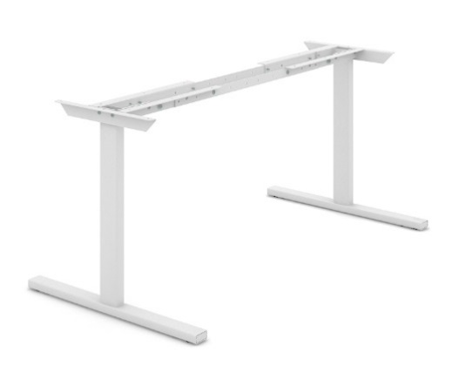


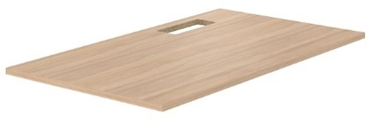
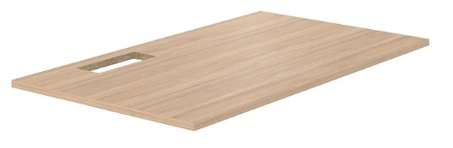
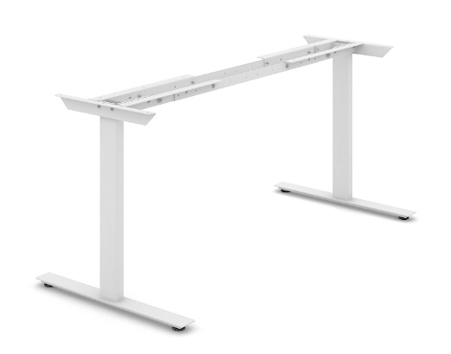

Range
Desks
Meeting tables
Telescopic frame with legs
Desktop with cut-out for grommet
Plain
With cut-out for grommet
2000x1200 / 2400x1200 mm
With cut-out (scallop) for wire management
! Desk length 1200 / 1400 / 1600 / 1800 mm

Slide 8
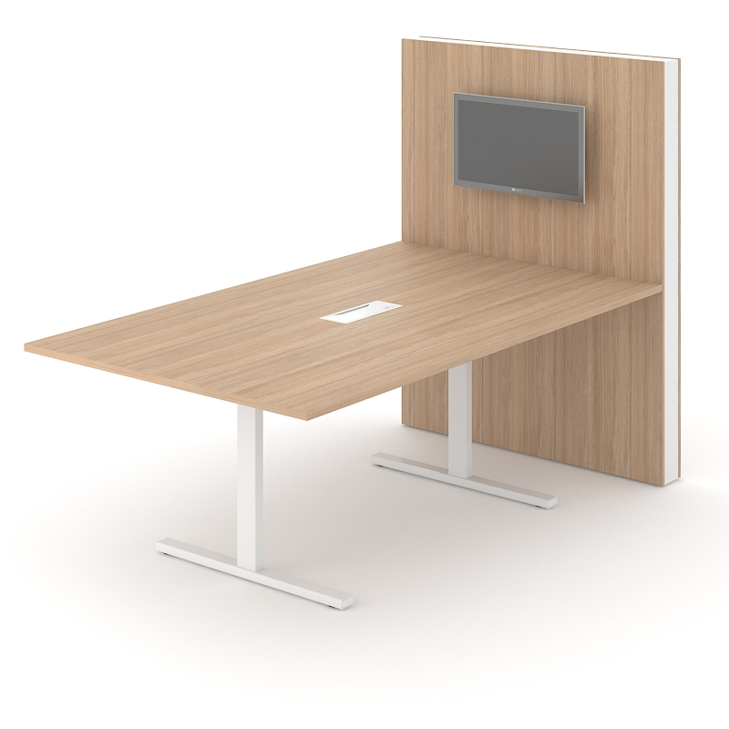
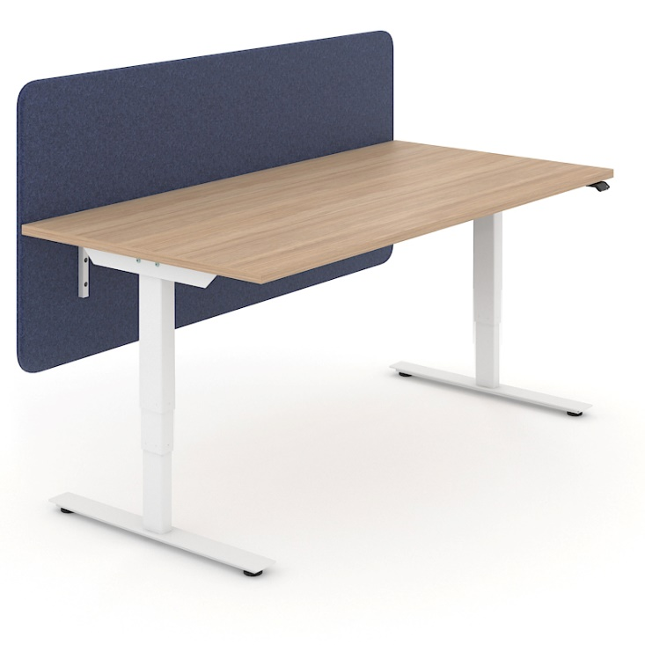
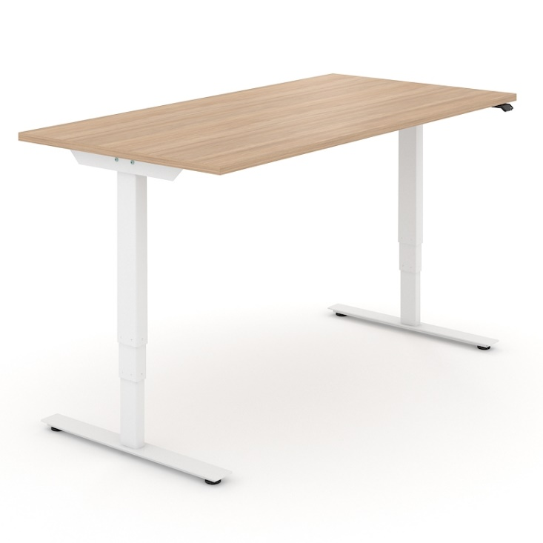
T-EASY desks are compatible with:
EASY screens
EASY sit-stand desks
MEDIA conference wall

