Slide 1
TANGO
Exceptional character with a smile

Slide 2
“Elegant and divided back enlarges the comfort of the chairs and at the same time the chair has a strong iconic expression.”
Christina Strand and
Niels Hvass

Slide 3
DESIGN
Notes:
You need two to TANGO:

Slide 4
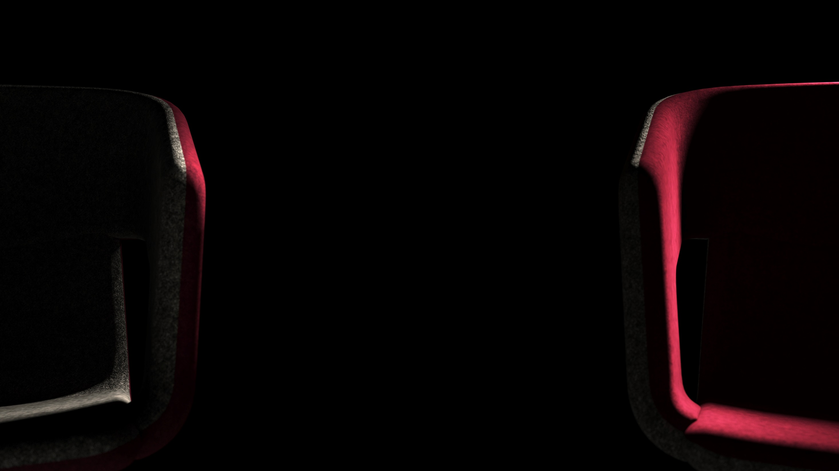
It takes two
to TANGO!

Slide 5
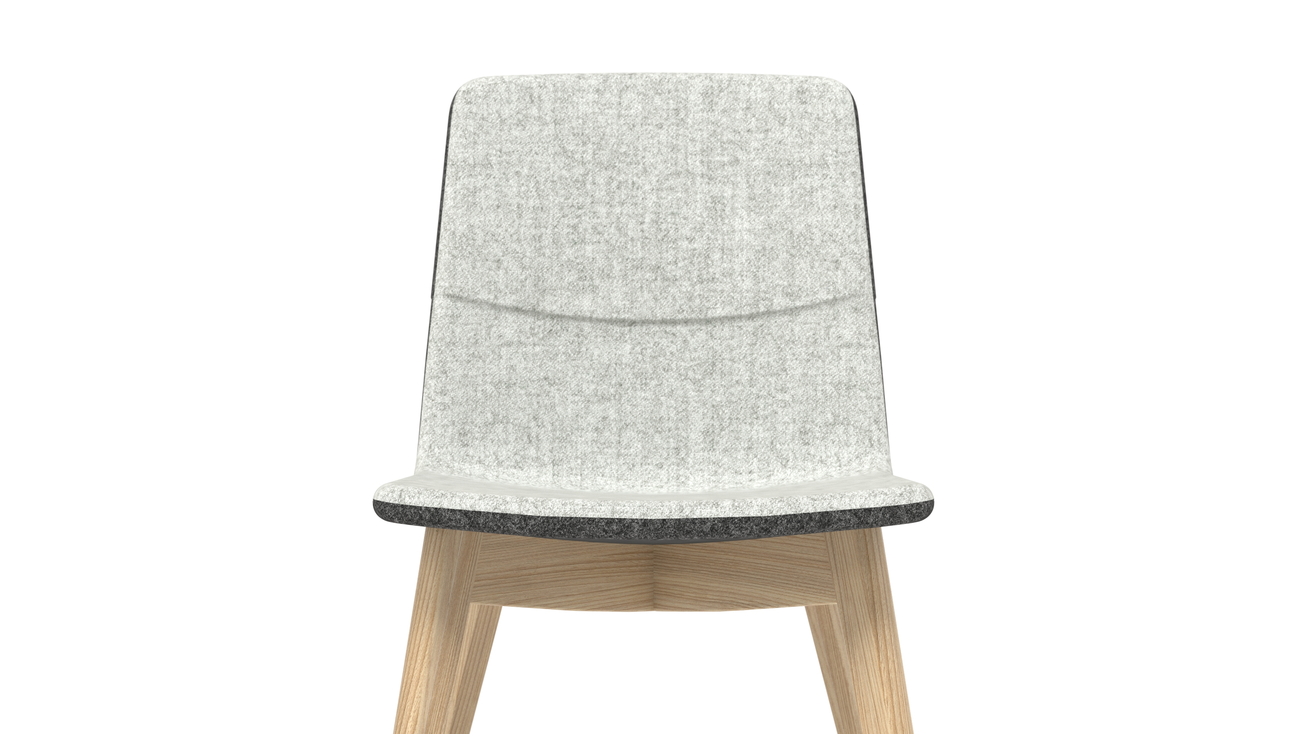
Unforgetable smile
Notes:
The TANGO family features a divided back which gives a unique character to these chairs. A distinctive connection between the top and bottom parts of the chair creates an instantly recognizable line in the shape of a “smile”, a unique feature characteristic of the TANGO furniture.

Slide 6
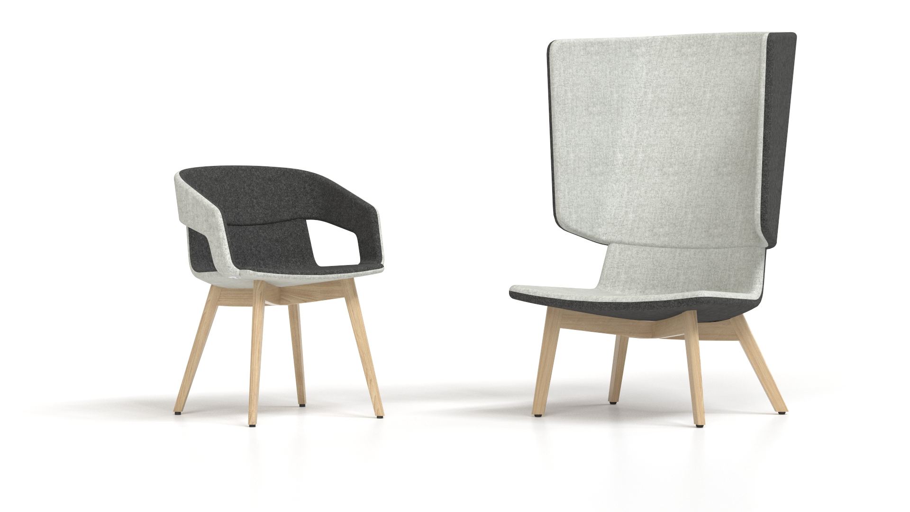
Extraordinary contrast
Notes:
Select any upholstery fabric you like from our standard colour range or mix and match different colours to create a contrast between the interior and exterior surface of the chair for a more unique look.

Slide 7
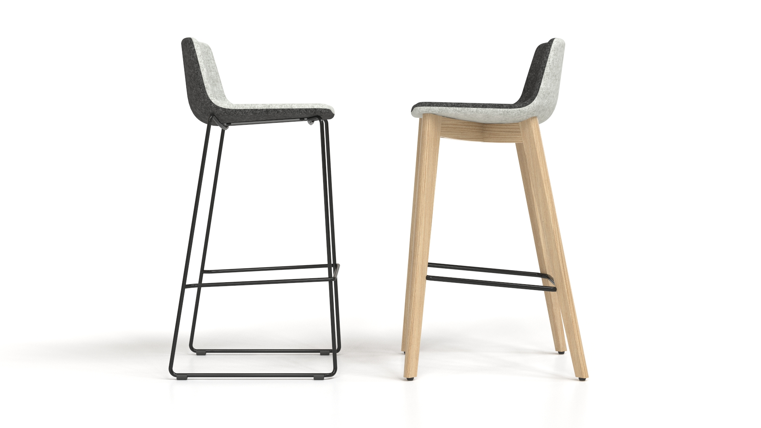
Uncompromising style
Notes:
Each TANGO chair comes in a range of different base options. When choosing the right one, consider your functional needs as well as the fabric or design that suits your individual preferences, without making any compromises. Metal bases have a more modern look and are more practical, whereas wooden ones give the office a more homely feel and at the same time add more elegance to the room.

Slide 8
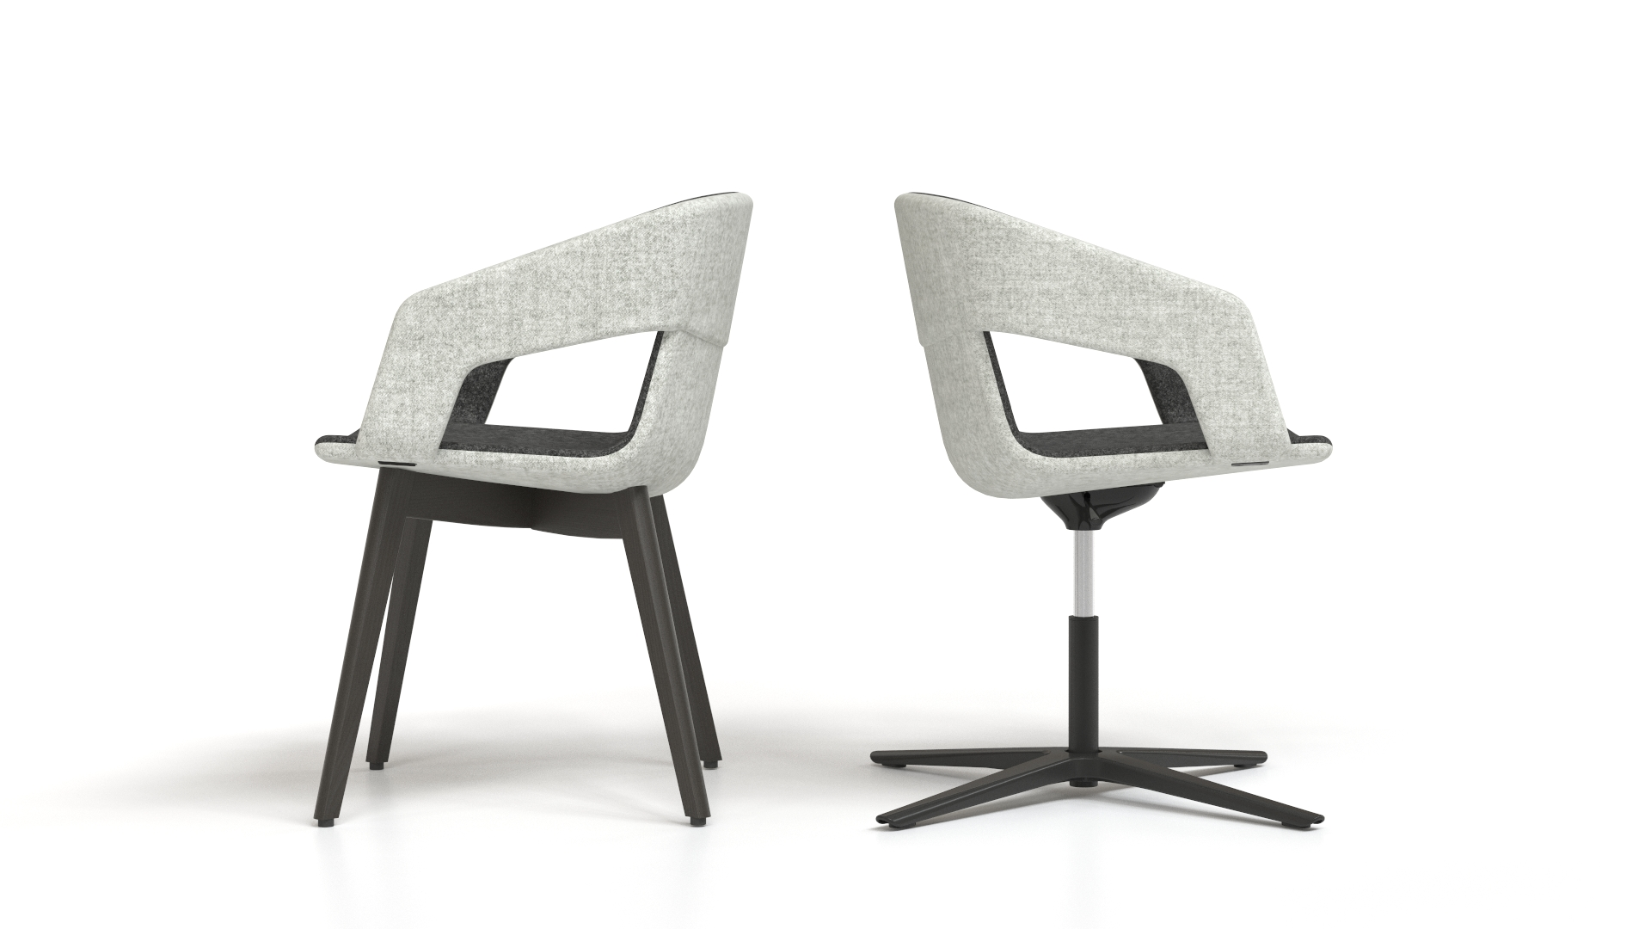
Unique
selection
Notes:
Metal or wooden chair bases are available in both dark and light colours: metal bases in a chrome or dark paint finish, and wooden bases in light ash or black-stained ash. You can choose a black-stained ash finish if you prefer an elegant yet contemporary style, or opt for a black metal finish if you want a more practical, yet sophisticated, look.

Slide 9
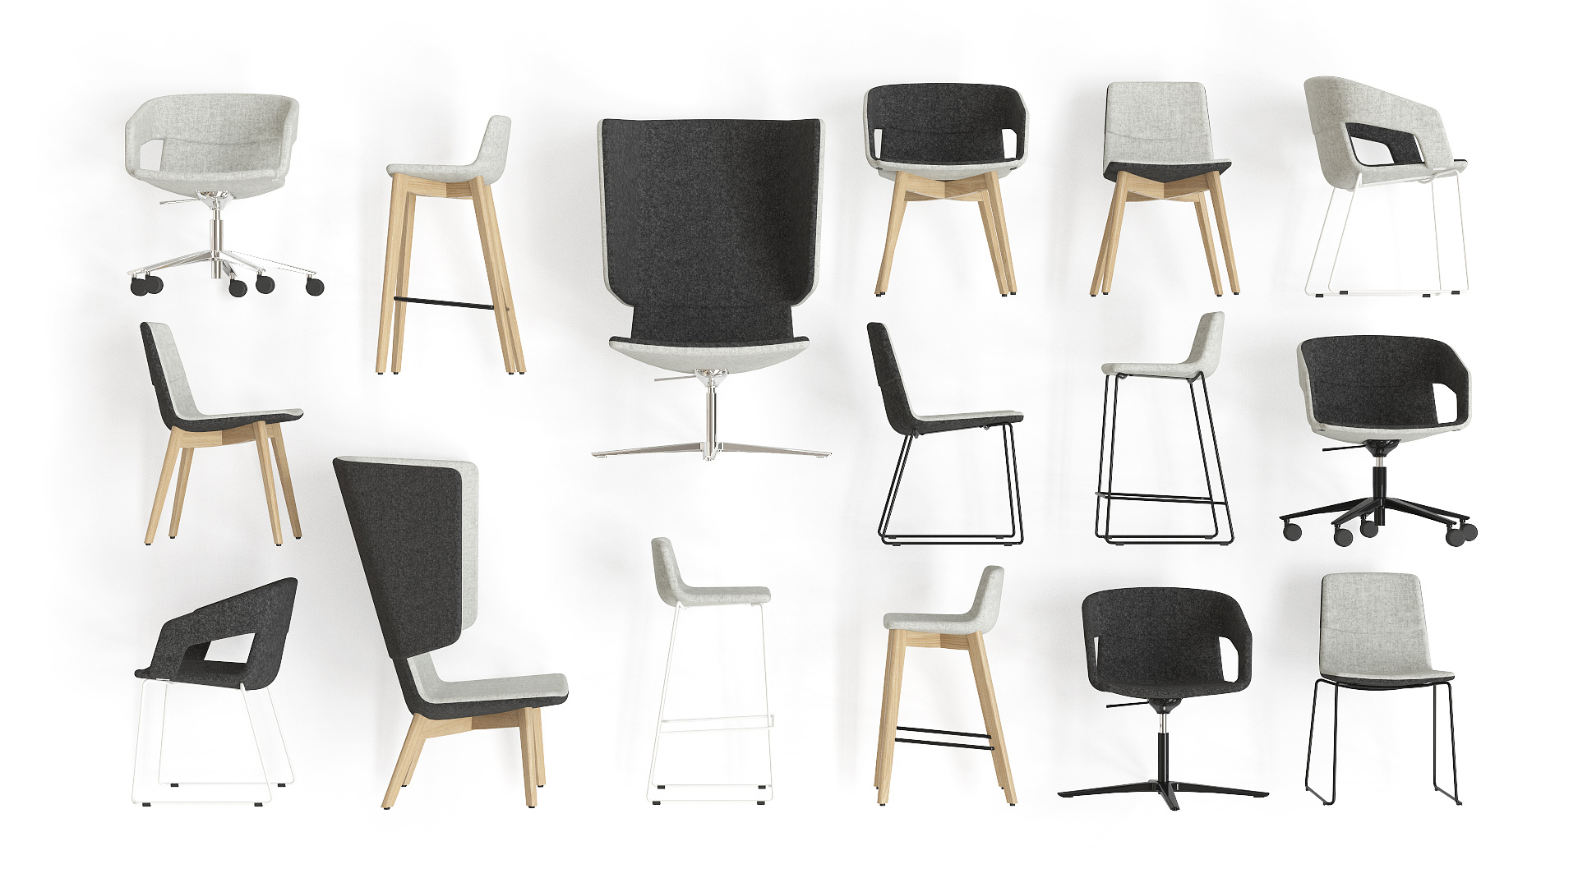

Slide 10
RANGE

Slide 11
Dance of style whenever, whatever...
Notes:
Dance of style whenever, wherever

Slide 12
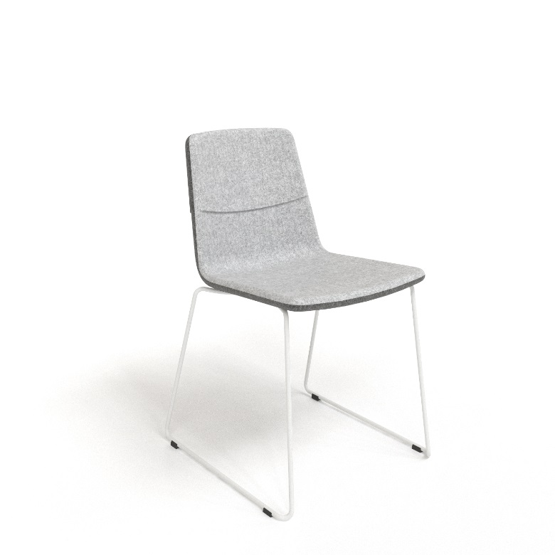
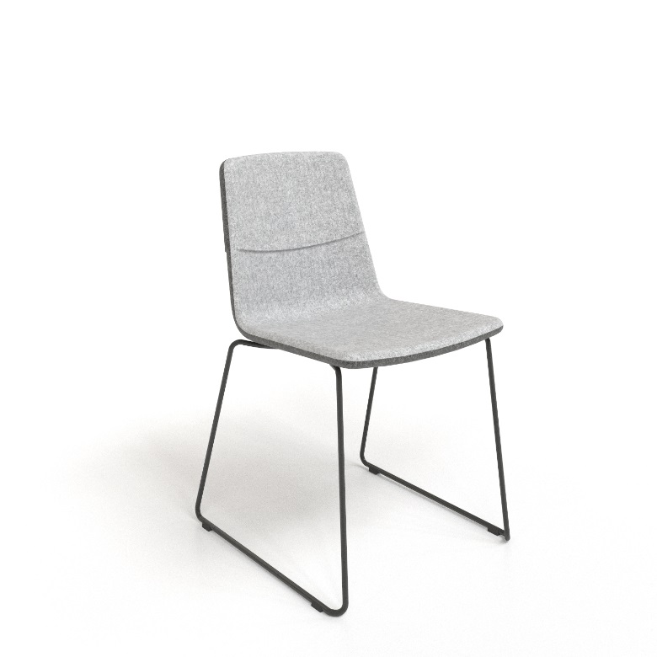
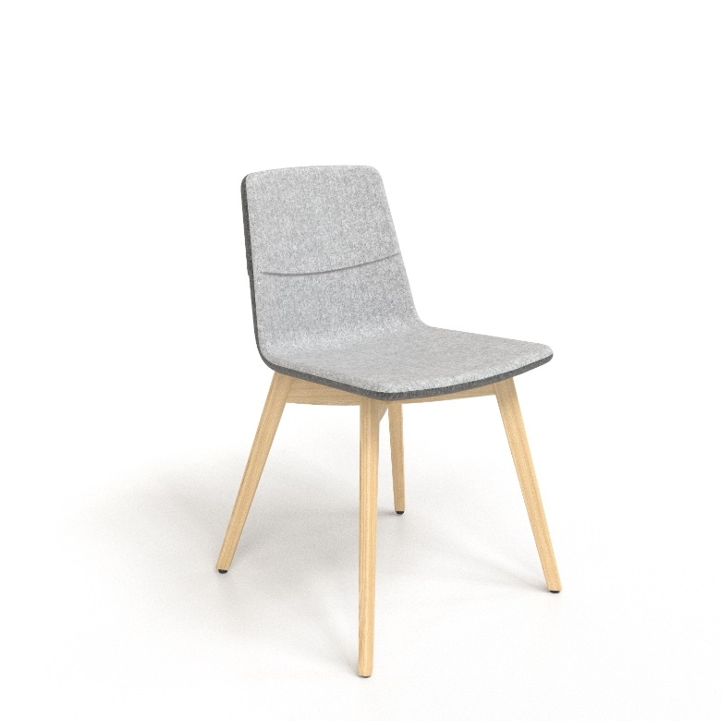
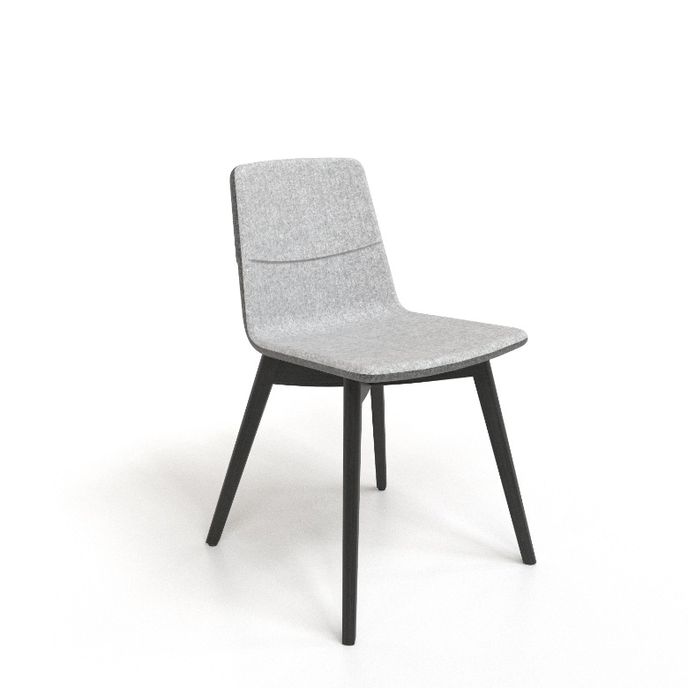
Visitor & Conference chairs
Metal frame
White painted
Metal frame
Black painted
Wooden frame
Ash
Wooden frame
Black stained ash

Slide 13
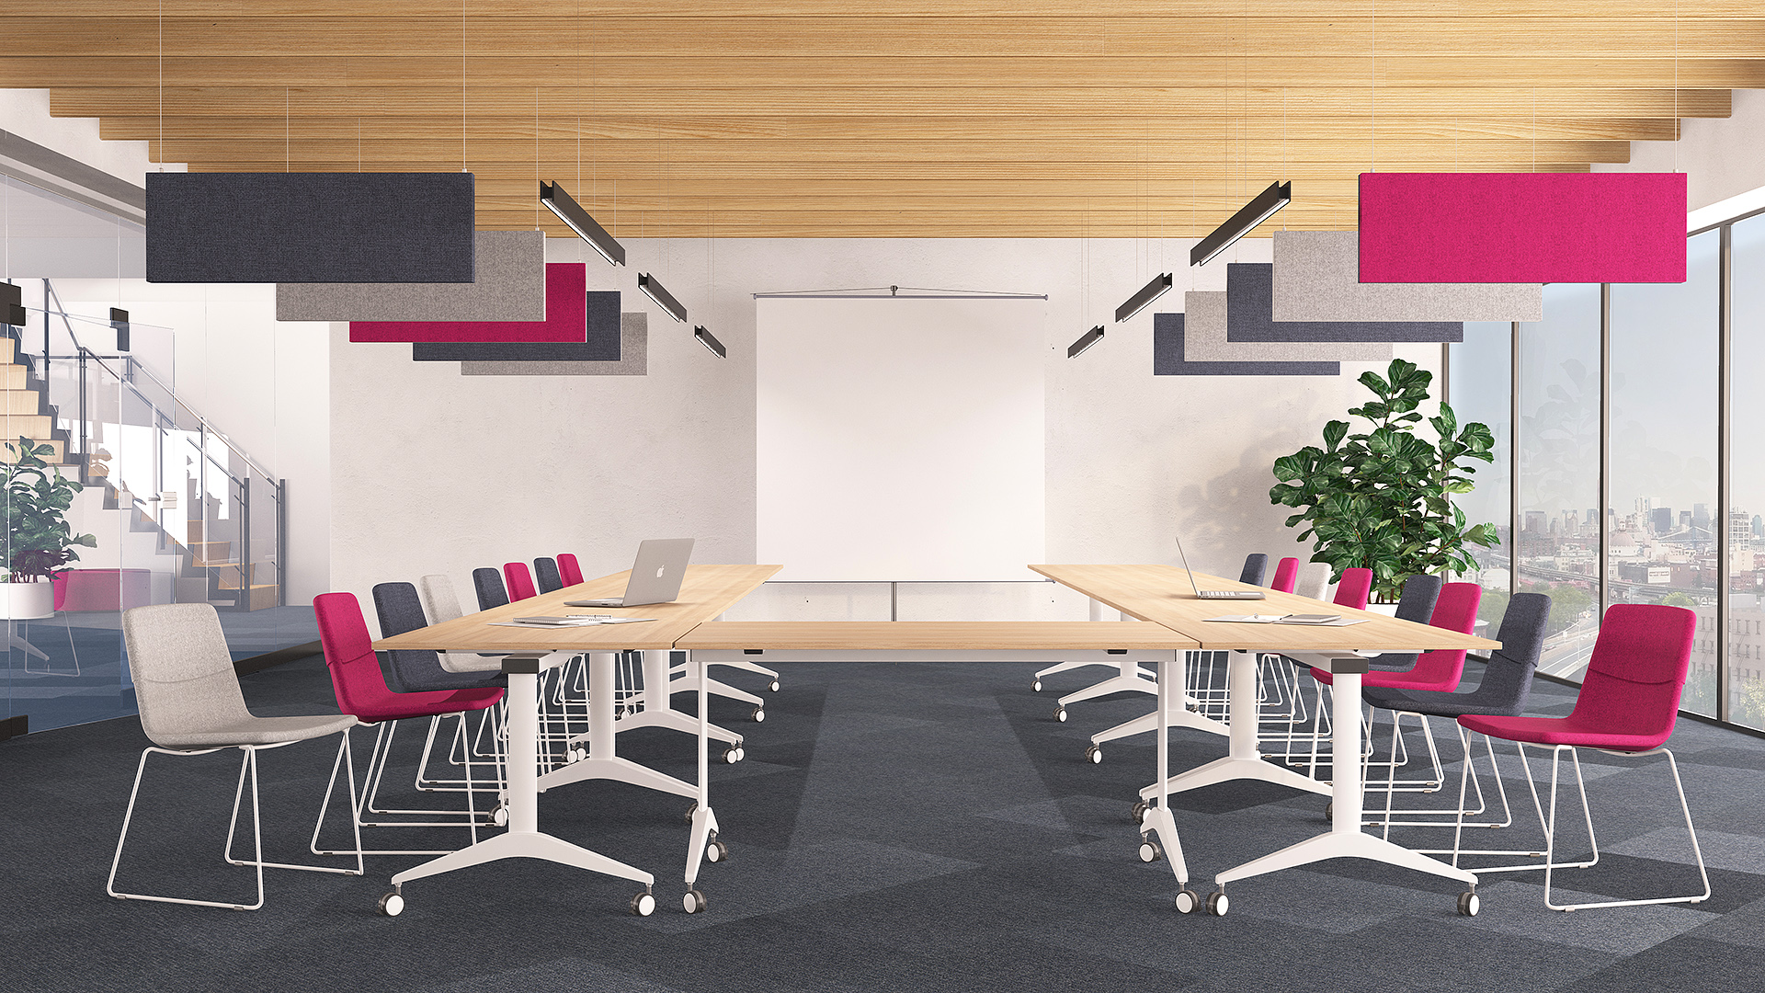
Visitor & Conference chairs

Slide 14
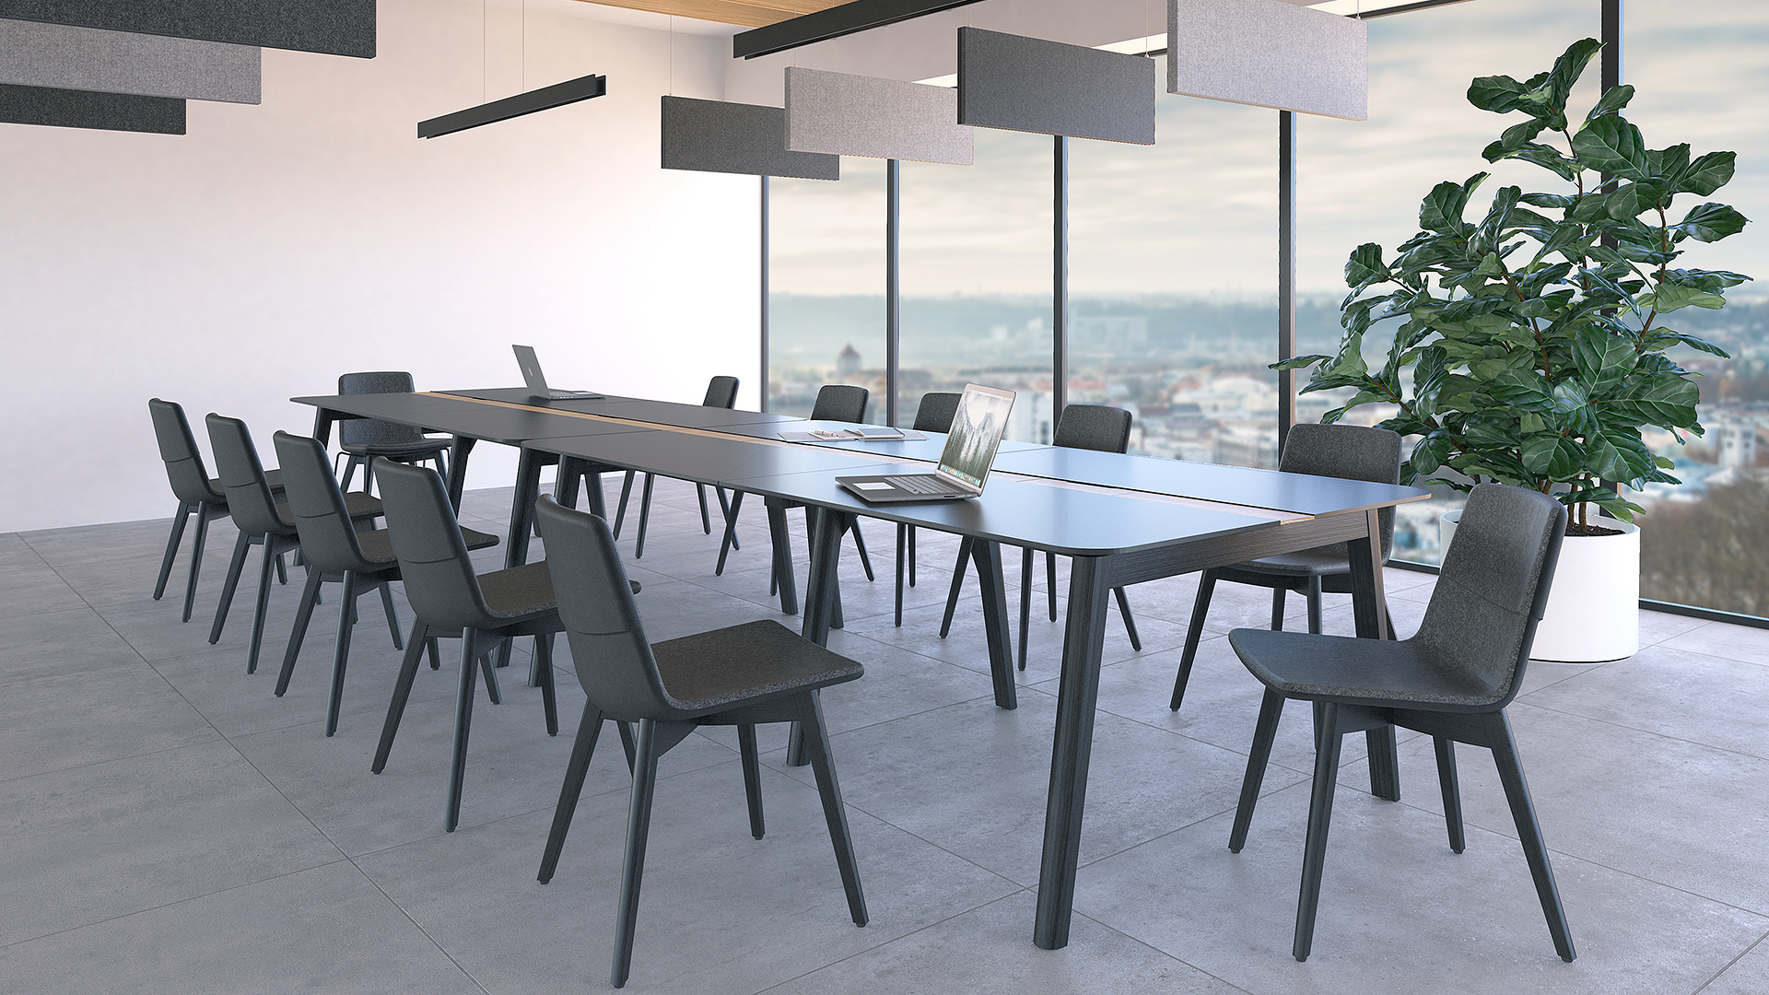
Visitor & Conference chairs

Slide 15
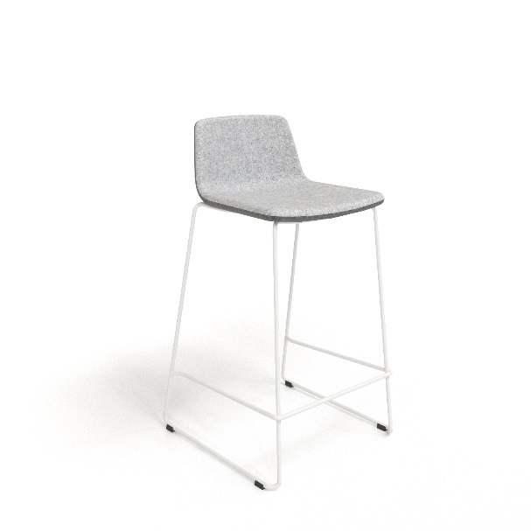
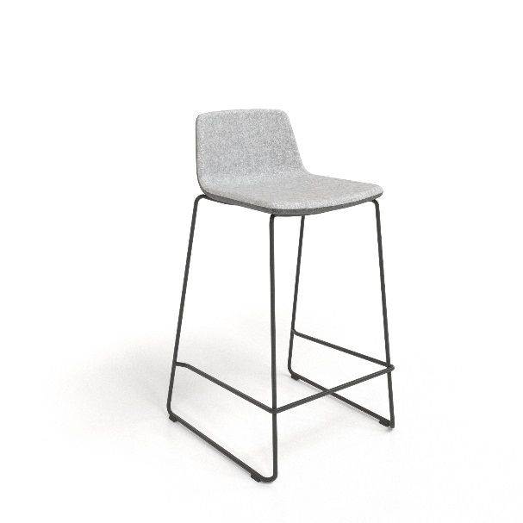
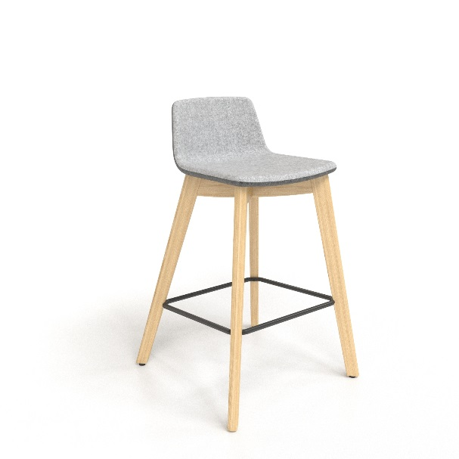
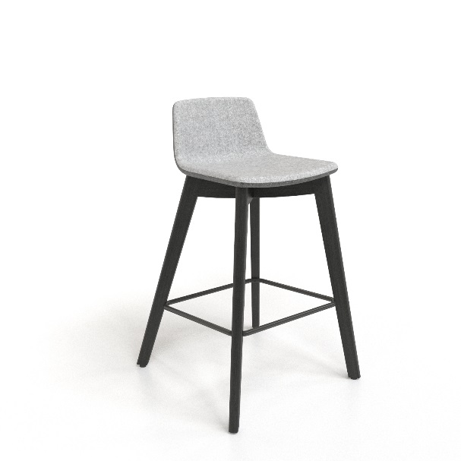
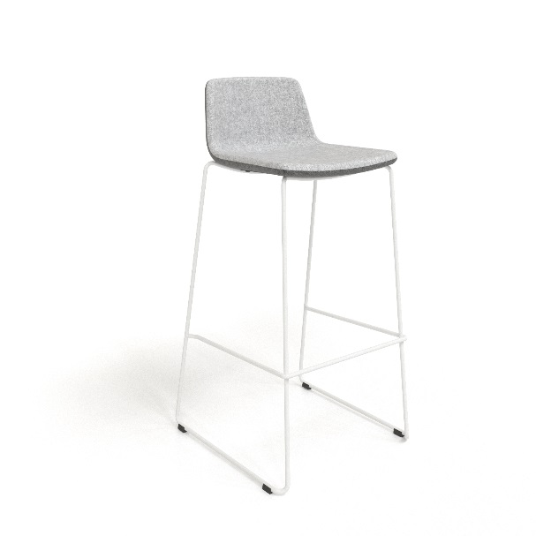
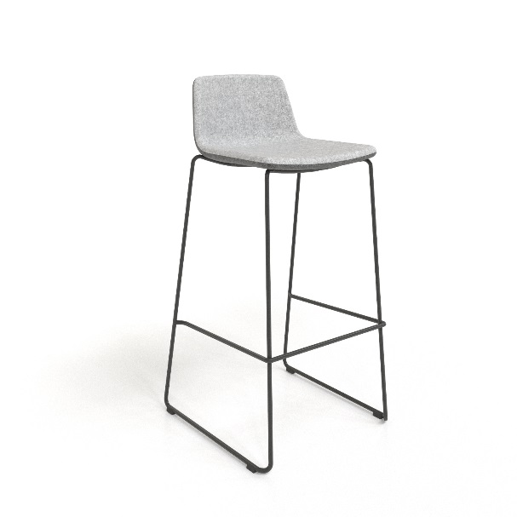
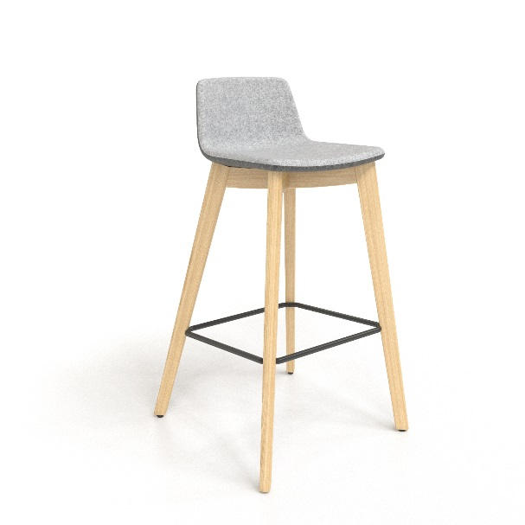
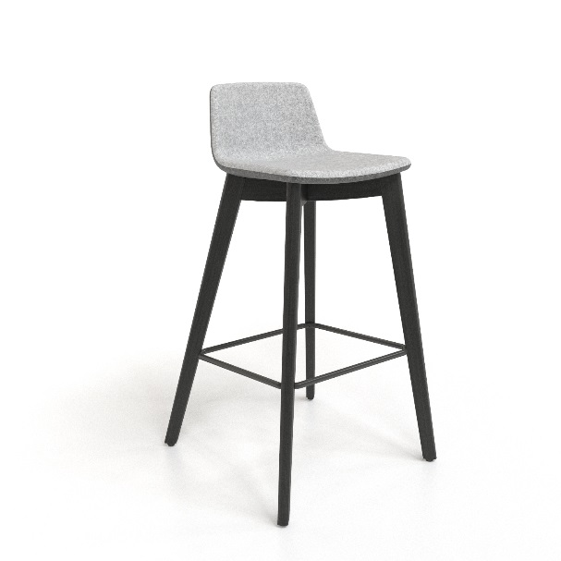
High chairs
Metal frame, low
White painted
Metal frame, low
Black painted
Wooden frame, low
Ash
Wooden frame, low
Black stained ash
Metal frame, high
White painted
Metal frame, high
Black painted
Wooden frame, high
Ash
Wooden frame, high
Black stained ash

Slide 16
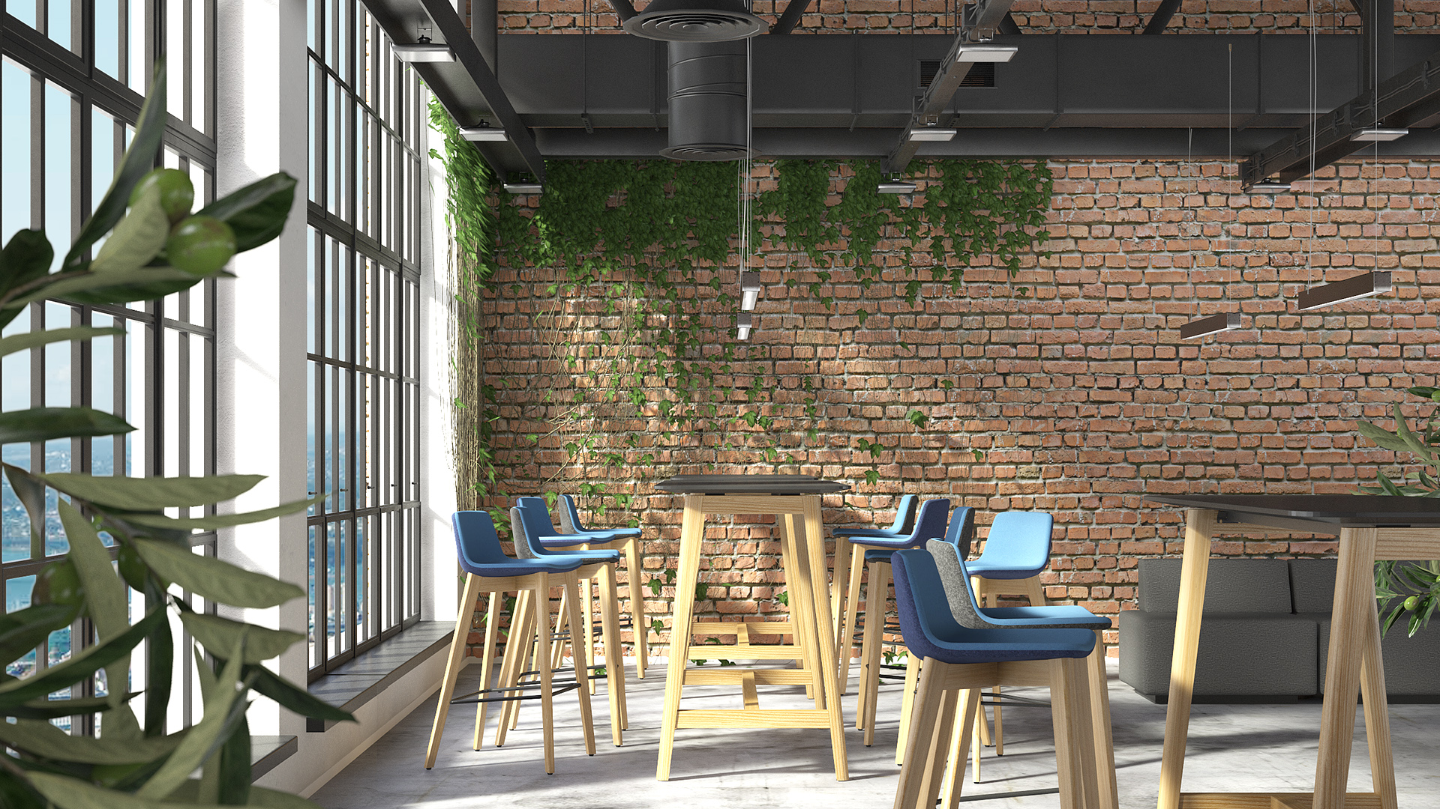
High chairs

Slide 17
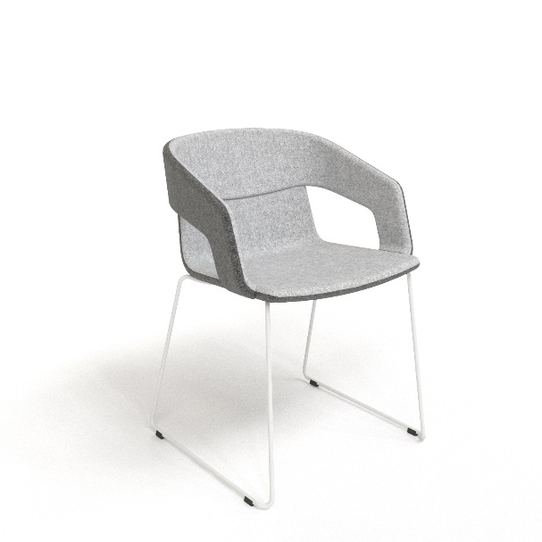
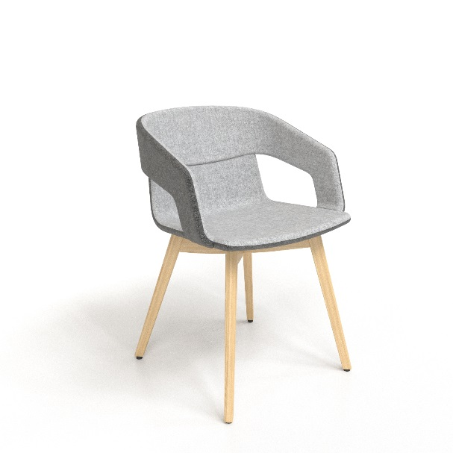
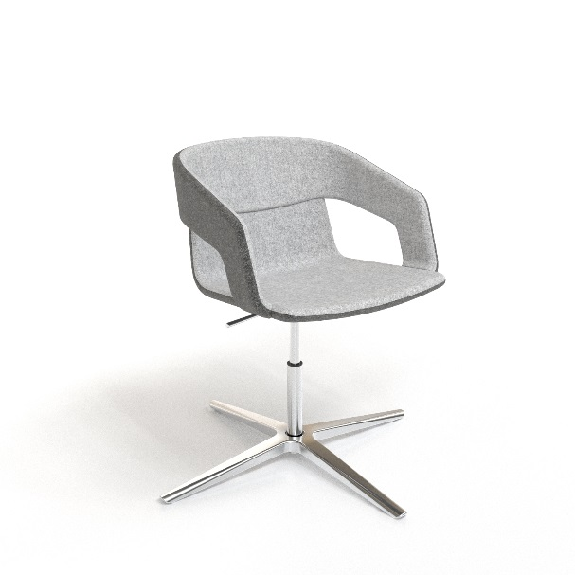
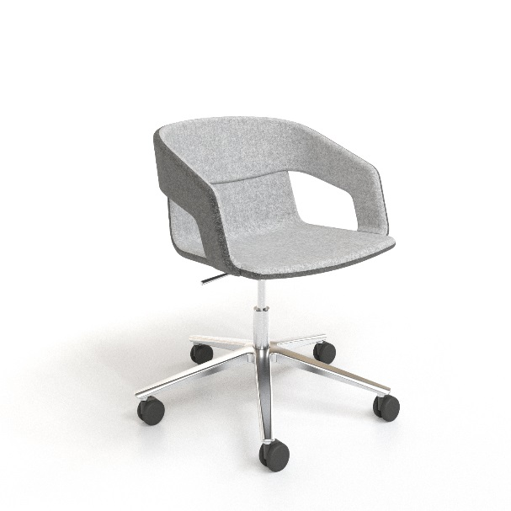
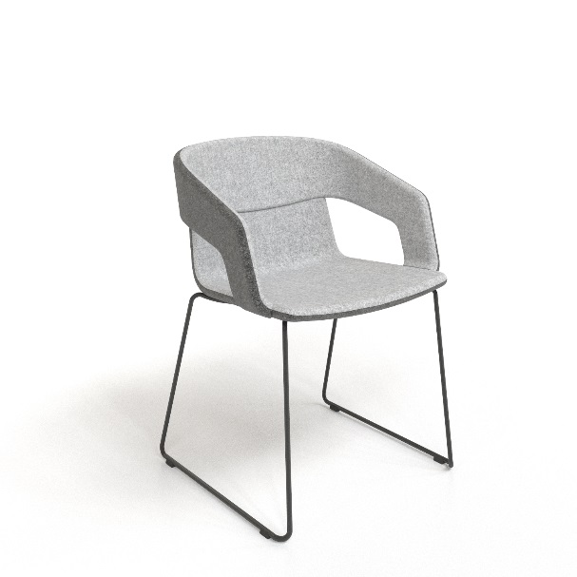
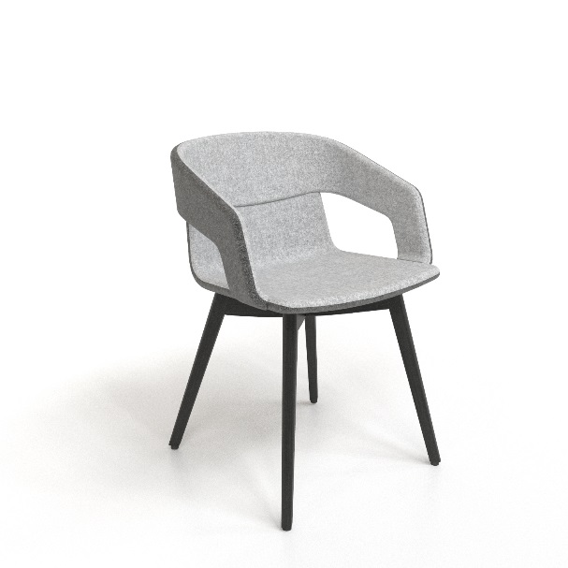
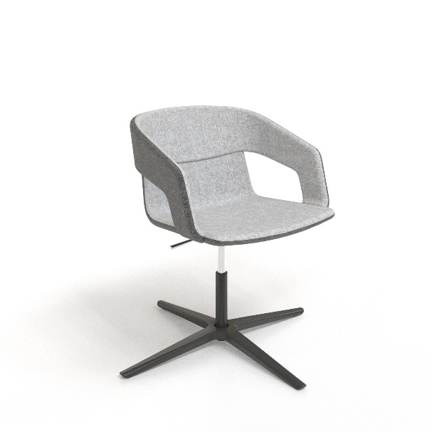
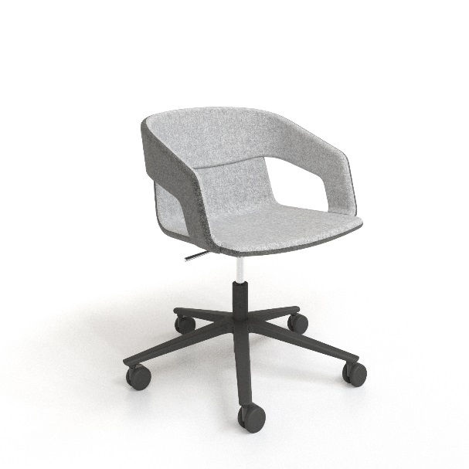
Lounge & Soft furniture
Metal frame
White painted
Wooden frame
Ash
4-point star
Chrome
5-point star
Chrome
Metal frame
Black painted
Wooden frame
Black stained ash
4-point star
Black painted
5-point star
Black painted

Slide 18
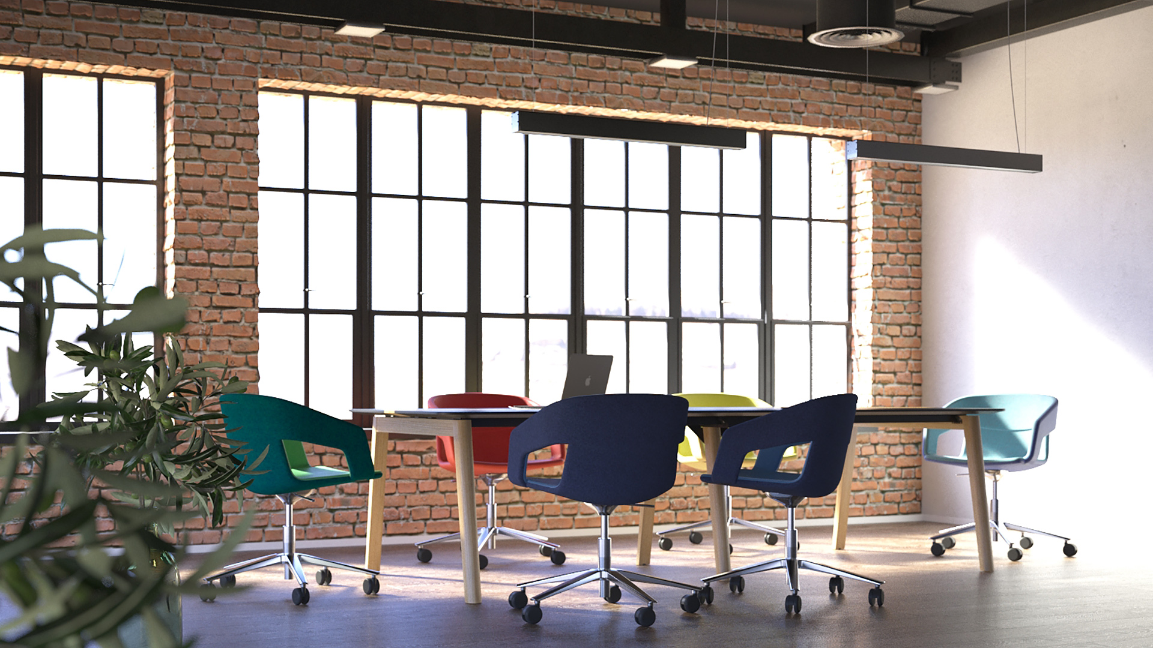
Lounge & Soft furniture

Slide 19
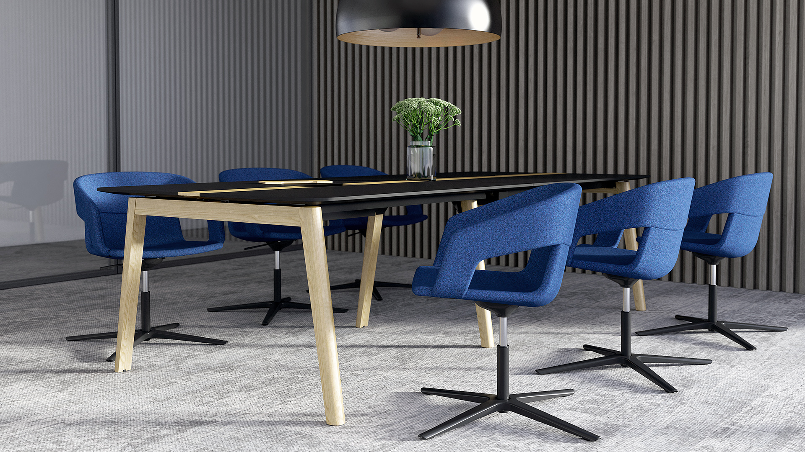
Lounge & Soft furniture

Slide 20
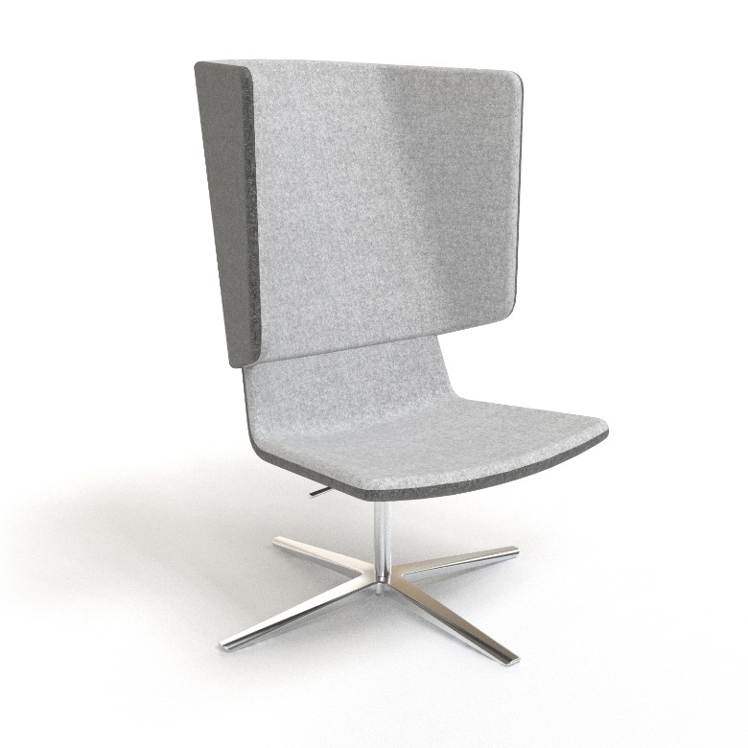
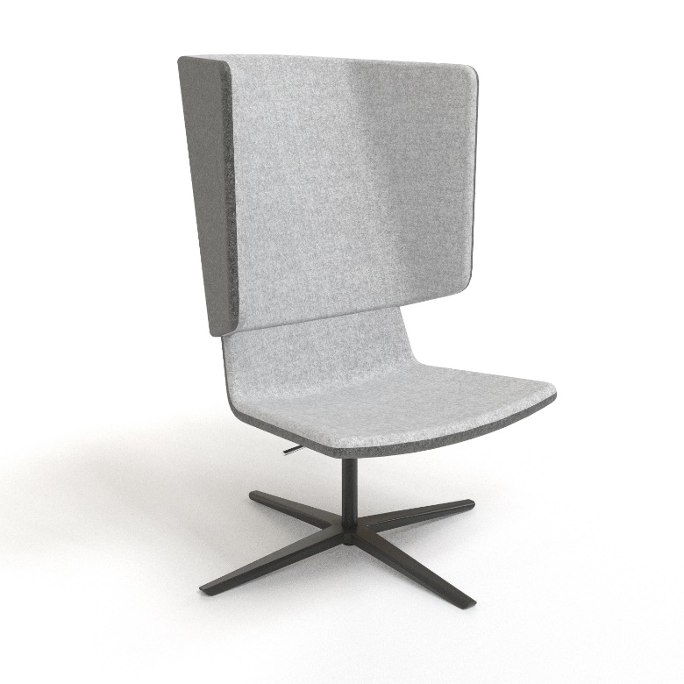
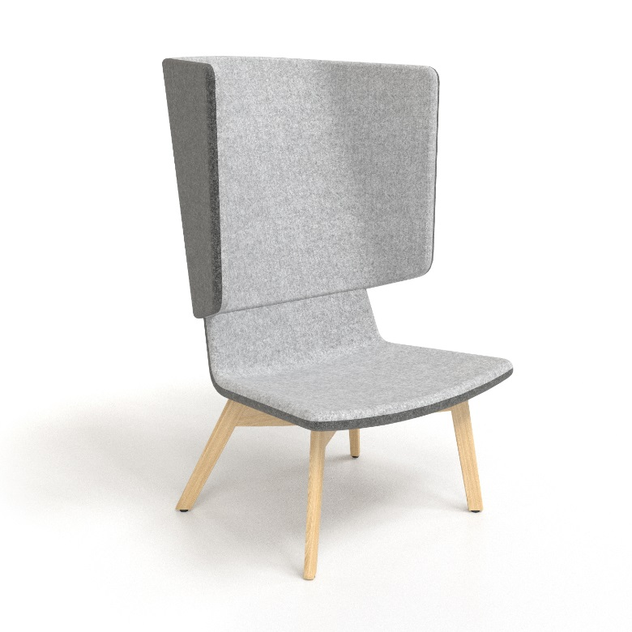
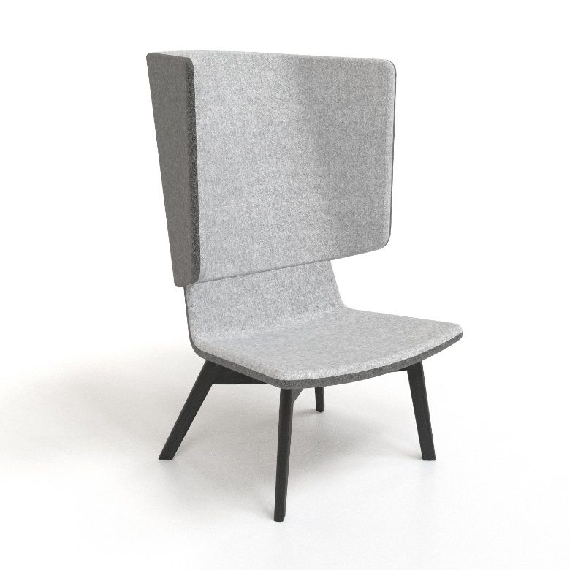
Lounge & Soft furniture
Metal frame
Chrome
Metal frame
Black painted
Wooden frame
Ash
Wooden frame
Black stained ash

Slide 21
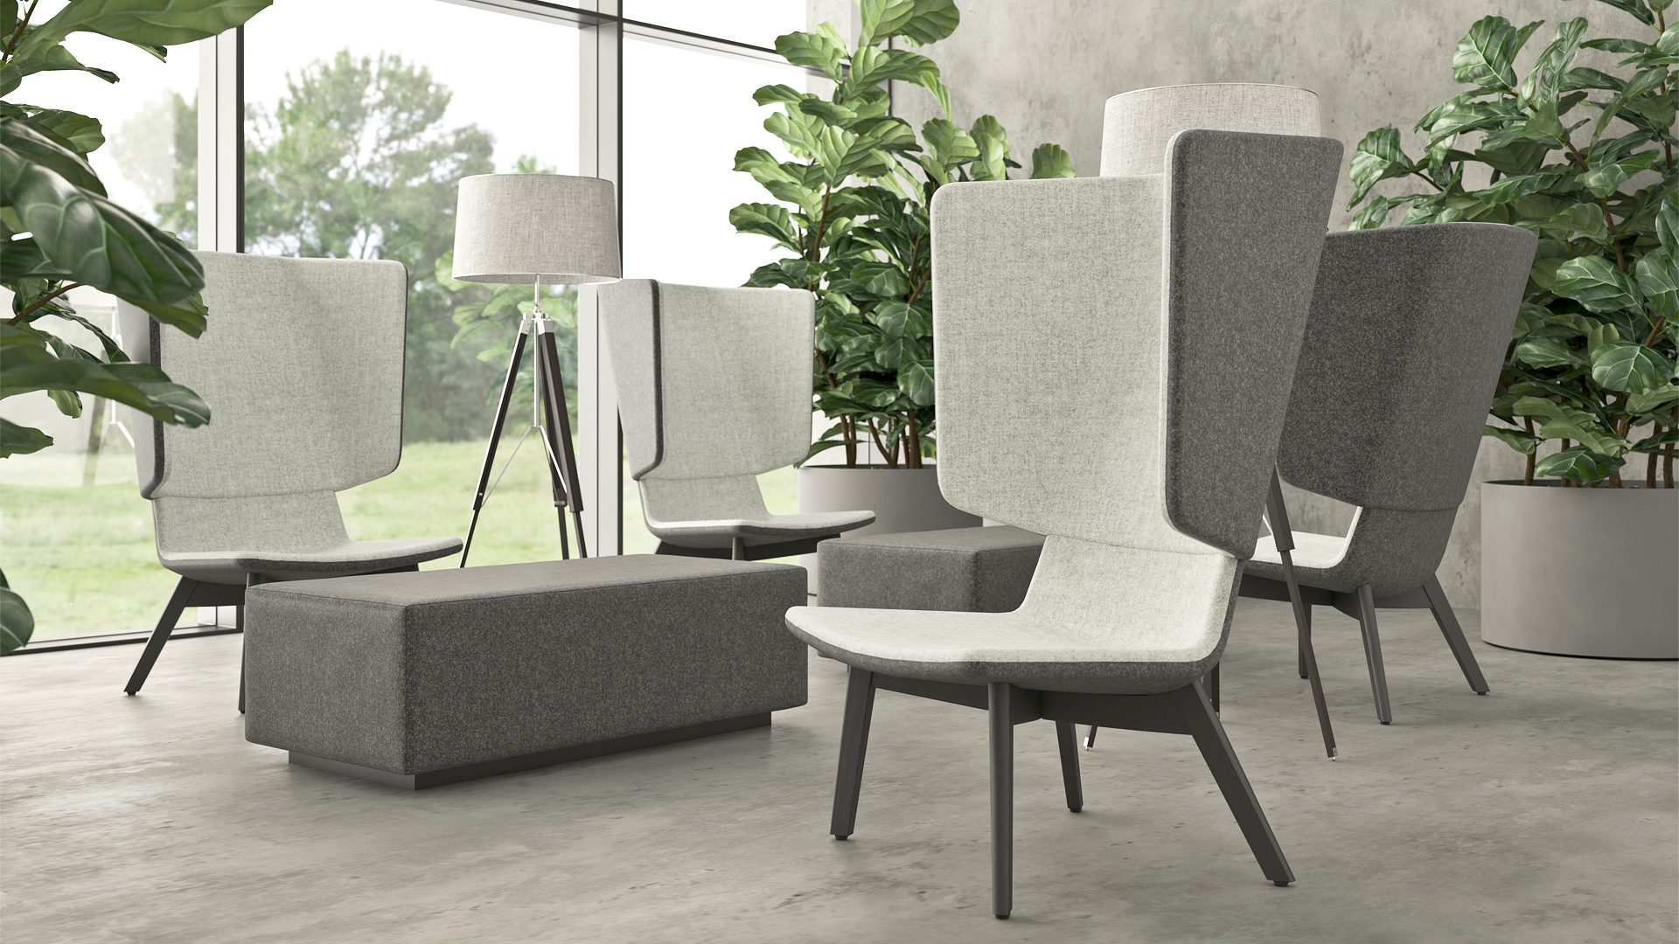
Lounge & Soft furniture

Slide 22
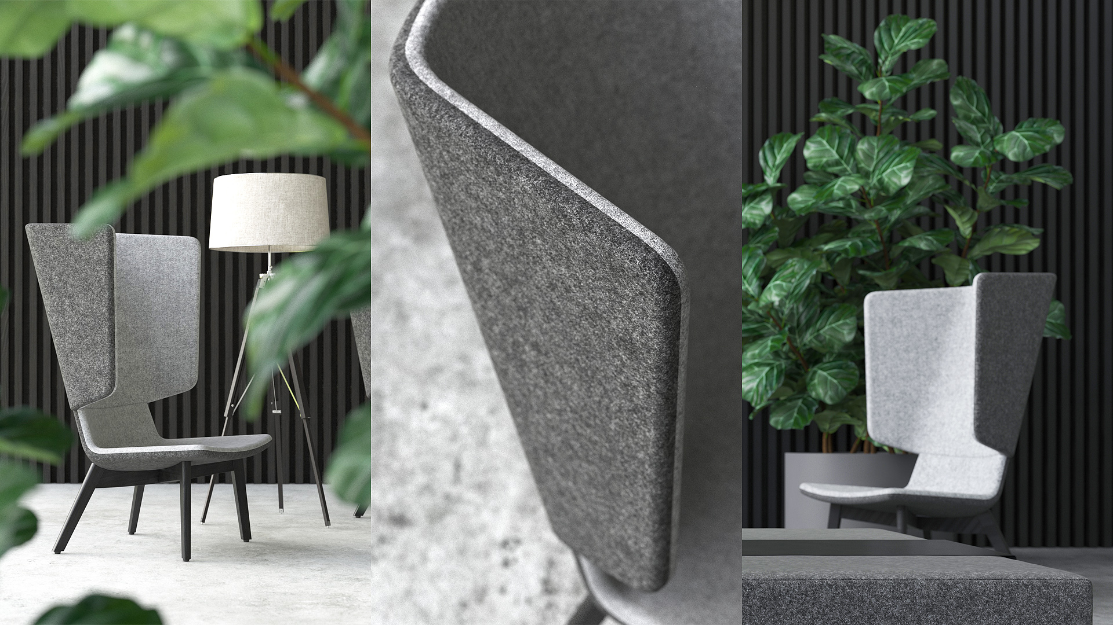
Lounge & Soft furniture

Slide 23
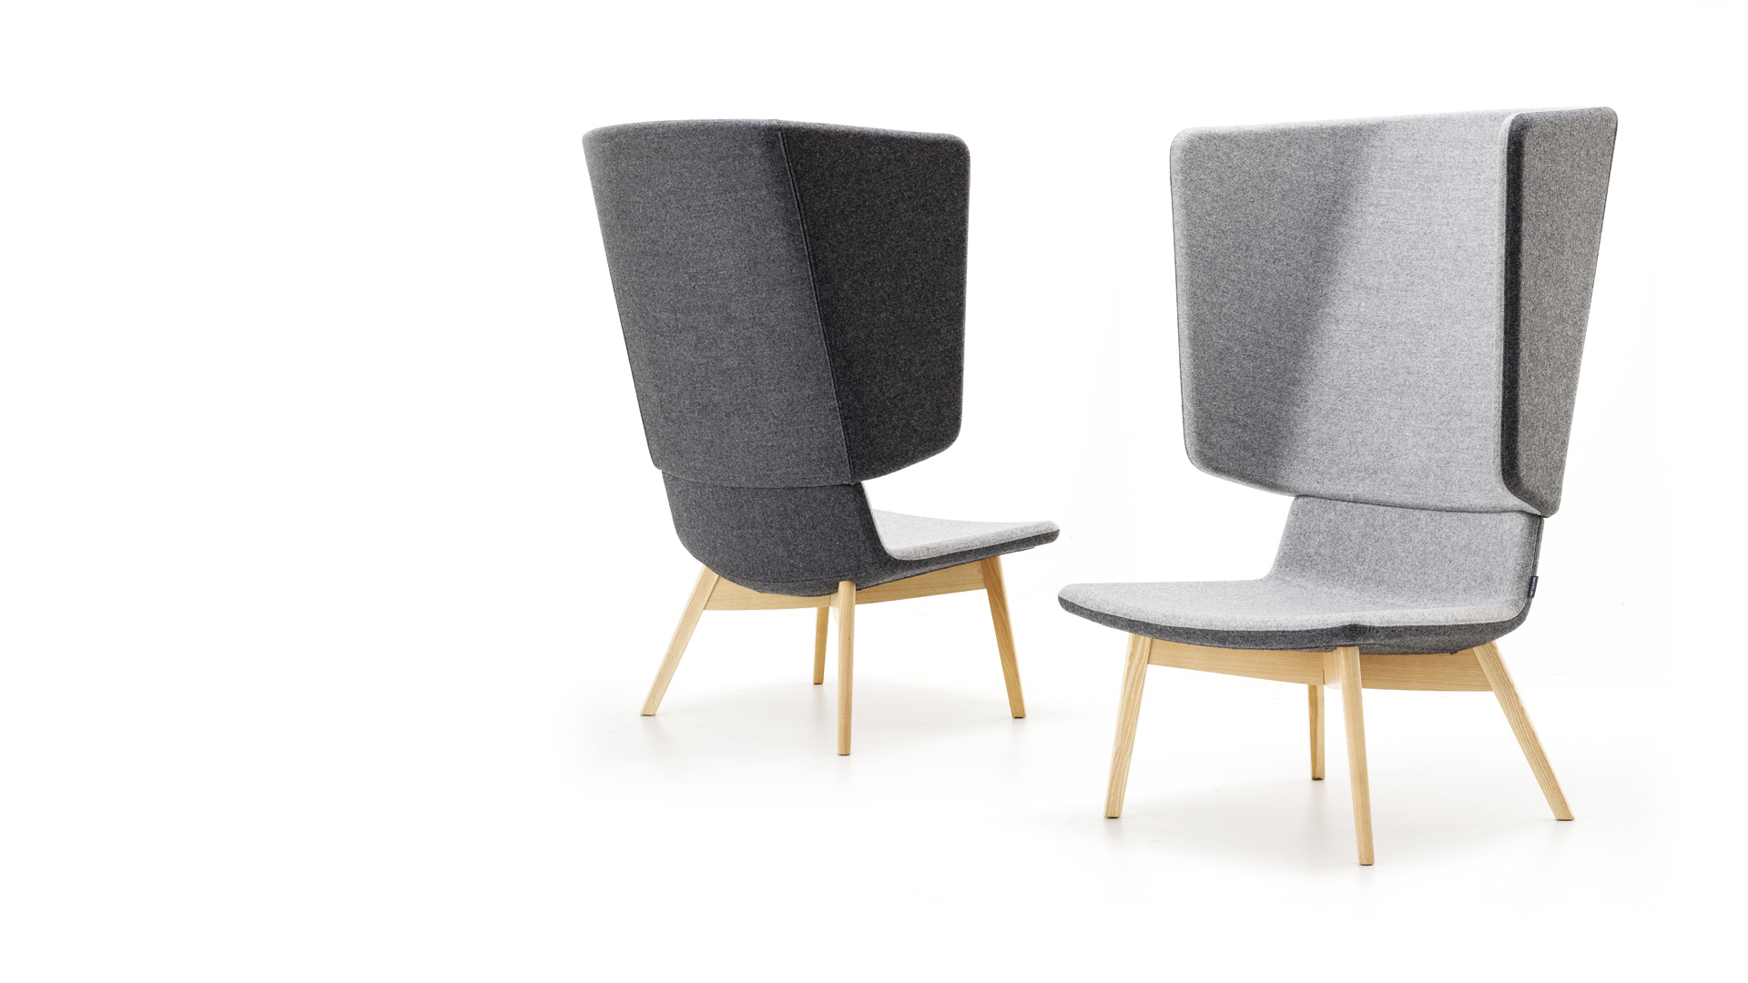
TANGO Lounge is the winner of the 2019 Red Dot Award: Product Design.

Slide 24
